Slide 1
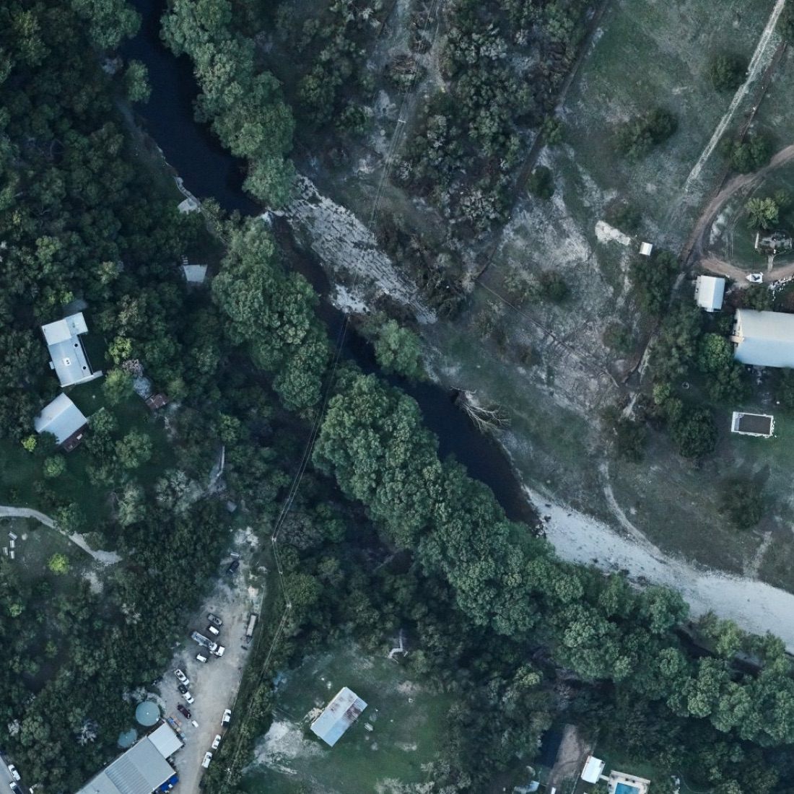
Waterline
See how fast the water rises
An AR flood replay app built on real Texas flood data and two trained models
Guadalupe River at Hunt, a week after July 4 2025 · NOAA via UTSA dataset
Notes:
Waterline lets you watch a real flood rise around you, hour by hour, so the speed of a flash flood stops being abstract. Everything in it comes from real Texas data and two models we trained this weekend.

Slide 2
Floods move faster than people expect
30 ft
7 min
1 ft
River rise at Hunt in about 3 hours on July 4 2025, before the gauge was destroyed
At Kerrville, from dry ground to over an adult’s head, for a spot 20 ft above the river
Of moving water can float most cars. Many flood deaths happen in vehicles
Sources: USGS gauges 08165500 (Hunt) and 08166200 (Kerrville), 15-minute readings; National Weather Service “Turn Around, Don’t Drown”.
Notes:
People think of a flood as "a lot of water". The real danger is the speed: at Hunt the river rose about 30 feet in roughly three hours overnight. At Kerrville, a spot 20 feet above the normal river went from dry to over your head in seven minutes.

Slide 3
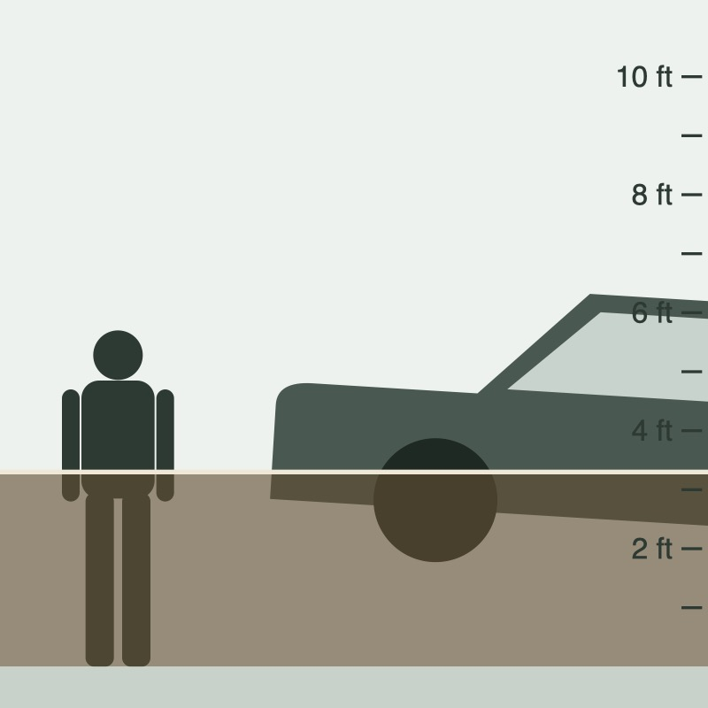
Waterline puts that speed in front of you
1
Rise: AR flood replay
Point your camera at a wall or car. Water from a real flood rises on it hour by hour, with depth markers, haptics and the model’s forecast. Your GPS sets how high your ground is.
2
Compare & Explore
All 575 before/after aerial pairs from the UTSA dataset, with floodwater heatmaps and a flood-likelihood score. Clearest floods first.
3
Label photos
A one-question screen that let two of us label 150 photos, which trained the photo model.
Side view in the app: 5 ft 8 in adult and a sedan, true to scale
Notes:
Three parts. Rise is the experience: a real flood replayed on the wall in front of you. Compare and Explore are the evidence: real before and after photos with heatmaps. Label is how we got training data.

Slide 4
The social impact we’re aiming for
Leave earlier
Reach who’s exposed
Seeing water reach your knees in minutes makes “move to higher ground now” feel real, before the water is at the door.
Hill Country river corridors and camps, commuters at low-water crossings, renters and students new to the area.
Accessible by design
Honest, not alarmist
Screen-reader labels, haptic warnings, a no-camera side view and large controls. Spanish is next.
Every screen says it is an illustration of a past flood, not a forecast, and points to official warnings.
Goal: more people move to higher ground, and turn around at flooded roads, before the water reaches them.
Notes:
Our hoped-for impact: people act earlier. We are not claiming measured outcomes yet; a pilot with a county emergency office or a school could test whether people say they would leave sooner after using it.

Slide 5
How it fits together
DATASETS
MODELS
APP
UTSA flood images
Photo models
Phone app · Expo Go
1,204 aerial photos · 575 before/after pairs · Hugging Face
Change model · Colab L4 GPU
Compare & Explore
Floodwater colour rule
heatmaps
before/after photos, floodwater heatmaps, “94% likely flooded”
Team labels
150 photos × 2 people · 92% agreement
Flood photo classifier · AUC 0.86
USGS river gauges
USAA Datathon Qwen server
Rise
18 gauges near the photos · 15-min, 2014–2025
River-level forecaster
forecasts
AR flood replay at your spot, with the forecast
LightGBM · rise 1–12 h ahead
Open-Meteo rainfall
Qwen LLM · debugged the training
hourly ERA5 rain at each gauge
Notes:
Left to right: four datasets, four models, two app screens. The photos also decided which river gauges we trained on: we used the 18 gauges the UTSA metadata links to the photos.

Slide 6
Four datasets, all public or ours
575
18
12 yrs
300
before/after pairs
river gauges
of hourly rain
team labels
UTSA flood images (Hugging Face, jennifer-fowler/UTSA-flood-images): 1,204 NOAA and USDA aerial photos from Harvey 2017 and the 2025 Hill Country flood, 273 metadata columns
USGS Water Data API: 15-minute river levels, 2014–2025, at the gauges the photo metadata links to
Open-Meteo historical archive (ERA5) at each gauge, for the forecaster’s rain features
150 photos labelled “flooded or not” by two of us; we agreed on 92% (κ 0.62)
Notes:
The UTSA images are the core dataset. Their metadata linked each photo to a USGS gauge, which is how we chose rivers for the forecaster. The labels are ours.

Slide 7
Model 1: how fast will the river rise?
Average error on floods it never saw (ft, lower is better)
Question
Given the last 3 days of river level and rain, how many feet will the river rise in the next 1–12 hours?
1.13
1.03
1.0
0.77
Data
0.71
590,000 training hours from 18 gauges; Hurricane Harvey and the 2025 Hill Country flood held out entirely
0.5
0.32
0.36
Result
Beats the baseline at every lead time, and is 24% more accurate while rivers are rising (2023+ test years)
0.0
1 h ahead
3 h ahead
6 h ahead
Our forecaster (LightGBM)
Baseline: the river stays the same
Notes:
Trained on the Qwen server. The app replays the held-out floods with the model’s 1, 3 and 6 hour forecasts. Honest weak spot: it under-predicts sudden surges, see the limits slide.

Slide 8
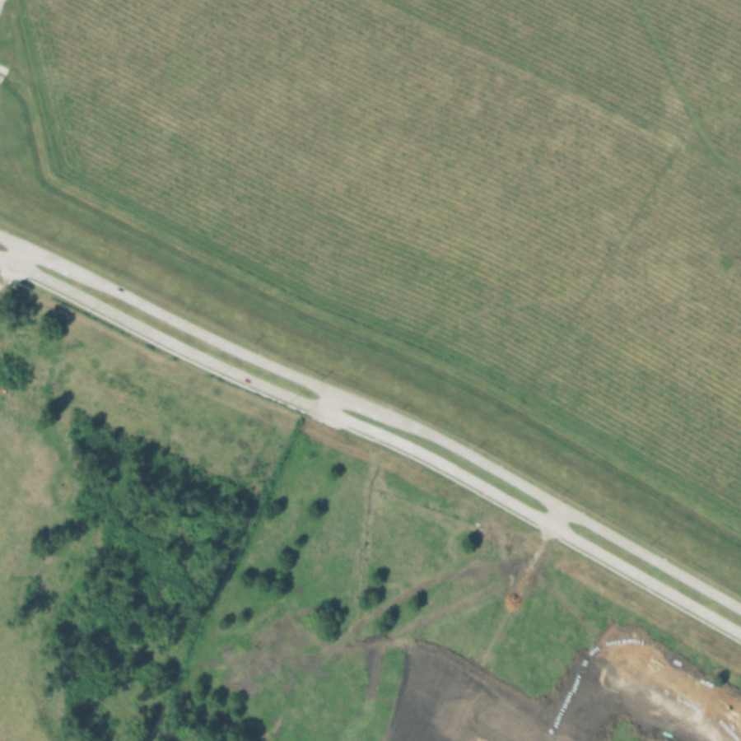
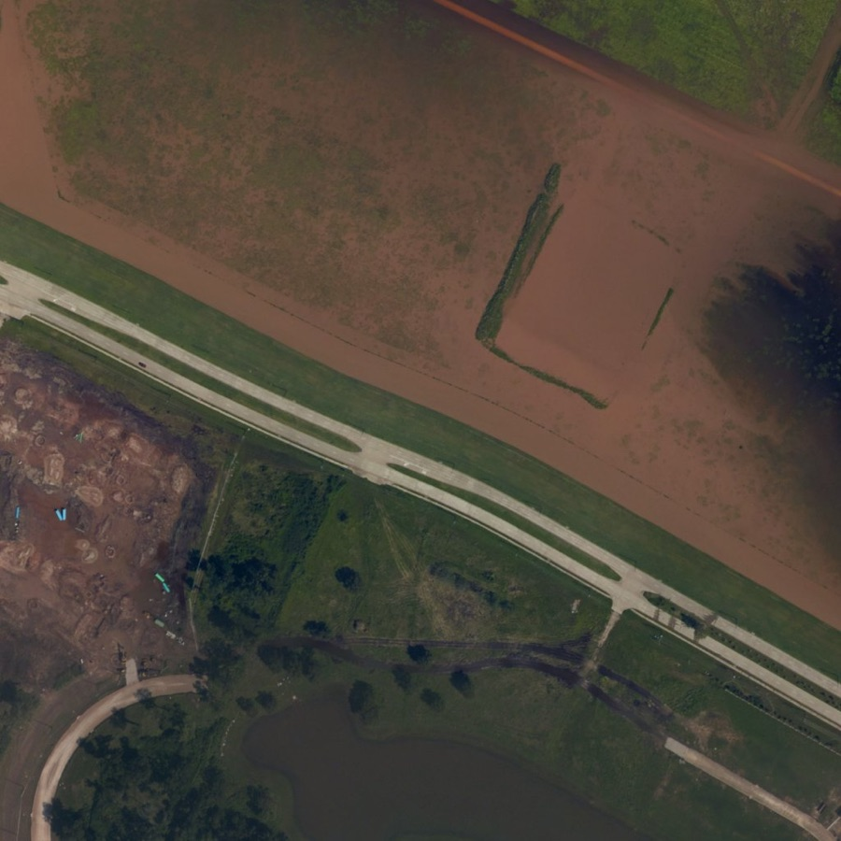
Model 2: which photos show flooding?
How often a flooded photo ranks above a dry one (AUC, on team labels)
Flood photo classifier
0.86
Floodwater colour rule
0.81
Before (2016)
After Harvey (2017)
Change model (Colab)
0.47
The app’s top-ranked example: 100% likely flooded
A self-supervised change model (no labels) learned to ignore camera differences but not to find water. A simple floodwater-colour rule did better, and a classifier trained on our 138 agreed labels combined both.
Coin flip
0.50
chance
Classifier likely range 0.80–0.92 · balanced accuracy 0.86 · tested on areas it never trained on
Notes:
Cross-validated by area, so test photos come from places the model never trained on. Classifier AUC 0.86, likely range 0.80 to 0.92; balanced accuracy 0.86. Only 12 dry photos, so the range is wide.

Slide 9
How we used LLMs
Qwen 3.8 27B · USAA Datathon Qwen server
Q
Debugged the river forecaster’s training code, running on the same machine that trained the model.
Claude Code (Anthropic) · coding assistant
C
Helped write the app, the AR camera math, the data pipelines and the evaluation scripts, and checked results with us.
What LLMs did not do
✓
No number in the app comes from an LLM. Forecasts, heatmaps and flood scores come from the trained models; the training labels came from two team members.
Notes:
LLMs sped up the work around the models. The models themselves are classic ML we trained and evaluated against baselines.

Slide 10
Limits we’re upfront about
1
An illustration, not a forecast for your address
Rise replays past floods; your GPS height is measured against the lowest ground within 1 km.
2
Sudden surges are the hardest part
At Kerrville the 3-hour forecast missed the 6 AM surge (about 3 ft predicted, 26 ft observed).
3
Colour-based photo scores miss grey water
Floodwater that looks grey or dark in haze ranks low; more labels of those photos would fix it.
4
Expo Go has no LiDAR
The camera tracks tilting and turning; after walking you re-aim at a new spot.
Notes:
We would rather show these than have a judge find them.

Slide 11
What’s next
1
Live forecasts from the Qwen server in the app
2
A flood map of all 575 locations and 18 gauges
Turn around, don’t drown.
3
Label grey-water photos and retrain
4
Spanish, and a pilot with a county emergency office
Notes:
Next steps, then thanks. Demo: Hunt replay in the side view, then the AR camera, then Compare’s top example.

