Slide 1
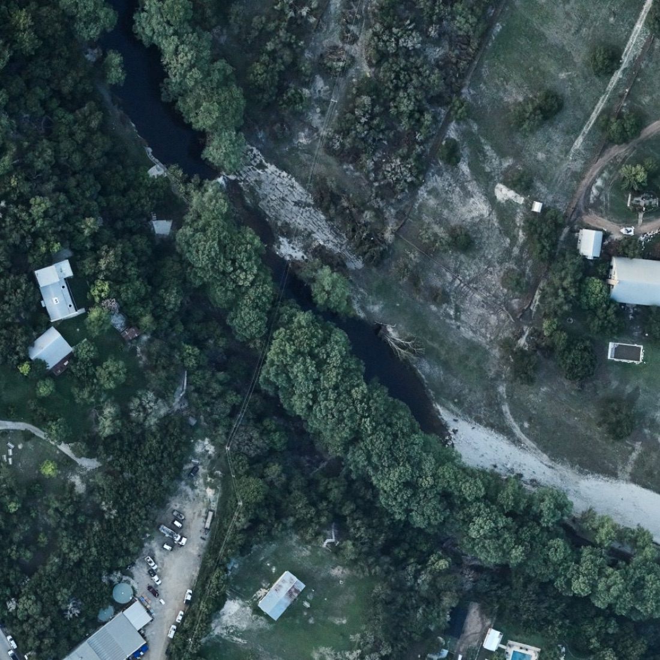
Waterline
See how fast the water rises
July 4 2025, Kerrville: a spot 20 ft above the Guadalupe River went from dry ground to over an adult’s head in 7 minutes.
Guadalupe River at Hunt, a week after July 4 2025 · NOAA via UTSA dataset
Notes:
[0:00–0:30] People picture a flood as “a lot of water”. The danger is speed. On July 4 2025 at Kerrville, a spot 20 feet above the river went from dry to over your head in seven minutes (USGS gauge readings). Waterline lets you watch a real flood like that rise where you stand.

Slide 2
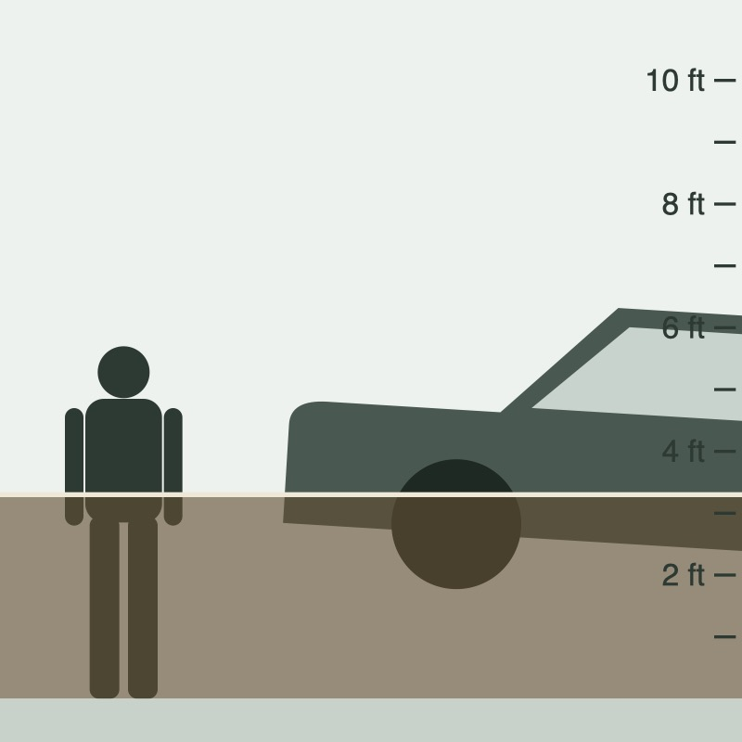
Demo: a real flood, replayed where you stand
1
Play the Hunt flood
River levels from the real USGS gauge, every 15 minutes. Watch the clock and the depth.
2
Use my location
USGS lidar elevation sets how high your ground is, so the depth is for where you stand.
3
Camera: place the water
Aim at the base of a wall, tap Place here, and the flood rises on it as you tilt and turn.
4
Compare
The clearest flood photo out of 575 before/after pairs, with its floodwater heatmap.
Side view in the app, true to scale
Notes:
[0:30–2:30] LIVE DEMO on the phone. (1) Rise: pick Guadalupe River at Hunt, press Play; point out the clock and how fast the depth goes from dry to over the man’s head. (2) Tap “Use my location”; depth now reflects our real height above nearby low ground. (3) Tap Camera, aim at the base of the wall, Place here; play again and tilt and turn. (4) Compare tab: the top-ranked example and its floodwater heatmap. Backup: screen recording if the network fails.

Slide 3
How it fits together
DATASETS
MODELS
APP
UTSA flood images
Photo models
Phone app · Expo Go
1,204 aerial photos · 575 before/after pairs · Hugging Face
Change model · Colab L4 GPU
Compare & Explore
Floodwater colour rule
heatmaps
before/after photos, floodwater heatmaps, “94% likely flooded”
Team labels
150 photos × 2 people · 92% agreement
Flood photo classifier · AUC 0.86
USGS river gauges
USAA Datathon Qwen server
Rise
18 gauges near the photos · 15-min, 2014–2025
River-level forecaster
forecasts
AR flood replay at your spot, with the forecast
LightGBM · rise 1–12 h ahead
Open-Meteo rainfall
Qwen LLM · debugged the training
hourly ERA5 rain at each gauge
LLMs: Qwen on the USAA Datathon Qwen server debugged the forecaster’s training. App numbers come from trained models, not LLMs.
Notes:
[2:30–3:15] Left to right: four datasets feed four models; the app shows their results. The UTSA photo metadata picked the 18 river gauges we trained on. The forecaster was trained on the USAA Datathon Qwen server, where the Qwen LLM debugged the training code. No number in the app comes from an LLM.

Slide 4
What the models show, and why it matters
0.86
Photo flood classifier
Social impact: show how severe flash floods are
Ranks a flooded photo above a dry one 86% of the time, tested on areas it never saw. Colour rule alone: 0.81. Chance: 0.50.
People underestimate flash floods. Waterline makes their speed and depth felt: ankle-deep to over your head in minutes.
Real Texas gauges and photos, replayed where you stand, so the danger feels local, not distant.
For those most exposed: Hill Country river corridors and camps, low-water-crossing commuters, students new to Texas.
Accessible: screen-reader labels, haptics and a no-camera view.
~9%
less error than “river stays the same”
River forecaster on the two floods held out of training: 1.03 vs 1.13 ft error at 6 hours ahead.
Notes:
[3:15–4:00] Results: the photo classifier, trained on 138 photos we labelled and agreed on, scores 0.86. The forecaster beats the “river stays the same” baseline on floods it never saw, though sudden surges remain hard. Our goal is awareness: flash floods rise in minutes, not hours, and seeing that where you stand makes people take warnings seriously. Thank you.

