Slide 1
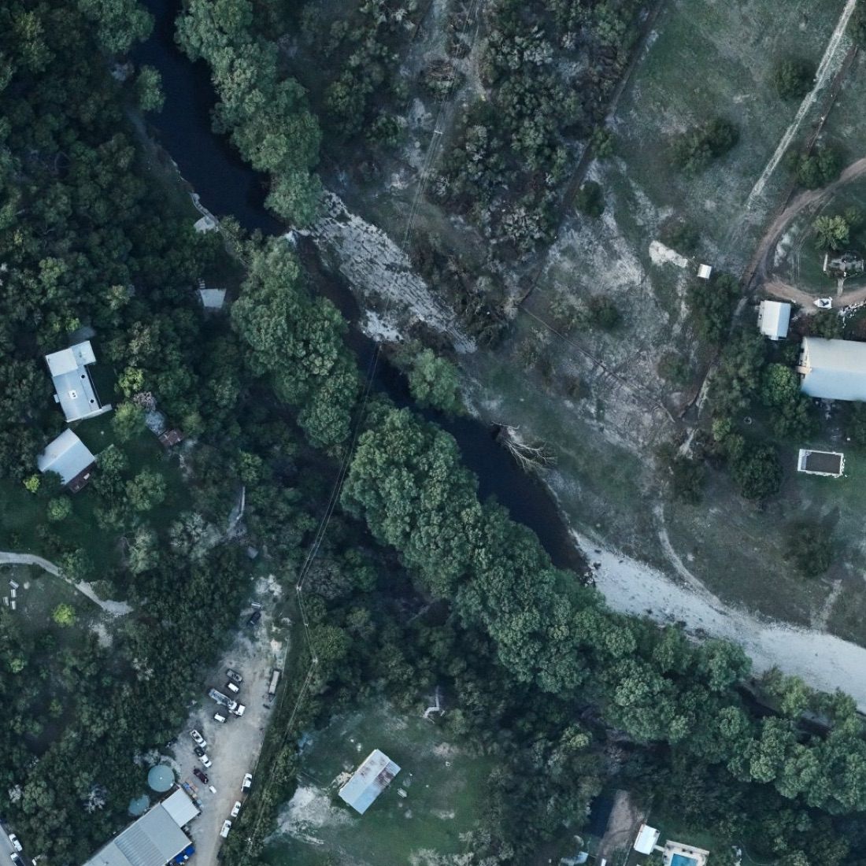
Waterline
See how fast the water rises
An AR flood replay app built on real Texas flood data and two trained models
Guadalupe River at Hunt, a week after July 4 2025 · NOAA via UTSA dataset
Notes:
Waterline lets you watch a real flood rise around you, hour by hour, so the speed of a flash flood stops being abstract. Everything in it comes from real Texas data and two models we trained this weekend.

Slide 2
Floods move faster than people expect
30 ft
7 min
1 ft
River rise at Hunt in about 3 hours on July 4 2025, before the gauge was destroyed
At Kerrville, from dry ground to over an adult’s head, for a spot 20 ft above the river
Of moving water can float most cars. Many flood deaths happen in vehicles
Sources: USGS gauges 08165500 (Hunt) and 08166200 (Kerrville), 15-minute readings; National Weather Service “Turn Around, Don’t Drown”.
Notes:
People think of a flood as "a lot of water". The real danger is the speed: at Hunt the river rose about 30 feet in roughly three hours overnight. At Kerrville, a spot 20 feet above the normal river went from dry to over your head in seven minutes.

Slide 3
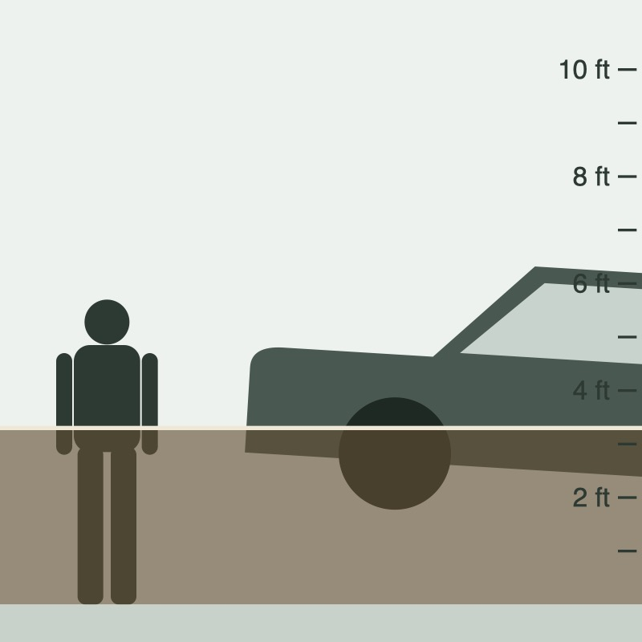
Waterline puts that speed in front of you
1
Rise: AR flood replay
Point your camera at a wall or car. Water from a real flood rises on it hour by hour, with depth markers, haptics and the model’s forecast. Your GPS sets how high your ground is.
2
Compare & Explore
All 575 before/after aerial pairs from the UTSA dataset, with floodwater heatmaps and a flood-likelihood score. Clearest floods first.
3
Label photos
A one-question screen that let two of us label 150 photos, which trained the photo model.
Side view in the app: 5 ft 8 in adult and a sedan, true to scale
Notes:
Three parts. Rise is the experience: a real flood replayed on the wall in front of you. Compare and Explore are the evidence: real before and after photos with heatmaps. Label is how we got training data.

Slide 4
Social impact: show how severe flash floods are
Feel the speed
Make it local
Ankle-deep to over your head in minutes, from a real Texas gauge, replayed where you stand.
Real USGS gauges and real aerial photos of Texas floods, not a generic animation.
Reach who underestimates it
Accessible and honest
Hill Country river corridors and camps, low-water-crossing commuters, students new to Texas.
Screen-reader labels, haptics and a no-camera view; clearly a replay of past floods, not a forecast.
Goal: people understand how fast and deep a flash flood gets, and take warnings seriously.
Notes:
Our aim is awareness of how severe flash floods are. We are not claiming measured outcomes yet; a pilot with a county emergency office or a school could test whether people rate flash floods as more dangerous after using it.

Slide 5
How it fits together
DATASETS
MODELS
APP
UTSA flood images
Photo models
Phone app · Expo Go
1,204 aerial photos · 575 before/after pairs · Hugging Face
Change model · Colab L4 GPU
Compare & Explore
Floodwater colour rule
heatmaps
before/after photos, floodwater heatmaps, “94% likely flooded”
Team labels
150 photos × 2 people · 92% agreement
Flood photo classifier · AUC 0.86
USGS river gauges
USAA Datathon Qwen server
Rise
18 gauges near the photos · 15-min, 2014–2025
River-level forecaster
forecasts
AR flood replay at your spot, with the forecast
LightGBM · rise 1–12 h ahead
Open-Meteo rainfall
Qwen LLM · debugged the training
hourly ERA5 rain at each gauge
Notes:
Left to right: four datasets, four models, two app screens. The photos also decided which river gauges we trained on: we used the 18 gauges the UTSA metadata links to the photos.

Slide 6
Four datasets, all public or ours
575
18
12 yrs
300
before/after pairs
river gauges
of hourly rain
team labels
UTSA flood images (Hugging Face, jennifer-fowler/UTSA-flood-images): 1,204 NOAA and USDA aerial photos from Harvey 2017 and the 2025 Hill Country flood, 273 metadata columns
USGS Water Data API: 15-minute river levels, 2014–2025, at the gauges the photo metadata links to
Open-Meteo historical archive (ERA5) at each gauge, for the forecaster’s rain features
150 photos labelled “flooded or not” by two of us; we agreed on 92% (κ 0.62)
Notes:
The UTSA images are the core dataset. Their metadata linked each photo to a USGS gauge, which is how we chose rivers for the forecaster. The labels are ours.

Slide 7
Model 1: how fast will the river rise?
Average error on floods it never saw (ft, lower is better)
Question
Given the last 3 days of river level and rain, how many feet will the river rise in the next 1–12 hours?
1.13
1.03
1.0
0.77
Data
0.71
590,000 training hours from 18 gauges; Hurricane Harvey and the 2025 Hill Country flood held out entirely
0.5
0.32
0.36
Result
Beats the baseline at every lead time, and is 24% more accurate while rivers are rising (2023+ test years)
0.0
1 h ahead
3 h ahead
6 h ahead
Our forecaster (LightGBM)
Baseline: the river stays the same
Notes:
Trained on the Qwen server. The app replays the held-out floods with the model’s 1, 3 and 6 hour forecasts. Honest weak spot: it under-predicts sudden surges, see the limits slide.

Slide 8
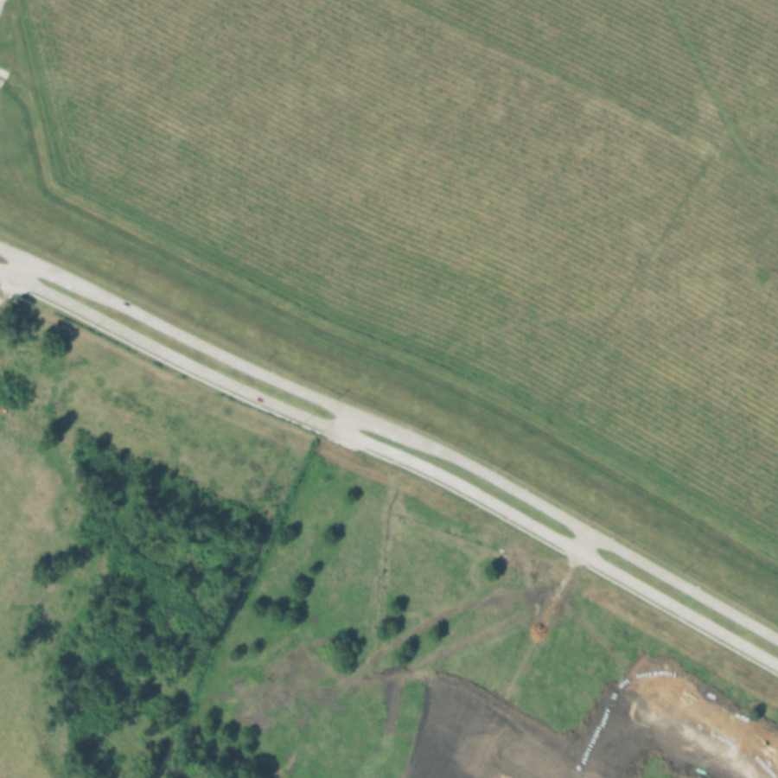
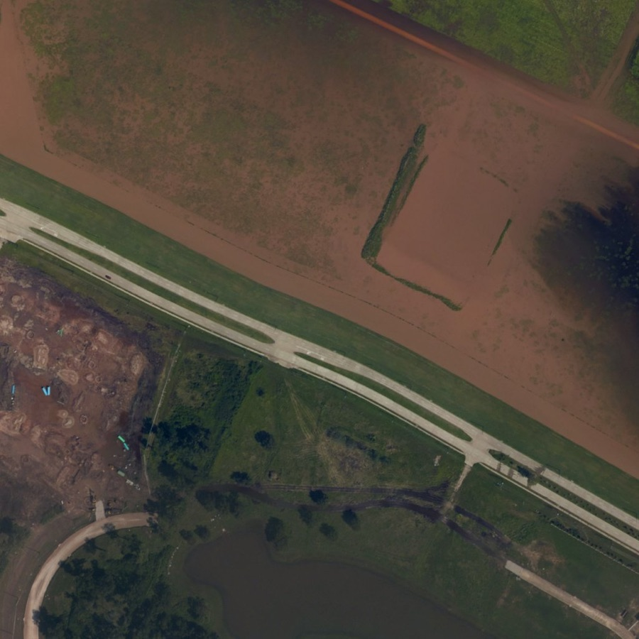
Model 2: which photos show flooding?
How often a flooded photo ranks above a dry one (AUC, on team labels)
Flood photo classifier
0.86
Floodwater colour rule
0.81
Before (2016)
After Harvey (2017)
Change model (Colab)
0.47
The app’s top-ranked example: 100% likely flooded
A self-supervised change model (no labels) learned to ignore camera differences but not to find water. A simple floodwater-colour rule did better, and a classifier trained on our 138 agreed labels combined both.
Coin flip
0.50
chance
Classifier likely range 0.80–0.92 · balanced accuracy 0.86 · tested on areas it never trained on
Notes:
Cross-validated by area, so test photos come from places the model never trained on. Classifier AUC 0.86, likely range 0.80 to 0.92; balanced accuracy 0.86. Only 12 dry photos, so the range is wide.

Slide 9
How we used LLMs
Qwen 3.8 27B · USAA Datathon Qwen server
Q
Debugged the river forecaster’s training code, running on the same machine that trained the model.
What LLMs did not do
✓
No number in the app comes from an LLM. Forecasts, heatmaps and flood scores come from the trained models; the training labels came from two team members.
Notes:
LLMs sped up the work around the models. The models themselves are classic ML we trained and evaluated against baselines.

Slide 10
Limits we’re upfront about
1
An illustration, not a forecast for your address
Rise replays past floods; your GPS height is measured against the lowest ground within 1 km.
2
Sudden surges are the hardest part
At Kerrville the 3-hour forecast missed the 6 AM surge (about 3 ft predicted, 26 ft observed).
3
Colour-based photo scores miss grey water
Floodwater that looks grey or dark in haze ranks low; more labels of those photos would fix it.
4
Expo Go has no LiDAR
The camera tracks tilting and turning; after walking you re-aim at a new spot.
Notes:
We would rather show these than have a judge find them.

Slide 11
What’s next
1
Live forecasts from the Qwen server in the app
2
A flood map of all 575 locations and 18 gauges
Turn around, don’t drown.
3
Label grey-water photos and retrain
4
Spanish, and a pilot with a county emergency office
Notes:
Next steps, then thanks. Demo: Hunt replay in the side view, then the AR camera, then Compare’s top example.

