Slide 1
ng2
Introduction to Angular (2)

Slide 2


Trainer Info
Jeremy Likness (@JeremyLikness)
https://github.com/jeremylikness
https://bit.ly/coderblog
Director of App Dev, iVision
http://www.ivision.com

Slide 3

Why?
Because Angular 2 is …

Slide 4
My (Experience-Based) Bias
Working on Angular since 2011
Example project:
25 developers
Global parallel development team
Almost 100,000 lines of TypeScript code
Over 200 components
3 years of development
4x improvement

Slide 5
4x Improvement
6 months spent with JavaScript and Knockout.js
Changed to Angular and TypeScript based on spike
4x development
Modular approach
Testability
Discoverability
Type-safety
Maintainability

Slide 6
What?
Angular
Expressions
Components
Dependency Injection
Templates
Data-binding
Tools (RxJs, etc.)
Testable

Slide 7
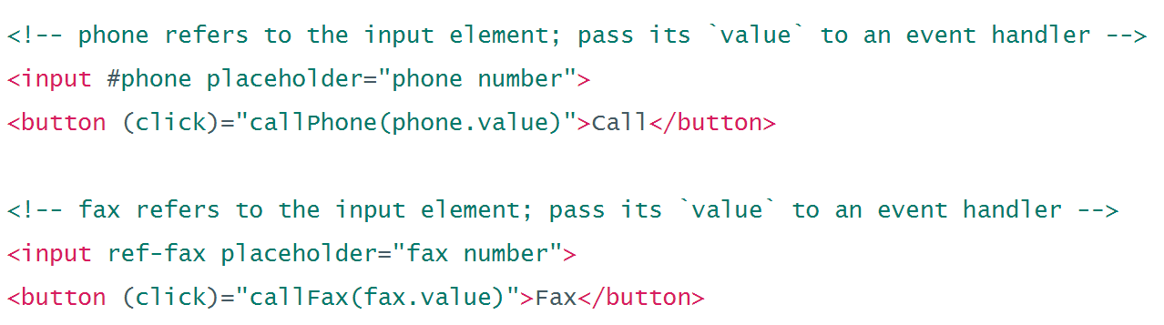
Expressions
Expressions
Parses expressions right in the DOM
Very JavaScript-like (but not JavaScript!)
Conditional DOM compilation
Easily manage UI in a declarative fashion

Slide 8
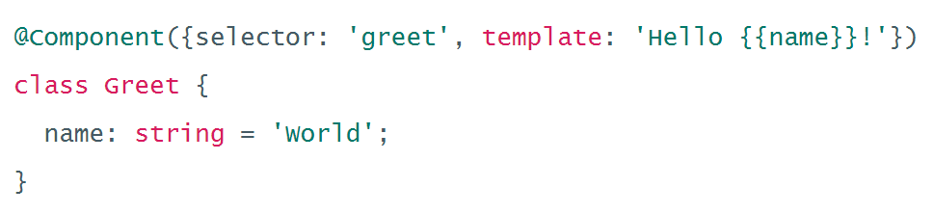
Components
Components
UI Building Block
Always have a template
Scoped CSS
Lifecycle hooks

Slide 9
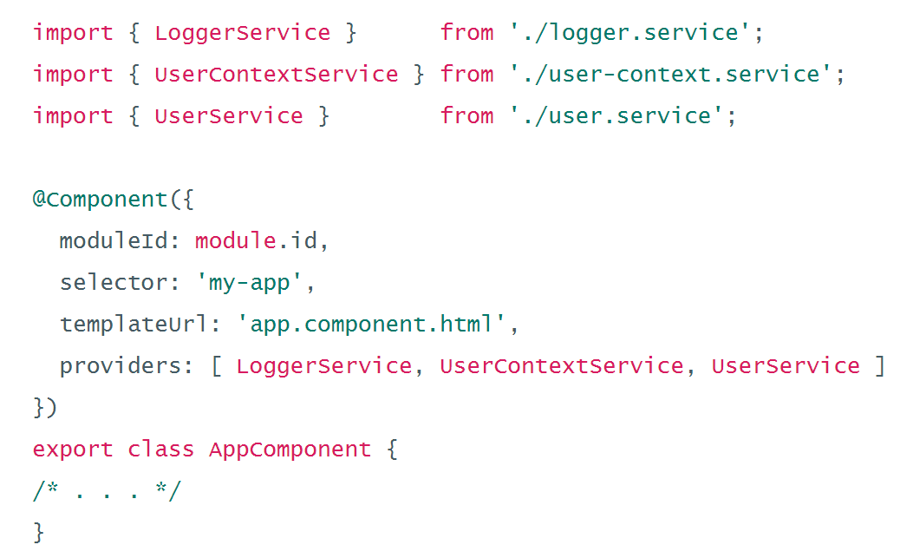
Dependency Injection
Dependency Injection
Provider model
Hierarchical
Mock services
Scope services
Control lifetime

Slide 10
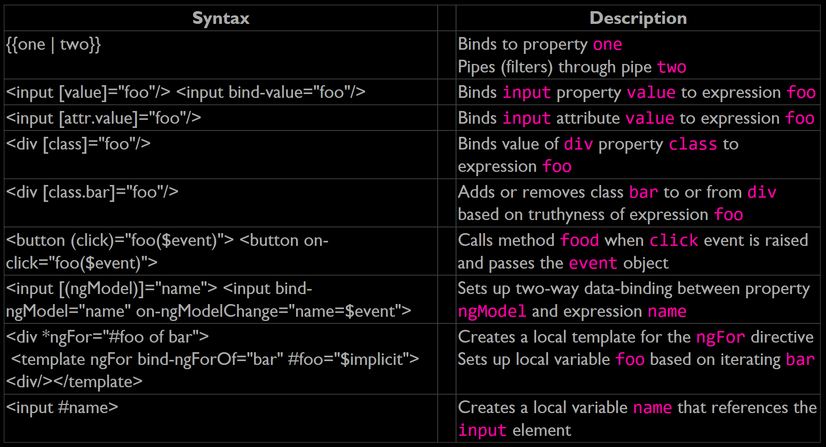
Templates
Templates
Binding syntax
Property binding
Attribute, class, and style binding
Event binding
Two-way data-binding
Inputs and outputs

Slide 11
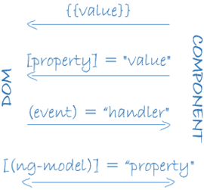
Data-binding
Data-binding
One-way and two-way
Advanced change detection and “zones”

Slide 12
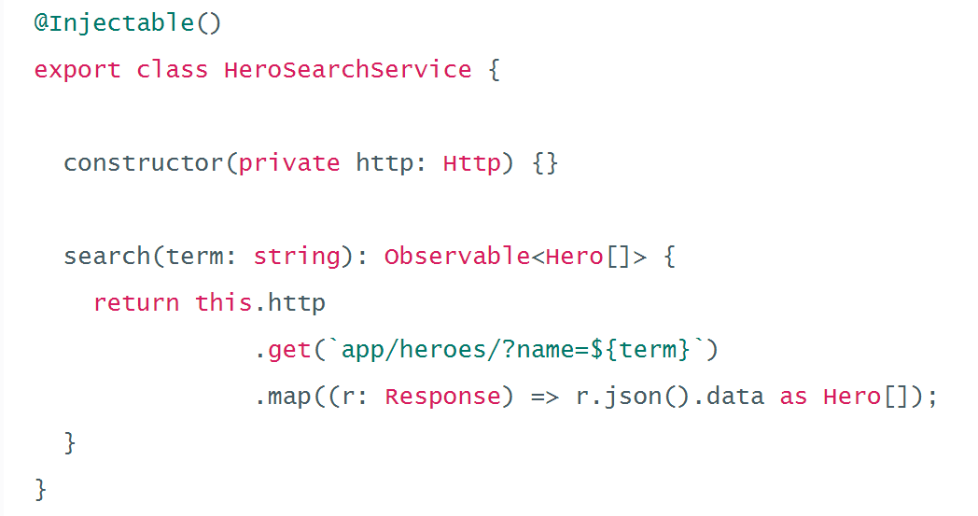
Tools
Tools (RxJs, etc.)
Universal – server-side, mobile, etc.
HTTP
Forms
Material
Router
Animation

Slide 13
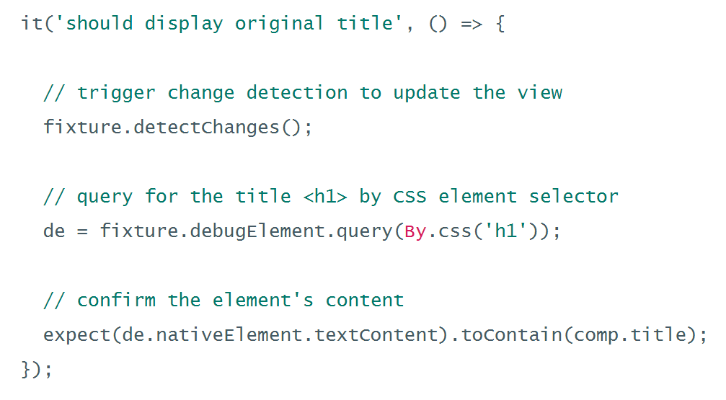
Testable
Testable
Jasmine
Angular mocks
Karma
Protractor

