Slide 1
ng2
Introduction to Angular (2)

Slide 2





Getting Started
https://github.com/JeremyLikness/ng2ts-workshop
https://nodejs.org/
npm i –g angular-cli@1.0.0-beta.16
https://angular.io/
https://code.visualstudio.com/
https://www.microsoft.com/net/core
https://www.docker.com/products/overview

Slide 3


Trainer Info
Jeremy Likness (@JeremyLikness)
https://github.com/jeremylikness
https://bit.ly/coderblog
Director of App Dev, iVision
http://bit.ly/ivisionappdev

Slide 4


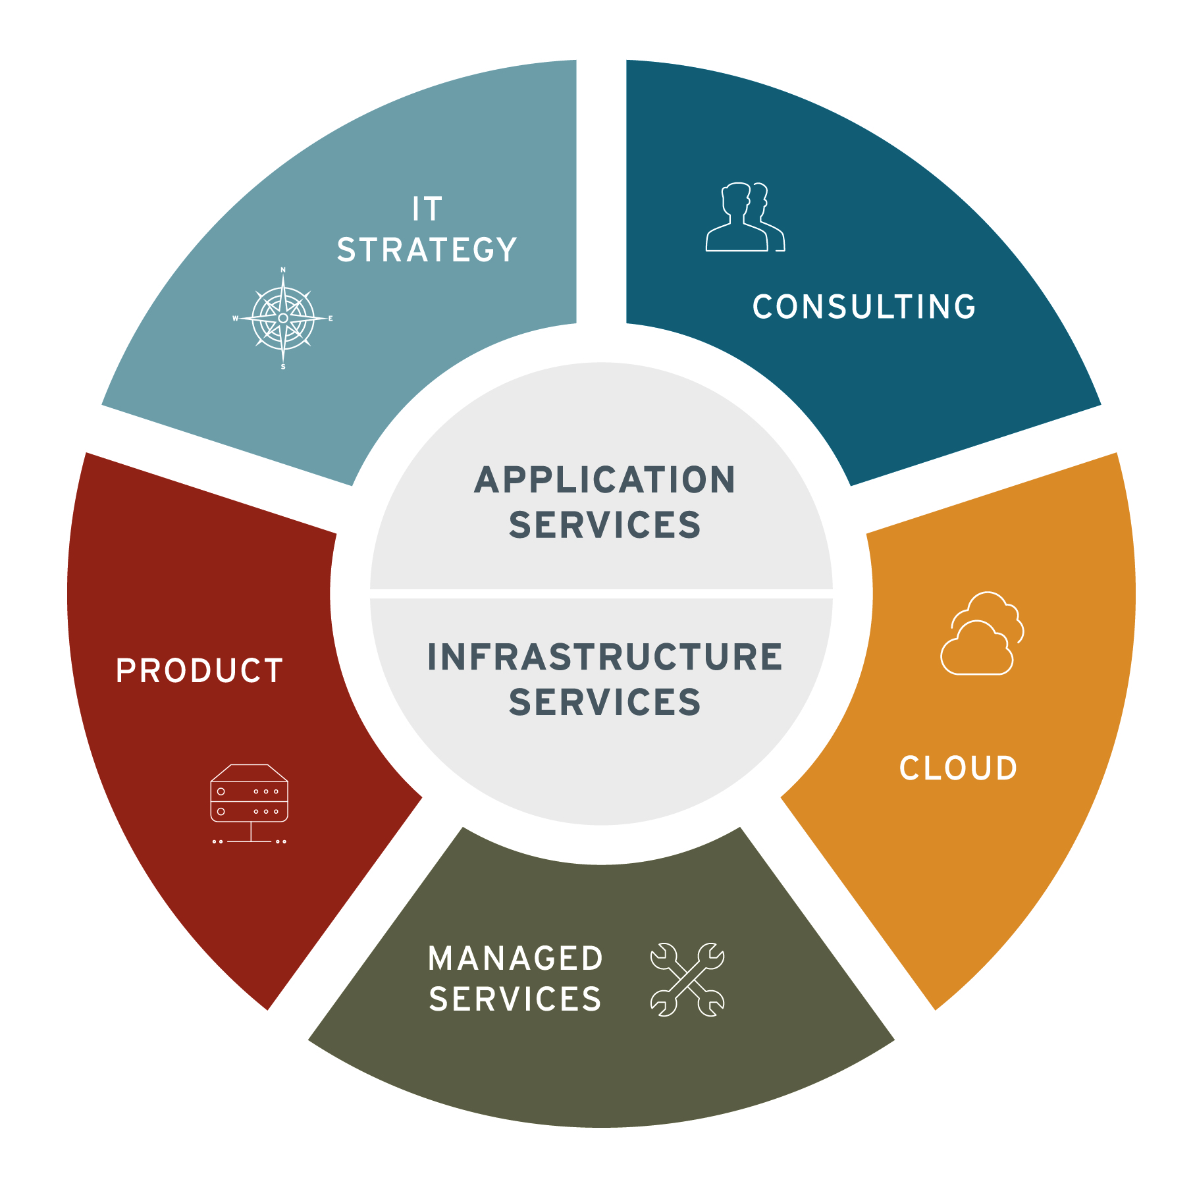
About iVision
About iVision
A privately held, IT consulting firm headquartered in Midtown, Atlanta.
At iVision, we seek to understand our clients’ business first. We work with clients to architect, transform and support their technology — enabling them to realize their vision of a better tomorrow.
The iVision Difference
Engineering Expertise
White Glove Service
Delivery Assurance
Flexible Business Model
Proven Partner Ecosystem
Culture & People
Jeremy Likness| Director of App Dev
https://bit.ly/ivisionappdev

Slide 5

Why?
Because Angular 2 is …

Slide 6
My (Experience-Based) Bias
Working on Angular since 2011
Example project:
25 developers
Global parallel development team
Almost 100,000 lines of TypeScript code
Over 200 components
3 years of development
4x improvement

Slide 7
4x Improvement
6 months spent with JavaScript and Knockout.js
Changed to Angular and TypeScript based on spike
4x development
Modular approach
Testability
Discoverability
Type-safety
Maintainability

Slide 8
What?
Angular
Expressions
Components
Dependency Injection
Templates
Data-binding
Tools (RxJs, etc.)
Testable

Slide 9
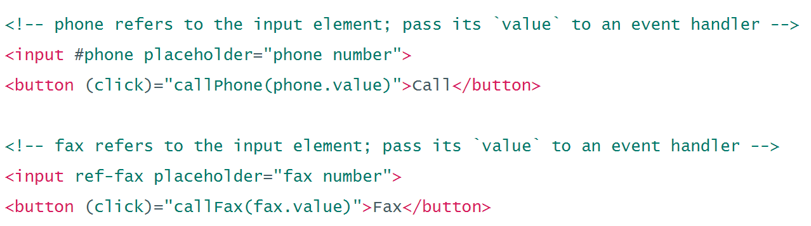
Expressions
Expressions
Parses expressions right in the DOM
Very JavaScript-like (but not JavaScript!)
Conditional DOM compilation
Easily manage UI in a declarative fashion

Slide 10
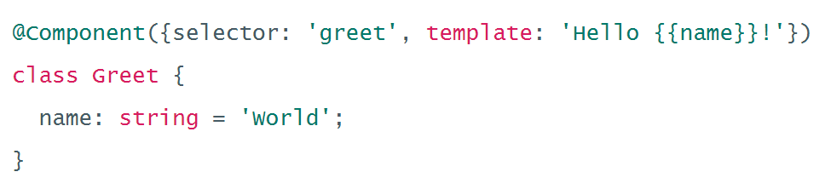
Components
Components
UI Building Block
Always have a template
Scoped CSS
Lifecycle hooks

Slide 11
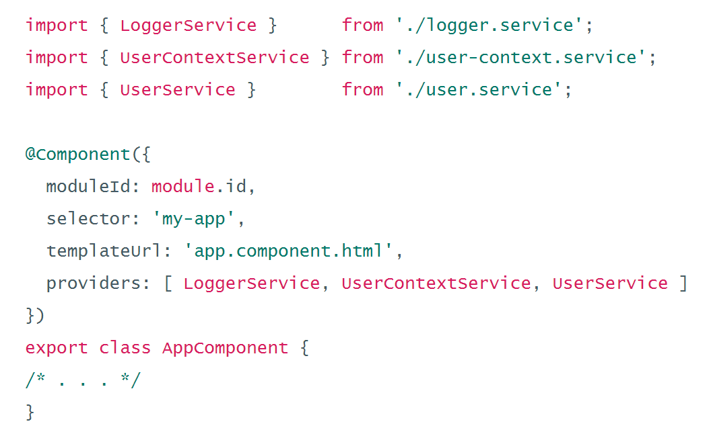
Dependency Injection
Dependency Injection
Provider model
Hierarchical
Mock services
Scope services
Control lifetime

Slide 12
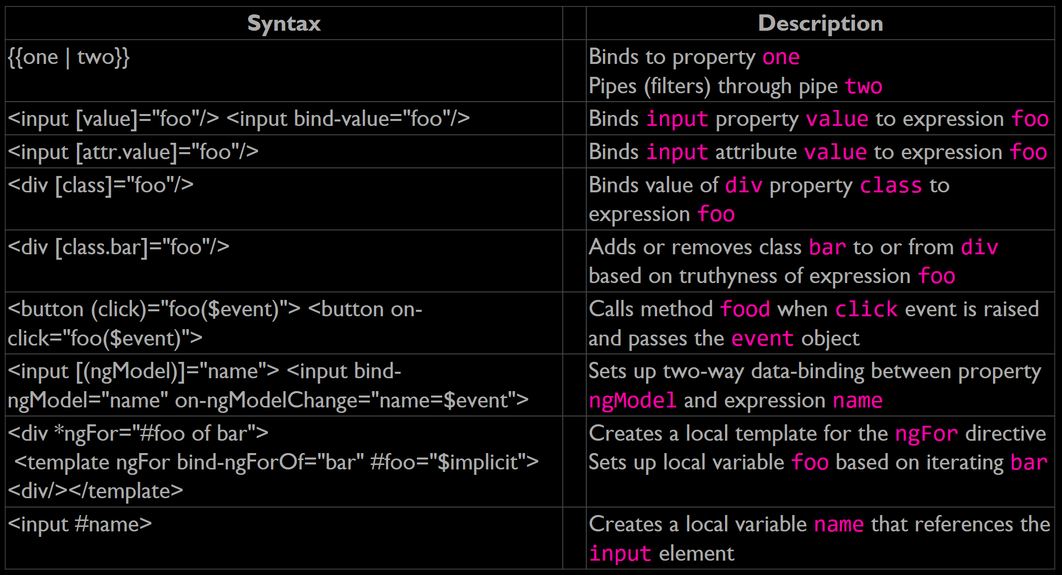
Templates
Templates
Binding syntax
Property binding
Attribute, class, and style binding
Event binding
Two-way data-binding
Inputs and outputs

Slide 13
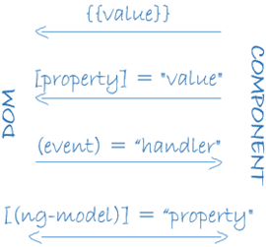
Data-binding
Data-binding
One-way and two-way
Advanced change detection and “zones”

Slide 14
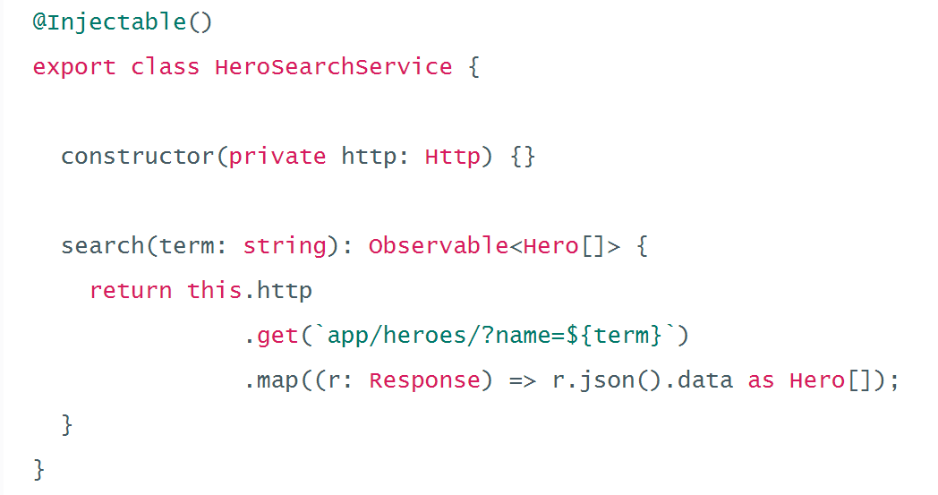
Tools
Tools (RxJs, etc.)
Universal – server-side, mobile, etc.
HTTP
Forms
Material
Router
Animation

Slide 15
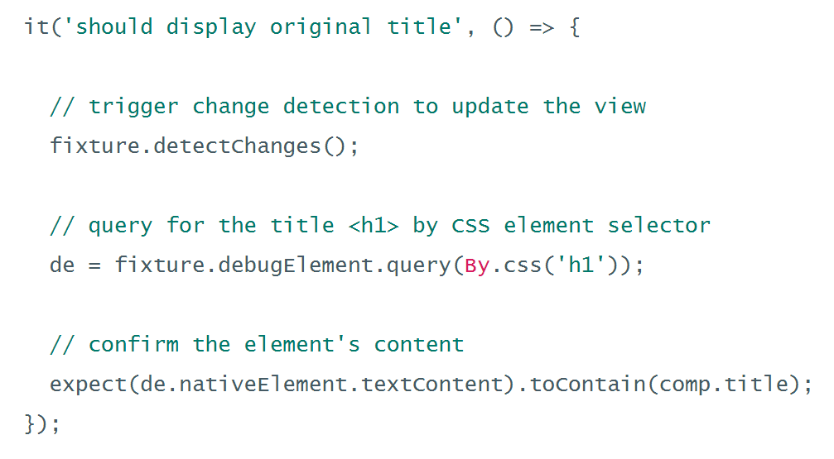
Testable
Testable
Jasmine
Angular mocks
Karma
Protractor

Slide 16
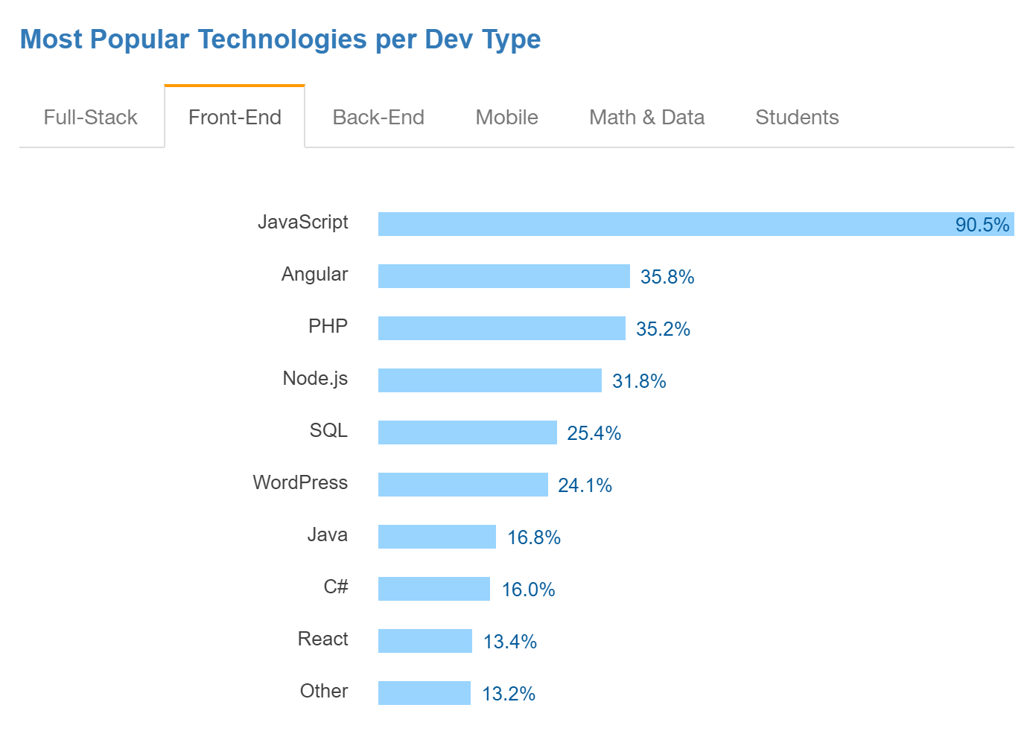
Summary: Why Angular?
Three D’s of Web Development: http://bit.ly/3dofweb
Declarative vs. Imperative
Data-binding
Dependency Injection
Components and Templates
Code Reuse
Parallel Development
Testability
Performance
Source: http://stackoverflow.com/research/developer-survey-2016

Slide 17

Why Angular 2?
Small footprint (á la carte)
Easy to read, understand, and learn declarative interface
Improved performance (5x rendering in all scenarios over Angular 1.x)
Great CSS management (CSS per component)
Module prefixing (easier to move related files in large projects)
Server-side rendering with Angular universal
Testing support
Advanced scaffolding with Angular-CLI (Webpack!)
TypeScript (stay tuned…)

Slide 18
Why TypeScript?
“I cannot say I have ever been a Microsoft fan but TypeScript has ‘softened’ me, it is easily one of the best web technologies to arrive in the past 3 years.” - https://tedpatrick.com/2013/06/25/7-months-with-typescript/
“Overall, TypeScript is wonderful to work with. It helps developers catch errors quickly, adds types and type-checking, and documents your progress so that if someone else wants to contribute, or you need to return to your work months later, you can easily pick up where you left off.” - http://www.livetiles.nyc/blog/typescript-a-digital-workplace-success-story/
“… we use TypeScript not because we’re part of Microsoft, but because we find tremendous value by improving our productivity and keeping our quality high which together allow us to move much faster.” - https://medium.com/@delveeng/why-we-love-typescript-bec2df88d6c2#.pzp9xp7an

Slide 19
Agenda
9:00 am – 9:30 am (intro)
9:30 am – 10:00 am (get installed, set up)
10:00 am – 10:30 am “Hello, World” (break for snacks any time)
10:40 am – 11:00 am Angular-CLI
11:00 am – 12:00 pm TypeScript Intro and Lab
12:00 pm – 1:00 pm Lunch
1:00 pm – 1:30 pm Components, Directives, and Pipes
1:45 pm – 2:15 pm Dependency Injection
2:30 pm – 3:00 pm Data-Binding
3:15 pm – 3:45 pm Asynchronous Operations and RxJS (break for snacks any time)
4:00 pm – 4:30 pm Routing and Page Navigation
4:45 pm – 5:30 pm Advanced Topics
5:45 pm – 6:00 pm Conclusion / Q&A

