Slide 1
Day 1
Welcome and introduction
Recap of Ansible basics & Ansible basic training
Short quiz
Variable precedence
Error Handling - "block, rescue", "handlers"
Best practices and use of modules (introduction to some common modules)
shell vs command
Privilege Escalation
Asynchronous Actions & Polling
Delegation, Local Actions

Slide 2
Day 2
Best practices and use of modules (introduction to some common modules)
Prompts / Start with / Step
File based configuration
Manage configuration in files instead of command line parameters
Dynamic inventory
Generation of inventory files, their advantages and uses
Templates / Jinja2
Syntax
Hands-on exercise on templates
Logging / Reporting (some ideas), incl. troubleshooting
Credential management
Ansible Vault
Hashicorp Vault

Slide 3
Day 3
Ansible Galaxy / Collections
Building generic roles & collections
Hands-on exercise to create your own collection
Use meta/main.yml and meta/requirements.yml
optional: Dynamic groups
Custom plugins
Create your own plugin (What types of plugins are there?)
Hands-on - Create your own filter
Custom modules
How to create your own module
Best practices - when does it make sense to create a module?
(optional) Hands-on - create your own module
Feedback and Conclusion

Slide 4

Ansible Collections
Molecule
Ansible Advanced Training

Slide 5
Shared Roles
Collections
Molecule
01
02
03

Slide 6
Collections
02
What is a collection?
Use of a public collection
Build your own collection

Slide 7
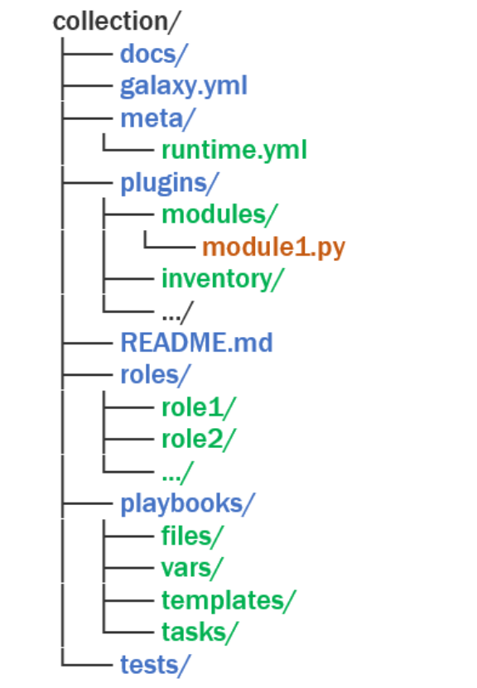
Overview
Collection of roles, modules, plugins and docs
Follows the idea of a marketplace
Ansible Galaxy
Focus on reusable roles
Share logic of your playbook roles
Share internal or external

Slide 8
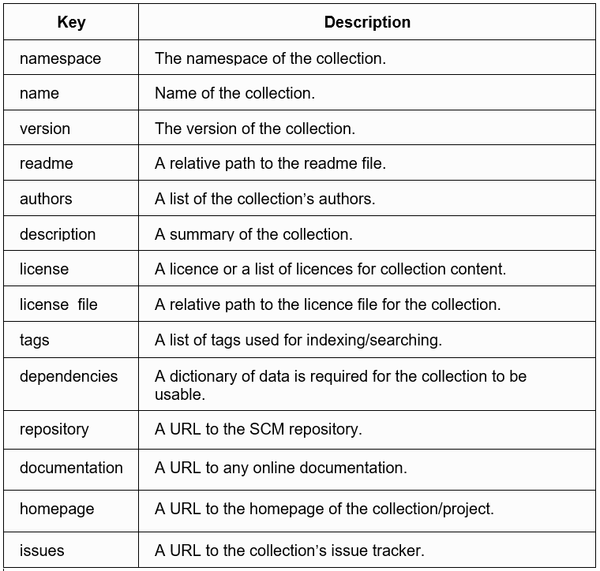
Configs / Important Keywords for collections

Slide 9
Testing / Molecule
03
Testing of Ansible Playbooks

Slide 10
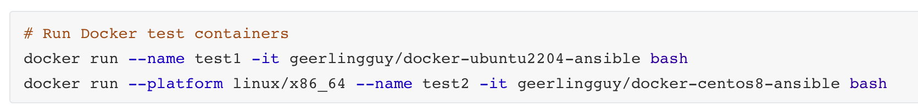
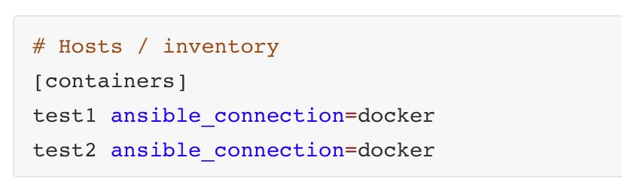
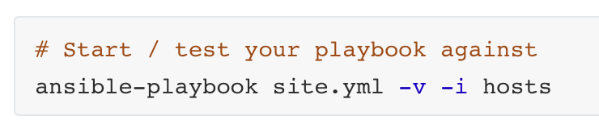
Why Testing
Test your playbook against multiple architectures / OS
Ubuntu, RHEL, SLES, …
Docker / Containers can help us to test playbooks
Locally
In a pipeline
Test a playbook for idempotency
Can I run my Playbook twice?
Use in combination with linting
You can integrate both in your pipeline
Console
Inventory / hosts file
Start / test your playbook

Slide 11
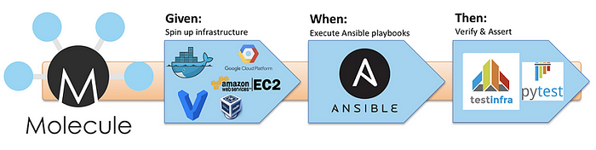
How molecule works
https://medium.com/opstree-technology/how-to-test-ansible-playbook-role-using-molecules-with-docker-b428a7f790d0

Slide 12
What molecule can help us
Wrapper around your Playbooks
Uses Ansible / Playbooks itself (python)
Test of
Collection
Roles
Testing
Initial Installation
Check idempotency
Side effect
Failover simulation, etc.
Validation / test
Cleanup of Testenvironment
Driver (Provider)
Runtime environment for tests
Docker, Podman, KubeVirt, ...
Scenario
e.g. VM Setup + Database installation
Command
To start target environment
e.g. Docker command
Verifier
Validation of the playbook run
Phases of molecule
create (provisioning of environment)
converge (test of your playbook)
verify (check of your playbook run)

Slide 13
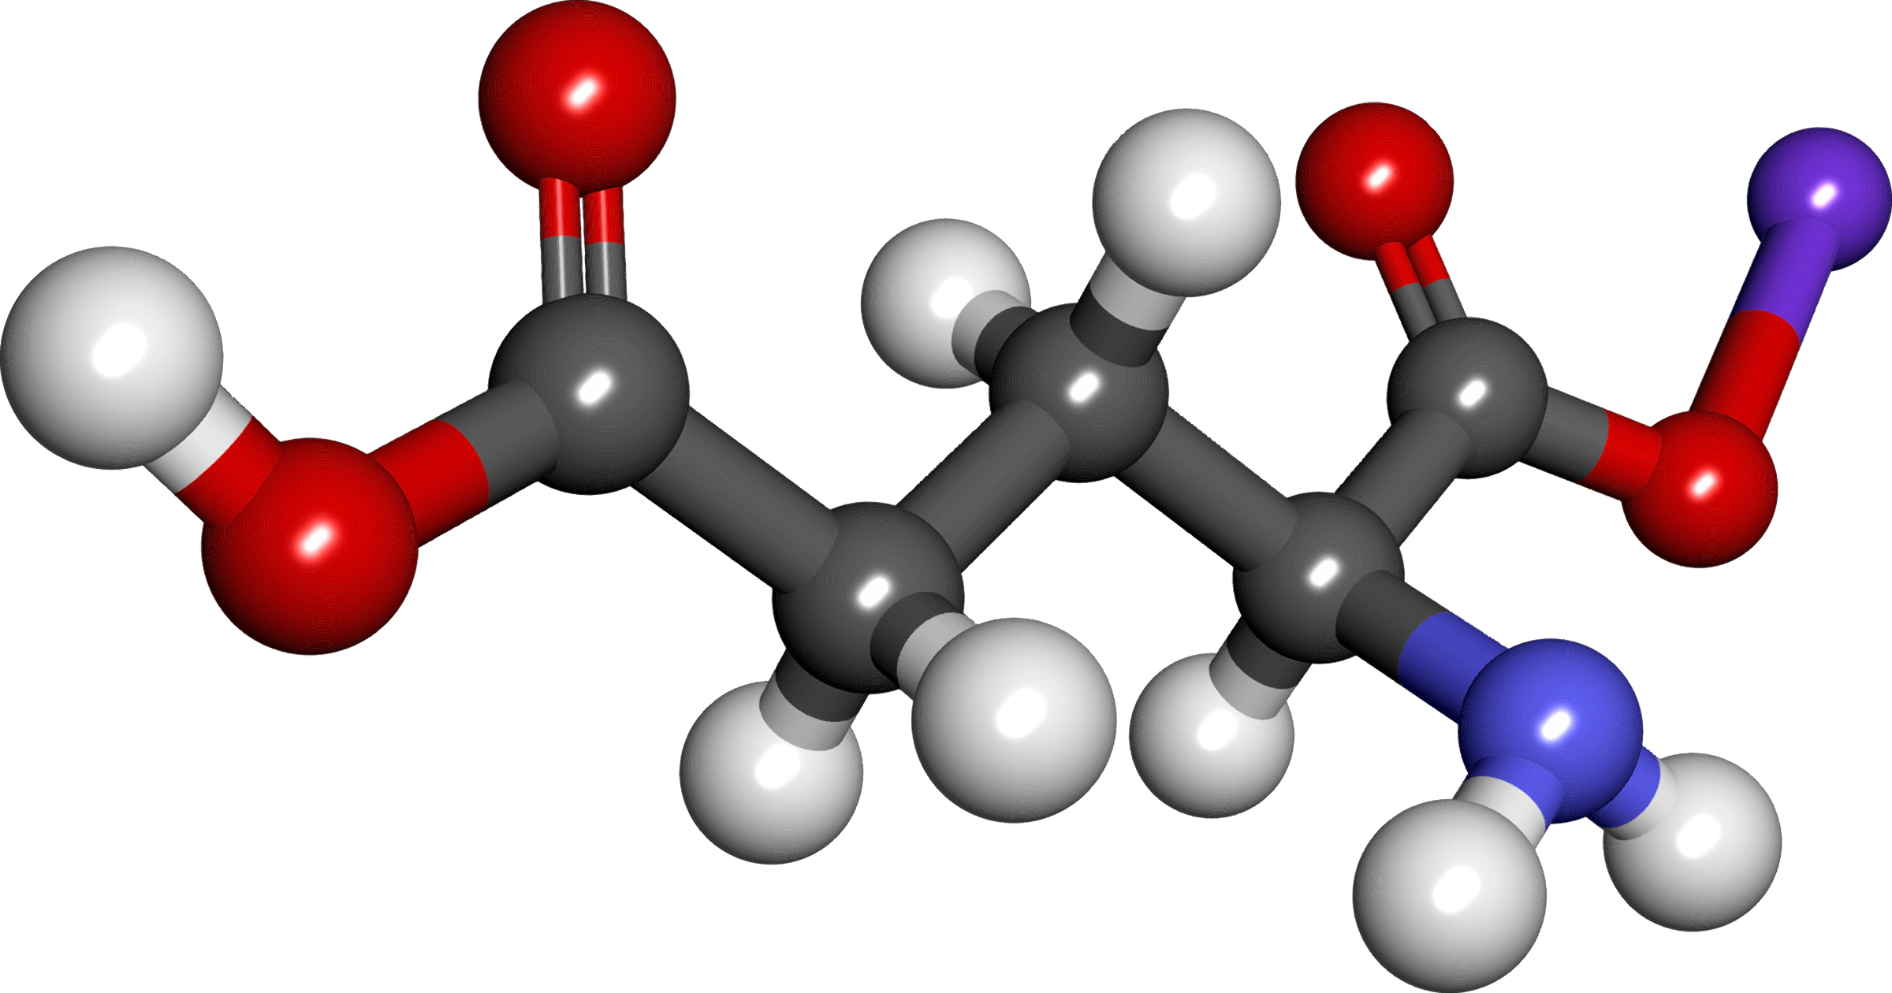
Molecule in action

