Slide 1

Palfinger as a Service
Team Dallas Cowboys

Slide 2
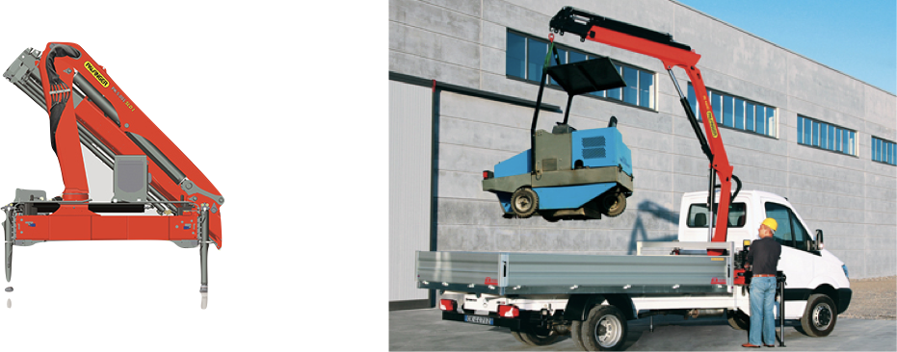
Digital Transformation
MachineProvider
ServiceProvider

Slide 3
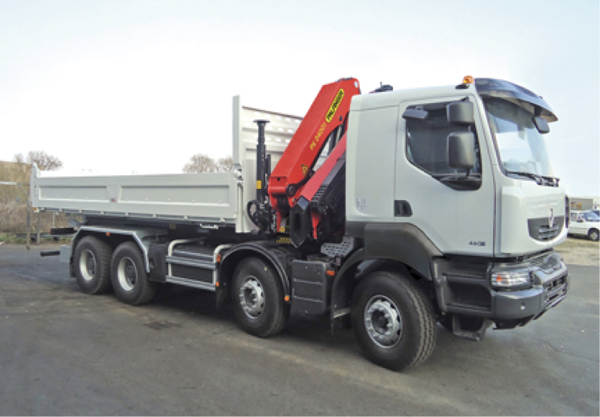
Software is the Key
Local Service
Pal Assistance Hub
Remote
Service
Software Rollout
Share Economy
Fleet Control

Slide 4
Showcase

