Slide 1

Palfinger as a Service
Team Dallas Cowboys

Slide 2
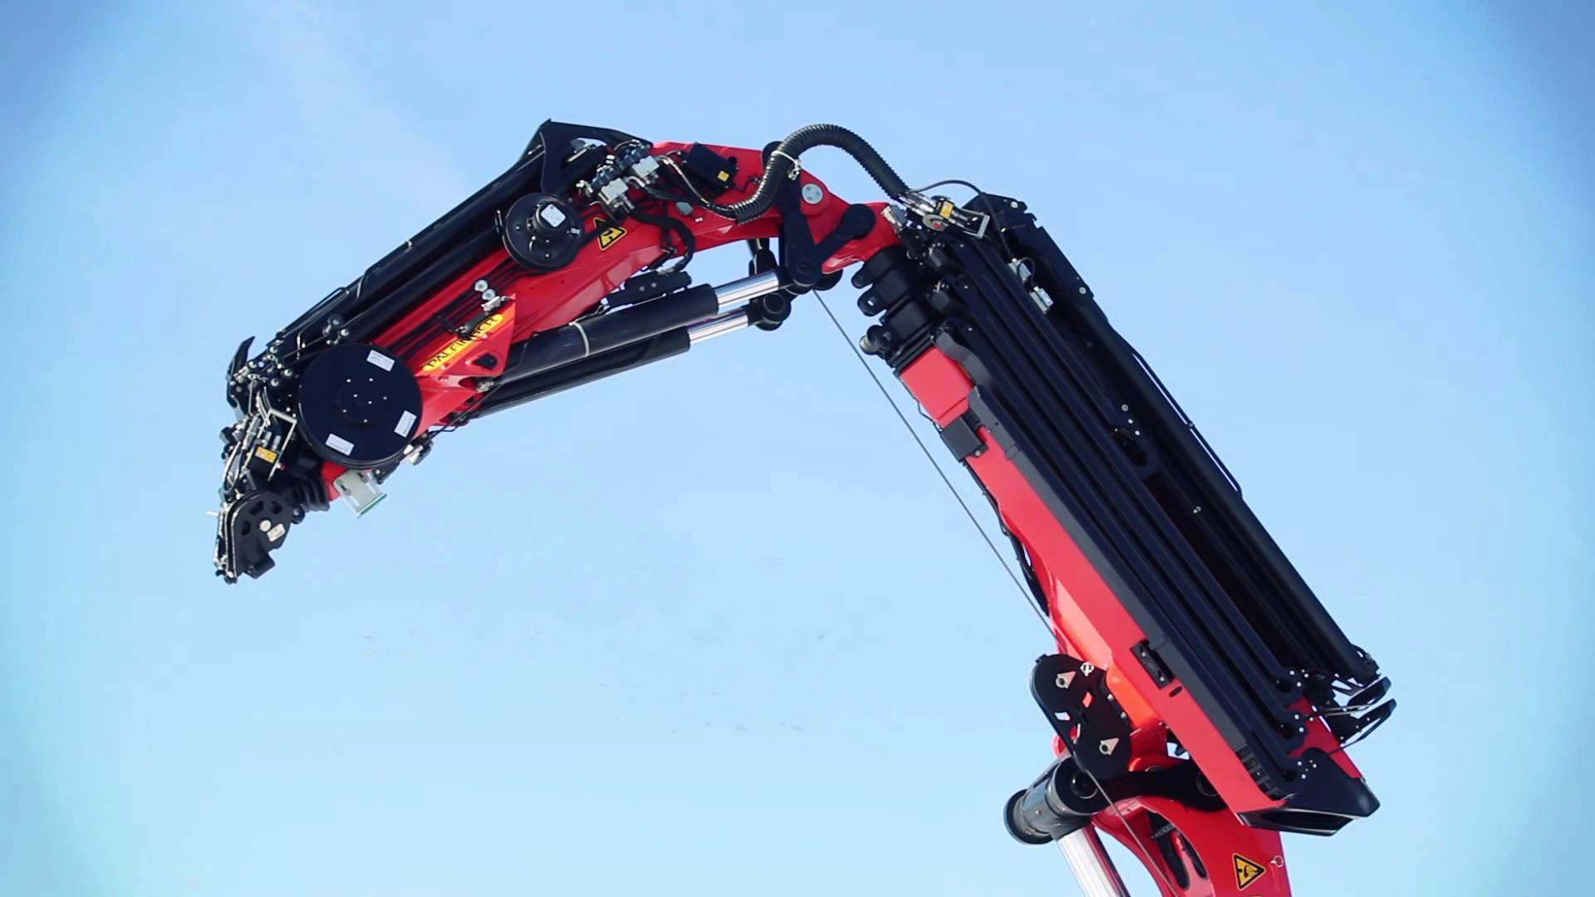

DIGITAL TRANSFORMATION
WIRD
Machine Provider
Service Provider
MachineProvider

Slide 3
SHOWCASE

Slide 4
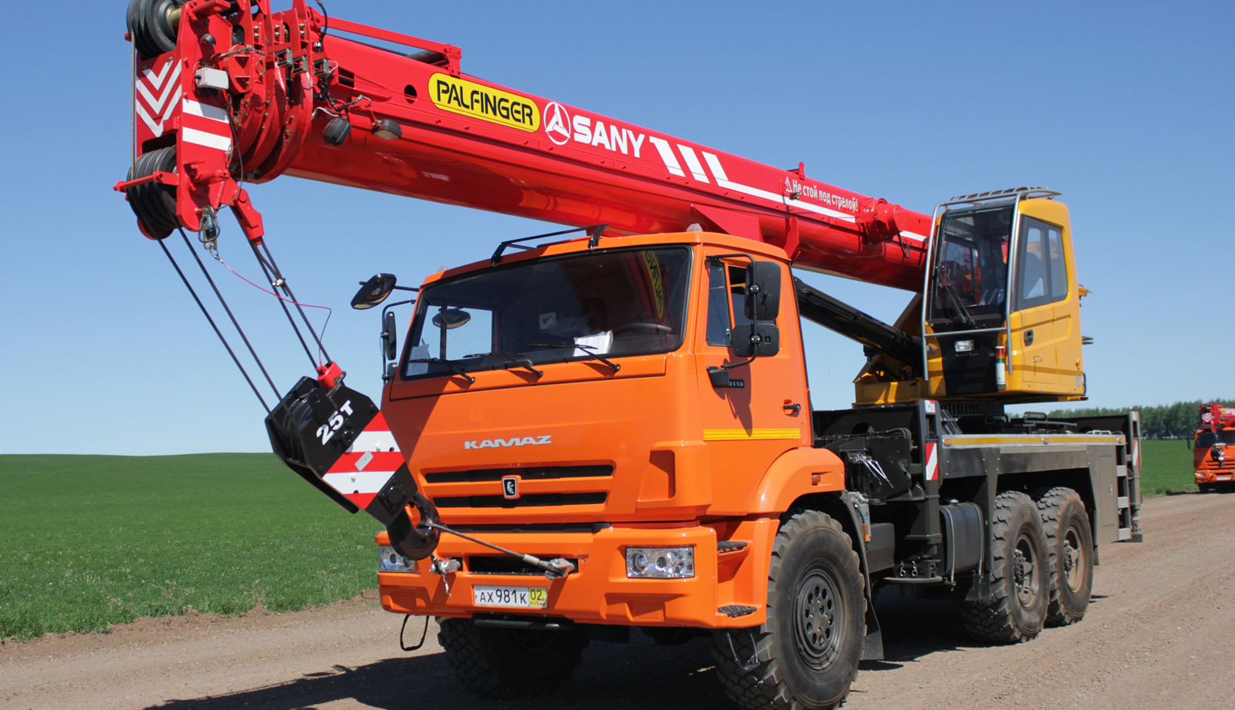
BENEFITS
Local Support
Efficient Service
Remote Support
Software Rollout
Future Proof
Share Economy

Slide 5
ZUSATZINFOS
Local Support
Efficient Service
Remote Support
Software Rollout
Future Proof
Share Economy

