Slide 1

Service A
API
Service B
How software architecture defines boundaries and APIs bridge them
Fabian Mauz

Slide 2
How software architecture defines boundaries and APIs bridge them
What is software architecture?
The software architecture of a program or computing
system is the structure or structures of the system,
which comprise software components, the externally
visible properties of those components, and the relationships
among them
[1]
„The goal of software architecture is to minimize the human resources required to build and maintain the required system“
Robert C. Martin, Clean Architecture, 2017
„Software architecture is those decisions which are both important and hard to change “
Martin Fowler
„Architecture represents the significant design decisions that shape a system, where significant is measured by cost of change “
Grady Booch
[1] L. Bass, P. Clements and R. Kazman. Software Architecture in Practice. Addison Wesley, 1999, ISBN 0-201-19930-0.

Slide 3
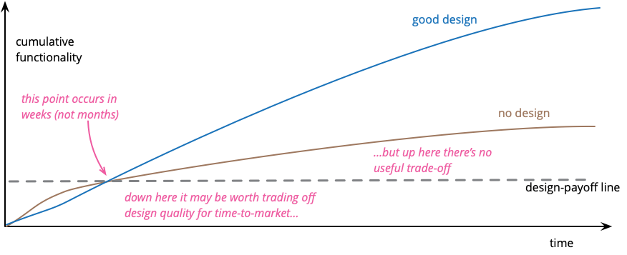
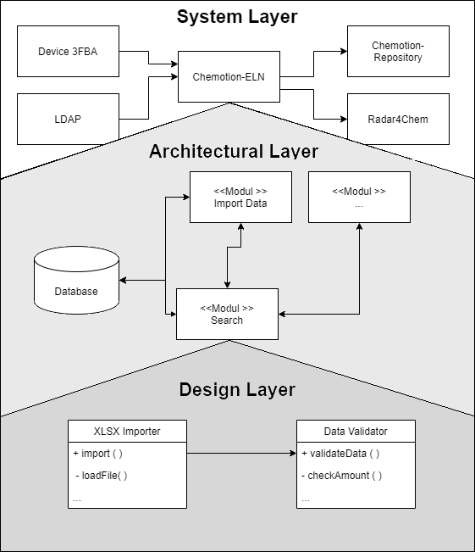
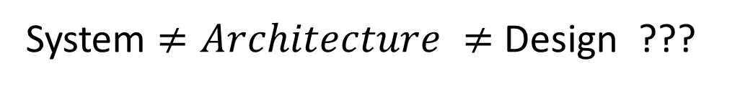
Sustainable software development / chapter 1
Short introduction
System $≠Architecture ≠$ Design ???
[2] M. Fowler, Design Stamina Hypothesis, 2007

Slide 4
Sustainable software development / chapter 1
Short introduction
One big problem to change software are dependencies
Data Provider A
UniProtKB
Query: EC 1.1.1.1
Algorithm A
How difficult is it to change the data provider ???
Data Provider B
ENZYME

Slide 5
Sustainable software development / chapter 1
Short introduction
One big problem to change software are dependencies
Data Provider A
UniProtKB
Query: EC 1.1.1.1
Algorithm A
How difficult is it to change the data provider ???
Data Provider B
ENZYME
!! Loose Coupling !!

Slide 6
Sustainable software development / chapter 1
Ports and Adapters/Hexagonal architecture
Basic architecture of Backend service -> teaser for apis
Inner german border ^{[4]}

Slide 7
Sustainable software development / chapter 1
Microservice architecture
Small independent, specialized services
Own isolated data persistence
Communication takes place via well-defined APIs
UI
Service 1
Service 2
The good
The bad
„Small“ codebase, can be implemented independently
High scalability
Technological flexibility
Reliability
More complex than monolith
Deployment more complex
Data Consistency
Communication slower
DB 1
Service 3
DB 2

Slide 8
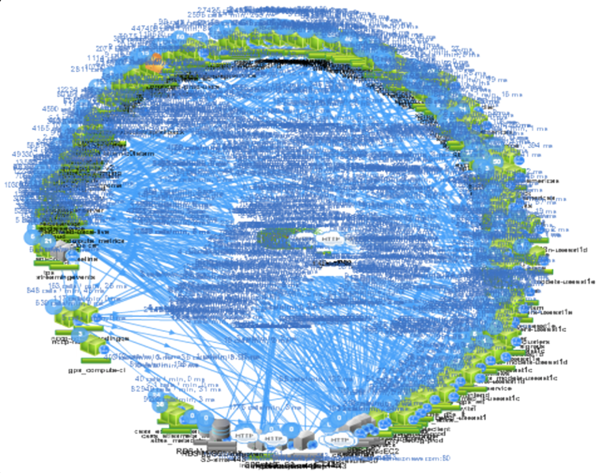
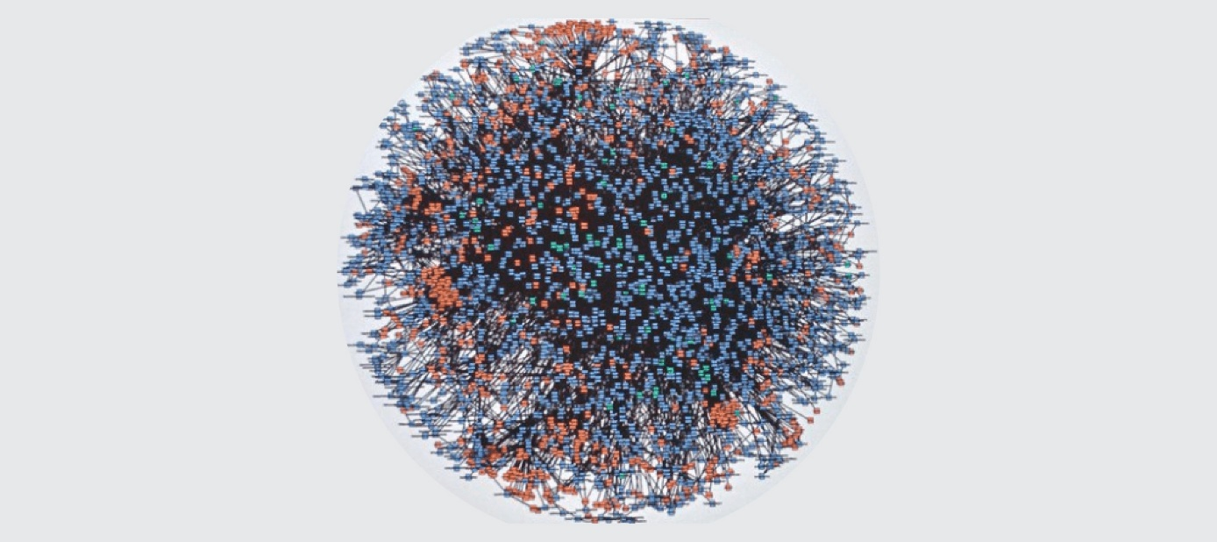
Sustainable software development / chapter 1
Microservice architecture - Examples
^{Amazon, 2000 [4]}
Netflix-Death-Star Architecture[4]

Slide 9
Sustainable software development / chapter 1
Short introduction
General definition of API, showing different Kind of apis
Inner german border ^{[4]}

Slide 10
Sustainable software development / chapter 1
Short introduction
Looking deeper into a REST call, showing problems (CORS)
Inner german border ^{[4]}

Slide 11
Sustainable software development / chapter 1
Short introduction
OPEN API and what are the benefits
Inner german border ^{[4]}

Slide 12
Sustainable software development / chapter 1
Short introduction
Tipps for a good API design
Inner german border ^{[4]}

Slide 13
Sustainable software development / chapter 1
Short introduction
Problems with APIs
Not stable, unclear, ….
Testablility -> leads to next slide
Inner german border ^{[4]}

Slide 14
Sustainable software development / chapter 1
Short introduction
Again architecture and focus on testing
Nachteil viel mehr Komponenten, komplexeres -> Automatisierung/Github Actions
-> Github actions example
Testing pyramide
Inner german border ^{[4]}

Slide 15
Sustainable software development / chapter 1
Short introduction
Caching in githubactions
Using of docker in github actions
Excustion: using GPUs in docker containers
Inner german border ^{[4]}

Slide 16
Sustainable software development / chapter 1
Short introduction
Docker compose and kubernetes
Inner german border ^{[4]}

Slide 17
Sustainable software development / chapter 1
Short introduction
Thanks
Inner german border ^{[4]}

