Slide 1

Short overview of JSONB and indices in postgres
Fabian Mauz

Slide 2
Short overview of JSONB and indices in postgres
Json Data Types
The json data type stores an exact copy of the input text. Functions must reparse on each execution, no index
jsonb data is stored in a decomposed binary format. It also supports indices.
specified in RFC 7159
Advantage against text is enforcing that each stored value is valid according to the JSON rules
CREATE TABLE xxx (data jsonb);
Operator | Description
-> | Get JSON object field by key or index
->> | Get object casted as text by key or index
#> | Get JSON object at specified path
@> | Does the left JSON value contain the right JSON path/value entries at the top level?
? | Does the string exist as a top-level key within the JSON value?
There are more operators and functions -> special ones are set generating functions -> they produce an own table

Slide 3
Short overview of JSONB and indices in postgres
Indices in postgres
Aditional datastructure with 2 main purposes: constraining and query optimization
Default type in postgres : Btree, but there are more (GIN,GIST,…)
Indices are stored as tuples (value[s],pointer to row) and referenced in pages of size 8kB organized as an array with adinitional tree structure for faster access
Some contstraints automatically create indices (primary key, unique, exclude)
You can see the metainformation of the index with pageinspect
CREATE EXTENSION pageinspect

Slide 4
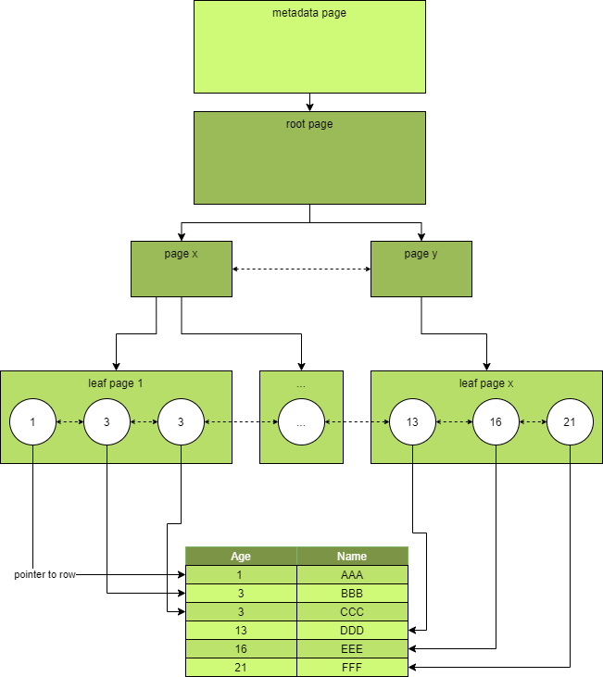
Short overview of JSONB and indices in postgres
Balanced Trees (B-Tree)
Based on Lehman & Yao Btree¹
CREATE INDEX btree_example ON metadata(id);
Meta infos of index
SELECT * FROM bt_metap('btree_example');
Infos of specific pages
SELECT * FROM BT_PAGE_ITEMS('btree_example',1);
If query is satisfied by values only from index, no access to “real” data
Supported operators: <,>,<=,>=,=
¹ Efficient Locking for Concurrent Operations on B-Trees, P. Lehman, B. Yao, 1981

Slide 5
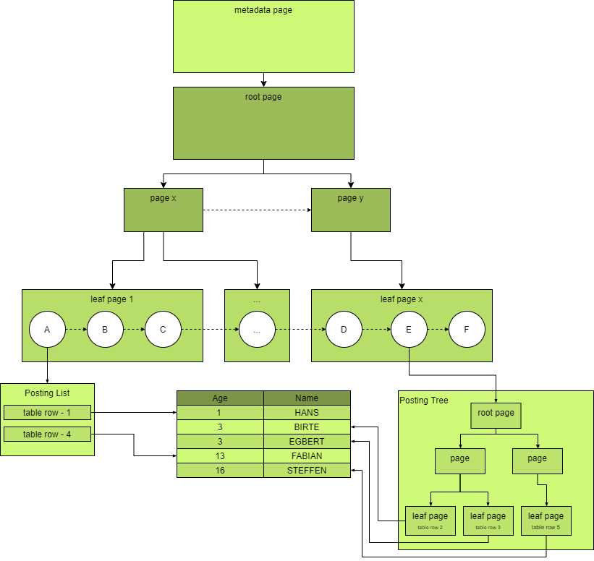


Short overview of JSONB and indices in postgres
Generalized Inverted Index (GIN)
Designed for cases where the items to be indexed are composite values
Inserting very slow -> You can disable an instant index update and do it later
Without index
With index
No duplicates in child nodes of the first B tree
Default supported operators for jsonb:
@>, @?, @@, ?,?|,?&

Slide 6
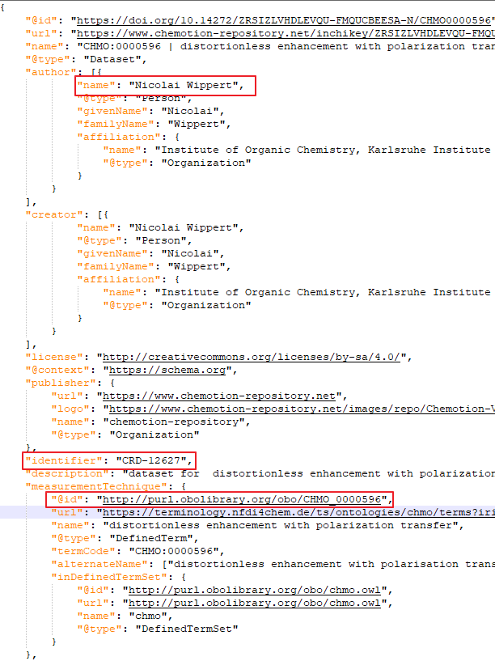
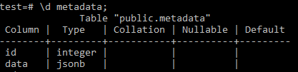
Short overview of JSONB and indices in postgres
Test environment
Postgres Version: 16
Running in a docker container
Datasource: chemotion repository metadata dump: 233 MB
Entries: 18799

Slide 7
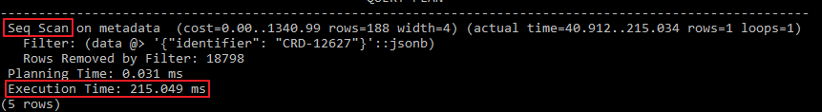
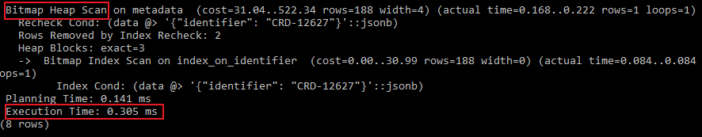
Short overview of JSONB and indices in postgres
UseCase 1 - Get the dataset with identifier CRD-12637
SELECT id FROM metadata WHERE data @> '{"identifier":"CRD-12627"}';
EXPLAIN ANALYZE SELECT id FROM metadata WHERE data @> '{"identifier":"CRD-12627"}';
Full table scan 215 ms
Create an GIN index on the column data of table metadata
CREATE INDEX index_on_identifier ON metadata USING GIN(data);
Index scan
0.305 ms

Slide 8
Short overview of JSONB and indices in postgres
UseCase 2 - Get all datasets with specific measurementTechnique
SELECT count(id) FROM metadata
WHERE data->'measurementTechnique' @> '{"@id": "http://purl.obolibrary.org/obo/CHMO_0000596"}';
916 rows returned
Full table scan 223 ms
CREATE INDEX index_on_measurement ON metadata USING GIN((data->'measurementTechnique'));
EXPLAIN ANALYZE SELECT count(id) FROM metadata
WHERE data->'measurementTechnique' @> '{"@id": "http://purl.obolibrary.org/obo/CHMO_0000596"}';
Index scan
9.128 ms
SELECT COUNT(id) FROM metadata
WHERE data->'measurementTechnique'->>'@id' = 'http://purl.obolibrary.org/obo/CHMO_0000596';
916 rows returned BUT no index was used
Btree index works
CREATE INDEX index_on_measurement_id ON metadata using BTREE((data->'measurementTechnique'->>'@id'));

Slide 9
Short overview of JSONB and indices in postgres
UseCase 3 - Get all datasets from specific author
Get all datasets from Nicolai Wippert
Problem: Interresting item inside an array -> some psql magick must be done
SELECT COUNT(DISTINCT (id,x->'name'))
FROM metadata CROSS JOIN LATERAL (SELECT jsonb_array_elements(data->'author')::jsonb as x)
WHERE x @> '{"name":"Nicolai Wippert"}';
Full table scan 372 ms
CREATE INDEX index_on_author ON metadata USING GIN((data->'author'));
Still full table scan
CREATE INDEX index_on_author_name ON metadata using BTREE((data->'author'->>'name'));
Still full table scan

Slide 10
Short overview of JSONB and indices in postgres
Literature
https://www.cybertec-postgresql.com/en/gin-just-an-index-type/
http://www.louisemeta.com/blog/indexes-gin/
https://www.postgresql.org/docs/current/datatype-json.html
https://github.com/elixir-europe/biohackathon-projects-2023/blob/main/7/dumps/chemotion-datadump-2023-12-13.jsonld.gz
https://github.com/FabianMauz/ipb-talk-postgres-jsonb-index

