Slide 1

Connecting Galaxy – A short look & tell
Fabian Mauz

Slide 2
Connecting Galaxy – A short look & tell
Overview of Galaxy
Galaxy is an open source, web-based platform for data intensive biomedical research
Many “ready to use” tools like plotting, searching in dbs or data convertions
Idea: Use tools provided by Galaxy in an external software (e.g. chemotion-eln) without media break
There are different “public” instances of galaxy:
- https://galaxyproject.org/
- usegalaxy.eu/
- test.galaxyproject.org
And much more, can be self hosted

Slide 3
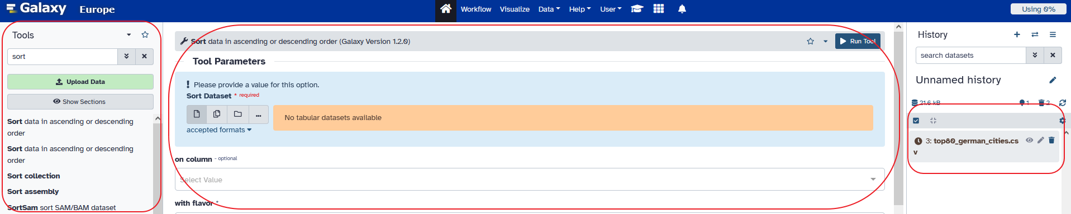
Connecting Galaxy – A short look & tell
Browser UI of Galaxy
Left: tool you can use, you can create your own tool in another process
Middle: detailed information about selected item (sorting tool). It gives you detailed infos about inputparameter,…
Right: infos about history(ies). A history is one of the concepts of organizing things like data, jobs, …

Slide 4
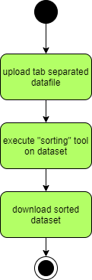
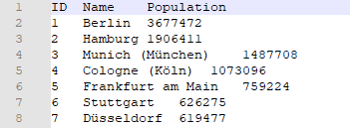
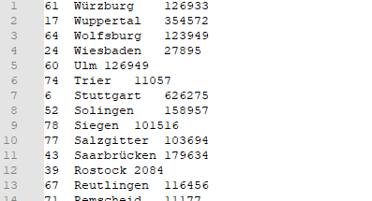
Connecting Galaxy – A short look & tell
Usecase: Sorting data with Galaxy
Used tool is called “Sort” and sorts data in desired direction on a chosen column
Life demo on galaxy.eu

Slide 5
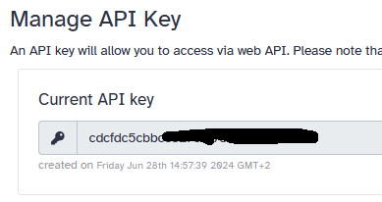


Connecting Galaxy – A short look & tell
Galaxy REST API
Open API docu: https://test.galaxyproject.org/api/docs
Many endpoints, some not yet migrated/documented
Authentication based on API – key of user
- authentication by URL param
- authentication in header
- (authentication by session cookie)

Slide 6
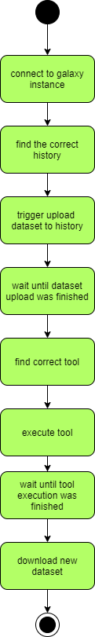
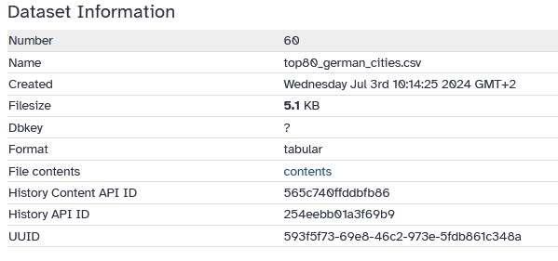
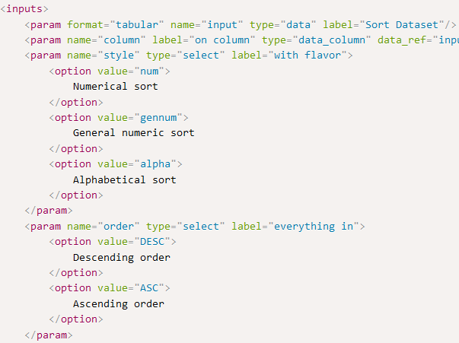
Connecting Galaxy – A short look & tell
UseCase in java demo app
Python: Bioblend
Java: blend4j
Dataset has more than one identifier
Possible states of jobs: pending, queued, running, ok, …
Life demo on test.galaxyproject.org

Slide 7
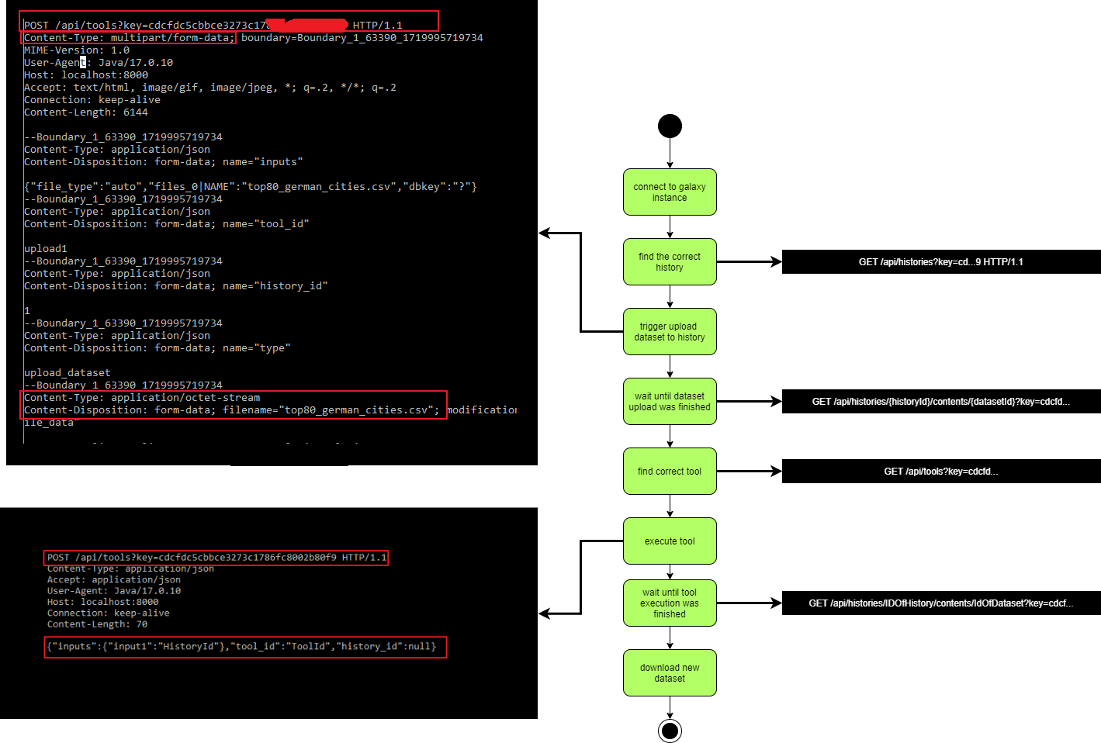
Connecting Galaxy – A short look & tell
Mapping of java sub processes to HTTP requests

Slide 8
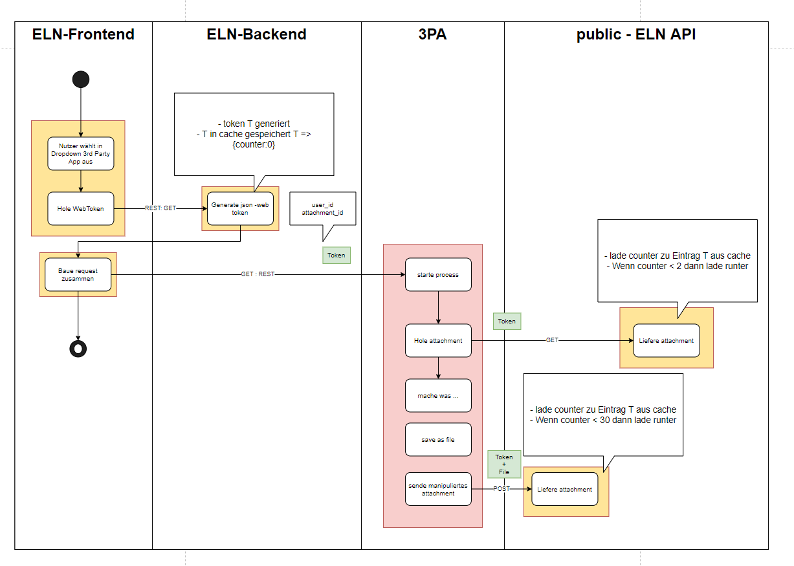
Connecting Galaxy – A short look & tell
Chemotion ELN – Third Party App Integration
3PA needs to push and be pushed
3PA needs to have an ELN token of user
Communication based on ELN IDs

Slide 9
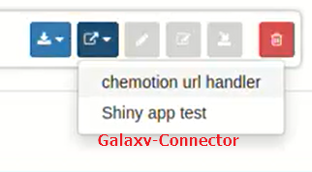
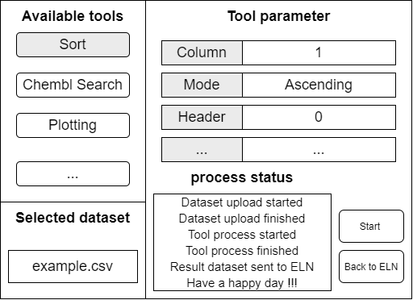
Connecting Galaxy – A short look & tell
Things to think about
Fix problems with input parameters
Supporting also workflows
How to handle the quota of a user
Chemotion eln: create an own Galaxy Connector Third-party-app ?

Slide 10
Connecting Galaxy – A short look & tell
More to read
https://training.galaxyproject.org/training-material/topics/dev/tutorials/bioblend-api/slides.html
https://galaxyproject.org/
https://bioblend.readthedocs.io/en/latest/
https://github.com/FabianMauz/ipb-talk-galaxy-api-20240704
https://github.com/galaxyproject/blend4j

