Slide 1
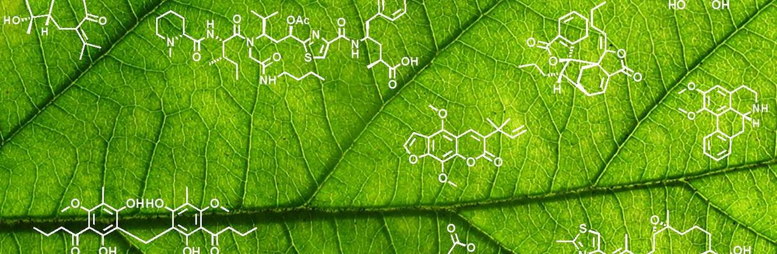
Enzyme ML
Workshop 2025
Enzyme ML workshop - 2025
Fabian Mauz

Slide 2
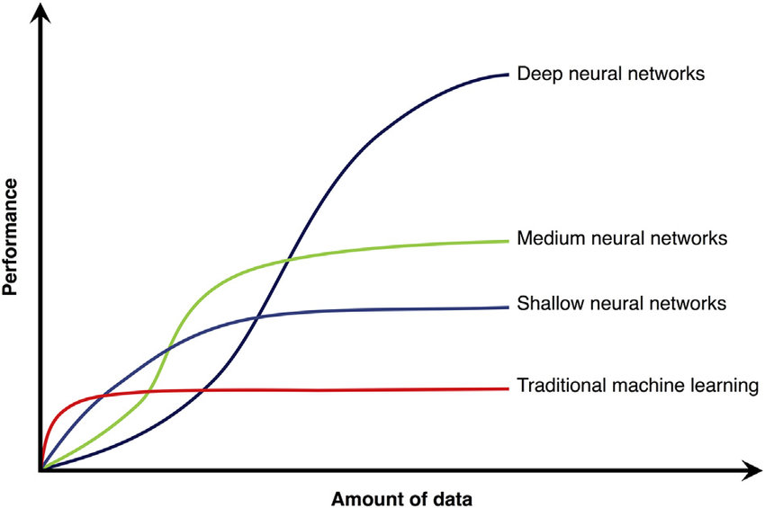
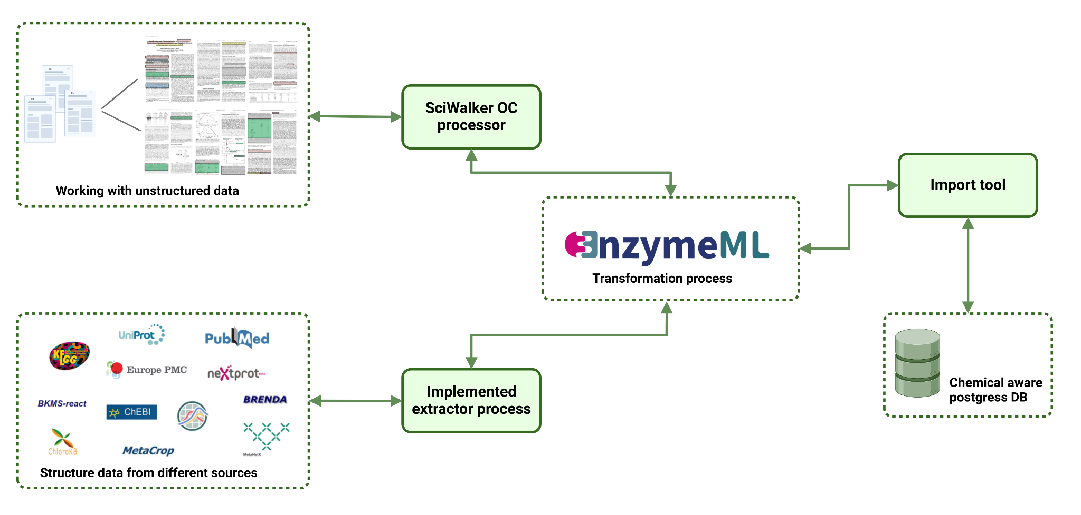
Enzyme ML workshop - 2025
BioCasNavi
DiP-BioCasNavi: An AI platform for the rapid creation of biocatalytic cascades for innovative bioprocesses
Based on an internal database of enzyme reactions prediction of new cascades (and more ) by LLM
Main Data is a representation of enzymatic reactions
Softwarearchitecture: What and Why
Examples : Microservices and Hexagonal architecture
What is an API 2 Examples
Open API
Testing APIs

Slide 3
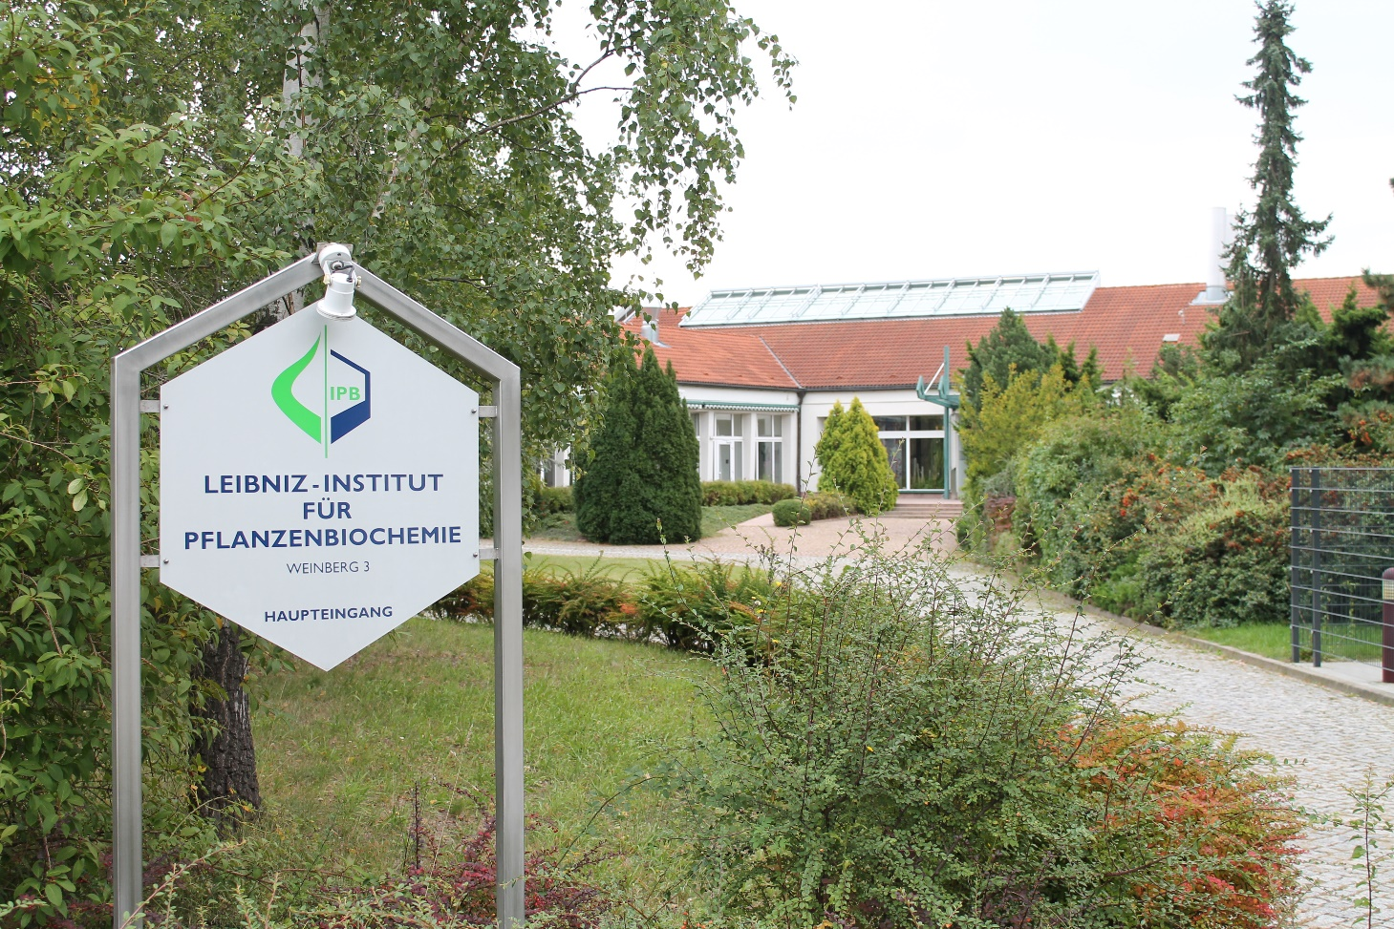

Enzyme ML workshop - 2025
Thank you
I would like to thank
Prof. Ludger Wessjohann
The EnzymeML group
Dr. Mehdi Davari
Dr. Frank Broda
NWC department & Dr. Steffen Neumanns group
Funded by

