Slide 1
Capstone SQL
Davis University

Slide 2
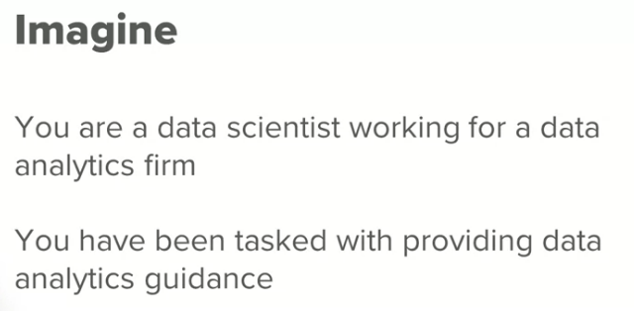
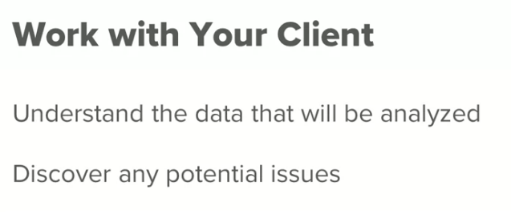
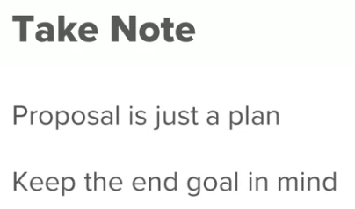
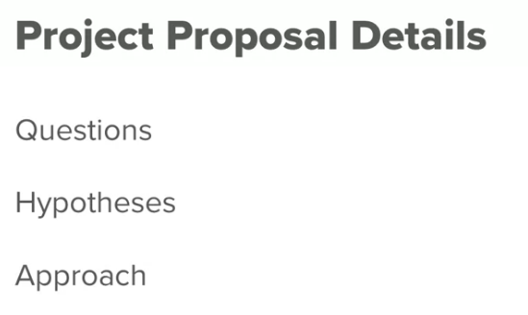
Initial information

Slide 3
Data set
Client 3: SportsStats (Olympics Dataset - 120 years of data)
SportsStats is a sports analysis firm partnering with local news and elite personal trainers to provide “interesting” insights to help their partners. Insights could be patterns/trends highlighting certain groups/events/countries, etc. for the purpose of developing a news story or discovering key health insights.

Slide 4
Step 1: Preparing for Your Proposal
1. Which client/dataset did you select and why?
Client 3: SportsStats (Olympics Dataset - 120 years of data)
The client/dataset selected was SportStats with the Olympics dataset, I chose it because one of the applications of data science is the business of sports, and I want to discover information about the performance of different countries in the Olympics, one of the ways nations show their "power" to the world.

Slide 5
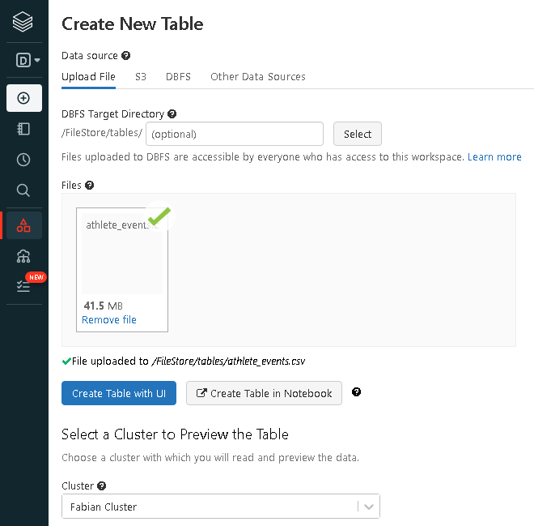
Step 1: Preparing for Your Proposal
2. Describe the steps you took to import and clean the data.
1. I have used Databricks to upload the athlete_events.csv archive, using the cluster previously created.

Slide 6
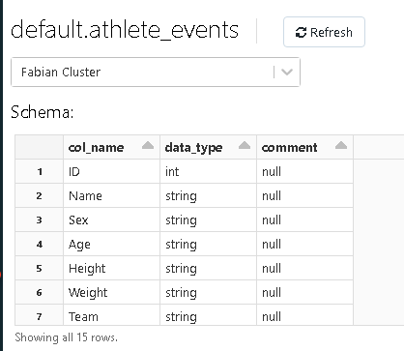
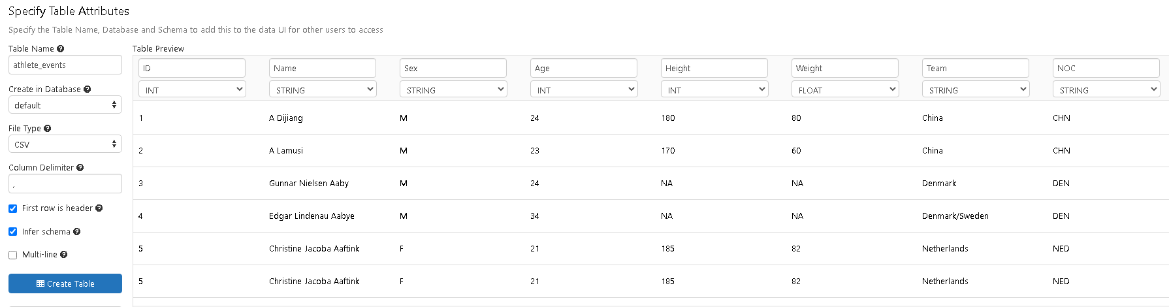
Step 1: Preparing for Your Proposal
2. Describe the steps you took to import and clean the data.
2. I have specify the table attributes, using the headers in the document and allowing the program to infer the data schema. The table created is called ‘athlete_events’ and looks correct.

Slide 7
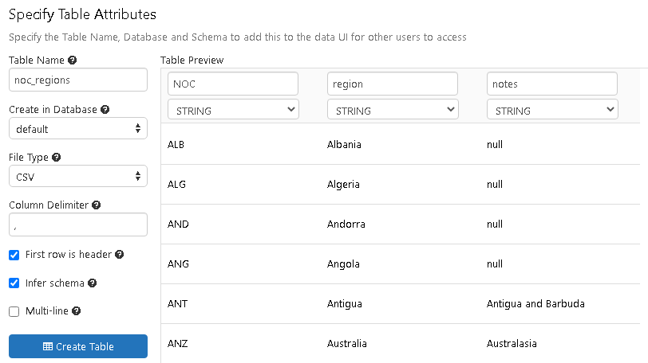
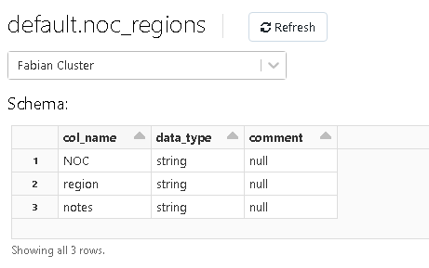
Step 1: Preparing for Your Proposal
2. Describe the steps you took to import and clean the data.
3. Doing the same steps the table ‘noc_regions’ is created.

Slide 8
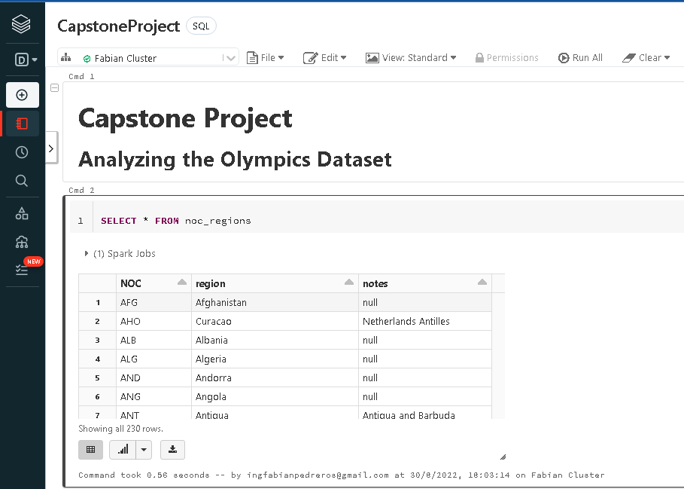
Step 1: Preparing for Your Proposal
2. Describe the steps you took to import and clean the data.
4. The notebook ‘CapstoneProject’ is created, in this is possible to run queries with the tables.

Slide 9
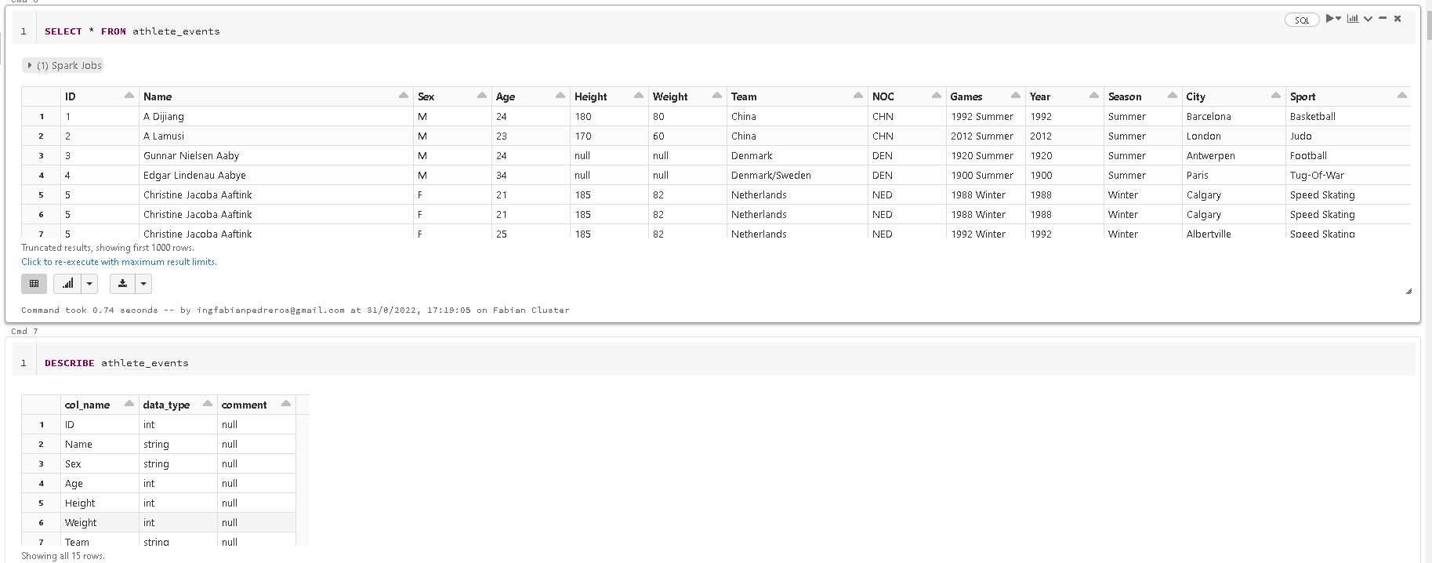
Step 1: Preparing for Your Proposal
2. Describe the steps you took to import and clean the data.
5. Understanding the data
Querying the tables to see the data, understand it and using the describe command to validate the data types.
In the 'athlete_events' is ok to:
In the Medal attribute is normal to have null values. This are the values with 'NA'
Have multiple rows for the same ID and Name.

Slide 10
Step 1: Preparing for Your Proposal
2. Describe the steps you took to import and clean the data.
5. Data cleansing
In the athletes_events table i need to execute the next validation:
For categorical attributes:
Validate null values in Name, Sex, Team, Noc, Games, Season, City, Sport, Event.
Establish the step to follow with the null values found.
Validate the values in the next columns: Sex, Team, NOC, Games, Season, City, Sport, Event and Medal.
Establish the step to follow with the values that seems incorrect.
For numeric attributes:
Validate null values in ID, Age, Height, Weight, and Year.
Establish the step to follow with the null values found.
Establish the min, max and range for the numeric values.
Establish the step to follow with the values that seems incorrect.

Slide 11
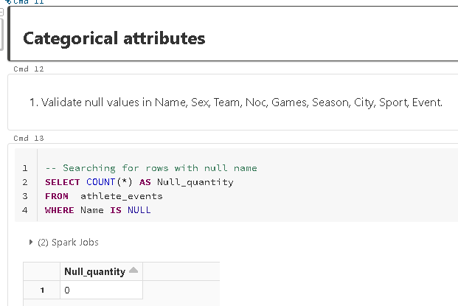
Step 1: Preparing for Your Proposal
2. Describe the steps you took to import and clean the data.
5. Data cleansing categorical values
Query the data to find Nulls
Only are found Null values in the Medal column, this are 231333 rows, not are an error, due in the data set we have all the history of the participations and are athletes that doesn't win a medal.
This values are represented with 'NA'

Slide 12
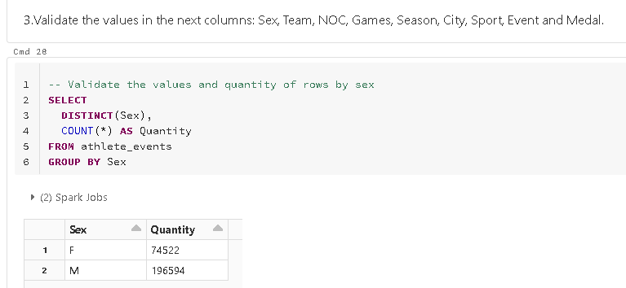
Step 1: Preparing for Your Proposal
2. Describe the steps you took to import and clean the data.
5. Data cleansing categorical values
Value validation
I don't find any value that seems incorrect and needs an update:
We have two values for sex (M, F)
We have a large quantity of teams with 1184
It appears we don't have any inconvenient with the NOC
Our data is from 51 different games
The seasons are divided in summer or winter
42 different cities has been received the Olympics
66 different sports are been included in the Olympics, but this is a global aggrupation like a sports category
756 sports or events has been taken place in the Olympics
The medal earned has been Gold, Silver and Bronze

Slide 13
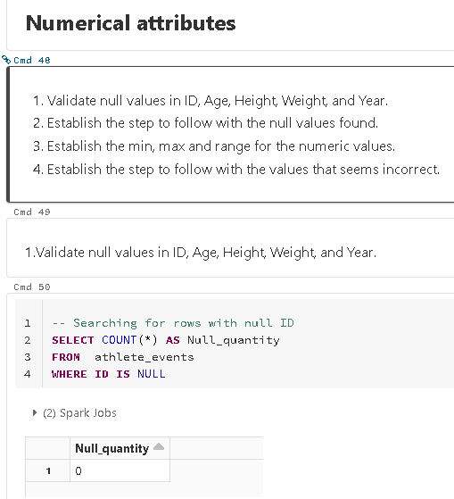
Step 1: Preparing for Your Proposal
2. Describe the steps you took to import and clean the data.
5. Data cleansing numerical values
Nulls validation
We don't have the age for 9474 rows.
We don't have the height for 60171 rows.
We don't have the weight for 62875 rows.
We can’t exclude this values due to the quantity in any case, so in the data science work this values have to be imputed.

Slide 14
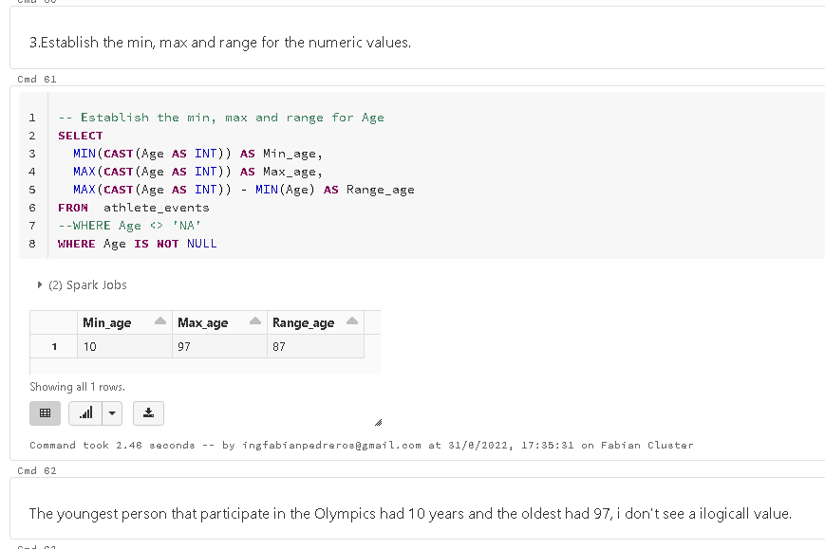
Step 1: Preparing for Your Proposal
2. Describe the steps you took to import and clean the data.
5. Data cleansing numerical values
Value validation
I don't see any value that needs to be corrected or an outlier that needs to be verified.

Slide 15
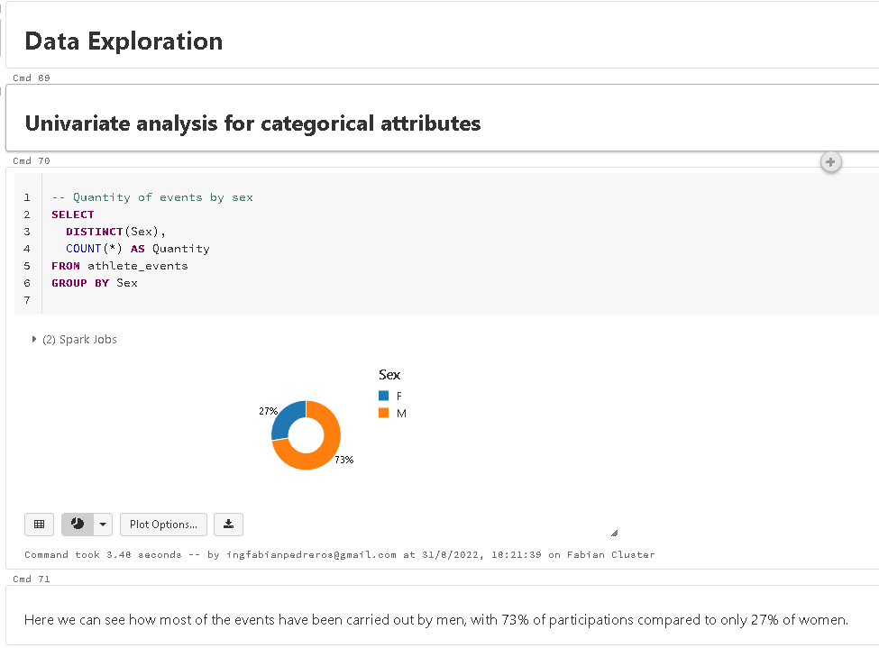
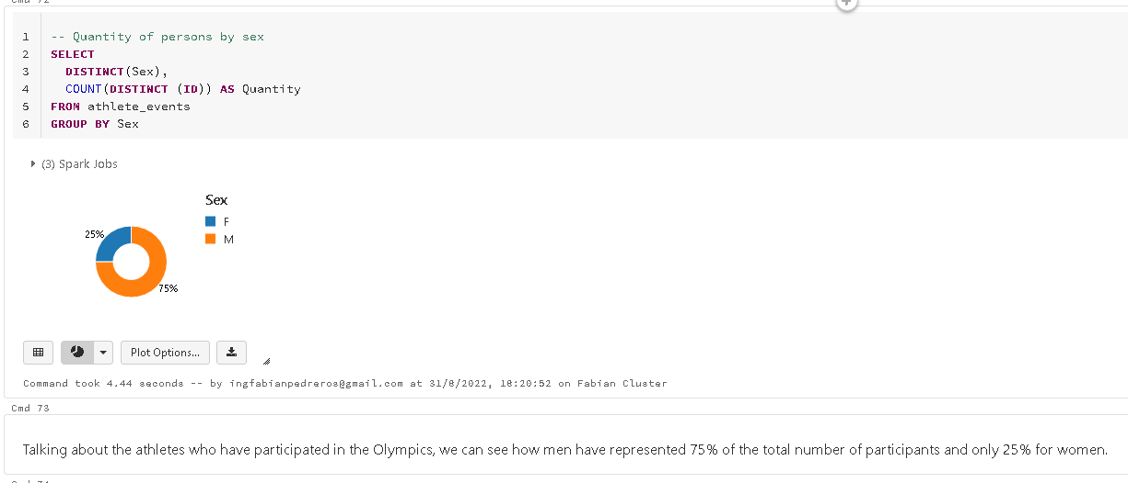
Step 1: Preparing for Your Proposal
3. Perform initial exploration of data and provide some screenshots or display some stats of the data you are looking at.
Univariate data exploration is performed to establish certain baseline behaviors for both categorical and numerical data. Data visualization is key.

Slide 16
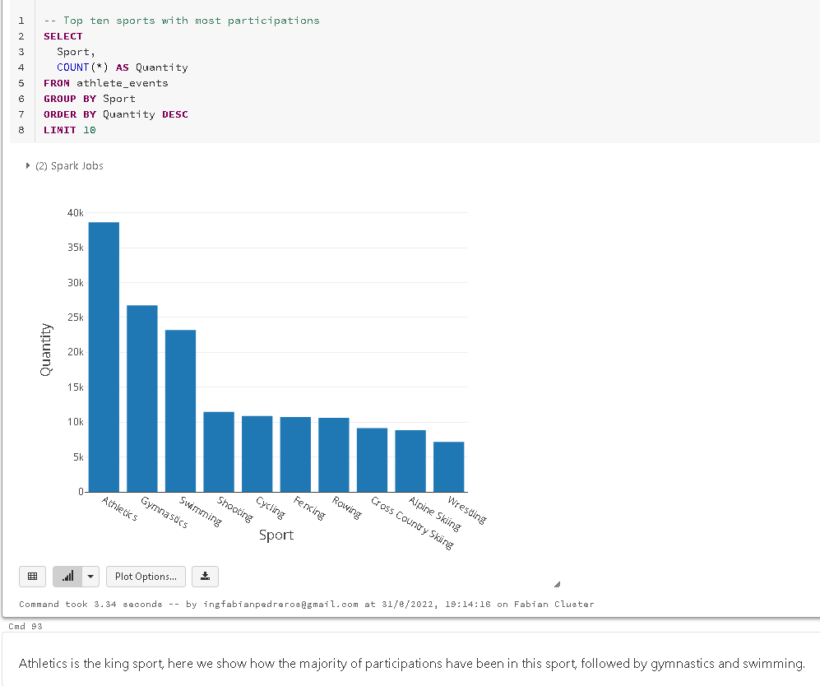
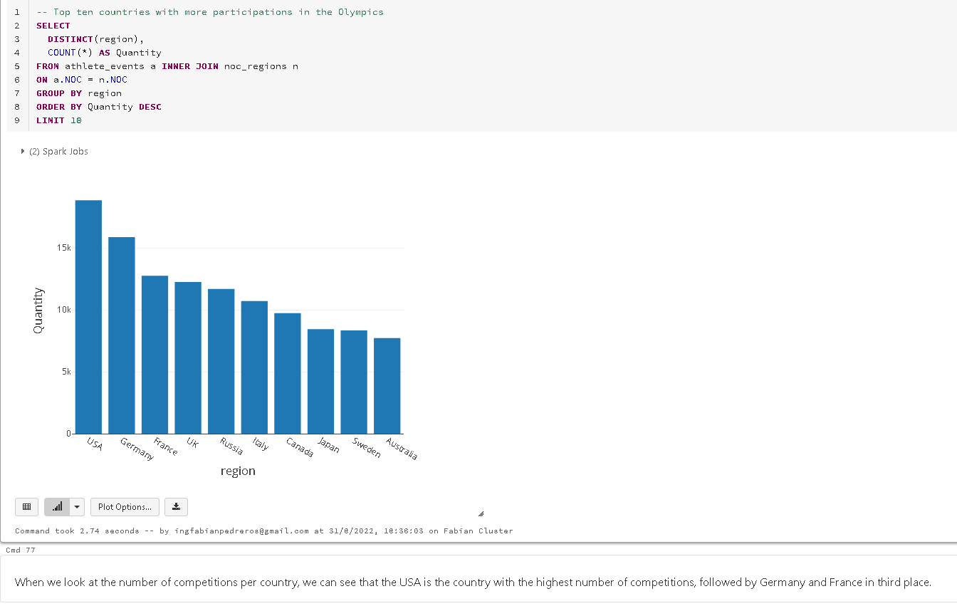
Step 1: Preparing for Your Proposal
3. Perform initial exploration of data and provide some screenshots or display some stats of the data you are looking at.

Slide 17
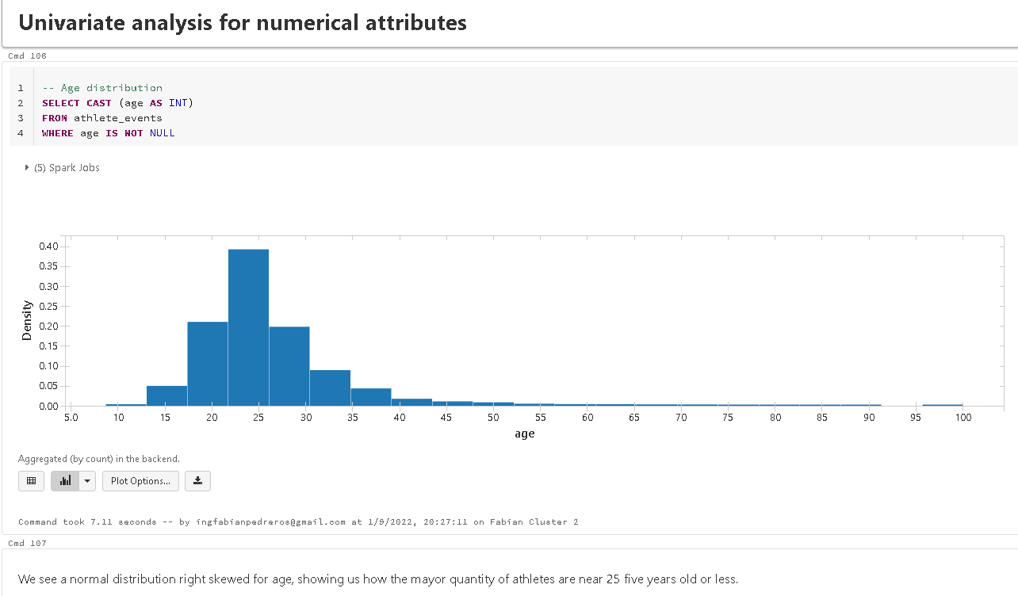
Step 1: Preparing for Your Proposal
3. Perform initial exploration of data and provide some screenshots or display some stats of the data you are looking at.

Slide 18
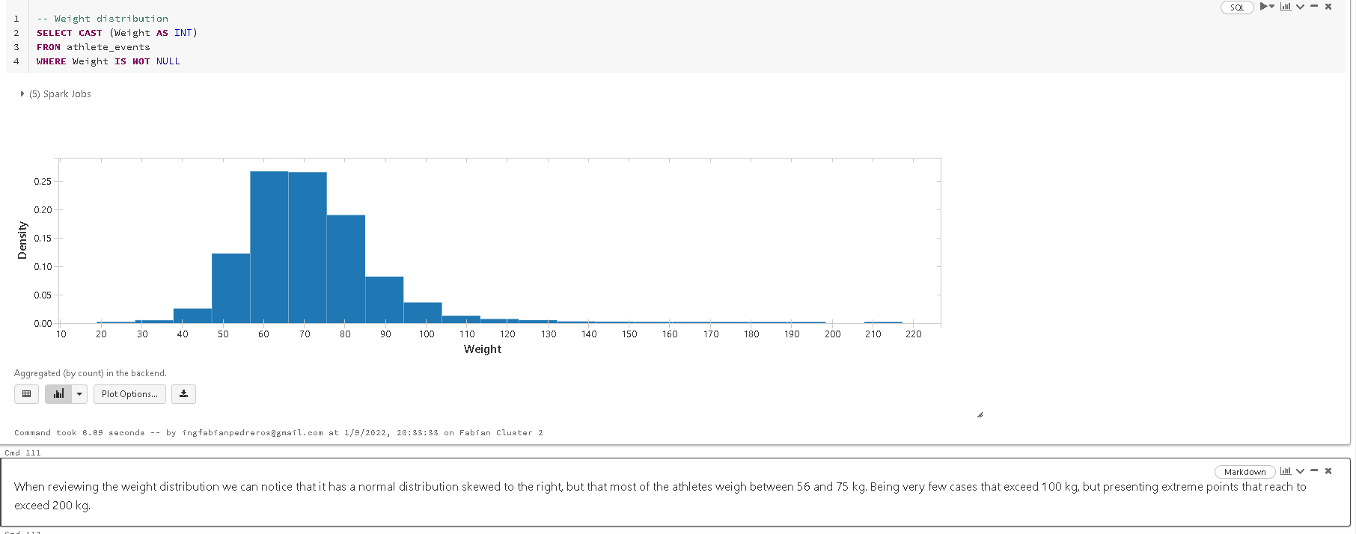
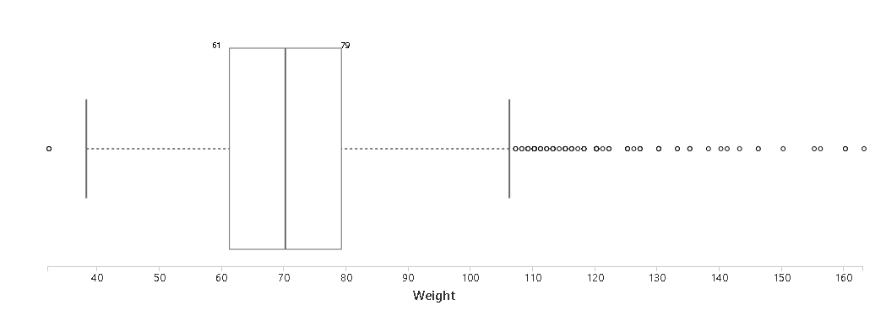
Step 1: Preparing for Your Proposal
3. Perform initial exploration of data and provide some screenshots or display some stats of the data you are looking at.

Slide 19
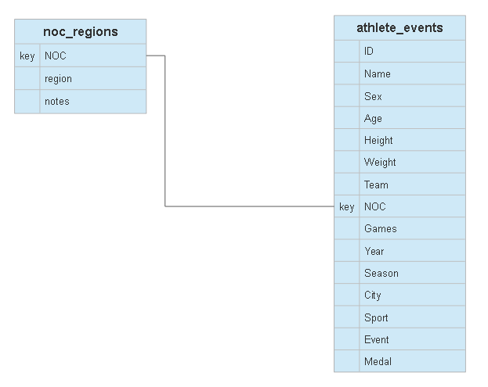
ER diagram for Olympics Dataset

Slide 20
Step 2: Develop Project Proposal
Description
Establish what demographic attributes make an athlete more capable to win a medal in the Olympics, such age, sex, weight and height. Just for Athletics athletes.
This information is of interest to the athletes, the teams that attend the games and the ministries of sport in each country that are in charge of selecting and taking athletes to the Olympic Games, so that they can establish whether or not the athlete has the necessary characteristics to compete for a medal.
To be considered:
The project will be developed using descriptive statistics in SQL, not using logistic regression models or any other supervised machine learning algorithm. It should be noted that the data are not a sample, they are all the results of historical participation of athletes, so fit or hypothesis tests are not required, we are working with the population and not with a sample.

Slide 21
Step 2: Develop Project Proposal
Questions
Does an athlete have a greater or lesser chance of winning a medal at the Olympics if she is a woman?
Do young athletes (under 20 years old) have a greater chance of winning a medal in athletics than athletes over 20 years old?
Does the height and weight of the athletes influence the chances of winning a medal?

Slide 22
Step 2: Develop Project Proposal
Hypothesis
I believe that women have a greater chance of winning a medal in athletic competitions at the Olympics, given that there are fewer women than men who enter.
My instinct leads me to think that if there is a relationship between age, height, weight and medal winning, athletes under the age of 20 should be in better physical condition and therefore should win the most medals.

Slide 23
Step 2: Develop Project Proposal
Approach
The attributes to be used will be:
age
sex
weight
Height
Medal
Sport
A new attribute is required to be created which is Medal_winner, which will specify whether an athlete won medal (1) or not (0), as well as the attribute 'under 21'.
SQL will be used to query the required information and through data visualization to determine if there are differences between populations. The measures to be taken into account will be the proportions of medal winners, for the categorical attributes, and for the numerical will be the observed behavior of the distributions and box plots.

Slide 24
Descriptive statistics and hypothesis validation

Slide 25
Descriptive statistics
Multivariate analysis for the selected data
First we need to generate the new variables or attributes:
‘Medal_winner’, which will specify whether an athlete won medal (1) or not (0),
'Under 21' which specifies whether the athlete is under 21 years of age at the time the test was taken or not.
This new variables are generated for only the events that are catalogued as Athletics in the sports and doesn`t have Null values.
The measures to be taken into account will be the proportions of medal winners, for the categorical attributes, and for the numerical will be the observed behavior of the distributions and box plots.
The proportions help me to establish whether there has been different historical behavior for two different categories. And from there validate whether there is a higher probability of occurrence for an action or not.
Probability distributions, histograms, box plots and central statistics (such as the average), help me to establish if there are different behaviors between two categories, so it allows me to analyze if there is any trend in the data and therefore a correlation between variables.

Slide 26
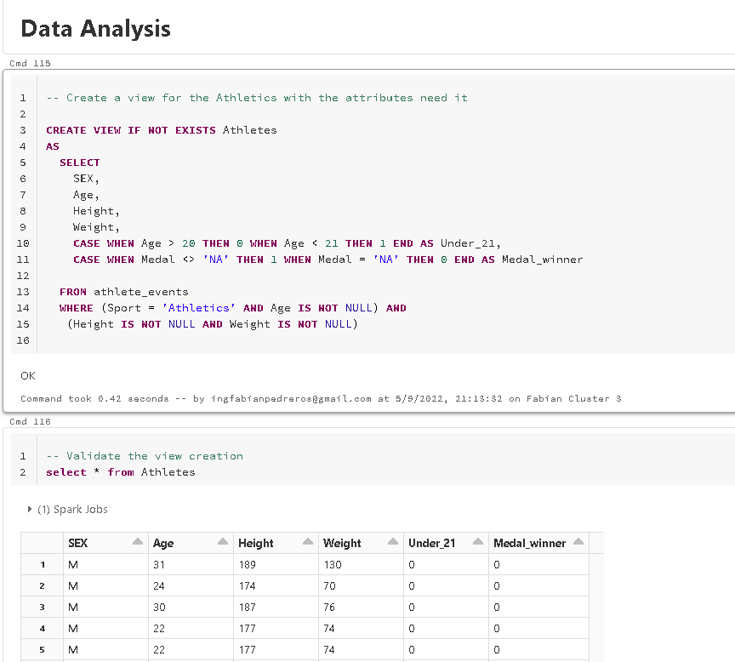
Data Analysis
Creation of a view with the data need it and the new variables creation.

Slide 27
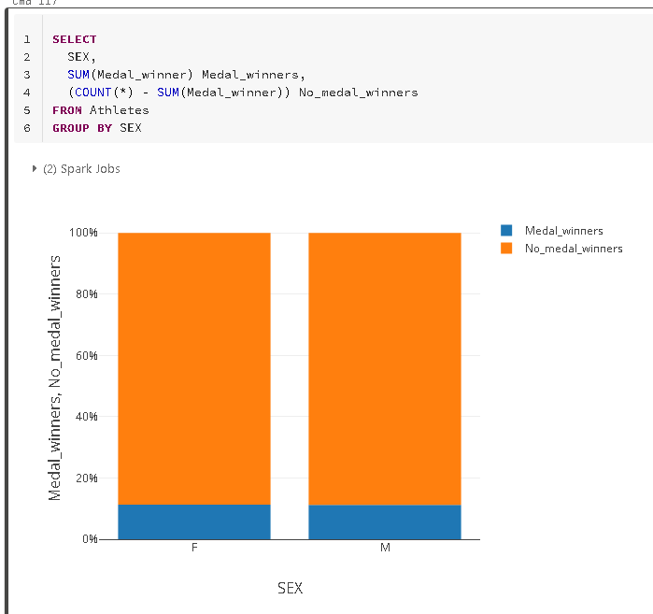
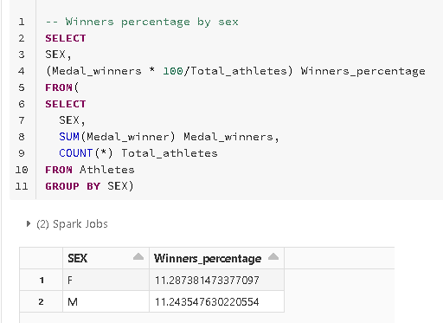
Data Analysis
Does an athlete have a greater or lesser chance of winning a medal at the Olympics if she is a woman?
Winners by gender are similar, 11.2% of the athletes win a medal, no matter if the athlete is a woman or a man, all have the same probability according to the number of participants and the winning rate.

Slide 28
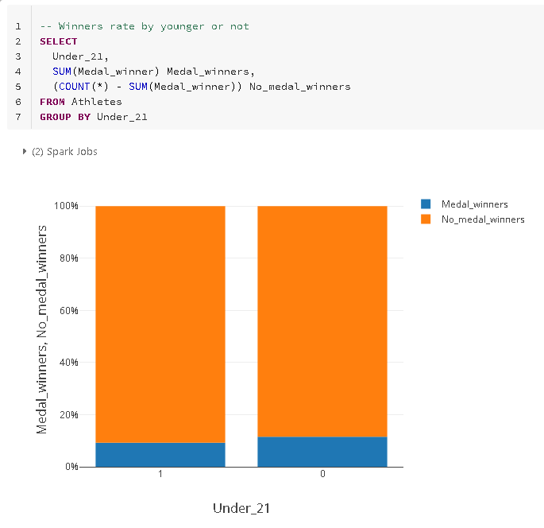
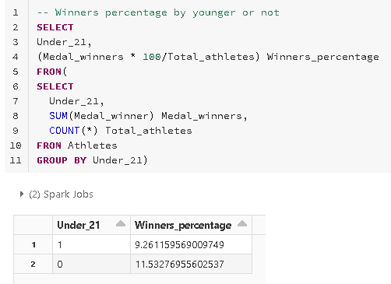
Data Analysis
Do young athletes (under 20 years old) have a greater chance of winning a medal in athletics than athletes over 20 years old?
It can be seen that there is a difference between medal winners depending on whether the athlete is under 20 years of age or not. The proportion of U21 athletes who win medals is lower than the proportion of older athletes who win medals. So we can say that the fact of being a young athlete does not increase the probability of winning a medal, but on the contrary decreases it.

Slide 29
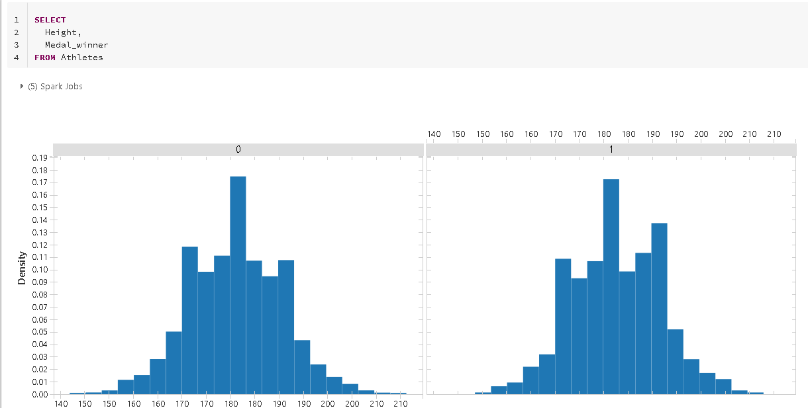
Data Analysis
Does the height and weight of the athletes influence the chances of winning a medal?
When analyzing the distributions of height according to whether or not the athlete won a medal, differences in the distributions can be observed, so that initially we can think that athletes with a greater height have a greater probability of winning a medal, although there is not a very marked difference.

Slide 30
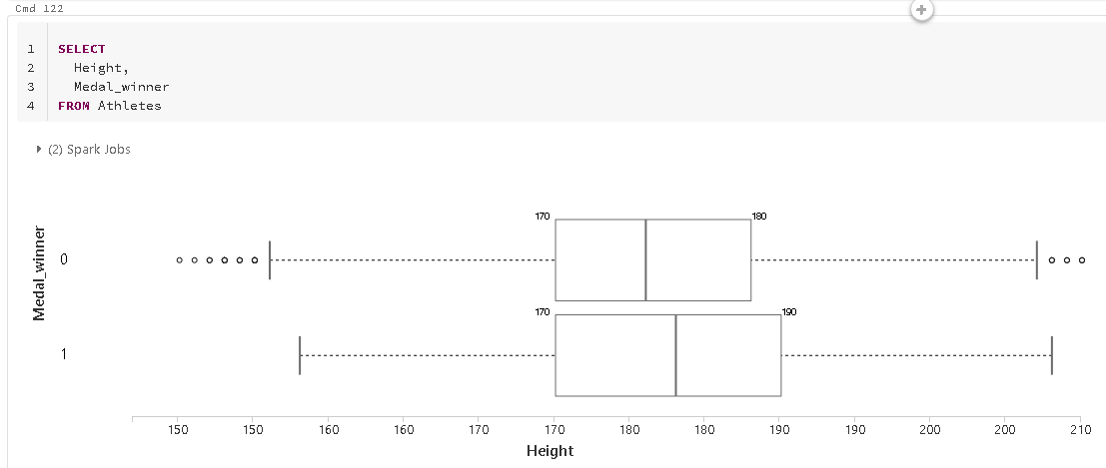
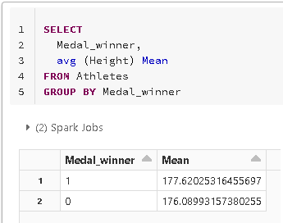
When reviewing the average height, we can see that there is indeed a higher average for athletes who won a medal, with an average height that is 1.6 cm higher than those who did not win.
The box plot helps us to see that there does indeed appear to be a greater average height and a higher IQR for athletes who win a medal.
But how the sex affect this measures?

Slide 31
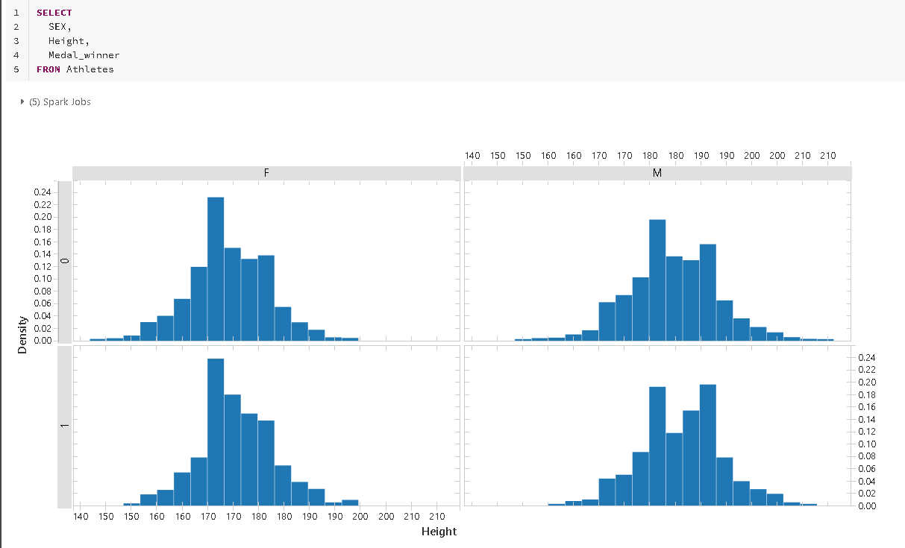
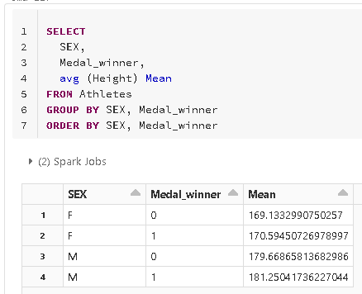
There are differences in the average height between those who won medals and those who did not, with the difference being greater in men.
The histograms separated by sex and if I win a medal, let us see that:
1. There are differences between the distributions of height according to sex.
2. Women with a height of less than 170 cm have won fewer medals.
3. In the case of men, it seems that historically those who are slightly taller than average have won medals.

Slide 32
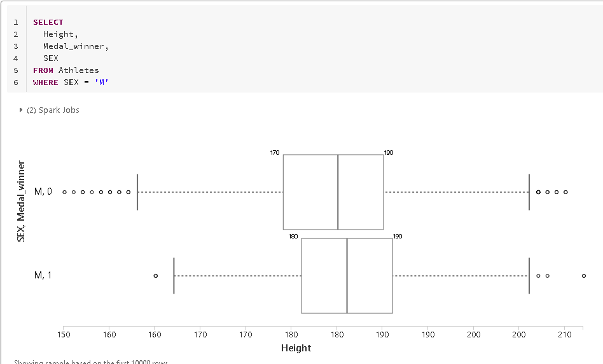
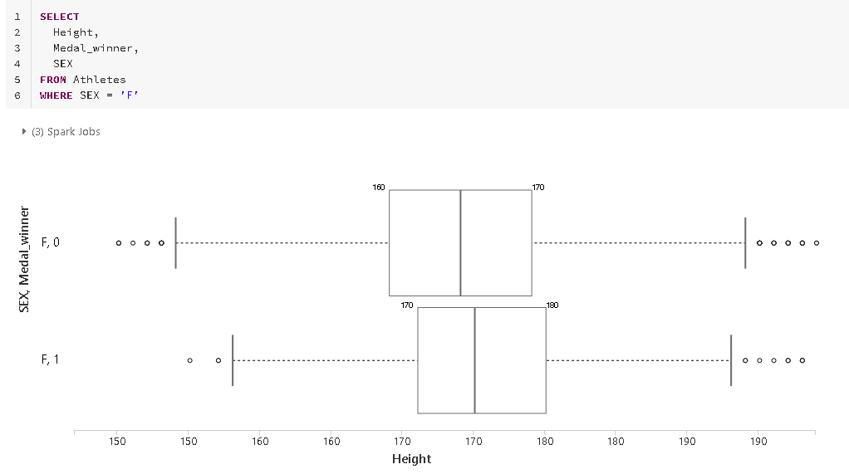
The boxplots by sex help us to see the differences in the central statistics between those who won a medal and those who did not, and although these are not as marked, being population data, we could argue that greater height suggests a greater probability of winning a medal in the Olympic Games for athletes.
This analysis should be further explored, since we have athletes who have participated several times in different events and others who have not.

Slide 33
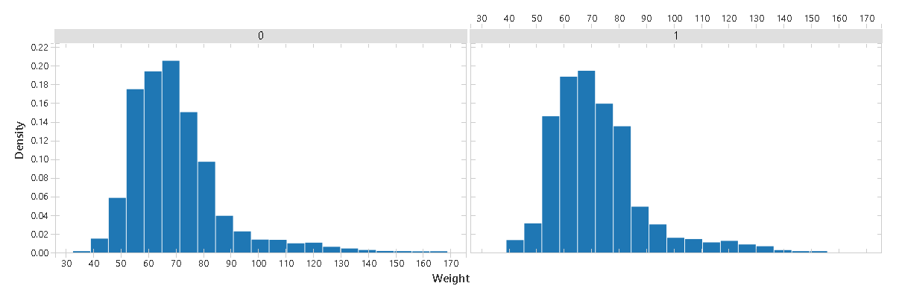
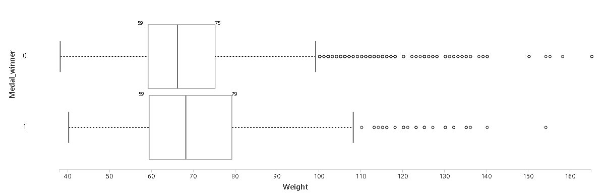
Differences were observed in the weight distributions according to whether the athletes won a medal or not, showing a higher mean weight for those who won, although they also have a higher dispersion and IQR.

Slide 34
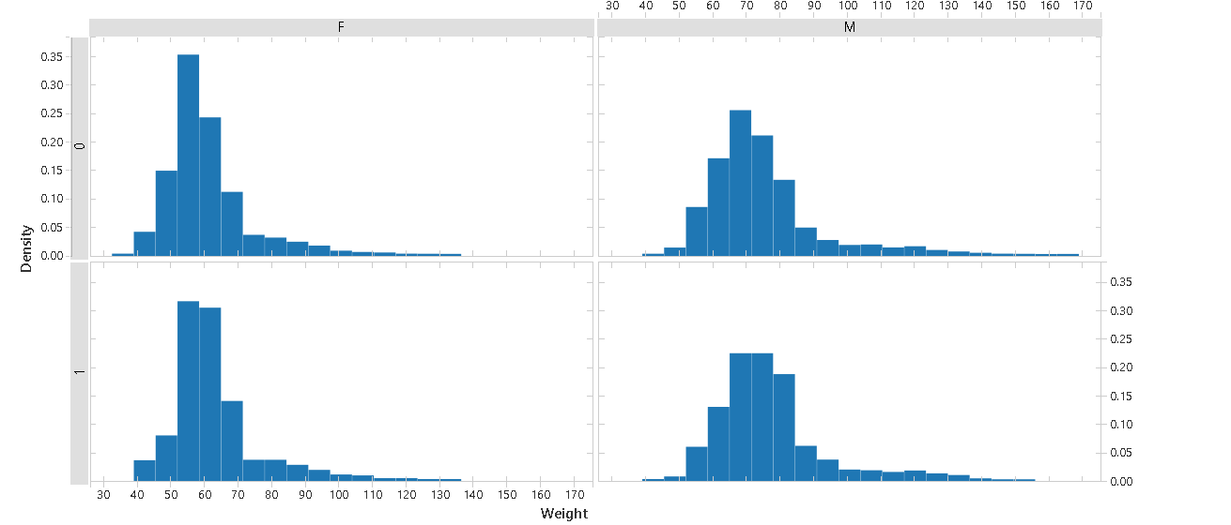
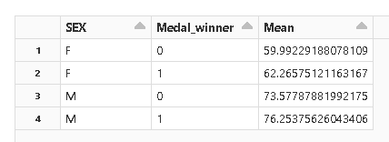
Performing the statistical analysis, we can see how there are differences between the weight distributions between men and women, as well as differences between the subgroups that did and did not win a medal in the Olympics. So we can establish that on average athletes who win medals have a higher body weight.

Slide 35
Hypothesis
I believe that women have a greater chance of winning a medal in athletic competitions at the Olympics, given that there are fewer women than men who enter. Rejected hypothesis.
There are no significant differences between the proportions of athletes who have won medals according to sex, so women have the same probability as men of winning a medal.
My instinct leads me to think that if there is a relationship between age, height, weight and medal winning, Accepted hypothesis.
Medal-winning athletes are on average taller and heavier than non-medal winners, however, the sex of the athletes must be taken into account, as there are differences between the distributions of men and women.
athletes under the age of 20 should be in better physical condition and therefore should win the most medals. Rejected hypothesis.
There is no greater proportion of medal-winning athletes under 21 years of age, in fact the proportion of medal-winning older athletes is greater than that of younger athletes.

Slide 36
Additional questions
What is the correlation between the variables studied and winning a medal?
My hypothesis is that there will be an average positive correlation between weight and height with respect to winning or not winning a medal. And that age, when included in ten-year ranges, will show a negative correlation.
Although some of the initial hypotheses have been rejected, it would be valid to establish what is the degree of correlation between variables, in the case of age, eliminating the categorization of Under_21 and generating age bins for each 10 years.

Slide 37
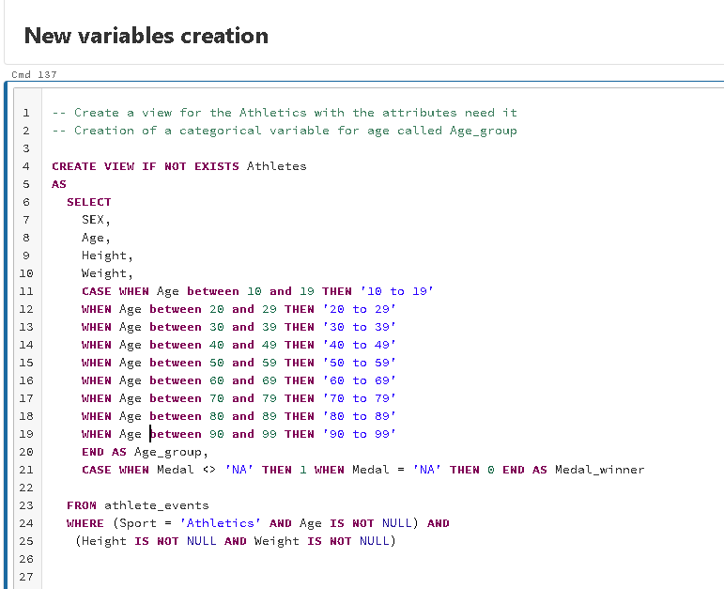
New variables creation
The categorical variable Age_group is created for the numerical variable age, so that it can be used to classify the athletes more globally than the age itself; this is one of the transformations normally used for data of this type.

Slide 38
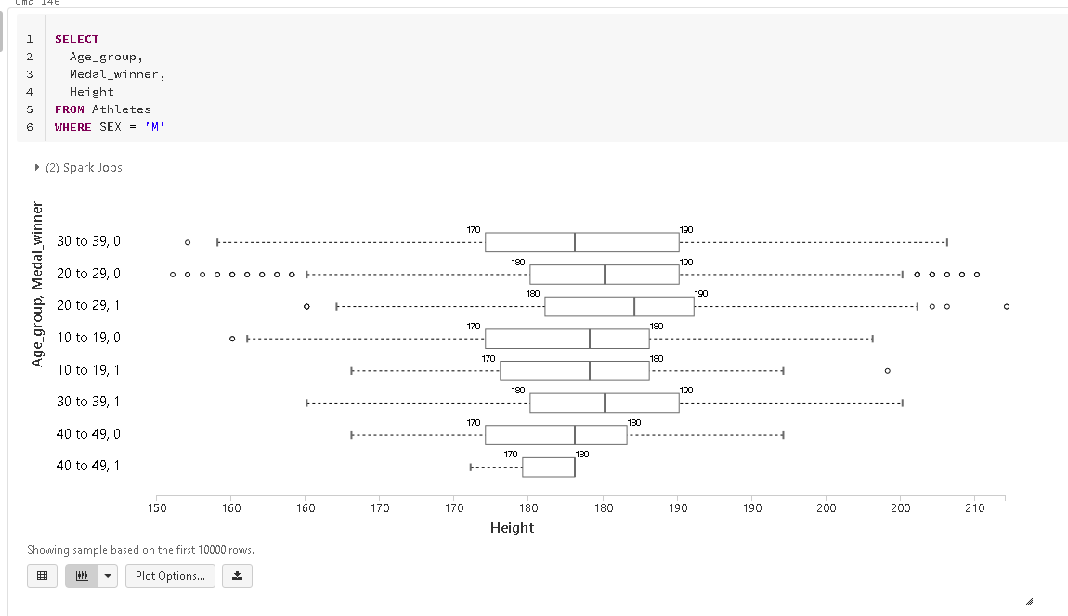
The differences observed for both weight and height by sex, in terms of the central statistics, are not sufficient to validate that statistically there is a difference in age, weight and height that explains whether or not an athlete wins an Olympic medal.

Slide 39
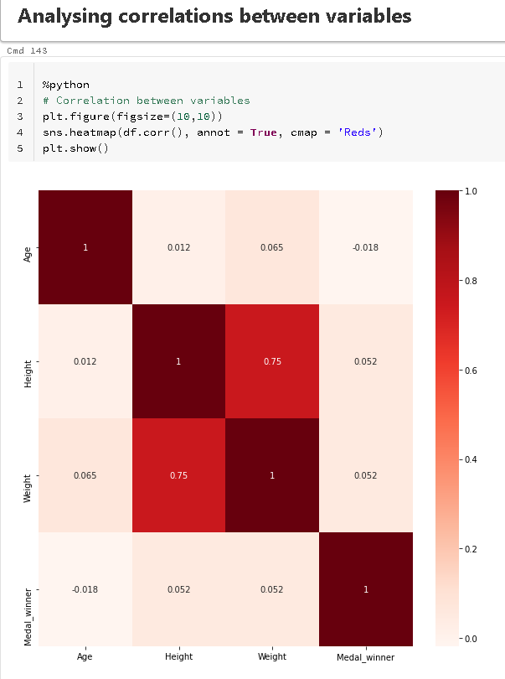
What is the correlation between the variables studied and winning a medal?
My hypothesis is that there will be an average positive correlation between weight and height with respect to winning or not winning a medal. And that age, when included in ten-year ranges, will show a negative correlation. Hypothesis rejected.
No Pearson correlation is observed that would indicate an associative behavior between winning a medal for athletes and other variables such as age, weight or height. Therefore, the hypothesis generated is rejected.

Slide 40
Conclusion
Statistically there is no correlation between winning a medal for athletes who practice athletics with age, weight, height and sex.
Therefore, it cannot be established whether or not an athlete with any specific behavior of these variables has a greater chance of winning a medal in the Olympics.
In order to generate a model that can calculate the probability of winning a medal for athletes, other data is required, either demographic or specific to the performance of athletes in other competitions.

Slide 41
Puntuación del curso
2 estrellas y me arriesgo
Esta es la peor especialización que he tomado hasta el momento en Coursera, y he tomado varias, ya sean de universidades o empresas privadas.
El primer curso esta bien para alguien que ya tiene conocimientos en SQL y solo necesita un repaso, pero no deja de ser un curso con cero profundidad en el uso de SQL en ciencia de datos. Son solo diapositivas, se pueden encontrar mejores explicaciones de SQL en YouTube.
El segundo curso muestra un uso interesante de SQL, que normalmente no es tratado. Pero la estructura, las evaluaciones, tareas y proyecto final son muy abiertas y ambiguas. Las explicaciones son superfluas y se nota que el curso fue hecho deprisa, sin prestar atención a los detalles y con deficiencias en la docencia.
Tal vez el tercer curso es el mejor, ya que presentan una tecnología y plataforma de utilidad.
El proyecto final es una desilusión total, ya que no esta centrado en SQL y en su uso en actividades propias de Data Science, los vídeos son en gran parte un reciclado de los vistos en los anteriores cursos, por lo que de SQL, que es lo que se trata la especialización, no se aprende algo nuevo o se da la oportunidad de aplicarlo como realmente se aplica en la Ciencia de datos. Se encuentran mejores proyectos de SQL en YouTube, pero estos no dan un certificado avalado por una institución educativa como lo es la Universidad de California, Davis. Penoso que las lecturas en la semana cuatro sean links a otros cursos, no se molestaron en crear material o si quiera referenciarlo de una mejor manera.
Cero material es compartido en el desarrollo de la especialización.
Tras esta experiencia creo que no tomare algun otro curso o especialización de esta Universidad, así como no recomendarla, la terminé tan solo para recibir el certificado, pero creo que no vale la pena gastar tiempo en ella.

Slide 42
This is the worst specialization I have taken so far on Coursera, and I have taken several, either from universities or private companies.
The first course is fine for someone who already has SQL knowledge and just needs a refresher, but it is still a course with zero depth in the use of SQL in data science. It is just slides, better explanations of SQL can be found on YouTube.
The second course shows an interesting use of SQL, which is not normally covered. But the structure, assessments, assignments and final project are very open and ambiguous. The explanations are superfluous and you can tell that the course was made in a hurry, with no attention to details and with deficiencies in teaching.
Perhaps the third course is the best, as they present a useful technology and platform.
The final project is a total disappointment, as it is not focused on SQL and its use in Data Science activities, the videos are largely a recycling of those seen in previous courses, so that SQL, which is what the specialization is about, you do not learn something new or have the opportunity to apply it as it really applies in Data Science. Better SQL projects are found on YouTube, but these do not give a certificate endorsed by an educational institution such as the University of California, Davis. Sad that the readings in week four are links to other courses, they did not bother to create material or even reference it in a better way.
Zero material is shared.
After this experience I think I will not take any other course or specialization of this University, as well as not recommend it, I finished it just to receive the certificate, but I think it is not worth spending time on it.

