Slide 1
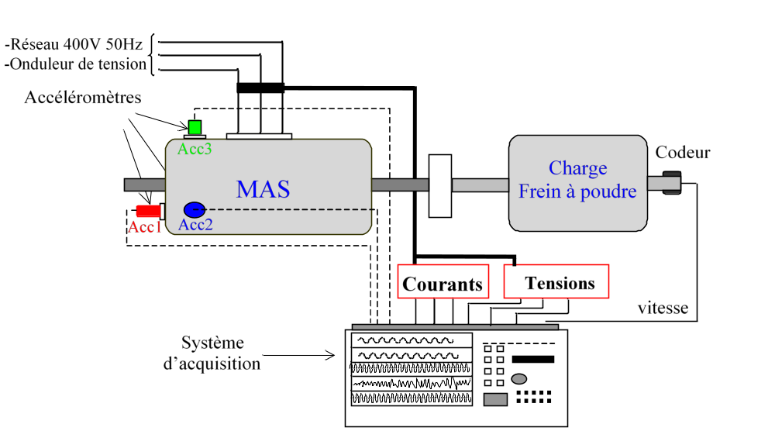
50 Hz, 400 V
Supply grid
Inverter
Induction motor
Electromagnetic brake
Voltage sensors
Current sensors
Odyssey Gould Nicolet

Slide 2
Input shaft
Intermediate shaft
Output shaft
Bearings
Gears
50 Hz, 400 V
Supply grid
Electromagnetic Brake
Accelerometer
9 balls
Inverter
90 teeth
Coupling
36 teeth
Induction motor
100 teeth
Direcr current supply
29 teeth
Bearing and gear of experiments
Voltage sensors
Current sensors
Two acquisition cards of National Instruments 9234

