Slide 1
Learning of Time Sequences through Plasticity in Externally Driven Networks
Fabian Schubert
18.07.2018

Slide 2
Introduction to Sequence Learning
The Machine Learning Approach to Sequence Learning
Unsupervised Local Learning Mechanisms
Homeostatic Tuning
Dendritic Computation for Sequence Prediction

Slide 3
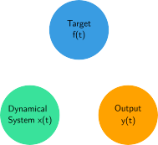
Introduction to Sequence Learning
How can a dynamical system with states be modified appropriately, such that it can generate an output signal that mimics or predicts some target signal ?
Different tasks have to be distinguished:

Slide 4
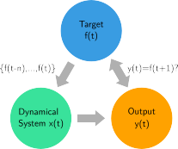
Introduction to Sequence Learning
In one scenario, the system is supposed to predict the future state of based on its history.
This task involves feeding the target signal into the dynamical system, even after learning, since an accurate prediction requires the integration of information about the past. In this case, the role of the dynamical system can be regarded as a computational, or information processing unit.

Slide 5
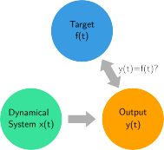
Introduction to Sequence Learning
In another case, the dynamical system is supposed to autonomously generate an output that reproduces .
Here, does not receive as an input, since this would turn the task into a trivial problem, solved by simply passing on to .
In contrast to the first case, the process of learning can be rather interpreted as solely building an internal model of the dynamics underlying .

Slide 6
Introduction to Sequence Learning
Still, also the first task requires the system to build some internal representation of the underlying structure of the signal it receives.
In a living organism, the need to autonomously generate patterns of output might seem more “obvious”, e.g. with respect to motor control. However, being able to predict sensory signals is also crucial for taking appropriate actions under a changing environment.
In the following, we will focus on methods of solving this prediction task.

Slide 7
The Machine Learning Approach to Sequence Learning
such that it minimizes an error measure, e.g. the RMS
The general idea to approach this is to expand the sequence into some high-dimensional feature vector which is then used to predict through a linear model

Slide 8
The Machine Learning Approach to Sequence Learning
This expansion has a potentially unbounded amount of parameters, so one takes a recursive approach:
We can further resctrict this to recursive functions that take the form of a discrete-time recurrent network:
In the classical learning paradigm, the sequence learning task is now a problem of appropriately setting the linear components of the recursive function aswell as of the readout to minimize the error.

Slide 9
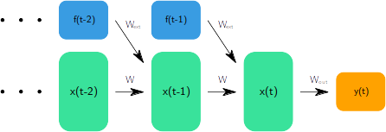
The Machine Learning Approach to Sequence Learning
One of the most prominent algorithms of this kind is Backpropagation through Time:
This method unfolds the recurrent part of the network into a feed-forward structure. In practice, this unfolding is truncated at some point backwards in time, depending on the amount of past information that is required for the prediction.

