Slide 1
London Crime Data
Fabian Sperrle, Fabio Brückel, Matthias Miller, Matthias Kraus

Slide 2
Data
Month,
Longitude, Latitude,
Location (description - e.g. “on or near nobel street”),
LSOA code, LSOA name (city district – e.g.“Camden”),
Crime type (e.g. “drugs possession”),
Outcome (e.g. “drugs possession warning”),
Other: Crime ID, Reported by (police district), Falls within (police district)

Slide 3
Visualization Possibilities

Slide 4
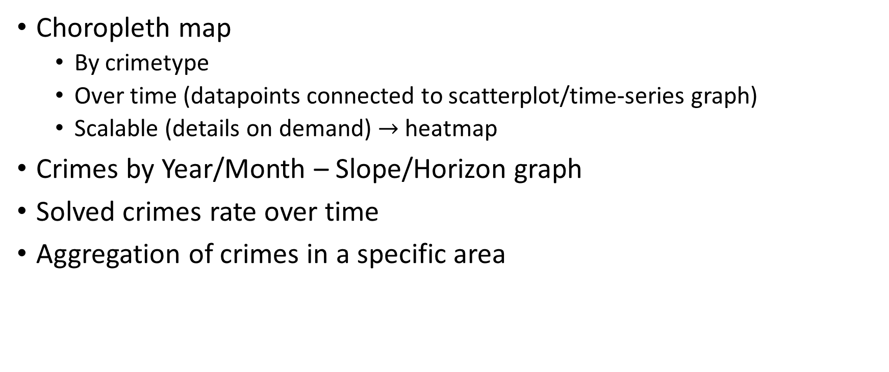
Visualization Possibilities
Choropleth map
By crimetype
Over time (datapoints connected to scatterplot/time-series graph)
Scalable (details on demand) $→$ heatmap
Crimes by Year/Month – Slope/Horizon graph
Solved crimes rate over time
Aggregation of crimes in a specific area

Slide 5
Possible questions to analyze
Which area has the highest crime risk?
Gang activities / ghetto development over years
Crime rates per city district over time
Shifts over time
In what areas is a crime offender most likely caught and prosecuted?
Differences summer/winter and during special times (christmas)

Slide 6
Thank you for your attention!

