Slide 1

Speak smart

Slide 2
Speech Recognition and Feedback Application
This project focuses on developing a web application that integrates machine learning models for real-time audio transcription and feedback processing.
Main Features:
Real-time speech recognition
Confidence scoring
Grammar and feedback analysis

Slide 3
Project development
Key Goals:
Utilize pre-trained machine learning models for accurate speech recognition.
Implement real-time feedback mechanisms to enhance transcription quality.
Leverage existing APIs (Google Cloud Speech-to-text API for transcription, OpenAI and LanguageTool for feedback) to streamline development.
Main technologies used:
Python, Google Cloud Speech-to-text API, OpenAI API, LanguageTool
Flask, Socket.IO, JavaScript, HTML, CSS

Slide 4

Main Libraries
Google Cloud Speech-to-Text is a cloud service that converts spoken language into text.
It uses machine learning models to transcribe audio from various sources into written text, supporting a wide range of languages and dialects.
The service provides real-time transcription – Streaming Recognizer - which was the one selected for this project.
It provides a confidence score, which is the degree of accuracy of the speech recognizer's response.

Slide 5
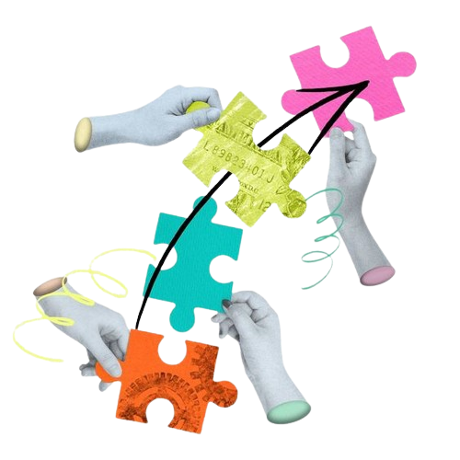
Main Libraries
OpenAI API is designed to handle a wide range of natural language processing tasks, making it a versatile tool for enhancing text-based applications.
In this project it assesses the transcript generated by the speech recognizer and provides feedback on text quality, especially for coherence and grammar, and highlights words/phases that may have been mispronounced or misunderstood by the speech recognizer.

Slide 6
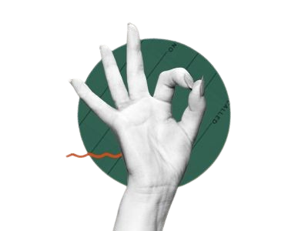
Main Libraries
LanguageTool is a comprehensive NLP tool for enhancing the quality and accuracy of written content by addressing a broad range of language issues.
In this project it is used for contextual understanding of the transcript generated by the speech recognizer and generates feedback on grammar issues and suggested corrections.

Slide 7
Data Processing Pipeline ​
1. Audio Capture:
Recorded and streamed in real-time.
Segmented into chunks for better processing.
2. Speech Recognition:
Audio chunks are sent to Google Cloud Speech-to-Text API.
Responses include transcripts and confidence scores.
3. Feedback Analysis:
Text analyzed for grammatical issues and contextual accuracy.
Feedback generated using OpenAI and LanguageTool.

Slide 8
DEMO
http://127.0.0.1:5000/

Slide 9

Real-life application
Helps individuals improve their public speaking skills.
Useful for students, professionals, and anyone preparing for presentations or speeches.
Can be used in educational settings for language learning and proficiency exam preparation.
Can be used to transcribe meetings or conferences, providing a real-time record and feedback.
Enhances accessibility for individuals with hearing impairments by providing accurate transcriptions and feedback.

Slide 10

Challenges & limitations
Data Quality: Variability in audio quality affecting recognition accuracy.
Real-Time Processing: Handling large audio streams and ensuring timely feedback.
Contextual Errors: Limited by current capabilities of speech-to-text and feedback algorithms.

Slide 11

Future Improvements
Enhanced Accuracy: Improve transcription accuracy with advanced models and custom training.
Contextual Awareness: Better context understanding and more nuanced feedback for different purposes.
User Experience: Refine real-time feedback interface and integrate additional analytics.

Slide 12
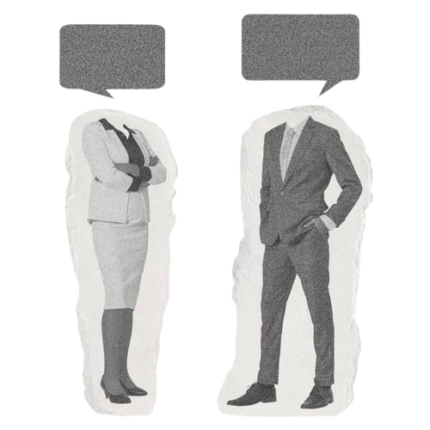
THANK YOU
Time for Q&A

