Slide 1

AIR CONTAMINATION IN CALIFORNIA
Fabiana Rossi – January 2021
Downtown Los Angeles on a bad air day in 2014. (Francine Orr / Los Angeles Times)

Slide 2
INTRODUCTION
Most of the cities in California state report days of unhealthy air quality
>90% of Californians live in counties with unhealthy air
Poor air quality negatively influences health (nervous system, lungs, cardiovascular system, etc.)
OBJECTIVE: analyze California cities contamination and determine whether the % of parks had a relation with the air quality data. Since it has been demonstrated that population density has both benefits and costs for air quality, agglomeration will also be considered in the analysis.

Slide 3
METHODOLOGY
Data collection consisted in five parts, as follows:
part 1= Californian cities population density data from Wikipedia (https://en.wikipedia.org/wiki/List_of_largest_California_cities_by_population)(https://en.wikipedia.org/wiki/List_of_largest_California_cities_by_land_area)
part 2= Californian cities latitude and longitude data from Kaggle (https://www.kaggle.com/camnugent/california-housing-feature- engineering?select=cal_cities_lat_long.csv)
part 3= air quality data from the United States Environmental Protection Agency (US EPA) (https://www.epa.gov/outdoor-air-quality-data/air-quality-index-report)
part 4= final dataframe and preliminary analysis (previous dataframes merging)
part 5= California cities venues data from Foursquare. (https://foursquare.com/)

Slide 4
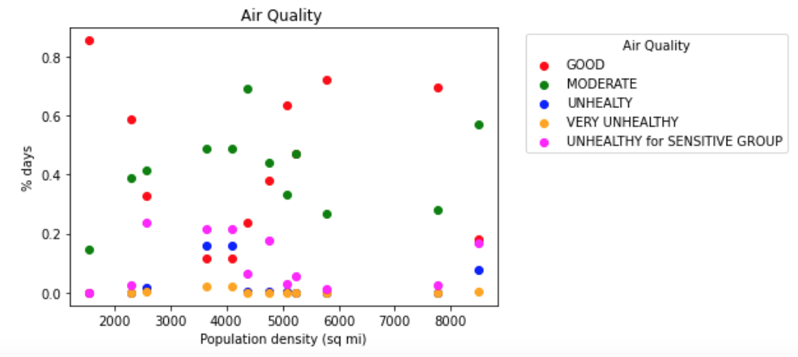
RESULTS
Agglomeration was analyzed prior to clustering. The scatter plot shows the percentage of days of a given air quality category against population density
Population density was excluded from the clustering analysis as there was no correlation between the variables

Slide 5
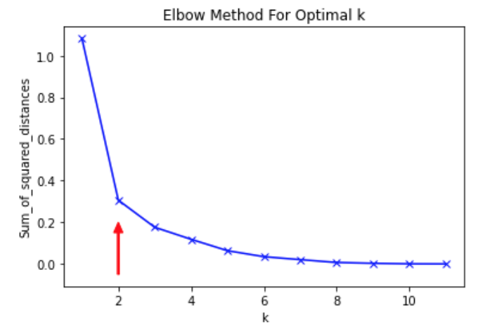
RESULTS
Californian cities were clustered according to their air quality characteristics using k-means clustering. Firstly 'k' selection was performed using Elbow method
k=2 was selected as k value for k-means clustering.

Slide 6
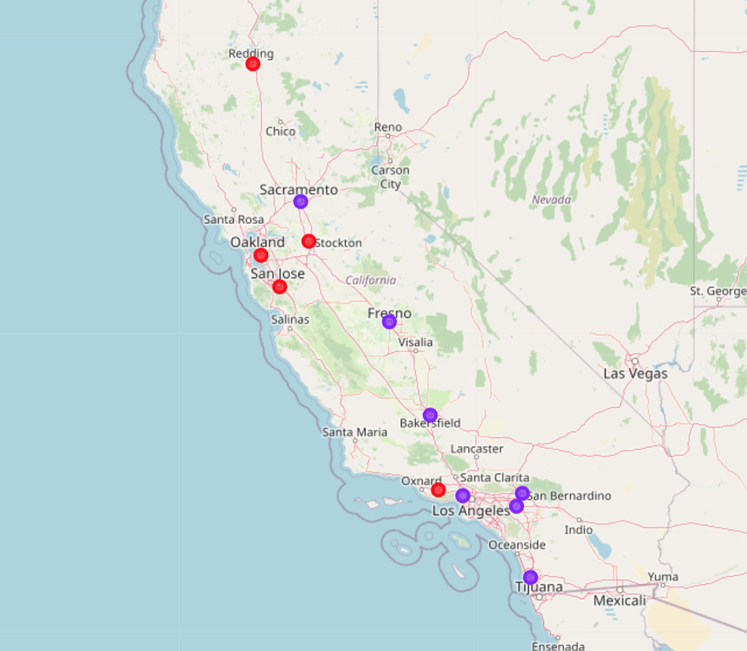
RESULTS
Cities from each cluster were superimposed on a California map.
cluster 0 = RED
cluster 1= VIOLET

Slide 7
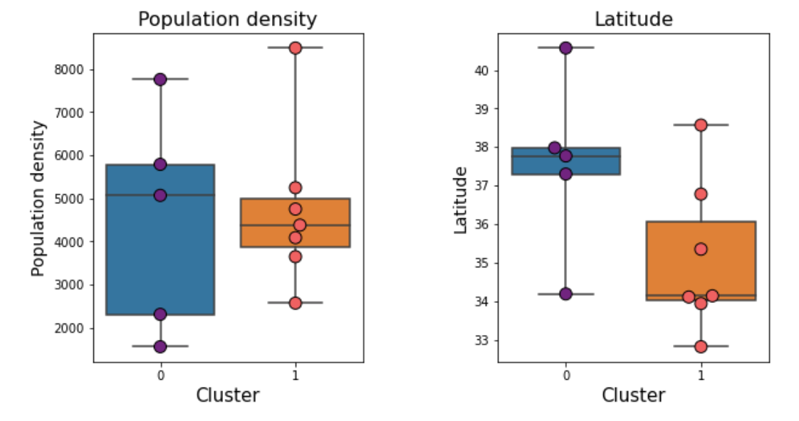
RESULTS
Cluster characterization
The mean latitude for cities in cluster 0 was higher than the mean latitude from cluster 1
(not statistically significant).
The mean population density is similar between cities from each cluster

Slide 8
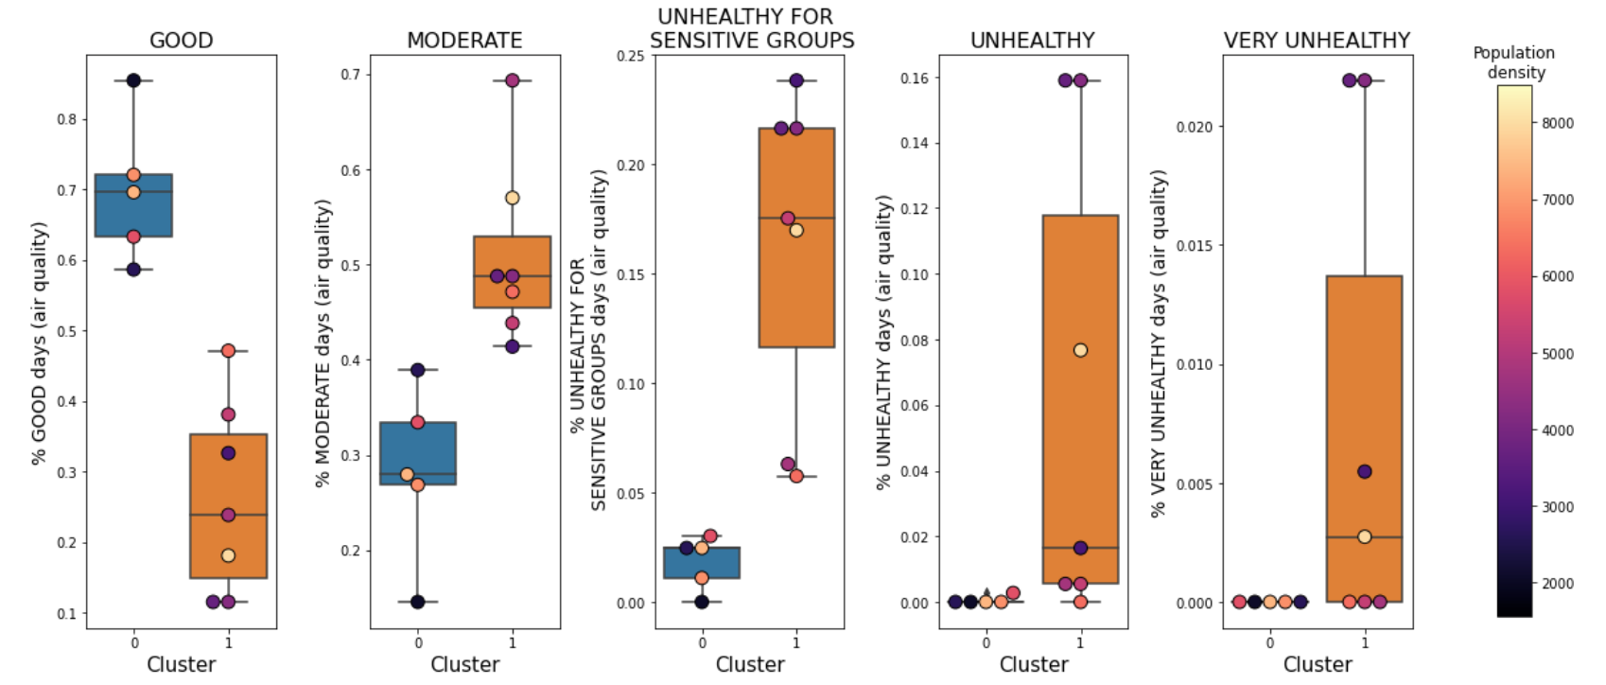
RESULTS
Cluster characterization
Cluster 0 is less contaminated than cluster 1 (population density does not correlate with air pollution in neither of the categories nor clusters)

Slide 9
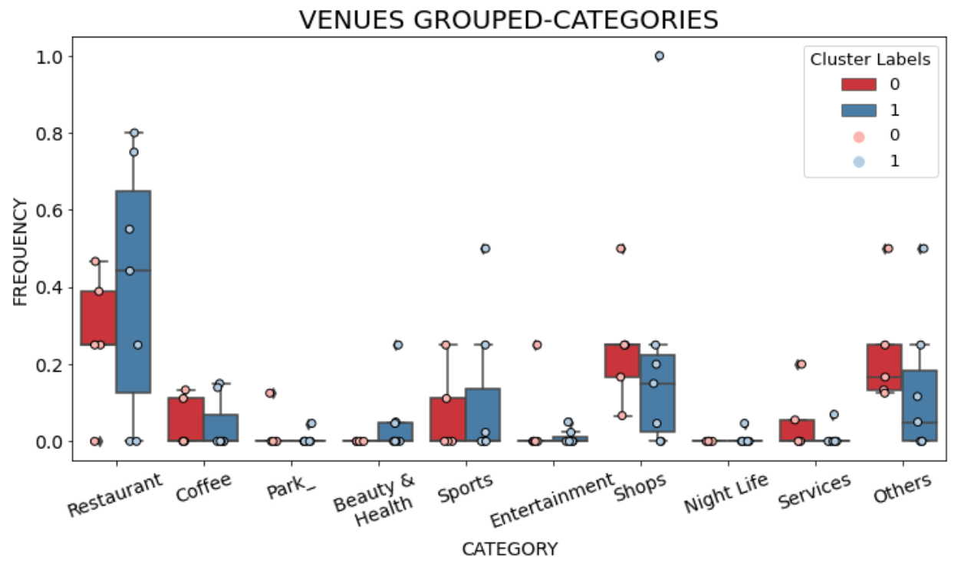
RESULTS
Cluster characterization after data regrouping in new ‘higher-order’ categories
clusters’ venues categories percentages were similar, except for 'SHOPS’
(as cluster 0 had a higher proportion of venues in this category than cluster 1)

Slide 10
RESULTS
Cluster characterization - PARKS
NOT ENOUGH DATA to perform analysis on the relation between % of parks and air quality

Slide 11
DISCUSSION & CONCLUSION
Our study identified 2 clusters, that differed mainly in the extent of air pollution (cluster 0 is less contaminated than cluster 1).
Cities in cluster 0 are located at higher latitudes than cities in cluster 1.
Population density did not seem to affect air quality.
Venues categories were similar for both clusters.
The proportion of parks in each cluster and its relation to air quality could not be studied in the present analysis due to insufficient data. It would be worthwhile to perform a more detailed analysis in the future with a larger set of Californian cities and venues per city.

