Slide 1
Kubernetes

Slide 2
Usecases
QA, Developer
New environment in one click
Developer
Debug on any environment locally
DevOps
CI / CD
Single configuration for multiple environments
Loadbalancing out of the box
Manager
Cheep and stable cluster

Slide 3
Overview

Slide 4
What is Kubernetes?
“Kubernetes is a portable, extensible open-source platform for managing containerized workloads and services, that facilitates both declarative configuration and automation.”
kubernetes.io
It is open-source
It is platform
It can manage Docker containers
It can wrap Docker containers in logical abstractions
It is providing infrastructure as a code
It is providing automation

Slide 5
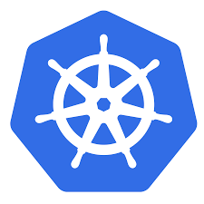
What does Kubernetes mean? K8s?
The name Kubernetes originates from Greek, meaning helmsman or pilot.
K8s is an abbreviation derived by replacing the 8 letters “ubernete” with “8”.

Slide 6
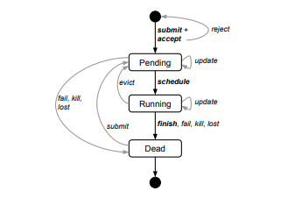
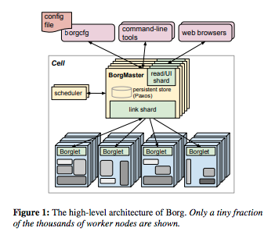
History
Google open-sourced the Kubernetes project in 2014.
Builds upon Borg

Slide 7
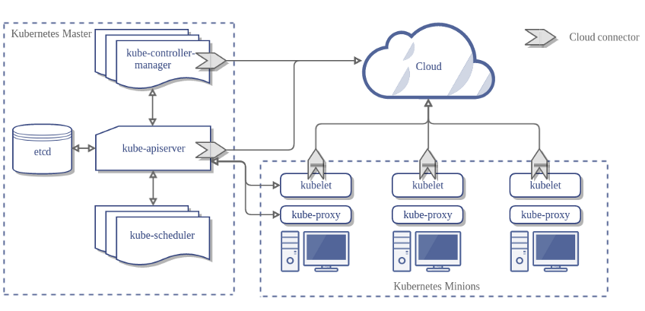
Architecture

Slide 8
Source code
Teams: evia.k8s-workshop
https://github.com/svitlychnyi/k8s-workshop.git

Slide 9
Tools
kubectl
minikube
dashboard
heapster – deprecated, use metrics-server + Prometheus
kubeadm

Slide 10
Objects
Pod
ReplicaSet
Deployment
Service
Ingress
Horizontal Pod Autoscaler
Persistent Volumes
Secrets

