Slide 1
Kubernetes

Slide 2
Usecases
QA, Developer
New environment in one click
Developer
Debug on any environment locally
DevOps
CI / CD
Single configuration for multiple environments
Loadbalancing out of the box
Manager
Cheep and stable cluster

Slide 3
Overview

Slide 4
What is Kubernetes?
“Kubernetes is a portable, extensible open-source platform for managing containerized workloads and services, that facilitates both declarative configuration and automation.”
kubernetes.io
It is open-source
It is platform
It can manage Docker containers
It can wrap Docker containers in logical abstractions
It is providing infrastructure as a code
It is providing automation

Slide 5
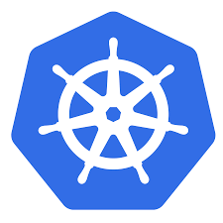
What does Kubernetes mean? K8s?
The name Kubernetes originates from Greek, meaning helmsman or pilot, and is the root of governor and cybernetic.
K8s is an abbreviation derived by replacing the 8 letters “ubernete” with “8”.

Slide 6
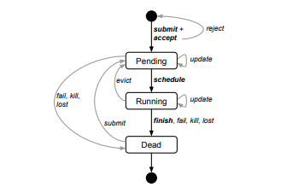
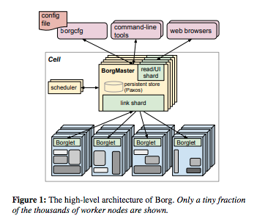
History
Google open-sourced the Kubernetes project in 2014.
Builds upon Borg

Slide 7
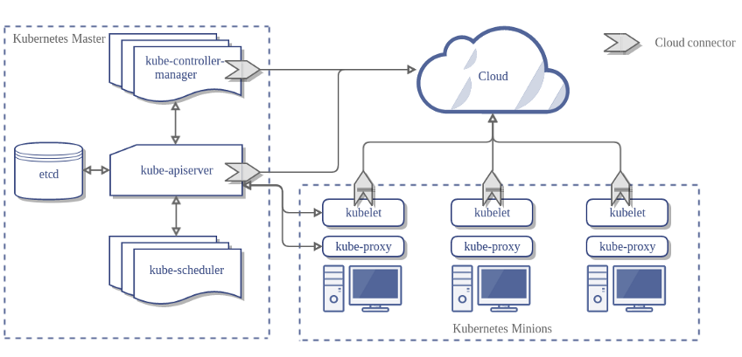
Architecture

Slide 8
Source code
https://github.com/svitlychnyi/k8s-workshop.git

Slide 9
Tools
kubectl
minikube
dashboard
heapster
kubeadm

Slide 10
Minikube

