Slide 1

Like: School, Year, Perquisites, Exam aso.
Detailed Information about the learning Unit are inside the Baseinformation.pdf

Slide 2
School and year
ITT - Istituto Tecnico Tecnologico
4th year
At the beginning of the semester

Slide 3
Prerequisites
Basic programming concepts
The programming language does not matter, each student can use the language they are most comfortable with.
Variables, loops, functions, arrays, etc. should be known.
Basic mathematics concepts
Basic algebra
log function
Very basic probability (there won’t be a proof for hash tables, but it helps to understand the concept)

Slide 4


Time management
6h a week
2h Theory in class
4h programming in the laboratory

Slide 5
Materials
Theory Part
Practice Part
Notebook and Pen
Mobile device for algo-learn and Kahoot
Laboratory

Slide 6
Learning outcome
How sorting and searching algorithms work
Be able to implement it in their preferred programming language
Analyze the time complexity (not with big-O notation)
Using a variation of the algorithms to solve a real application problem
Improve programming skills and problem-solving thinking

Slide 7
BubbleSort
Sorting algorithms
Week1 – Part1 (Theory)

Slide 8
Different parts of the week
Theory
Practice
Explain ground concepts
Pseudocode
Analysis
Program the explained concepts.
Get a real problem and find a solution.
Have fun, since you can program.

Slide 9
Math Recap
A little recap on some math properties
Open your phone and wait for further instructions
We will use Kahoot

Slide 10
Sorting-introduction
8
1
3

Slide 11
Sorting-introduction
1
8
3

Slide 12
Sorting-introduction
3
8
1
4
7
6

Slide 13
Sorting-introduction
1
3
8
4
7
6

Slide 14
Sorting-introduction
7
7
8
8
3
3
6
4
6
4
1
1

Slide 15
Sorting-introduction
4
1
7
8
3
6
1
3
4
6
7
8

Slide 16
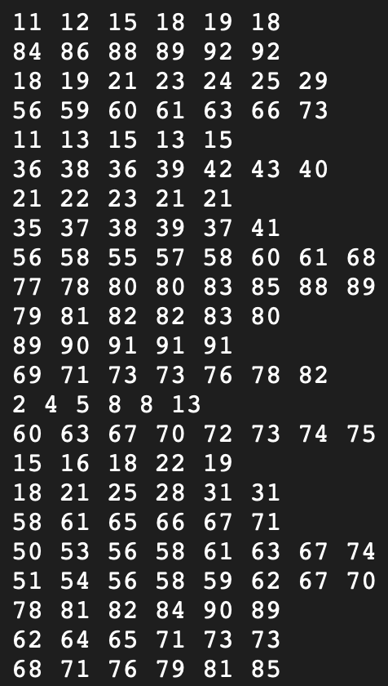
Sorting-General
Is this simple to sort by hand?
How to sort this efficient?

Slide 17

Ideas?

Slide 18
Bubblesort approach
Go from left to right (through the list of numbers)
Compare two items; swap if they’re in the wrong order.
Move to the next pair and repeat.
Biggest item “bubbles” to the end.
Start again from front
Repeat until the list is sorted.
8
1
1
8

Slide 19
Example
4
1
7
8
3
6

Slide 20
Example
1
4
7
8
3
6

Slide 21
Example
1
4
7
8
3
6

Slide 22

Example
1
4
7
8
3
6

Slide 23
Example
1
4
7
8
3
6

Slide 24
Example
1
4
7
8
3
6

Slide 25
Example
1
4
7
8
3
6

Slide 26
Example
1
4
7
3
8
6

Slide 27
Example
1
4
7
3
8
6

Slide 28
Example
1
4
7
3
6
8

Slide 29
Example
1
4
7
3
6
8
Biggest at the end

Slide 30
Example
1
4
7
3
6
8

Slide 31
Example
1
4
7
3
6
8

Slide 32
Example
1
4
7
3
6
8

Slide 33
Example
1
4
7
3
6
8

Slide 34
Example
1
4
7
3
6
8

Slide 35
Example
1
4
3
7
6
8

Slide 36
Example
1
4
3
7
6
8

Slide 37
Example
1
4
3
6
7
8

Slide 38
Example
1
4
3
6
7
8

Slide 39
Example
1
4
3
6
7
8

Slide 40
Example
1
4
3
6
7
8

Slide 41
Example
1
4
3
6
7
8

Slide 42
Example
1
3
4
6
7
8

Slide 43
Example
1
3
4
6
7
8

Slide 44
Example
1
3
4
6
7
8

Slide 45
Example
1
3
4
6
7
8

Slide 46
Example – Done?
1
3
4
6
7
8
One control run must be done
Then we are sure the numbers are sorted

Slide 47
Let’s Play 1
10 Students line up at the front of the class
The other students sort those by height
Use of the Bubble Sort algorithm

Slide 48
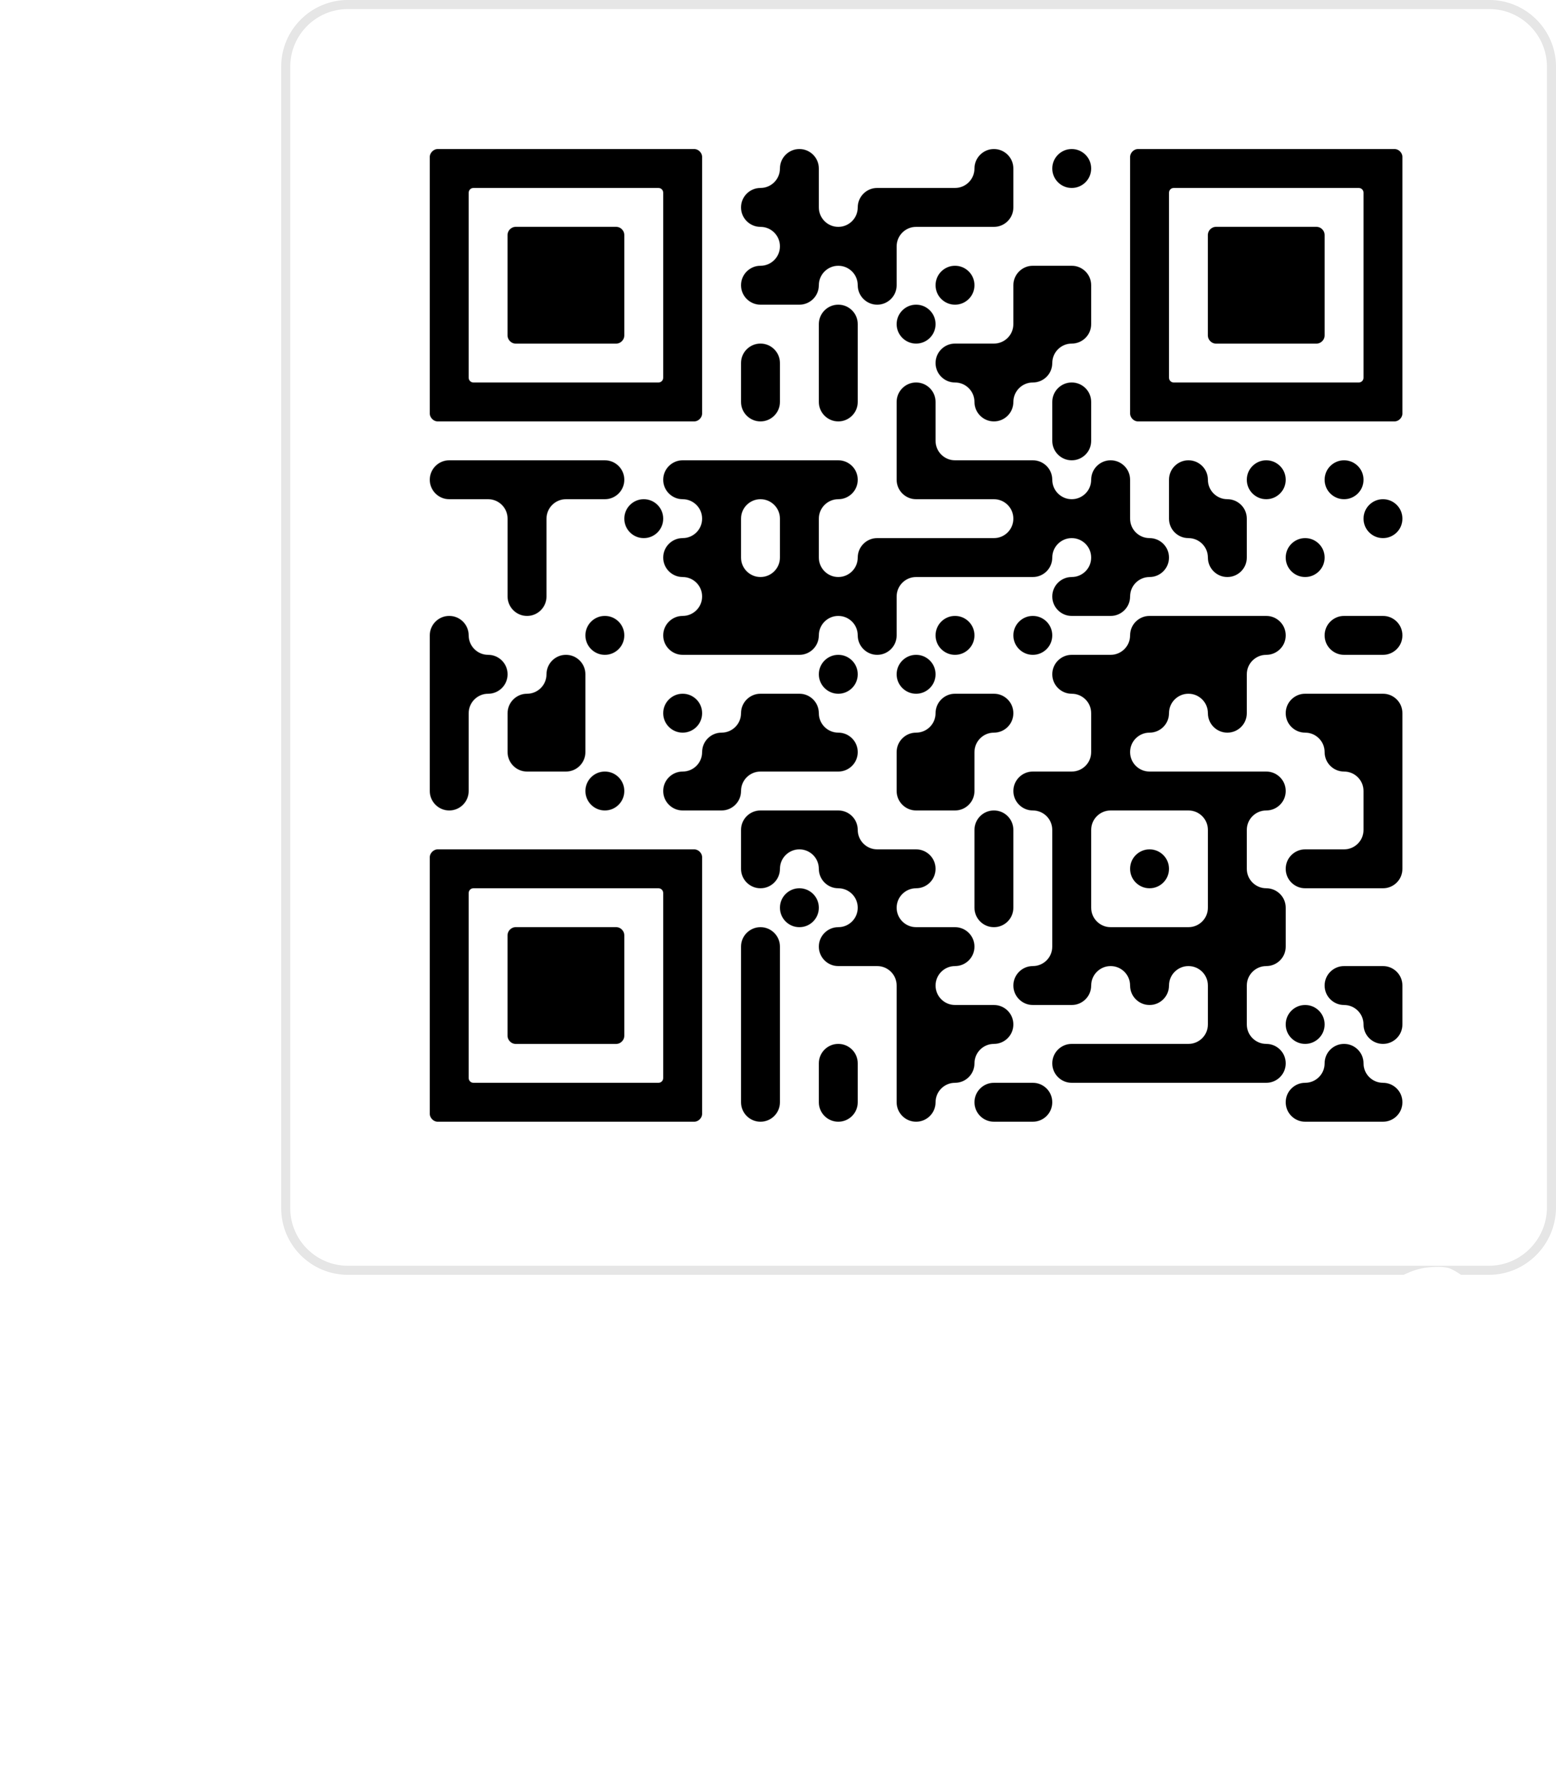
Let’s Play 2 (Also, at Home possible)
https://tcs.uni-frankfurt.de/algo-learn-testing/refs_heads_feat-bubbleSort/en

Slide 49
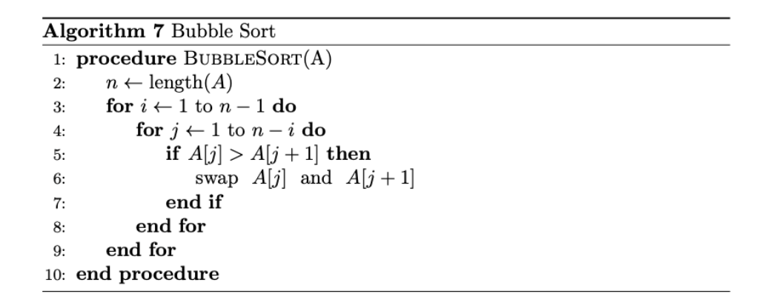
Pseudocode
This is very basic
Not perfect, because it can still be improved (slightly) by you

Slide 50
Runtime?
What is the worst case of ordering?

Slide 51

Runtime – Worst case
If field is in reverse order
Bubble biggest to the back ($n$ steps)
Bubble second biggest to the back ($n$ steps)
…
For n elements this will be $n^{2}$

Slide 52
Runtime?
What is the BEST case of ordering?

Slide 53
RunTime – Best case
If the field already order
One time going through
No swap, follows already sorted

Slide 54
Laboratory - Exercise
Get used to programming again
Implement the Bubble Sort algorithm
Count the number of swaps necessary until the numbers are sorted
Given an array: [[‘a’, 1], [‘r’, 5], …] sort this array on two ways
Based on the second value inside the tuple
Based on the lexicographical order of the letters (first tuple value)
More detailed descriptions will be provided in the laboratory session.

Slide 55
Done for Today :-)
See you on xxxx in the laboratory

Slide 56
Study at home
https://tcs.uni-frankfurt.de/algo-learn-testing/refs_heads_feat-bubbleSort/en
https://www.youtube.com/watch?v=9I2oOAr2okY&pp=ygUbYnViYmxlIHNvcnQgYW5pbWF0aW9uIHZpZGVv
https://www.youtube.com/watch?v=Cq7SMsQBEUw&pp=ygUbYnViYmxlIHNvcnQgYW5pbWF0aW9uIHZpZGVv

Slide 57
Exam
You are given the following list of numbers:
[5, 3, 8, 2, 1, 4, 7, 6]
1. Sort the list using the bubble sort algorithm. Write down the list after each iteration. (5P)
2. What is the time complexity of the bubble sort algorithm? (2P)
3. Why is the bubble sort algorithm not efficient for large data sets? (2P)
4. What is the best case time complexity of the bubble sort algorithm? (1P)

Slide 58
How to pass?
Get at least 4 points in the written test, to prove proper knowledge.
Implementation of the algorithm and solving the provided problems
The Bubble Sort algorithm must be implemented
The real application problems should have at least a solution approach
The practice units are given greater weight in the grade

