Slide 1

Like: School, Year, Perquisites, Exam aso.
Detailed Information about the learning Unit are inside the Baseinformation.pdf

Slide 2
Prerequisites
Basic programming concepts
The programming language does not matter, each student can use the language they are most comfortable with
Variables, loops, functions, arrays, etc. should be known
Basic mathematics concepts
Basic algebra
log function
Very basic probability (there won’t be a proof for hash tables, but it helps to understand the concept)

Slide 3


Time management
6h a week
2h Theory in class
4h programming in the laboratory

Slide 4
Materials
Theory Part
Practice Part
Notebook and Pen
Mobile device for algo-learn
Laboratory

Slide 5
Learning outcome
How the bubble sort algorithm works
Be able to implement it in their preferred programming language
Analyze the time complexity (not with big-O notation)
Understand why it is not efficient for large data sets
Using a variation of the algorithm to solve a real application problem

Slide 6
BubbleSort
Sorting algorithms
Week1 – Part1 (Theory)

Slide 7
Different parts of the week
Theory
Practice
Explain ground concepts
Pseudocode
Analysis
Program the explained concepts.
Get a real problem and find a solution.
Have fun, since you can program.

Slide 8
Sorting-introduction
8
1
3

Slide 9
Sorting-introduction
1
8
3

Slide 10
Sorting-introduction
3
8
1
4
7
6

Slide 11
Sorting-introduction
1
3
8
4
7
6

Slide 12
Sorting-introduction
7
7
8
8
3
3
6
4
6
4
1
1

Slide 13
Sorting-introduction
4
1
7
8
3
6
1
3
4
6
7
8

Slide 14
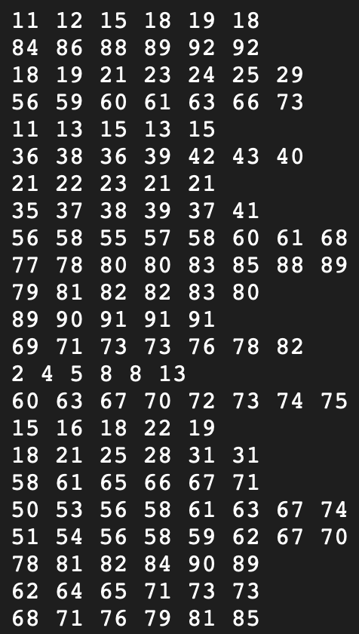
Sorting-General
Is this simple to sort by hand?
How to sort this efficient?

Slide 15

Ideas?

Slide 16
Bubblesort approach
Go from left to right (through the list of numbers)
Compare two items; swap if they’re in the wrong order.
Move to the next pair and repeat.
Biggest item “bubbles” to the end.
Start again from front
Repeat until the list is sorted.
8
1
1
8

Slide 17
Example
4
1
7
8
3
6

Slide 18
Example
1
4
7
8
3
6

Slide 19
Example
1
4
7
8
3
6

Slide 20

Example
1
4
7
8
3
6

Slide 21
Example
1
4
7
8
3
6

Slide 22
Example
1
4
7
8
3
6

Slide 23
Example
1
4
7
8
3
6

Slide 24
Example
1
4
7
3
8
6

Slide 25
Example
1
4
7
3
8
6

Slide 26
Example
1
4
7
3
6
8

Slide 27
Example
1
4
7
3
6
8
Biggest at the end

Slide 28
Example
1
4
7
3
6
8

Slide 29
Example
1
4
7
3
6
8

Slide 30
Example
1
4
7
3
6
8

Slide 31
Example
1
4
7
3
6
8

Slide 32
Example
1
4
7
3
6
8

Slide 33
Example
1
4
3
7
6
8

Slide 34
Example
1
4
3
7
6
8

Slide 35
Example
1
4
3
6
7
8

Slide 36
Example
1
4
3
6
7
8

Slide 37
Example
1
4
3
6
7
8

Slide 38
Example
1
4
3
6
7
8

Slide 39
Example
1
4
3
6
7
8

Slide 40
Example
1
3
4
6
7
8

Slide 41
Example
1
3
4
6
7
8

Slide 42
Example
1
3
4
6
7
8

Slide 43
Example
1
3
4
6
7
8

Slide 44
Example – Done?
1
3
4
6
7
8
One control run must be done
Then we are sure the numbers are sorted

Slide 45
Let’s Play 1
10 Students line up at the front of the class
The other students sort those by height
Use of the Bubble Sort algorithm

Slide 46

Let’s Play 2
https://tcs.uni-frankfurt.de/algo-learn-testing/refs_heads_feat-bubbleSort/en

Slide 47
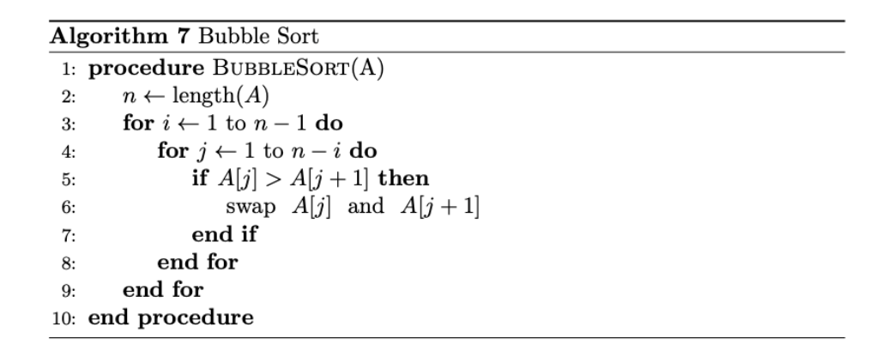
Pseudocode
This is very basic
Not perfect, because it can still be improved (slightly) by you

Slide 48
Runtime?
What is the worst case of ordering?

Slide 49

Runtime – Worst case
If field is in reverse order
Bubble biggest to the back ($n$ steps)
Bubble second biggest to the back ($n$ steps)
…
For n elements this will be $n^{2}$

Slide 50
Runtime?
What is the BEST case of ordering?

Slide 51
RunTime – Best case
If the field already order
One time going through
No swap, follows already sorted

Slide 52
Laboratory - Exercise
Get used to programming again
Implement the Bubble Sort algorithm
Given an array: [[‘a’, 1], [‘r’, 5], …] sort this array on two ways
Based on the second value inside the tuple
Based on the lexicographical order of the letters (first tuple value)

Slide 53
Done for Today :-)
See you on xxxx in the laboratory

Slide 54
Study at home
https://tcs.uni-frankfurt.de/algo-learn-testing/refs_heads_feat-bubbleSort/en
https://www.youtube.com/watch?v=9I2oOAr2okY&pp=ygUbYnViYmxlIHNvcnQgYW5pbWF0aW9uIHZpZGVv
https://www.youtube.com/watch?v=Cq7SMsQBEUw&pp=ygUbYnViYmxlIHNvcnQgYW5pbWF0aW9uIHZpZGVv

Slide 55
Exam
You are given the following list of numbers:
[5, 3, 8, 2, 1, 4, 7, 6]
1. Sort the list using the bubble sort algorithm. Write down the list after each iteration. (5P)
2. What is the time complexity of the bubble sort algorithm? (2P)
3. Why is the bubble sort algorithm not efficient for large data sets? (2P)
4. What is the best case time complexity of the bubble sort algorithm? (1P)

Slide 56
How to pass?
Get at least 4 points, to prove proper knowledge.
Good programming (or at least proven knowledge) of how to solve the given problem.

