Slide 1
BubbleSort
Week1 – Part1 (Theory)

Slide 2
Different parts of the week
Theory
Practice
Explain ground concepts
Pseudocode
Analysis
Program the explained concepts.
Get a real problem and find a solution.
Have fun, since you can program.

Slide 3
Sorting-introduction
8
1
3

Slide 4
Sorting-introduction
1
8
3

Slide 5
Sorting-introduction
3
8
1
4
7
6

Slide 6
Sorting-introduction
1
3
8
4
7
6

Slide 7
Sorting-introduction
4
1
7
8
3
6

Slide 8


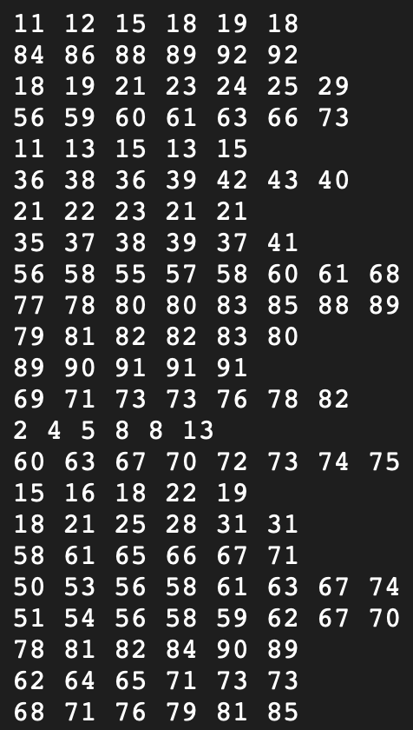
Sorting-General
Is this simple to sort by hand?
How to sort this efficient?

Slide 9

Ideas?

Slide 10
Bubblesort approach
Compare two items; swap if they’re in the wrong order.
Move to the next pair and repeat.
Biggest item “bubbles” to the end.
Start again from front
Repeat until the list is sorted.
8
1
1
8

Slide 11
Example
4
1
7
8
3
6

Slide 12
Example
1
4
7
8
3
6

Slide 13
Example
1
4
7
8
3
6

Slide 14

Example
1
4
7
8
3
6

Slide 15
Example
1
4
7
8
3
6

Slide 16
Example
1
4
7
8
3
6

Slide 17
Example
1
4
7
8
3
6

Slide 18
Example
1
4
7
3
8
6

Slide 19
Example
1
4
7
3
8
6

Slide 20
Example
1
4
7
3
6
8

Slide 21
Example
1
4
7
3
6
8
Biggest at the end

Slide 22
Example
1
4
7
3
6
8

Slide 23
Example
1
4
7
3
6
8

Slide 24
Example
1
4
7
3
6
8

Slide 25
Example
1
4
7
3
6
8

Slide 26
Example
1
4
7
3
6
8

Slide 27
Example
1
4
3
7
6
8

Slide 28
Example
1
4
3
7
6
8

Slide 29
Example
1
4
3
6
7
8

Slide 30
Example
1
4
3
6
7
8

Slide 31
Example
1
4
3
6
7
8

Slide 32
Example
1
4
3
6
7
8

Slide 33
Example
1
4
3
6
7
8

Slide 34
Example
1
3
4
6
7
8

Slide 35
Example
1
3
4
6
7
8

Slide 36
Example
1
3
4
6
7
8

Slide 37
Example
1
3
4
6
7
8

Slide 38
Example – Done?
1
3
4
6
7
8
One control run must be done
Then we are sure the numbers are sorted

Slide 39
Let’s Play 1
10 Students line up at the front of the class
The other students sort those by height
Use of the Bubble Sort algorithm

Slide 40
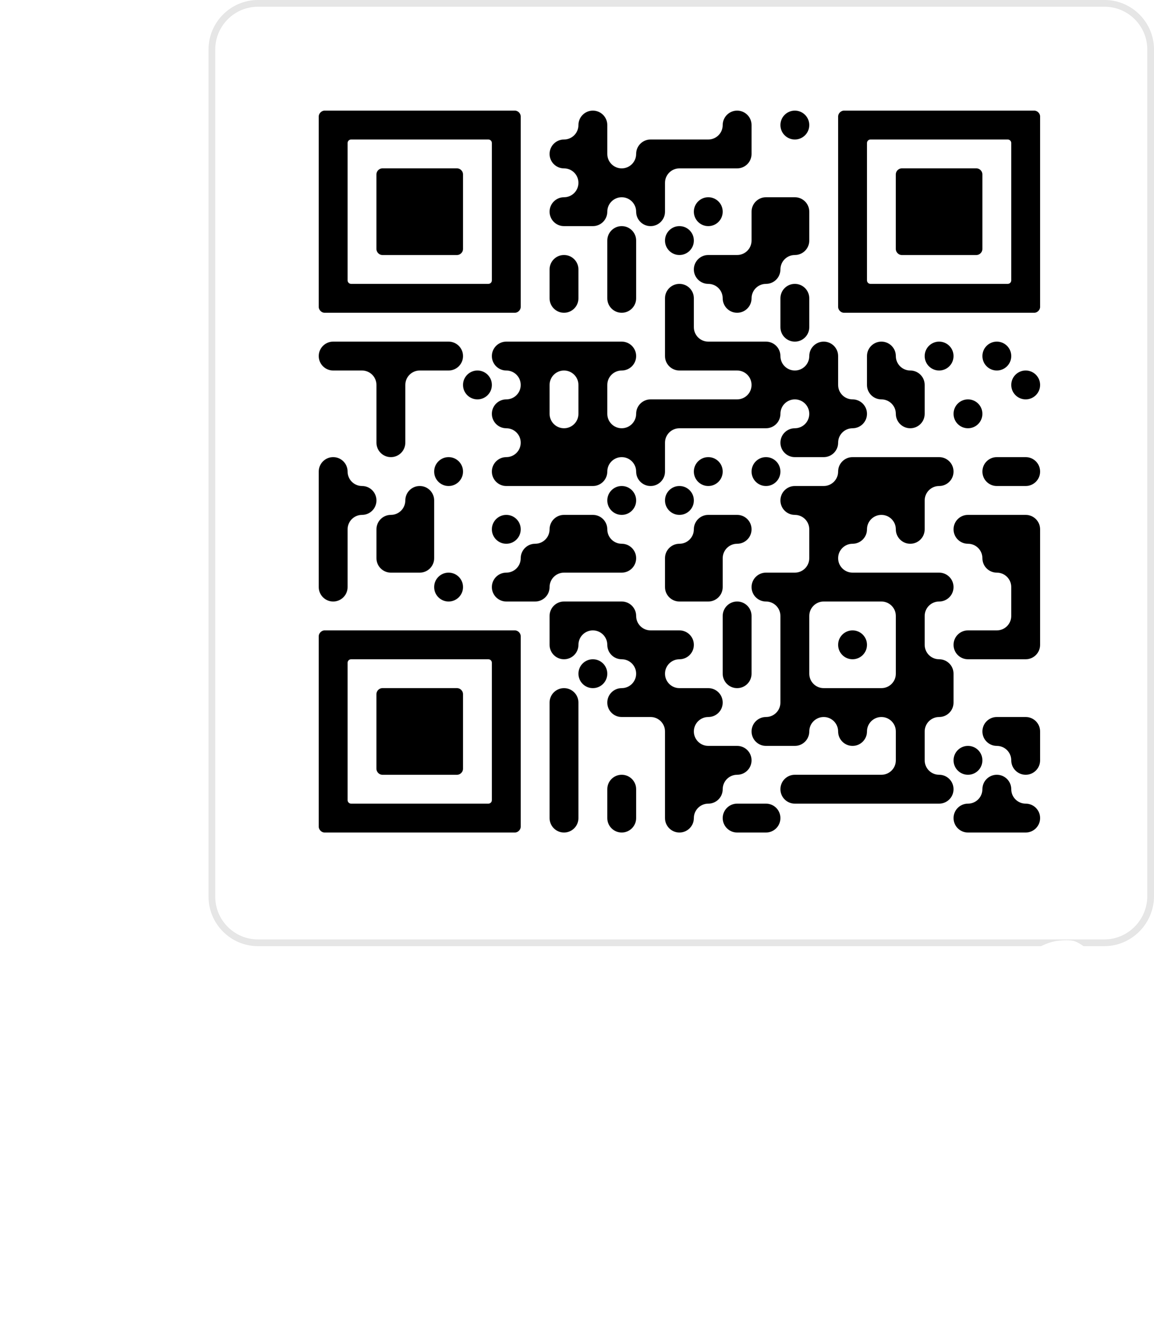
Let’s Play 2
https://tcs.uni-frankfurt.de/algo-learn-testing/refs_heads_feat-bubbleSort/en

Slide 41
Runtime?
What is the worst case of ordering?

Slide 42

Runtime – Worst case
If field is in reverse order
Bubble biggest to the back ($n$ steps)
Bubble second biggest to the back ($n$ steps)
…
For n elements this will be $n^{2}$

Slide 43
Runtime?
What is the BEST case of ordering?

Slide 44
RunTime – Best case
If the field already order
One time going through
No swap, follows already sorted

Slide 45
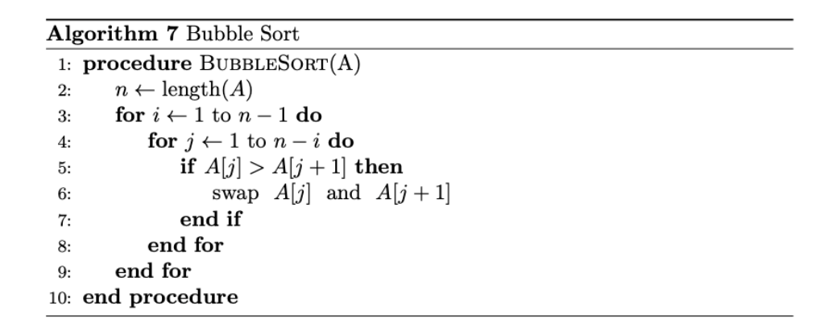
Pseudocode
This is very basic
Not perfect, because it can still be improved (slightly) by you

Slide 46
Laboratory - Exercise
Get used to programming again
Implement the Bubble Sort algorithm
Given an array: [[‘a’, 1], [‘r’, 5], …] sort this array on two ways
Based on the second value inside the tupel
Based on the lexicographical order of the letters

Slide 47
Done for Today :-)
See you on xxxx in the laboratory
Two nice videos to watch at home:
https://www.youtube.com/watch?v=9I2oOAr2okY&pp=ygUbYnViYmxlIHNvcnQgYW5pbWF0aW9uIHZpZGVv
https://www.youtube.com/watch?v=Cq7SMsQBEUw&pp=ygUbYnViYmxlIHNvcnQgYW5pbWF0aW9uIHZpZGVv

