Slide 1
Mini Games
Arduino Project

Slide 2
Let’s Play
Quick live demonstration of the games
TicTacToe
SimonSays

Slide 3
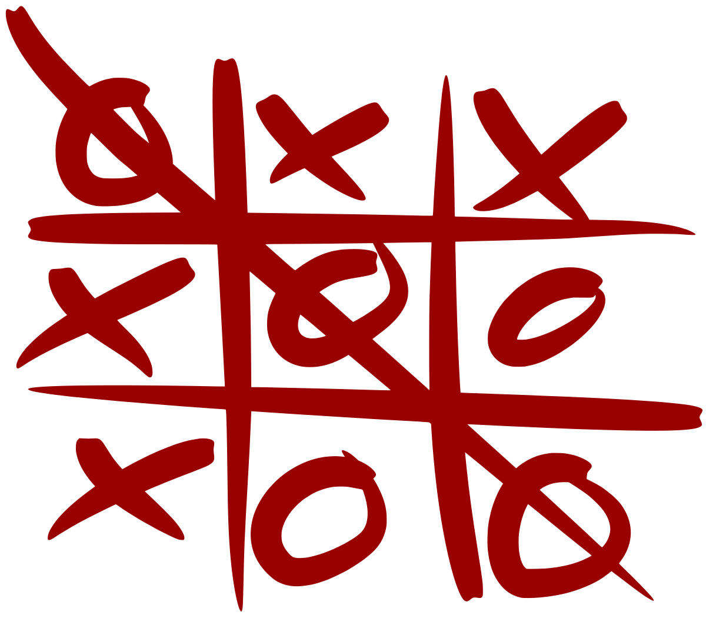
TicTacToe

Slide 4

SimonSays

Slide 5
How to?

Slide 6
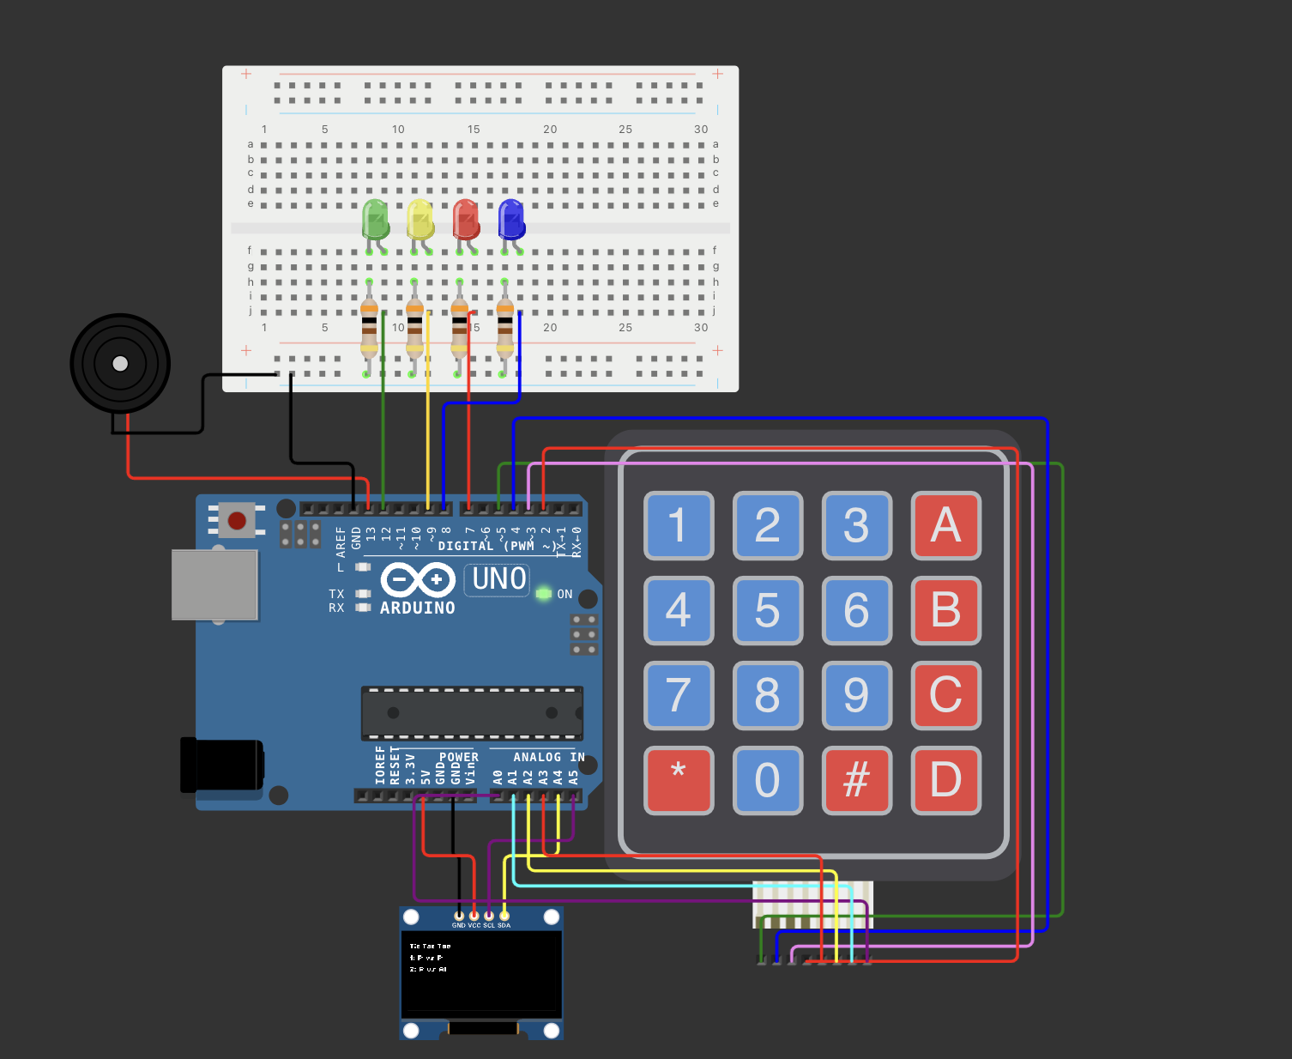
Circuit
Don’t worry, we will build it together

Slide 7
TicTacToe - Code
Game Initialization: The game initializes hardware components, sets up game variables, and displays a menu screen before the game begins.
Game Flow: The game starts with a menu screen, transitions to the game board after the user presses 1, and continues with player turns, move validation, and victory/draw conditions.
Game Mechanics: Players place their symbols on the board by pressing buttons, and the game checks for wins, draws, or continues the game accordingly.

Slide 8
SimonSays - Code
Game Flow: The game starts with a menu screen, followed by a sequence display and user repetition. The game continues with increasing sequence length if correct or ends if incorrect.
Game Setup: Initializes OLED Display, Keypad, LEDs, and Buzzer. Creates variables for the game sequence, player sequence, and current round.
Game Objective: Users watch and repeat a sequence of button presses, with the sequence length increasing if correct.

Slide 9
Other games
Develop any game you like
Use any hardware you would like to use
No limits, except it should be done within 6 weeks

Slide 10
HAVE FUN

