Slide 1
BubbleSort
Sorting algorithms
Week1 – Part1 (Theory)

Slide 2
Different parts of the week
Theory
Practice
Explain ground concepts
Pseudocode
Analysis
Program the explained concepts.
Get a real problem and find a solution.
Have fun, since you can program.

Slide 3
Sorting-introduction
8
1
3

Slide 4
Sorting-introduction
1
8
3

Slide 5
Sorting-introduction
3
8
1
4
7
6

Slide 6
Sorting-introduction
1
3
8
4
7
6

Slide 7
Sorting-introduction
7
7
8
8
3
3
6
4
6
4
1
1

Slide 8
Sorting-introduction
4
1
7
8
3
6
1
3
4
6
7
8

Slide 9


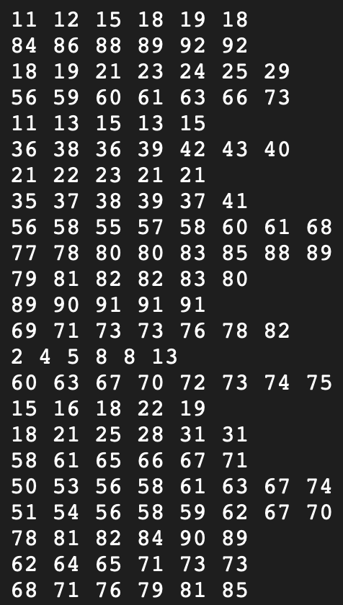
Sorting-General
Is this simple to sort by hand?
How to sort this efficient?

Slide 10

Ideas?

Slide 11
Bubblesort approach
Go from left to right (through the list of numbers)
Compare two items; swap if they’re in the wrong order.
Move to the next pair and repeat.
Biggest item “bubbles” to the end.
Start again from front
Repeat until the list is sorted.
8
1
1
8

Slide 12
Example
4
1
7
8
3
6

Slide 13
Example
1
4
7
8
3
6

Slide 14
Example
1
4
7
8
3
6

Slide 15

Example
1
4
7
8
3
6

Slide 16
Example
1
4
7
8
3
6

Slide 17
Example
1
4
7
8
3
6

Slide 18
Example
1
4
7
8
3
6

Slide 19
Example
1
4
7
3
8
6

Slide 20
Example
1
4
7
3
8
6

Slide 21
Example
1
4
7
3
6
8

Slide 22
Example
1
4
7
3
6
8
Biggest at the end

Slide 23
Example
1
4
7
3
6
8

Slide 24
Example
1
4
7
3
6
8

Slide 25
Example
1
4
7
3
6
8

Slide 26
Example
1
4
7
3
6
8

Slide 27
Example
1
4
7
3
6
8

Slide 28
Example
1
4
3
7
6
8

Slide 29
Example
1
4
3
7
6
8

Slide 30
Example
1
4
3
6
7
8

Slide 31
Example
1
4
3
6
7
8

Slide 32
Example
1
4
3
6
7
8

Slide 33
Example
1
4
3
6
7
8

Slide 34
Example
1
4
3
6
7
8

Slide 35
Example
1
3
4
6
7
8

Slide 36
Example
1
3
4
6
7
8

Slide 37
Example
1
3
4
6
7
8

Slide 38
Example
1
3
4
6
7
8

Slide 39
Example – Done?
1
3
4
6
7
8
One control run must be done
Then we are sure the numbers are sorted

Slide 40
Let’s Play 1
10 Students line up at the front of the class
The other students sort those by height
Use of the Bubble Sort algorithm

Slide 41
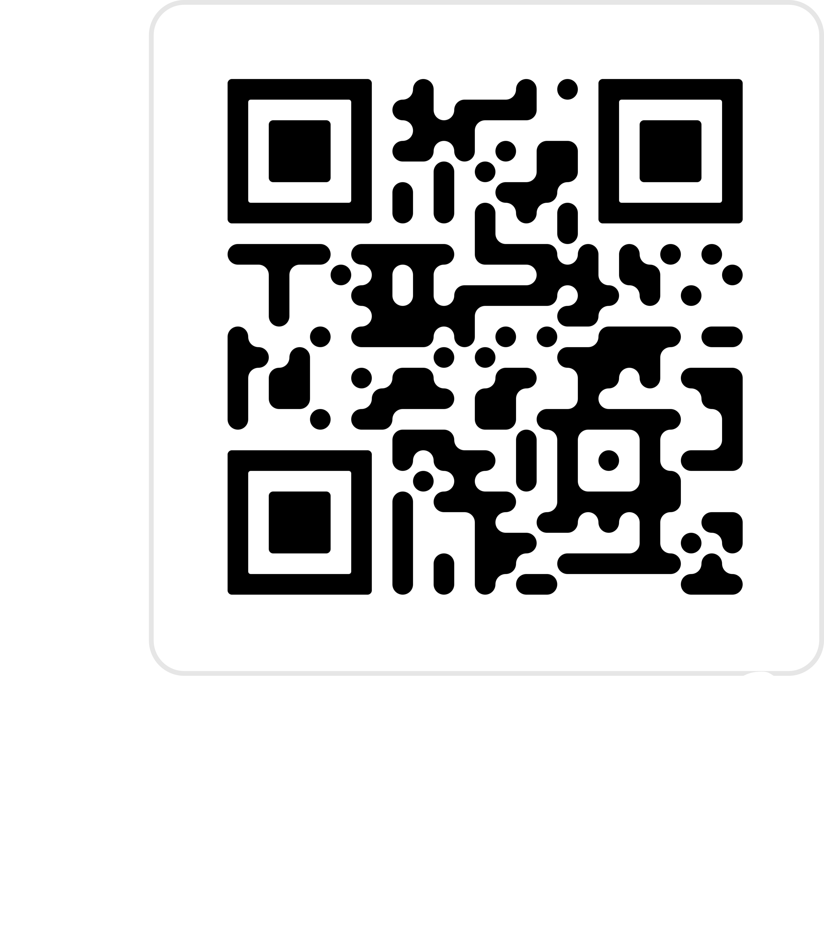
Let’s Play 2
https://tcs.uni-frankfurt.de/algo-learn-testing/refs_heads_feat-bubbleSort/en

Slide 42
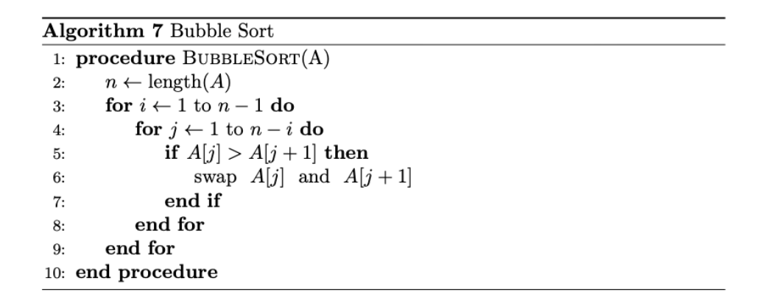
Pseudocode
This is very basic
Not perfect, because it can still be improved (slightly) by you

Slide 43
Runtime?
What is the worst case of ordering?

Slide 44

Runtime – Worst case
If field is in reverse order
Bubble biggest to the back ($n$ steps)
Bubble second biggest to the back ($n$ steps)
…
For n elements this will be $n^{2}$

Slide 45
Runtime?
What is the BEST case of ordering?

Slide 46
RunTime – Best case
If the field already order
One time going through
No swap, follows already sorted

Slide 47
Laboratory - Exercise
Get used to programming again
Implement the Bubble Sort algorithm
Given an array: [[‘a’, 1], [‘r’, 5], …] sort this array on two ways
Based on the second value inside the tuple
Based on the lexicographical order of the letters (first tuple value)

Slide 48
Done for Today :-)
See you on xxxx in the laboratory

Slide 49
Study at home
https://tcs.uni-frankfurt.de/algo-learn-testing/refs_heads_feat-bubbleSort/en
https://www.youtube.com/watch?v=9I2oOAr2okY&pp=ygUbYnViYmxlIHNvcnQgYW5pbWF0aW9uIHZpZGVv
https://www.youtube.com/watch?v=Cq7SMsQBEUw&pp=ygUbYnViYmxlIHNvcnQgYW5pbWF0aW9uIHZpZGVv

