Slide 1
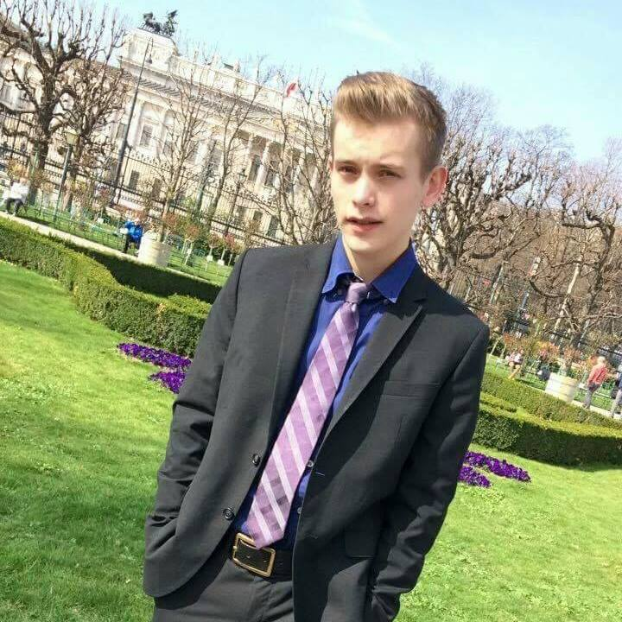














FABIEN DESABLENS
Junior Web Developer
ABOUT ME
Being familiar with the IT sector since I was a child, I recently decided to train to become a web developer. My autonomy and thirst for learning can help you to develop your business in an appropriate way.
PROFESSIONAL EXPERIENCES
CONTACT
2016 | Order picker and restocking (student) Pharma Belgium
77 Avenue des Genêts 6001 Marcinelle Belgium
+32 485 62 71 77
fdesablens@gmail.com
Belgian, single
Born on 30/11/1998
/Fabien-desablens
/fabien-desablens
STUDIES AND TRAININGS
2019 | Training - Junior Web developer Becode.org
2019 | Training - Creating an online business, create a website Technofutur TIC
2010 - 2018 | High Secondary Education Certificate (applied science) Notre-Dame Institute – Charleroi, Belgium
SOFT SKILLS
Physical resistance
Stress resistance
Flexibility
Team spirit
Autonomy
HARD SKILLS
HTML - CSS - Bootstrap Javascript Node.js, Socket.IO PHP, MySQL React Python AJAX Wordpress
LANGUAGES
CENTER OF INTERESTS
French
English
Dutch
Spanish
Sports ; running and bodybuilding
Music (IG : @streetkorner, @skpunchline, @sk16mesures)
Theater

