Slide 1
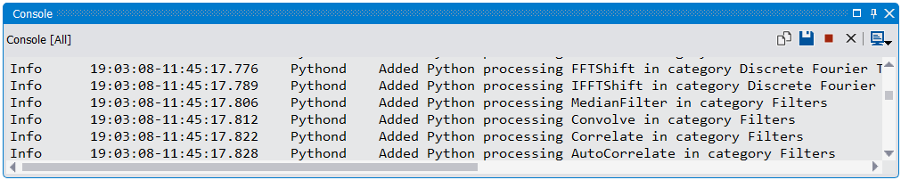
1
2

Slide 2
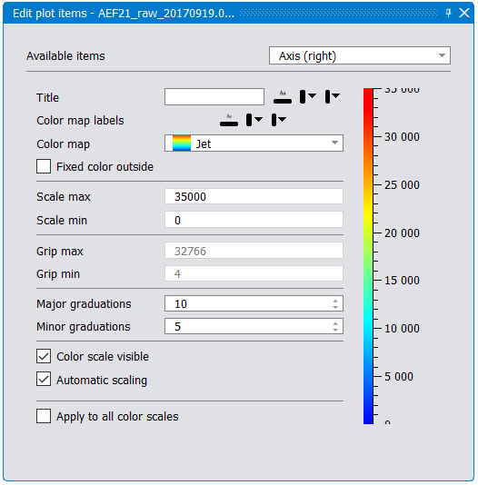
1
2
10
3
4
5
6
7
8
8
9

Slide 3
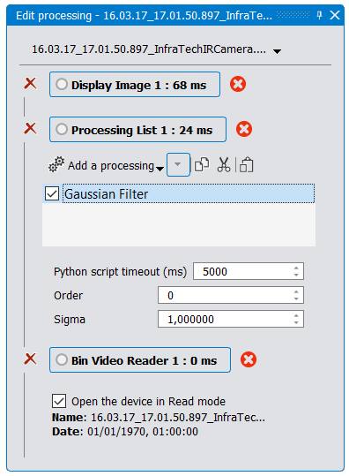
1
2
4
3
5

Slide 4
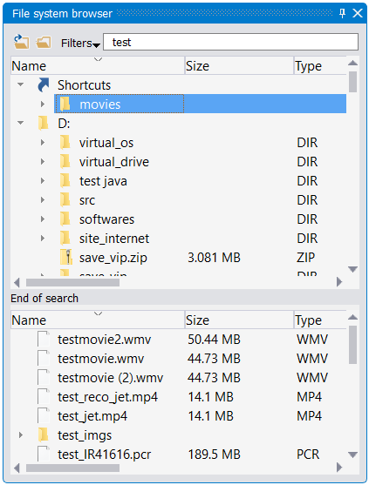
2
3
1
4
7
5
6

Slide 5
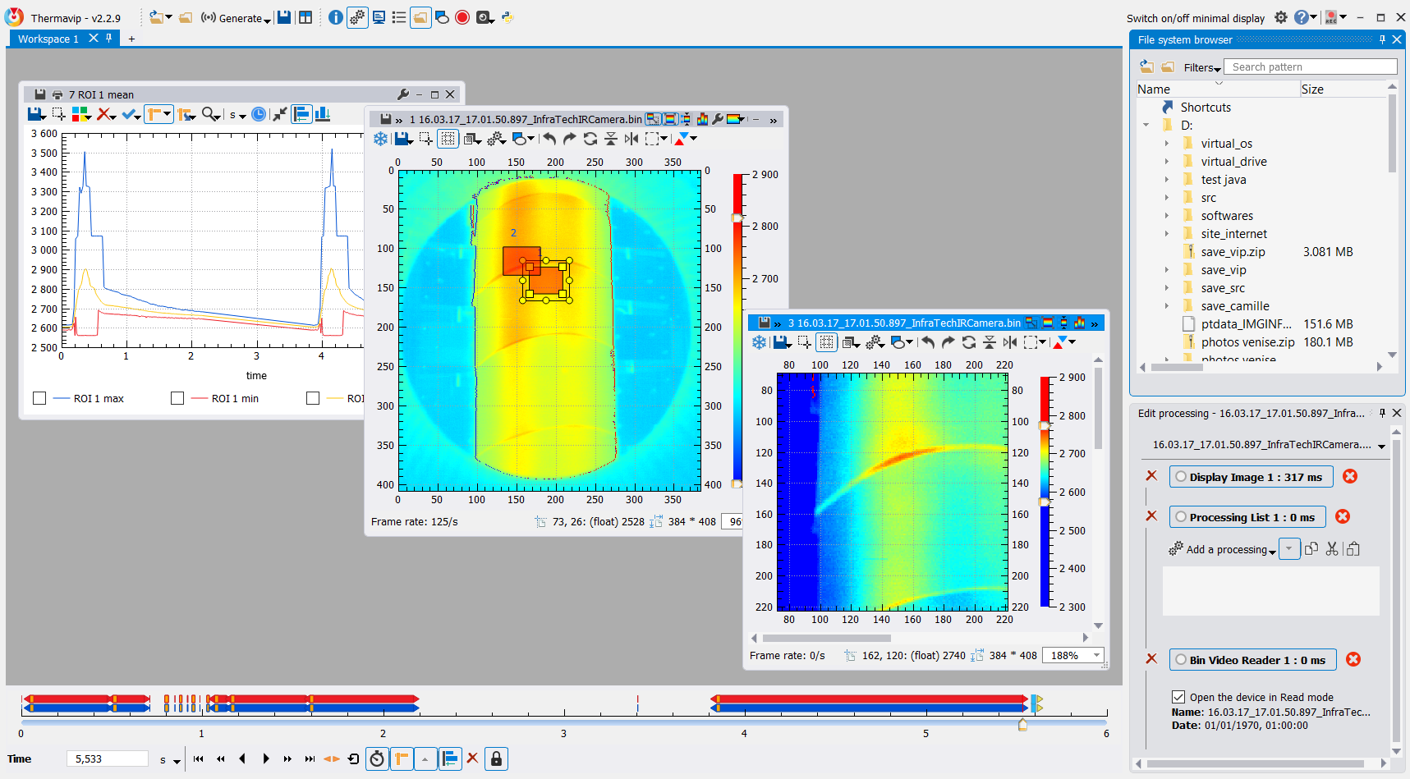
1
2
3
4
5
6
7
8
9
10
12
11
13

Slide 6
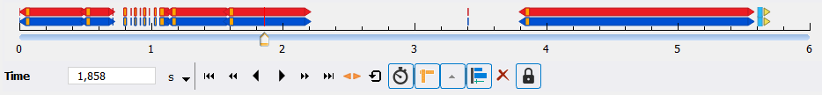
1
2
3
4
5
6
7
8
9
10
11
12
13

Slide 7
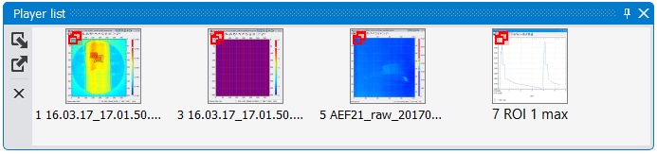
2
1

Slide 8
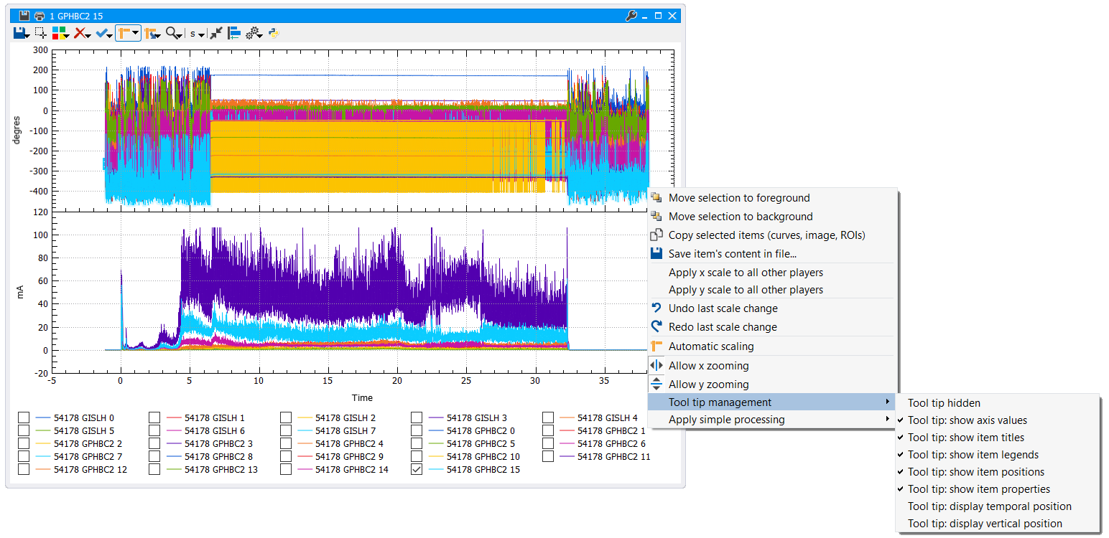
1
2
3
4
5
6
7
8
9
10
11
12
13
14
15
16
19
17
20
18

Slide 9
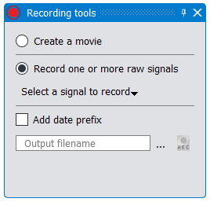
1
2
3
4

Slide 10
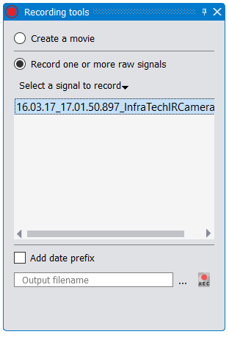
1
2

Slide 11
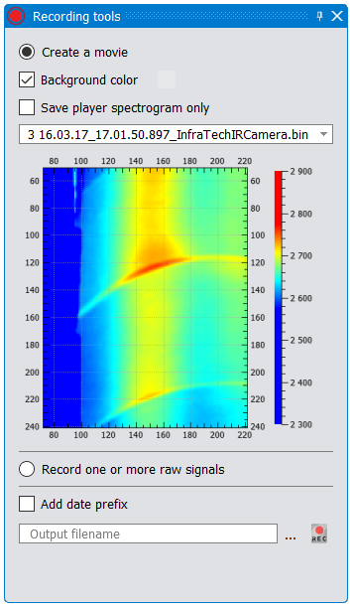
1
2
3
4

Slide 12
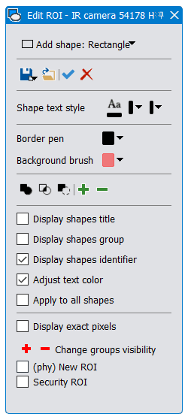
1
2
3
4
5
6
7
8
9

Slide 13
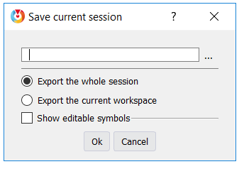
1
2
3

Slide 14
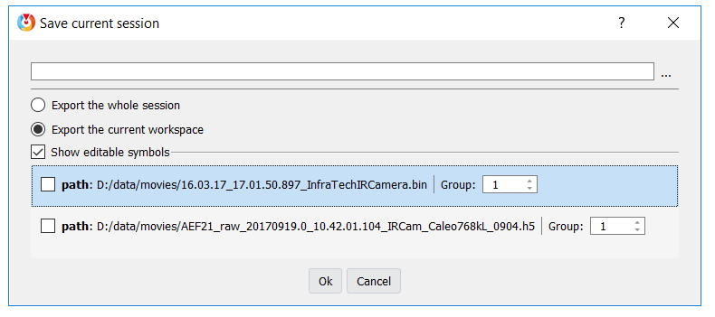
1
3
2

Slide 15
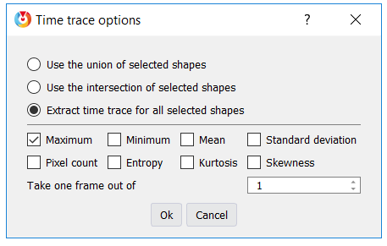
1
2
3

Slide 16
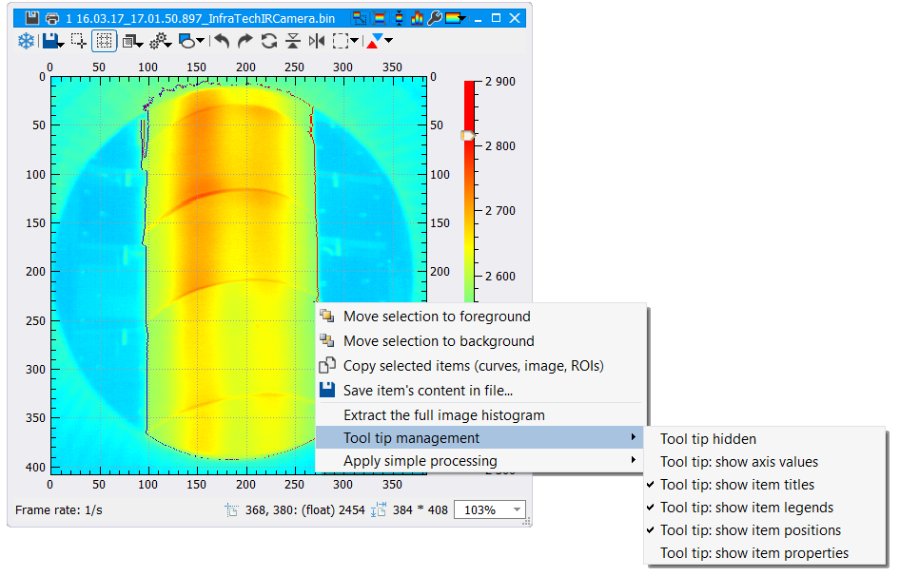
1
2
3
4
5
6
7
8
9
10
11
12
13
14
15
16
17
18
20
19
21
22
23
24

Slide 17
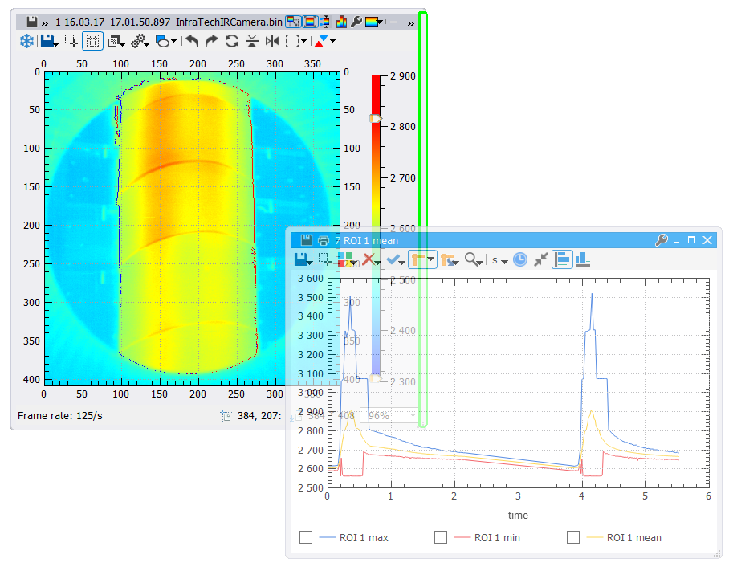


Slide 18
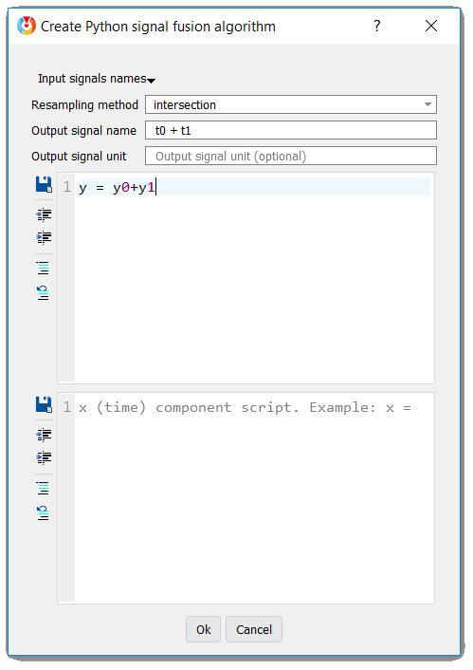
1
2
3
4
5
6

Slide 19
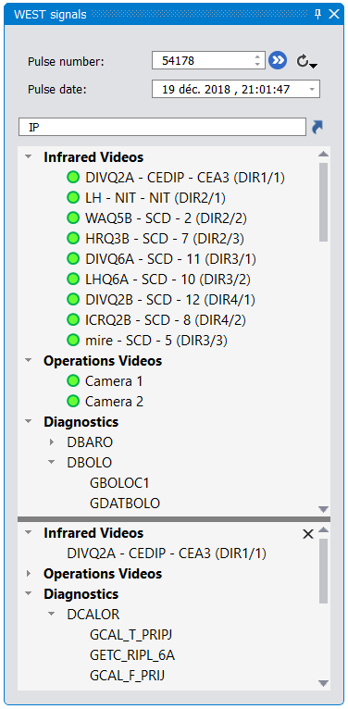
1
2
3
4
5
6
7
8

Slide 20
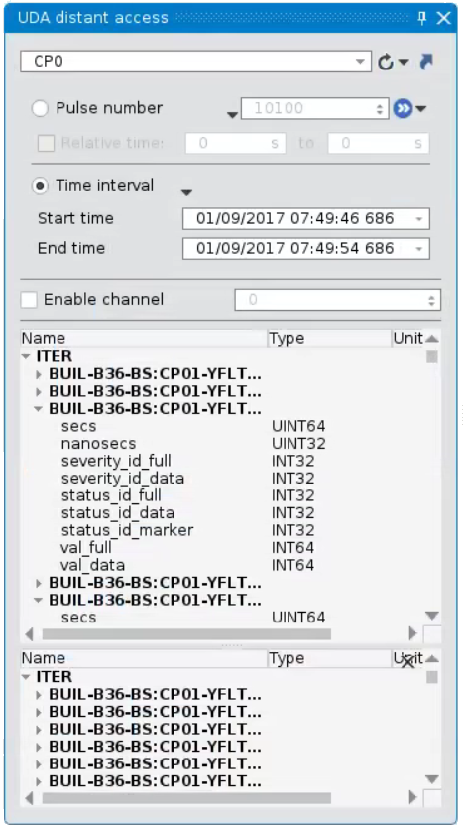
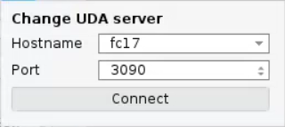
2
3
1
4
5
6
7
8
9
10
11

Slide 21
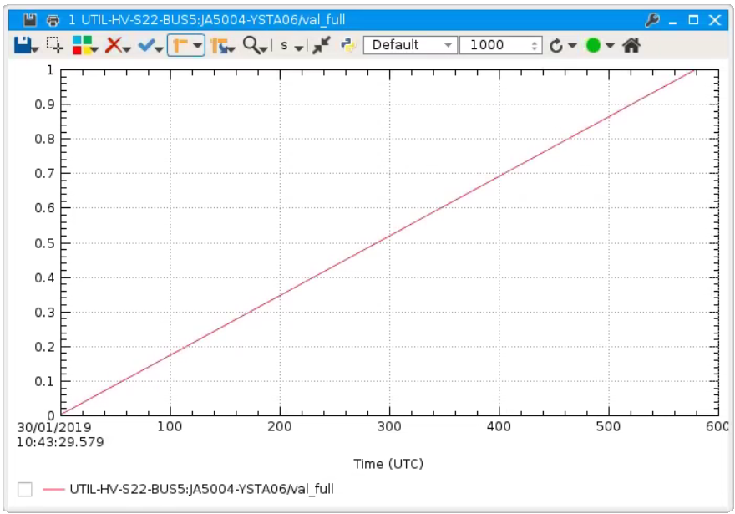
1
2
3
4
5

Slide 22
Algo. 1
Algo. 3
Video file loader
Algo. 4
Video saving
Algo. 2
Video display
Video file loader
Processing list
Display
(video player)

Slide 23
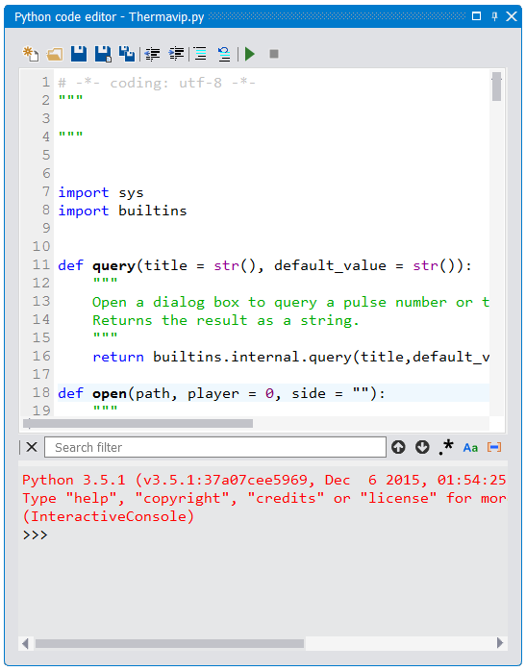
1
2
3
4
5
6
7
8
9
10
11
12
13
14

