Slide 1
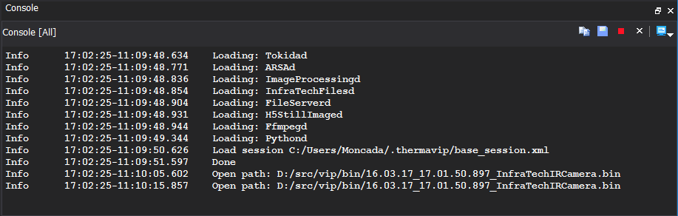
1
2

Slide 2
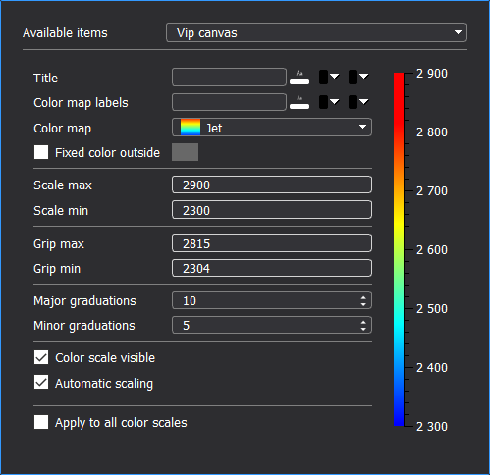
1
2
10
3
4
5
6
7
8
8
9

Slide 3
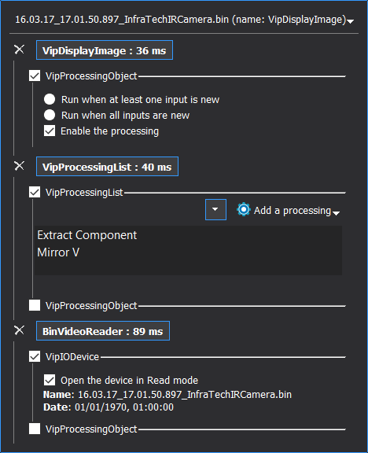
1
2
3
4
5
6

Slide 4
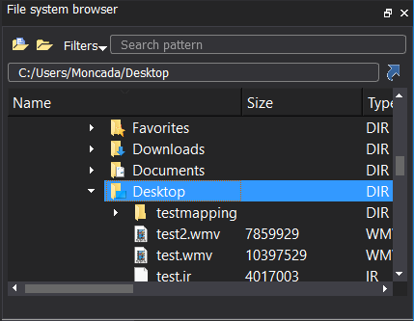
2
3
1
4
5
6
7

Slide 5
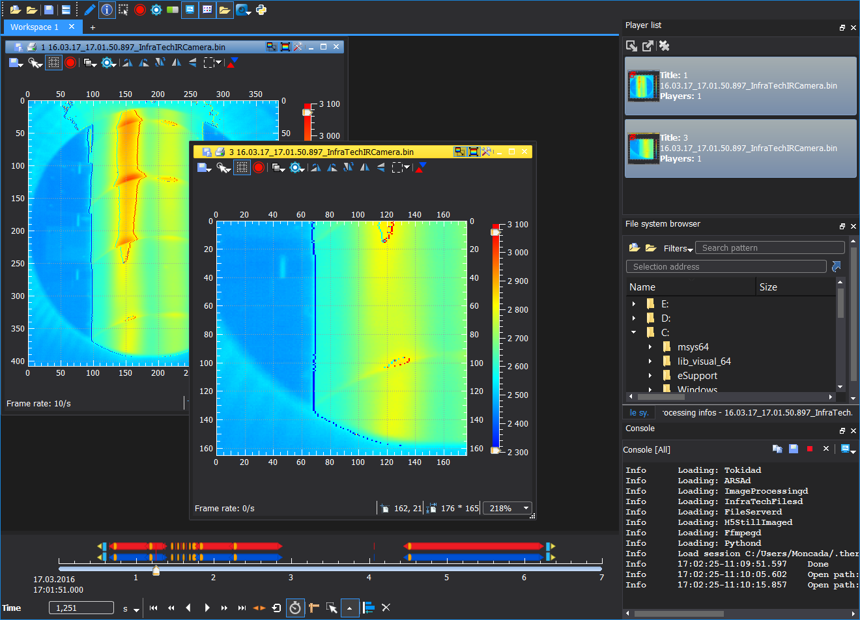
2
1
3
7
4
5
6

Slide 6
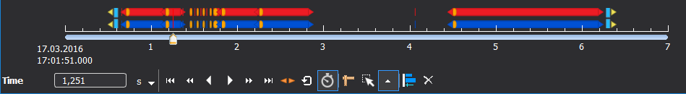
1
2
3
4
5
6
7
8
9
10
11
12
13

Slide 7
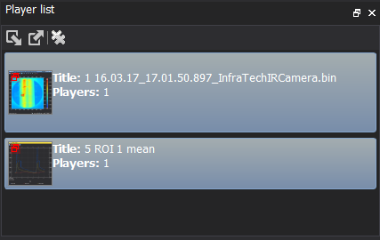
1
2

Slide 8
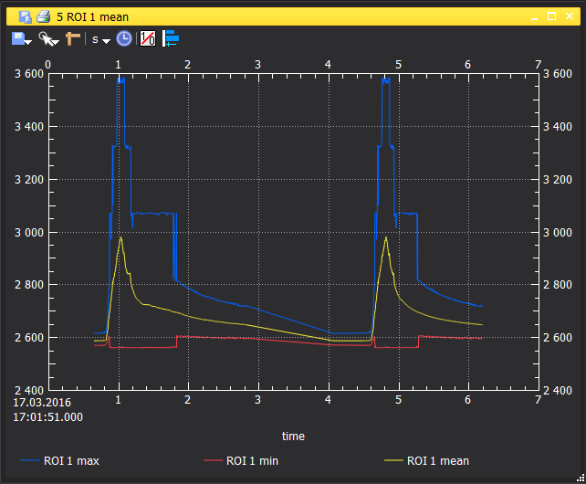
1
2
3
4
5
6
7
8

Slide 9
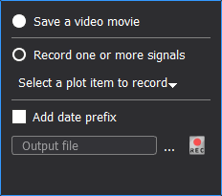
1
2
3
4

Slide 10
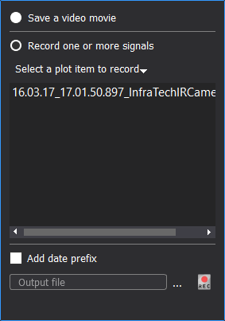
1
2

Slide 11
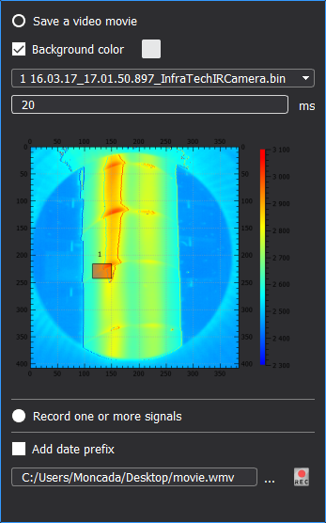
1
2
3
4

Slide 12
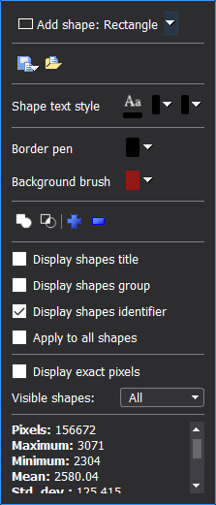
1
2
3
4
5
5
6
7
8
9
10

Slide 13
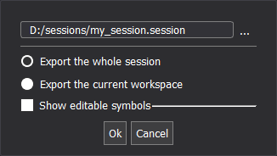
1
2
3

Slide 14
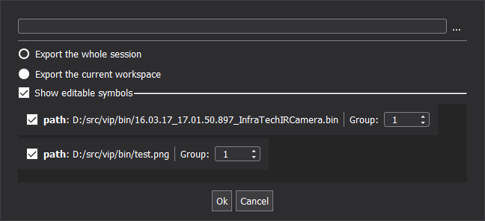
1
2
3

Slide 15
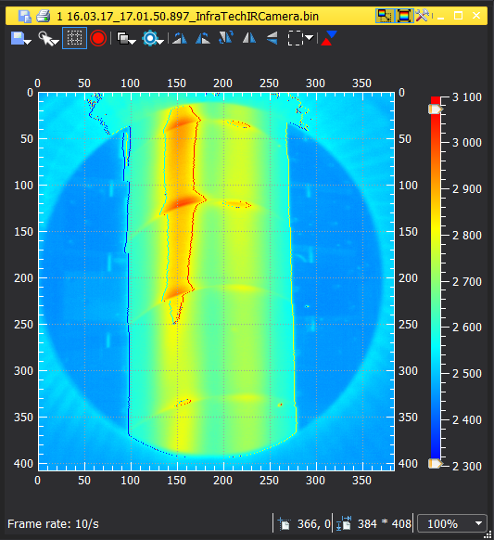
1
3
2
4
5
6
7
8
9
10
11
13
12
14
15

Slide 16
Algo. 1
Algo. 3
Video file loader
Algo. 4
Video saving
Algo. 2
Video display
Video file loader
Processing list
Display
(video player)

