Slide 1


PROJECT TRAINING I
Fabien Gadet
Pierre Saint-Sorny
Gallien Wong
Alexis Pottier

Slide 2
You will find with this document our project , there is everything you need to run a spark based app in this repository .

Slide 3
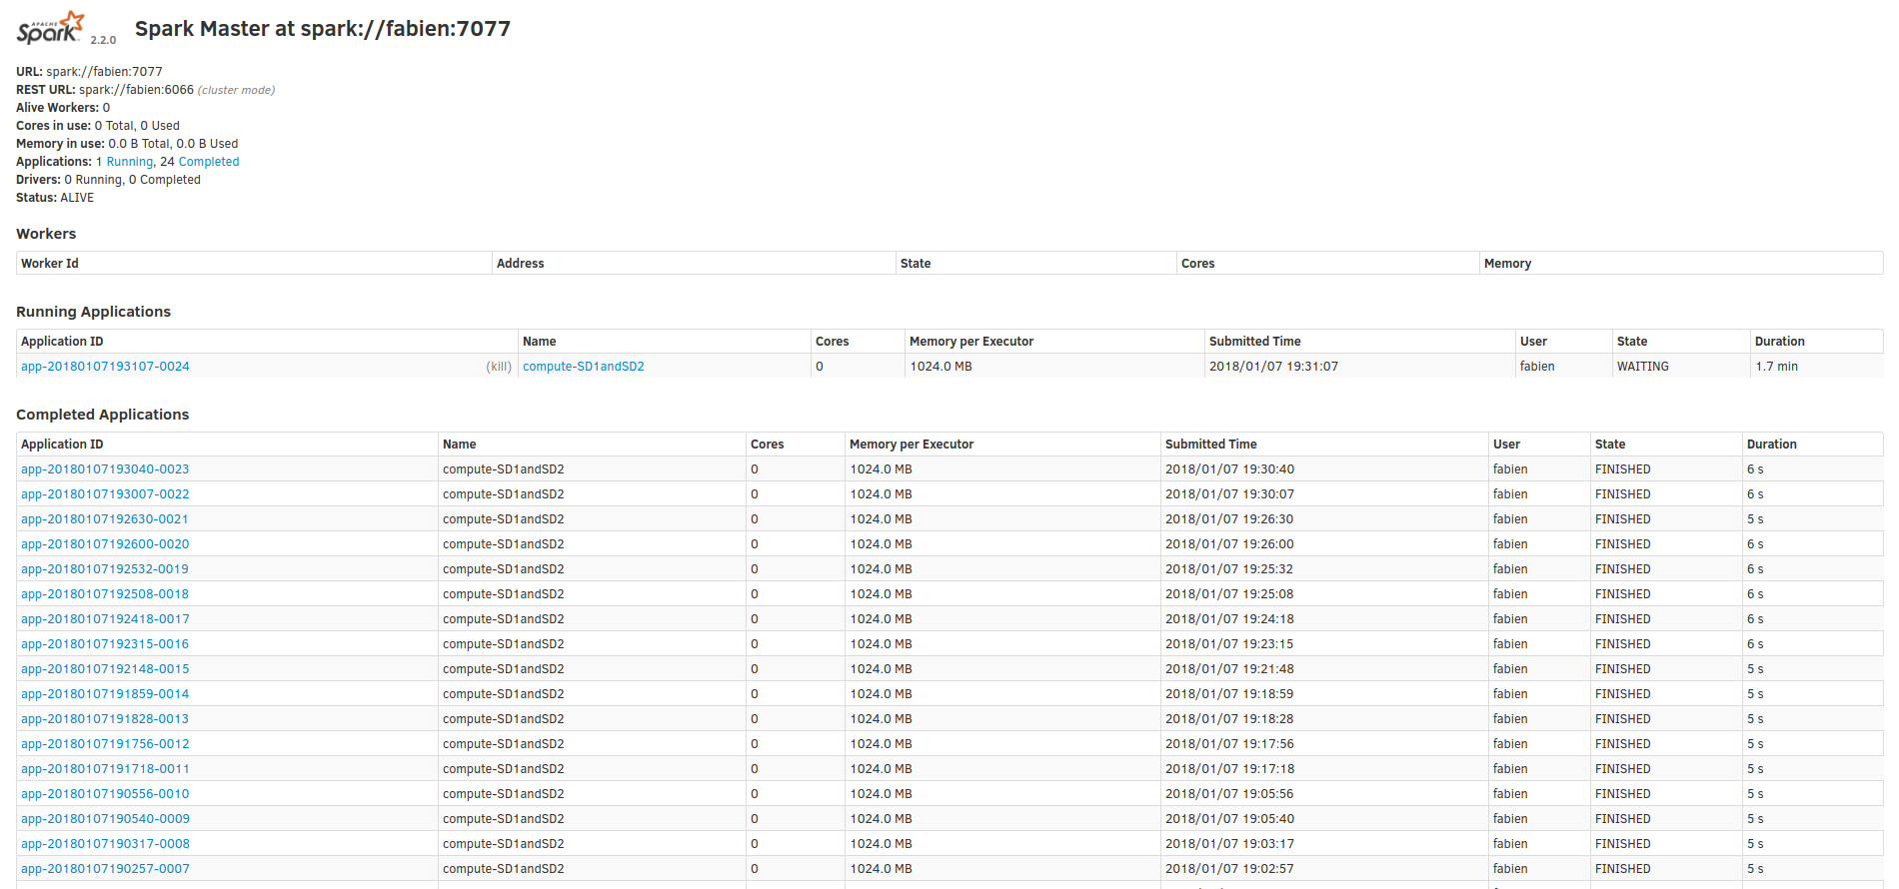

Slide 4

Technologies
We use spark and r (SparkR) , we wrote all the process in SparkR, and Ruby / Ruby on Rails for the web

Slide 5
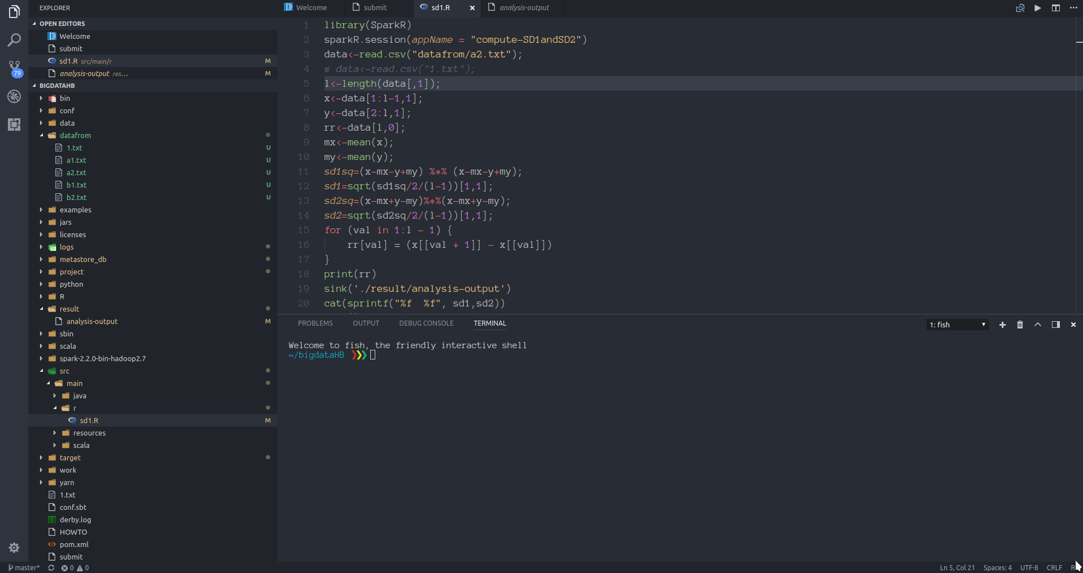
datafrom ->
text-file as input of the project.
result -> the file where the result are written (read by the web-interface)
src/main/ -> source files of the project.

Slide 6
The Project
We can handle text file in entry (like the one you gave to us in classes), calculate SD1 , SD2 , RR interval. And finally give an alert depending of these result.

Slide 7
Web Interface
We also did a web interface for making this project more user-friendly it’s running on Ruby on Rails , if you want to run it yourself , just install rails and type “rails s” in the folder “hbWebsite” and then go to localhost:3000.
A very simple plain-text app , you can also upload a new file as input with heart beat data.
A screenshot is available just after.

Slide 8
