Slide 1
Introduction to Morphophonological Analysis in the Ayeri Language
Computational Morphology, SoSe 2024
Dr. Yulia Zinova
Based on the Xerox finite state transducer
25.09.2024
Fabien Pascal Dallmann, Matrikelnr.: 3317534

Slide 2
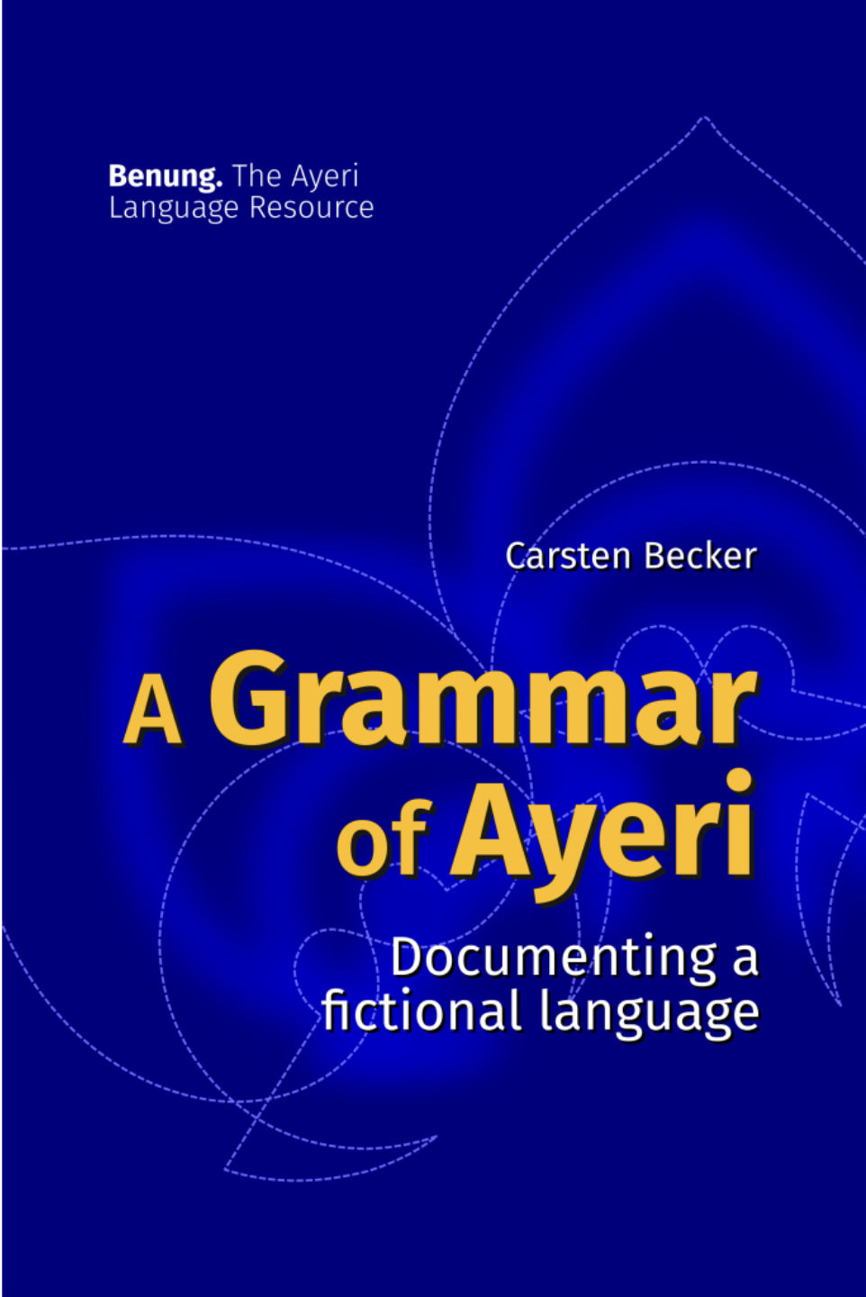
Outline
Overview of the Ayeri language
Overview of the Lexicon
Key Morphophonological Rules in Ayeri
On vowels
On conconants
Testing and Script Execution
Methodology for testing (input and output process)
Representative test examples
Challenges and Limitations
Conclusion
References
Fabien Pascal Dallmann, Matrikelnr.: 3317534

Slide 3
Overview of the Ayeri language

Slide 4
Overview of the Ayeri language
What is Ayeri?
Constructed language, designed by Martin Becker in 2003
„Personal artistic language“ (dt. Kunstsprache)
Created primarily for intellectual enjoyment and experimentation on linguistic structures
But not for practical use as an international language like Esperanto
Ayeri is an agglutinating language
Root morphemes are modified by affixes in terms of prefixes and suffixes
Verb-Subject-Object (VSO) structure, unlike German with Subject-Verb-Object (SVO) structure
„Moderately small“ consonant inventory and a balanced vowel system

Slide 5
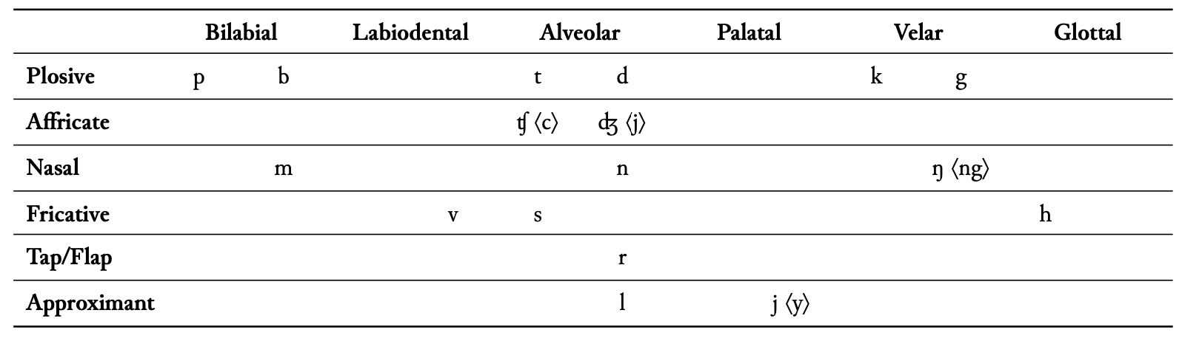
Overview of the Ayeri language
Consonant inventory (divergent orthography in brackets)

Slide 6
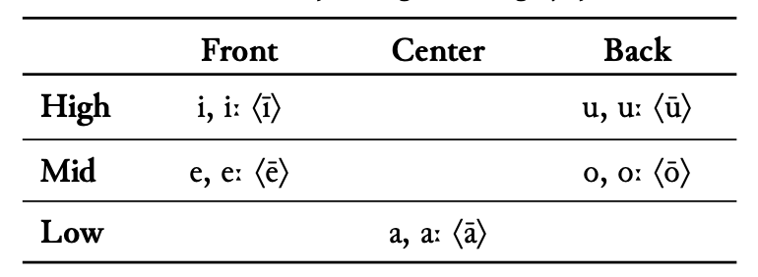
Overview of the Ayeri language
Vowel inventory (divergent orthography in brackets )
Lax vowels [ɪ] [ɛ] [ɔ] [ʊ] occur as allophones

Slide 7
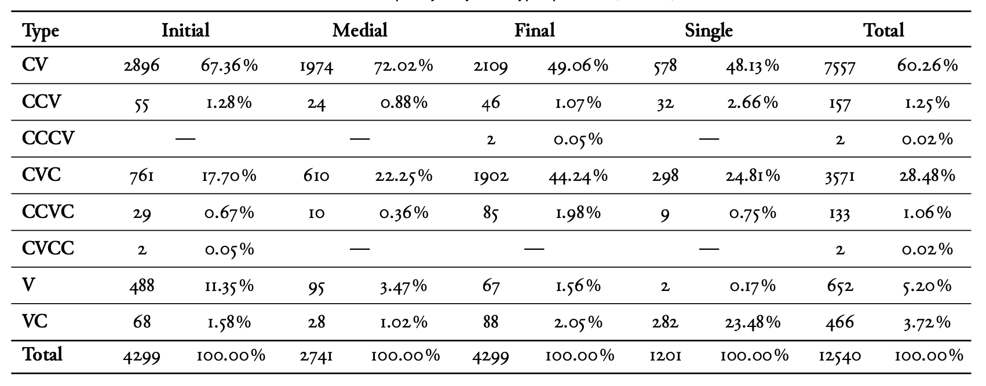
Overview of the Ayeri language
Syllable types per word (n = 5.500)

Slide 8
Overview of the Ayeri language
Basic Morphology
Ayeri is an agglutinating language
Morphem for each grammatical function on stem
In terms of prefixes and suffixes (but no infixes)
Division between animate / inanimate, singular / plural, agent / patient (no gender marking)
Five different cases: dative, genitive, locative, instrumental, causative
Topic agreement marker (topicalization prohibits case marking)
Diminutive: formed by reduplication of noun stem
Nouns
Prefixes on nouns
For instance: ku- (like), da- (such), eda- (this), ada- (that)

Slide 9
Overview of the Ayeri language
How to derive a noun: simple illustration
(Prefix)
Noun stem
Topic
Number
(Case)
(Quantifier)
Optional prefixes
+Npref:
For instance: ku- (like), da- (such), eda- (this), ada- (that)
Topic agreement marker
+Top: ∅ +Sg: ∅ .#.
Topicalization prohibits connection with case / quantifier

Slide 10
Overview of the Ayeri language
How to derive a noun: simple illustration
(Prefix)
Noun stem
Topic
Number
(Case)
(Quantifier)
Number
+Sg: ∅
+Pl: ye
Optional Cases (Division between animate / inanimate)
+A: ang (animate) / +A: reng (inanimate)
+P: as (animate) / +P: ley (inanimate)
+Dat: yam / +Loc: ya / +Caus: isa / + Gen: ena (na) and +Ins: eri (ri), depending on specific context

Slide 11
Overview of the Ayeri language
How to derive a noun: simple illustration
(Prefix)
Noun stem
Topic
Number
(Case)
(Quantifier)
Optional quantifier
+Q:
For instance: -hen (all / every), –kay (few / a bit ), -vā (most)
If a noun +Pl: ye then no connection with quantifier is allowed

Slide 12
Overview of the Ayeri language
How to derive a diminutive noun: simple illustration
Noun stem
(Prefix )
Noun stem
(Suffixes)
Diminutive by reduplication of noun stem
Optional prefix on „original“ noun stem
Optional suffixes after „original“ noun stem possible
Reduplicated noun stem remains unchanged

Slide 13
Overview of the Ayeri language
How to derive an adjective: simple illustration
(Prefix)
Adjective stem
(Comp.)
(Neg.)
(Nom.)
(Comp.)
(Neg.)
(Neg.)

Slide 14
Overview of the Ayeri language
How to derive an adjective: simple illustration
(Prefix)
Adjective stem
(Comp.)
(Neg.)
(Nom.)
Optional prefixes
+APref:
For instance: ku- (like), da- (such), eda- (this), ada- (that)
Optional nominalization
+Nom: an

Slide 15
Overview of the Ayeri language
How to derive an adjective: simple illustration
(Prefix)
Adjective stem
(Comp.)
(Neg.)
(Nom.)
Optional comparison
+Comp: -eng
+Supl: -vā
Optional negation
+Neg: arya
+Neg: oy

Slide 16
Overview of the Lexicon

Slide 17
Overview of the Lexicon
Lexicon structure
A total of 19 lexicons
Root, nouns, adjectives, number, case, quantifier etc.
„Special“ lexicons like SetAnimate, SetInanimate etc.
More than 20 Multichar_Symbols defined
+Adj, +Noun, +Nom, +Comp, +Supl etc.
Flag diacritics: @P.Animacy.animate@, @D.Topic.ON@, @R.Topic.ON@ etc.
^[ ^] for reduplication
Link to GitHub repository containing the files
Notes:
Auf Link klicken und Lexc file erklären

Slide 18
Key Morphophonological Rules in Ayeri

Slide 19
Key Morphophonological Rules in Ayeri
On vowels
Lax vowels: [ɪ], [ɛ], [ɔ], [ʊ] occur as allophones of their tense counterparts in closed syllables
Diphthonges ⟨ay⟩, ⟨ey⟩, ⟨oy⟩, ⟨uy⟩, and ⟨au⟩ as /aɪ eɪ ɔɪ ʊɪ aʊ/
Long vowels: two single vowels in a row become a long vowel
/u/ is commonly realized as [w] when followed by a vowel
Avoid hiatus: a / j / may be inserted between a long vowel and a following vowel
Notes:
Auf Link klicken und Lexc file erklären

Slide 20
Key Morphophonological Rules in Ayeri
On consonants
The NG-rule: / n g / become [ŋ] and / n / becomes [ŋ] before / k /
/ h / is pronounced as [ç] before vowels [ + Front ] and as [x] before [ + Back ]
/ u / becomes [w] before vowels
Genitive / Instrumental rule: / E / realized as [∅] if noun stem ends in a vowel, otherwise [e]
Double consonants collaps to single consonant
Notes:
Auf Link klicken und Lexc file erklären

Slide 21
Testing and Script Execution

Slide 22
Testing and Script Execution
Methodology for testing (input and output process)
Link to GitHub repository containing the files

Slide 23
Testing and Script Execution
Representative text examples
Link to GitHub repository containing the files

Slide 24
Challenges and Limitations

Slide 25
Challenges and Limitations
Problems which occured – and how I solved them
Why do my rules not work in context of suffixes / prefixes?
Because I treated them like one symbol in the lexc file
Compare +Neg:arya # ; vs. < "+Neg":[[a] [r] [y] [a]] > # ;
Why are my rules not applied across morphemes? (For instance with the long vowels)
Because of „hidden“ symbols between morphemes, not visible in the lower words
Command „print net“ find symbols and add to rule (left side)
Runtime error – xfst crashed due complexity and quantity of applied rules
For instance: Genitive rule and instrumental rule can be combined
Reduce the amount of rules and simplify them (at least I tried this)

Slide 26
Conclusion

Slide 27
Conclusion
Just a „beta version“ still many chances for optimizations (to improve performance)
Expand view on other grammatical categories like verbs or adverbs for instance
Learning: there isn‘t one right direction to go many possible ways lead to desired output (= Think outside the box!)
Time for questions 💬

Slide 28
References

Slide 29
References
Becker, Carsten. 2018. A grammar of Ayeri documenting a fictional language. Marburg: Lulu Press.
Becker, Carsten. o . D. Benung. The Ayeri Language Resource. https://ayeri.de.
Beesley, Kenneth R. & Lauri Karttunen. 2003. Finite state morphology (Studies in Computational Linguistics). Stanford, Calif: CSLI Publications.
Karttunen, Lauri, Andre Kempe & Tamas Gaal. o. D. Xerox finite state transducer. Grenoble, France.: Xerox Research Centre Europe.
Link to GitHub repository: Computational-Morphology-SoSe24.

