Slide 1



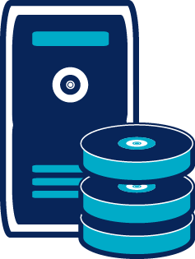




SGBD
Middleware de message
Queue
Applications
Console

Slide 2


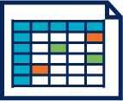
Applications
Applications
ESB
No SQL
Pull
Pull
Push
Queue
BAM
Console

Slide 3


Applications
Applications
Base
de donnée
Middleware de message
Console
Alertes
Agrégation
et alertes

Slide 4

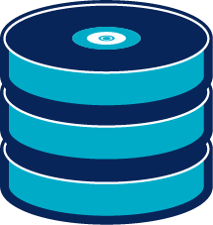
Cluster machine learning
Applications
Applications
Kafka
Topologie
Storm
Cluster Big DATA
(stockage)
Cluster NoSQL
(indexation)

