Slide 1






id=xxx
id=xxx
id=xxx
id=xxx
id=xxx
id=xxx
id=xxx

Slide 2




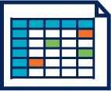


Applications
Applications
Base
de donnée
Middleware de message
Console
Alertes
Agrégation
et alertes

Slide 3


Cluster machine learning
Applications
Applications
Cluster Big DATA
(stockage)
Kafka
Topologie
Storm
Cluster NoSQL
(indexation)

