Slide 1
Showcase Vaccination
Govtech Hackathon 28 and 29 May 2026

Slide 2
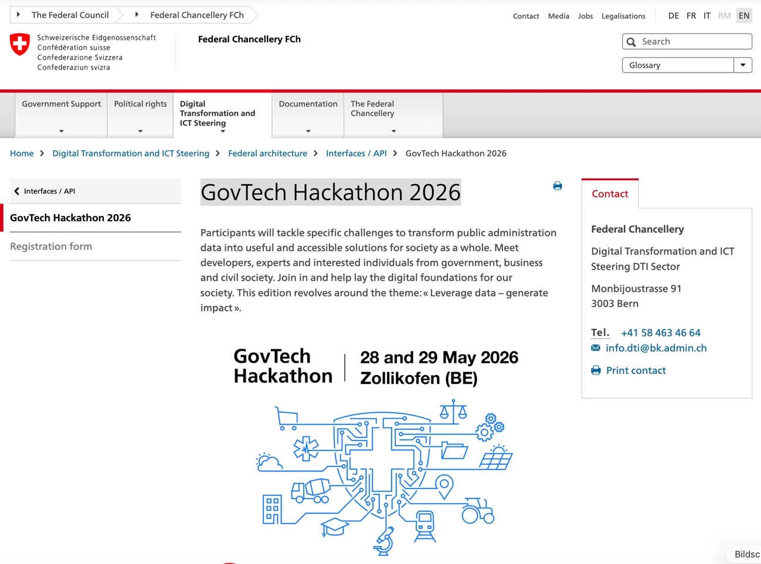

GovTech Hackathon 2026
https://govtech.digisus-lab.ch/event/2
https://www.bk.admin.ch/bk/en/home/digitale-transformation-ikt-lenkung/bundesarchitektur/api-architektur-bund/govtech-hackathon26.html

Slide 3
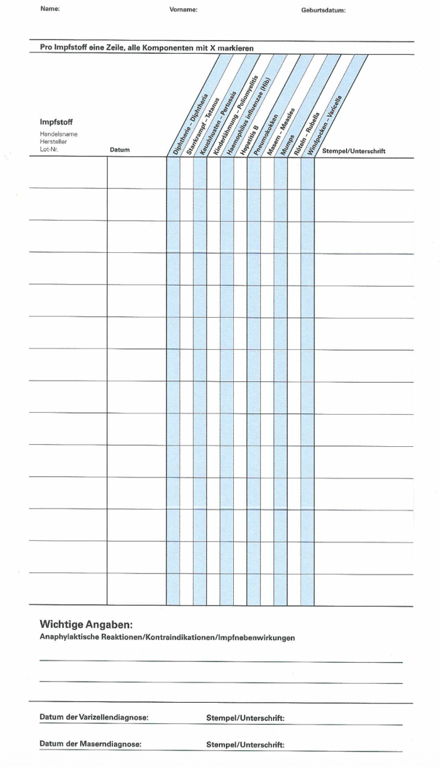
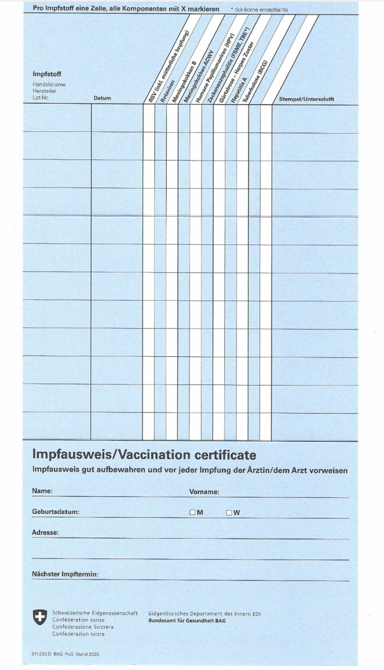
Showcase Vaccination Record
Digital Vaccination Record as a SaaS Solution
Demonstrating the interplay between openEHR and FHIR:
FHIR CH VACD for communication and data exchange
openEHR for long-term, lifelong and consistent storage of high-quality data
Clear and immediate value for all stakeholders, especially the public and healthcare professionals
Implementation on an open platform using open-source components

Slide 4


Showcase Vaccination Record – Big Picture
Data producer
Data Consumer
Documentation of an administered vaccination
View Vaccination Record
CH VACD Immunization
Administration Document
CH VACD Vaccination
Record
Platform and interoperability services
Person registry
Vaccination clinical data
Terminology service
tx.fhir.ch/r4

Slide 5
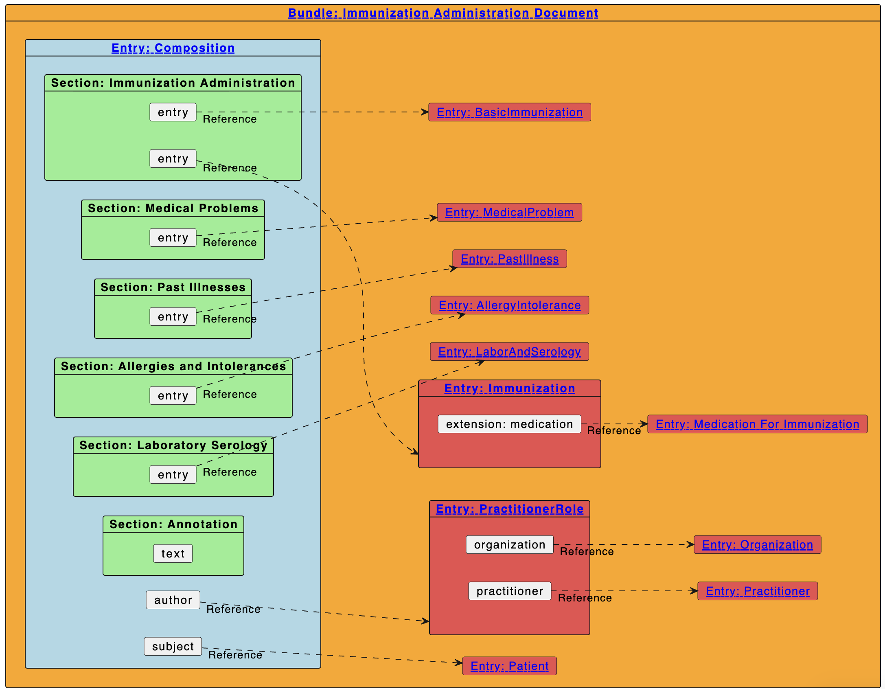
FHIR Implementation Guide – Immunization Administration Document
FHIR document Bundle representing the patient’s immunization status at a specific point in time, including administered immunizations and further relevant sections such as medical and exposure risks or serology results.
https://www.fhir.ch/ig/ch-vacd/immunization-administration-document.html

Slide 6
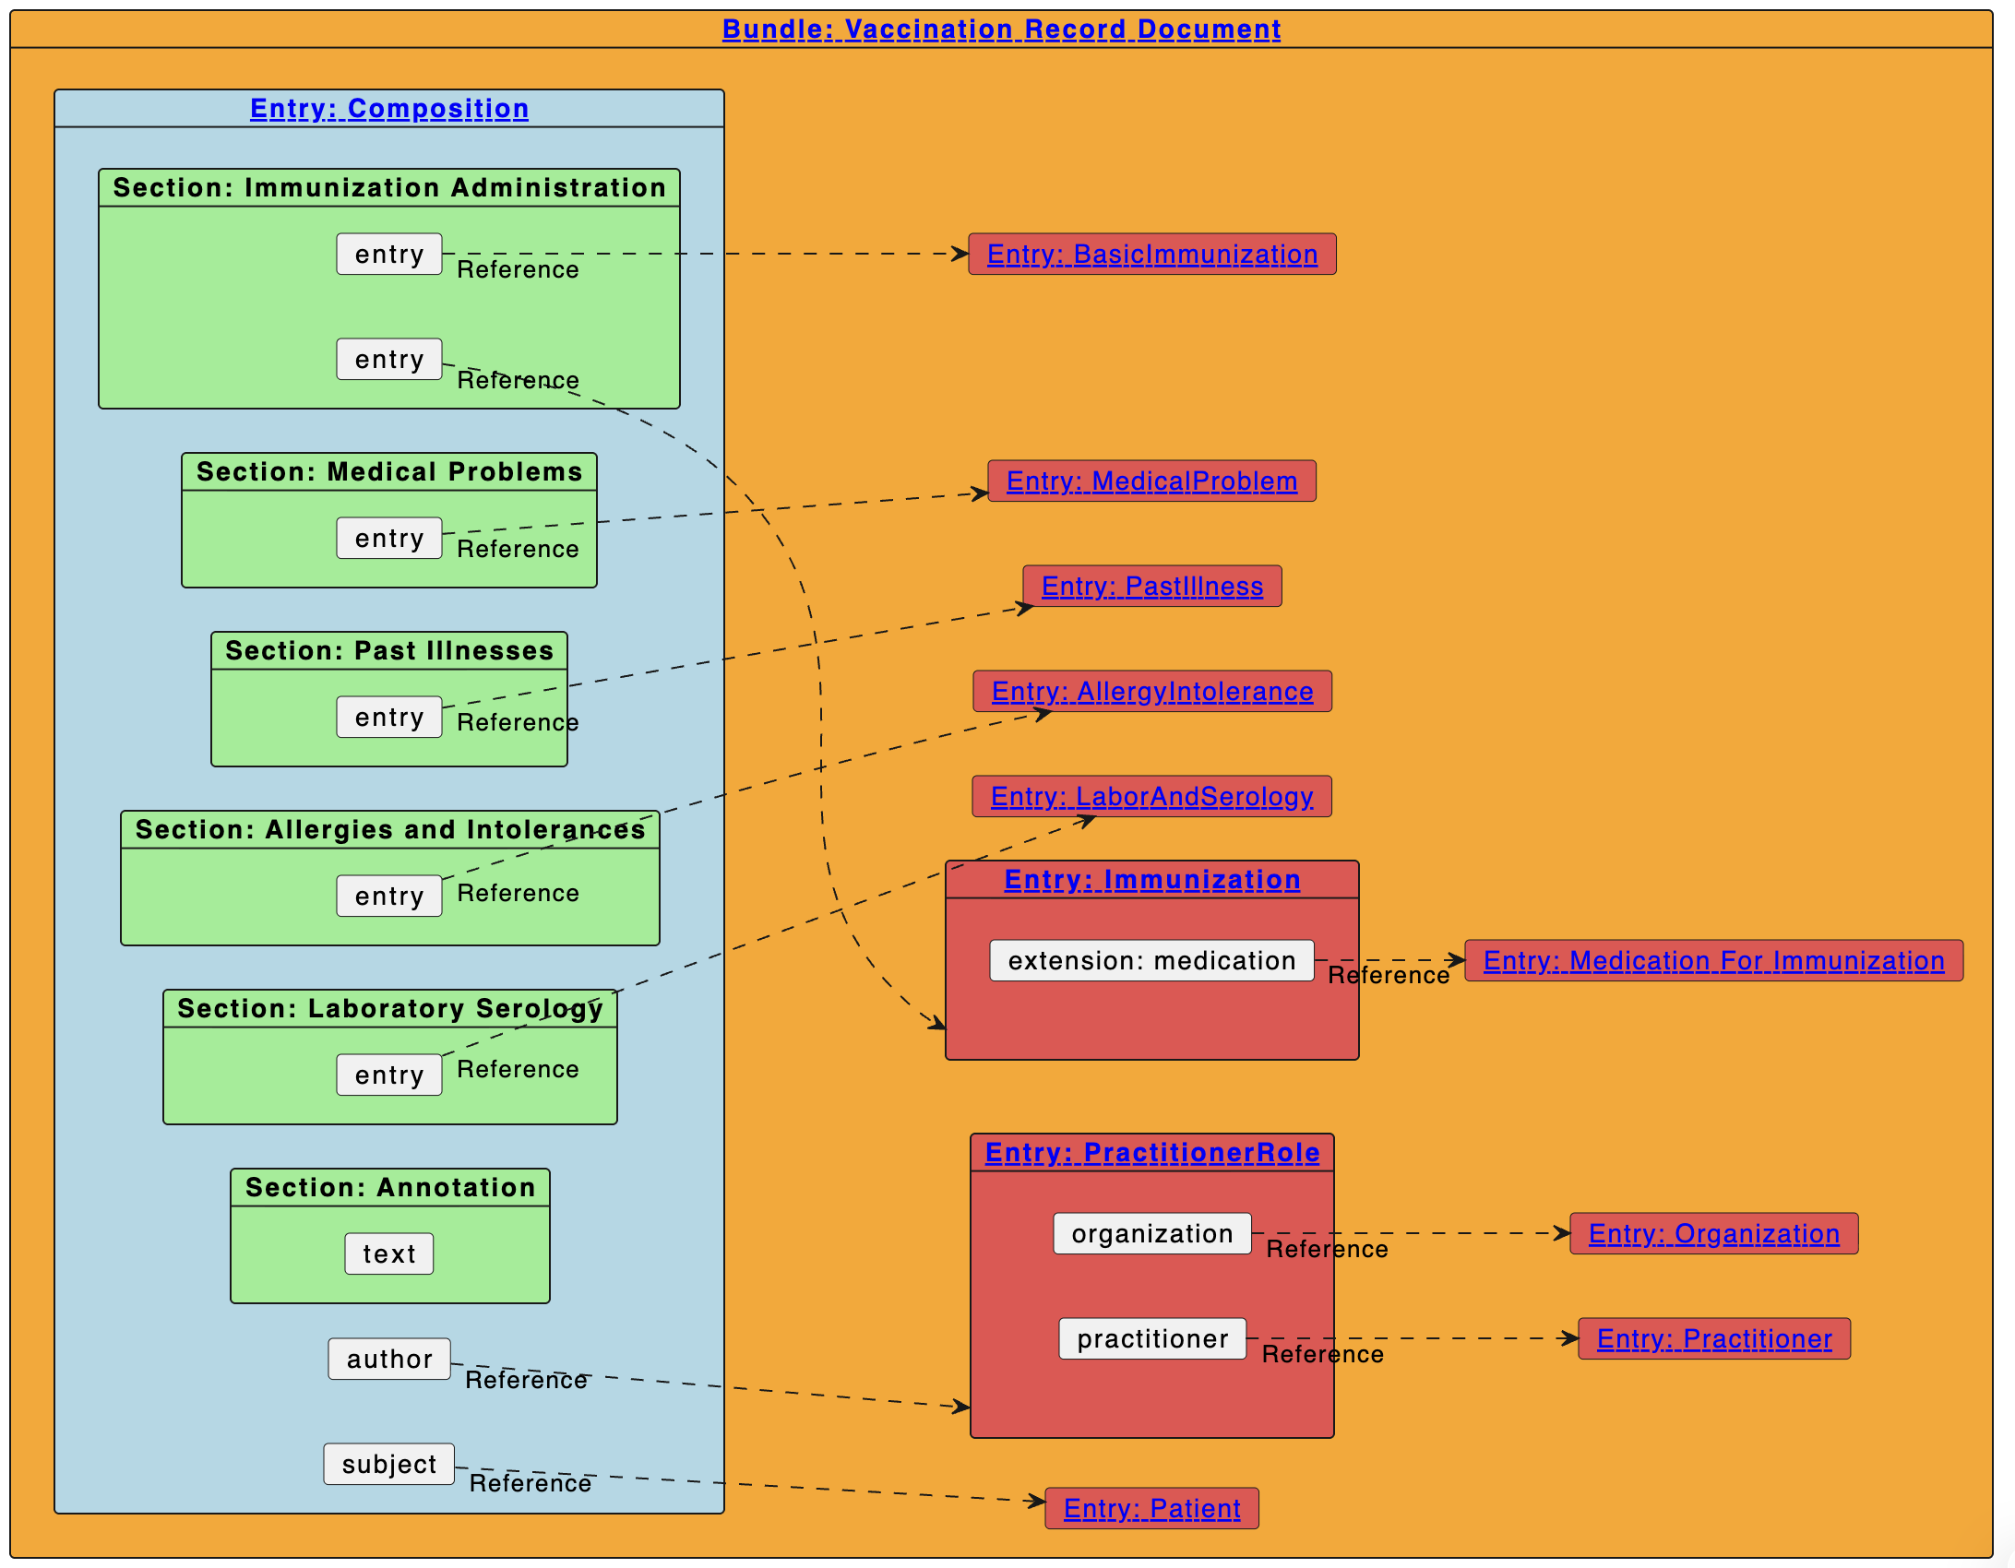
FHIR Implementation Guide – Vaccination Record Document
Describes the content and format of a vaccination record.
It brings together all available vaccination-related information and therefore represents the patient’s immunization status at a specific point in time.
The vaccination record contains entries from the vaccination documentation, i.e. information on administered immunizations and further relevant sections such as medical and exposure risks or serology results.
https://www.fhir.ch/ig/ch-vacd/vaccination-record-document.html

Slide 7
Modelling in openEHR
For vaccination administration events
openEHR-EHR-COMPOSITION.encounter.v1
openEHR-EHR-ACTION.medication.v1 (as used in IPS)
openEHR-EHR-CLUSTER.medication.v2
openEHR-EHR-CLUSTER.dosage.v2
openEHR-EHR-CLUSTER.adverse_reaction_event.v1
Local: openEHR-EHR-CLUSTER.ch_vacd_immunization_protocol.v0
Local: openEHR-EHR-CLUSTER.ch_vacd_source_information.v0
For vaccination record
COMPOSITION.vaccination_list.v0 (?)
openEHR-EHR-ACTION.medication.v1 (as used in IPS)
openEHR-EHR-CLUSTER.medication.v2
openEHR-EHR-CLUSTER.dosage.v2
openEHR-EHR-CLUSTER.adverse_reaction_event.v1
Local: openEHR-EHR-CLUSTER.ch_vacd_immunization_protocol.v0
Local: openEHR-EHR-CLUSTER.ch_vacd_source_information.v0
https://discourse.openehr.org/t/swiss-vaccination-record-in-openehr-best-practices-for-modeling/11756/17

Slide 8

Modelling the openEHR templates
Data producer
Data Consumer
Documentation of an administered vaccination
View Vaccination Record
CH VACD Immunization
Administration Document
CH VACD Vaccination
Record
openEHR
Template
Action Vaccination Managment
openEHR Template
Vaccination record

Slide 9
Modelling the openEHR Compositions Logic
Data producer
Data Consumer
Documentation of an administered vaccination
View Vaccination Record
CH VACD Immunization
Administration Document
CH VACD Vaccination
Record
Composition
1 Composition for every Immunization Administration Document
Source-of-truth
openEHR Composition
Evaluation Vaccination summary
Creating on request
Composition
Variante: on change
Composition

Slide 10
Immunization Administration Document FHIR-to-openEHR transformation flow
FHIR CH VACD
Patient
Demografic Data
Immunization
FHIR CH Core Patient
openEHR Composition
FHIR Server
Vaccination clinical data
Copy of FHIR Document in
Feeder_Audit

Slide 11
Immunization Administration Document openEHR-to-FHIR transformation flow
FHIR CH VACD
Patient
Demografic Data
Immunization
FHIR CH Core Patient
openEHR Composition
FHIR Server
Vaccination clinical data

Slide 12
Implementation
Combining the international standards HL7 FHIR and openEHR

Slide 13

Showcase Vaccination Record – Architecture – Facade
Data producer
Data Consumer
Documentation of an administered vaccination
View vaccination record
CH VACD Immunization
Administration Document
CH VACD Vaccination
Record
FHIR Facade / CH VACD API
Orchestration / Transformation Services
Terminology service
Person registry
Vaccination clinical data

Slide 14



Architecture for the showcase ?
Producer App
(Data Producer)
Consumer App
(Data cConsumer)
Reverse Proxy / API Gateway
HAPI FHIR Server (FHIR Facade)
FHIR REST API Endpoints
Vaccination Orchestration & Transformation Service
Plattform Business Logic-Layer
Terminology Server
(FHIRsmith)
openEHR Mapping Engine
FHIR-Connect
EHRBase
(openEHR REST API)
ProgreSQL
(HAPI DB)
ProgreSQL
(openFHIR State DB)
ProgreSQL
(EHRBase DB)

Slide 15


