Slide 1
Feature extraction of rotor fault based on EEMD and curve code
Átila Luna
Fabio Braga
HIML – DEM/PUC-Rio

Slide 2
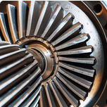
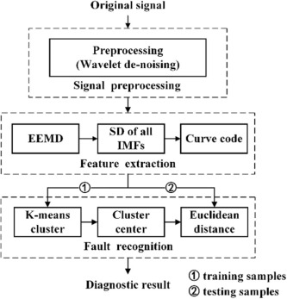
PROBLEM DESCRIPTION
Key Points
Feature extraction is an important step in fault diagnosis.
Time-domain and frequency-domain analysis methods have limitations.
EEMD is an adaptive processing technology that is suitable for complicated signals.
CC is a curve coding method that is used to represent the standard deviation of the IMFs obtained from EEMD.
The proposed method is shown to be effective in improving the stability of feature extraction and ensuring a high FDR.

Slide 3
LITTERATURE REVIEW
Recent progress on decoupling diagnosis of hybrid failures in gear transmission systems using vibration sensor signal: A review
https://www.sciencedirect.com/science/article/abs/pii/S026322411630104X
A novel method for rotor fault diagnosis based on deep transfer learning with simulated samples
https://www.sciencedirect.com/science/article/abs/pii/S0263224122015469
An improved NOFRFs-based fault feature extraction method and its application to quantitative diagnosis in rotor rub-impact
https://www.sciencedirect.com/science/article/abs/pii/S0022460X21004533

Slide 4
DATA VISUALISATION
Data Loading and Initial Visualization
Loading data from a .mat file
Segmenting the data into cases and defining labels (y for each case)
Plotting temporal signals for two cases (0 and 179) for each fault type (associated label)
Data Analysis using AutoReg and PCA
Employing AutoReg (autoregressive model) for each case data set (total of 180)
Transforming AutoReg results through Principal Component Analysis (PCA)
Calculating Variance ratios explained by principal components
Seeking the optimal number of retained components to represent at least 99.99% of variance
Visualization using Parallel Coordinates
Normalizing PCA-transformed data and adding labels
Utilising ‘pd.plotting.parallel_coordinates’ to visualize normalized data across multiple attributes based on fault labels

Slide 5
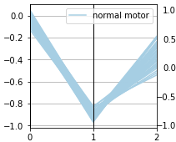
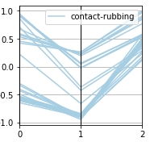
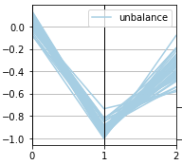
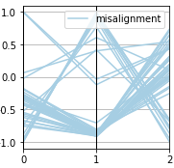
DATA VISUALISATION
CONTACT-RUBBING
UNBALANCING
MISALIGNEMENT
The project team is responsible for the successful execution of the project. Our team is composed of experienced professionals with the necessary skills and expertise to complete the project on time and budget
Our project budget is $100,000. This budget includes all expenses associated with the project, including salaries and equipment. We have allocated these resources to ensure that we are able to complete the project within budget
Our project requires a number of specialized pieces of equipment. We will be using [insert equipment and their functions]. All equipment is in good working condition and has been tested and calibrated prior to use

Slide 6
Testing Protocol
Data Preparation:
Split the dataset into training and testing sets (e.g., 80% training, 20% testing).
Perform any necessary preprocessing steps like normalization or scaling on the training data.
2. Evaluation:
a. Logistic Regression: - Train the logistic regression model on the training data. - Evaluate the model's performance on the test set. - Record the accuracy score.
b. Support Vector Machine (SVM): - Use the optimized SVM model with the best hyperparameters found. - Train the SVM model on the training data. - Evaluate the model's performance on the test set. - Record the accuracy score.
c. k-Nearest Neighbors (k-.00NN): - Use the optimized k-NN model with the best hyperparameters found. - Train the k-NN model on the training data. - Evaluate the model's performance on the test set. - Record the accuracy score.
d. Random Forest: - Use the optimized Random Forest model with the best hyperparameters found. - Train the Random Forest model on the training data. - Evaluate the model's performance on the test set. - Record the accuracy score.

Slide 7
3. Comparison and Analysis:
Compare the accuracy scores obtained from different models.
Identify the model with the highest accuracy on the test set as the best-performing model.
Analyze other metrics (if relevant) like precision, recall, or F1-score for further insights.
4. Further Steps (Optional):
Perform cross-validation or additional testing iterations to ensure stability and robustness of results.
Fine-tune hyperparameters further if necessary based on the performance results.
Generate visualizations (e.g., confusion matrices) to understand the models' behavior on different classes.

Slide 8
Measures and Analysis (Supervised Learning / Unsupervised Learning):
Supervised Learning:
Training a logistic regression model (softmax_reg1) on features (Xscaled).
Evaluation of the logistic regression model's accuracy using the accuracy function.
Supervised Learning (Models):
Use of models like SVM, k-NN with specific parameters (non-optimized) to train and predict labels (y).
Calculation of accuracy for each model using the accuracy function.
Hyperparameter Optimization:
Use of GridSearchCV or RandomizedSearchCV to search for the best hyperparameters for SVM, k-NN, decision trees.
Training models with the best-found hyperparameters and evaluation of their accuracy on a test set (X_test, y_test).
Unsupervised Analysis:
Although the code doesn't explicitly include unsupervised techniques, the use of PCA for dimensionality reduction could be considered a form of unsupervised analysis.

Slide 9
Conluding Remarks
The model performances vary considerably:
The k-NN model with 4 neighbors has the best performance with an accuracy of 85%. This indicates its strong ability to generalize and accurately predict fault labels.
However, the k-NN model with optimized hyperparameters shows a significant drop in accuracy, down to only 36.11%. This might suggest sensitivity to parameters or potential overfitting.
Other models like logistic regression and SVMs (both linear and with optimized hyperparameters) exhibit lower performances ranging from 50% to 60% accuracy.
The decision tree model with optimized hyperparameters displays the lowest performance, with only 30.56% accuracy.
The performance observation suggests that the non-optimized k-NN model with 4 neighbors performs the best in this specific context of fault classification. However, hyperparameter optimization for this model did not improve its performance, raising questions about the robustness of its results. Other models showed varying performances, generally inferior to the initial k-NN model. This highlights the significance of careful model and hyperparameter selection for achieving the best performance in this specific task of fault classification.

Slide 10
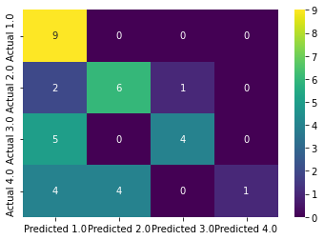
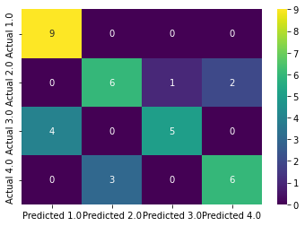
Confusion Matrice for SVM Model
Confusion Matrice for kNN Model

Slide 11
Future Work
Following this code, several paths could be explored for future work:
Model Optimization: Further exploration and optimization of model hyperparameters to enhance performance. Testing other machine learning algorithms or ensemble techniques for improved classification.
Feature Engineering: Delve deeper into temporal features for better data representation. Perhaps create new features or use advanced methods to extract richer information.
Cross-Validation: Employ more robust cross-validation methods to assess model generalization across different datasets.
Deeper Temporal Analysis: Explore other temporal analysis techniques to capture more complex relationships within the time series data.
Scientific Publication: The results and approach of this work could be presented in the form of a scientific article. It would be important to include a thorough discussion on methodology, results, their implications, and prospects for future research.

