Slide 1
JEWEL Model for Jet Quenching
Fabio de Moraes Canedo

Slide 2
The MC model of Jet Quenching
The model for Jet Quenching takes into account different types of phenomena:
Parton showers;
Elastic scattering with the medium;
LPM effect;

Slide 3
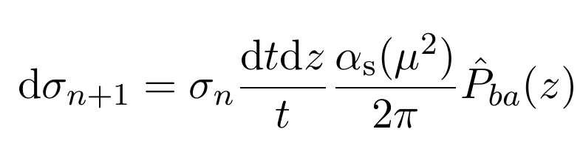
Parton showers
The parton showers is treated by making use of factorization in such a way that, given that the parton has gone through n branching processes, the differential cross-section of emitting an extra radiation is given by:

Slide 4
Parton showers
The scale at wich the coupling constant is evaluated is given by the virtuality of the parton t. The pole is avoided by inserting a infra-red cutoff t_{c}. This also set minimal and maximum values for z wich avoid the poles on the kernel P(z).

Slide 5
Parton showers
The angular ordering of emissions can be applied through the requirement that:
t₀>t₁>t₂>...>t_{c}

Slide 6
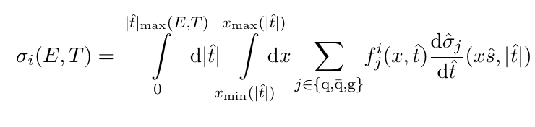
Elastic Scattering with The Medium
The medium on JEWEL is characterized as a collection of scattering centers with a Debye mass μ_{D}=3T, where T is the temperature of the medium. This identification yields a cross-section on the form:
The PDFs are calculated through integration of DGLAP equation.

Slide 7
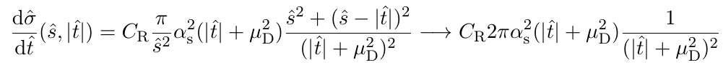
Elastic Scattering with the Medium
The differential part of the cross-section will be given by:
Thus, the medium is completely characterized by a density of scattering centers and its temperature profile. It is worth remarking that the inclusion of mass effects will only alter the virtuality calculations.

Slide 8
LPM effect
The LPM effect is the name of a destructive interference phenomena that happens when the gluon formation time on bremsstrahlung processes overlap with multiple scattering collisions.

Slide 9
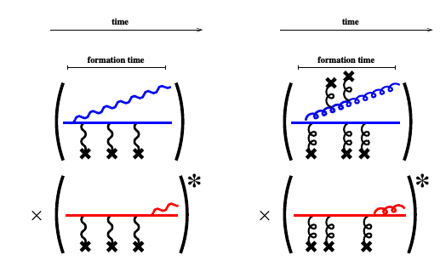
LPM effect
It can be pictorially viewed on the following Feynman diagrams:

Slide 10
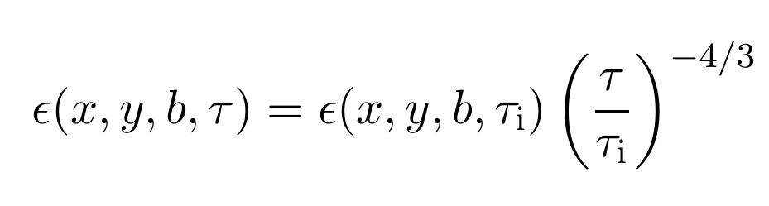
Medium Model
In the results that will be presented, the medium used for the parton propagation is built from a Glauber model initial conditions, alongside an ideal expansion, in such a way that the expansion is parametrically given by:

Slide 11
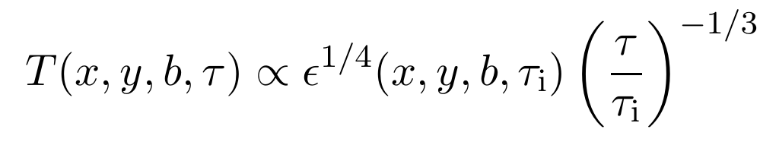
Medium model
The temperature profile, in turn, will be given by:

Slide 12
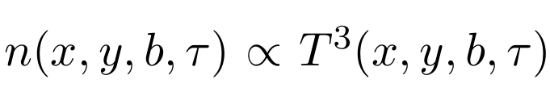
Medium model
The particle density, that gives the density of scattering centers, goes as:

Slide 13
JEWEL validation
On the absence of medium, the JEWEL reduces to PYTHIA, and the data is validated against data from LEP and p+p collisions at LHC.

Slide 14
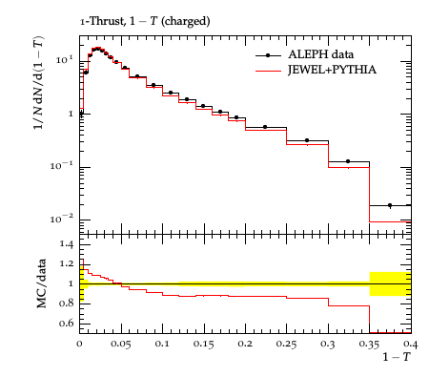
JEWEL validation

Slide 15
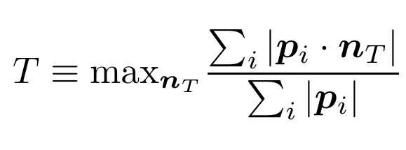
JEWEL validation
The variable thrust is defined as:
The value T=.5 is equivalent to a spherical distribution.

Slide 16
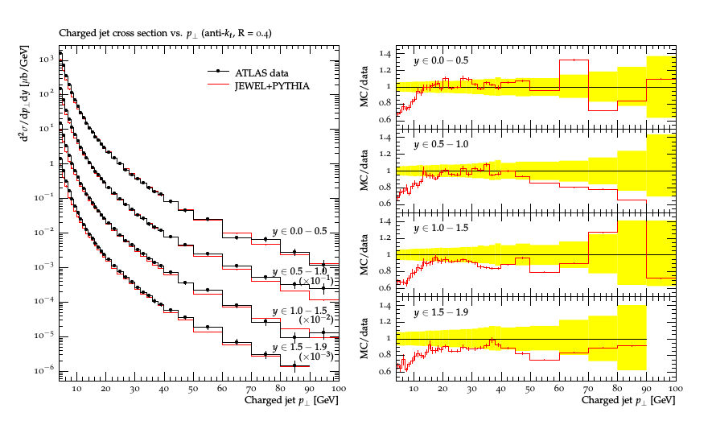
JEWEL validation

Slide 17
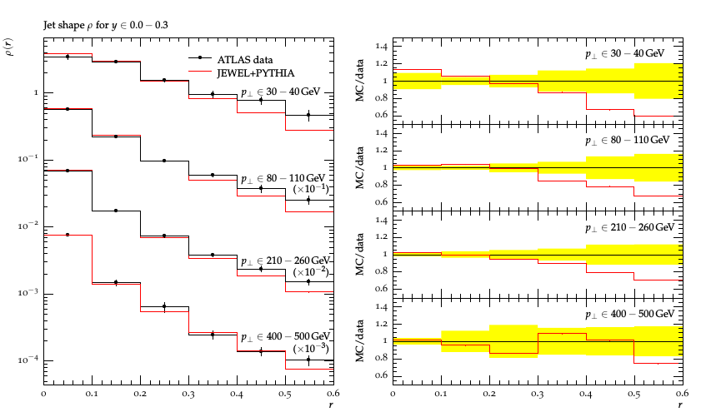
JEWEL validation

Slide 18
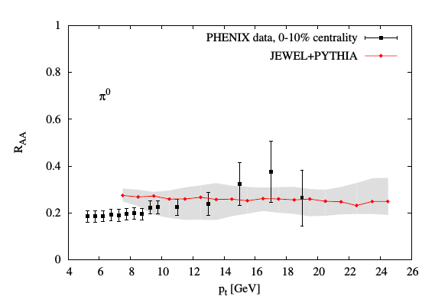
JEWEL validation
Here, the shaded region represents a variation of about 10% on the Debye mass, wich illustrates the sensitivity of data to temperature.

Slide 19
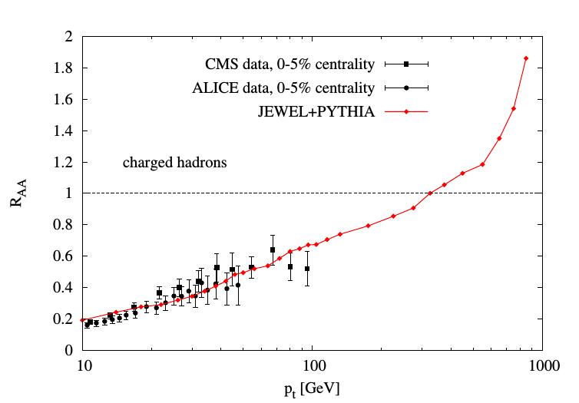
JEWEL validation

Slide 20
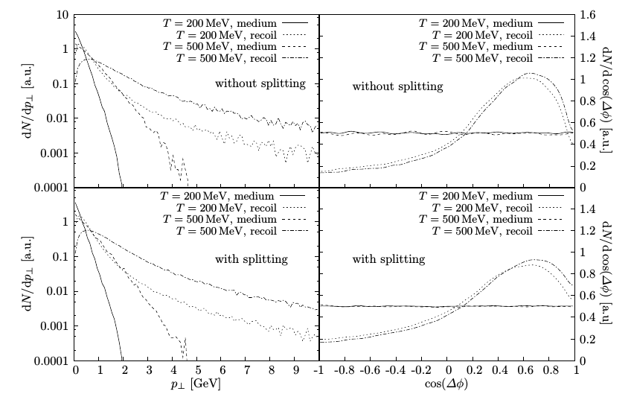
JEWEL response to medium

Slide 21
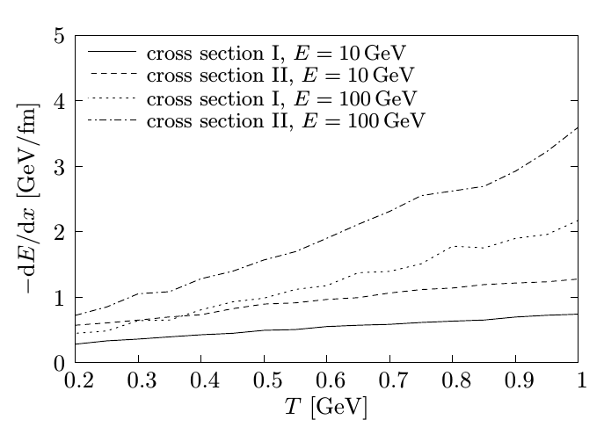
JEWEL response to medium
The energy loss temperature dependence on JEWEL:

Slide 22
Conclusion
Due to agreement with previous experimental data and high sensitive to temperature profiles, JEWEL provides a well suited model for testing more realistic hydrodynamic evolution and initial conditions models on future research.

Slide 23
Bibliography
Zapp, Korinna C., Frank Krauss, and Urs A. Wiedemann. “A Perturbative Framework for Jet Quenching.” Journal of High Energy Physics 2013, no. 3 (March 2013). https://doi.org/10.1007/JHEP03(2013)080.
Zapp, Korinna, Gunnar Ingelman, Johan Rathsman, Johanna Stachel, and Urs Achim Wiedemann. “A Monte Carlo Model for ‘Jet Quenching.’” The European Physical Journal C 60, no. 4 (April 2009): 617–32. https://doi.org/10.1140/epjc/s10052-009-0941-2.

