Slide 1

Online Learning Application Project Presentation
Gottschling Daniel - 11123625
Floris Fabio Marco - 10811227
Parenti Carolina – 10797066
Roberto Sonzini Gobbi - 10794845
Singh Karanbir - 10865124

Slide 2
Overview
Pricing problem with multiple products and inventory constraint
At each round t ∈ T:
The company chooses which types of product to sell and set price pi for each type of product
A buyer with a valuation for each type of product arrives
The buyer buys a unit of each product with price smaller than the product valuation

Slide 3
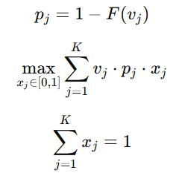

Requirement 1.1 Single product stochastic environment
with no inventory constraint
AGENT
UCB1 agent
BASELINE
Price chosen by solving the following linear programming:
PARAMETERS
Time horizon: T = 10000
Prices: pi ∈ [0,1]
VALUATION DISTRIBUTION
At each round the valuation is sampled from:

Slide 4
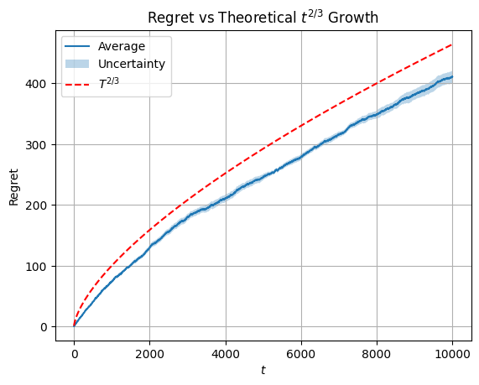
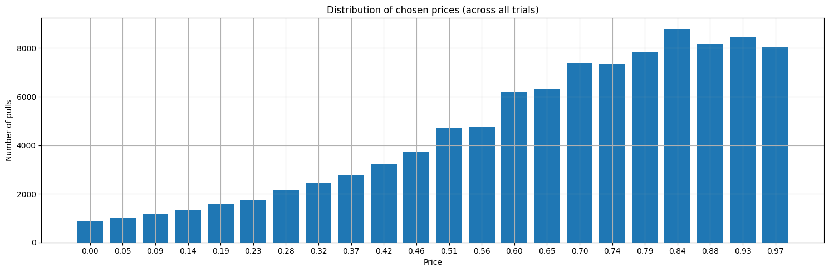
Requirement 1.1 Single product stochastic environment
with no inventory constraint

Slide 5

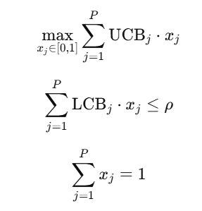
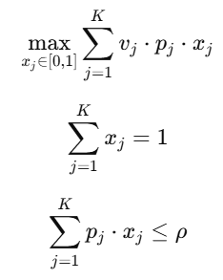
Requirement 1.2 Single product stochastic environment with inventory constraint
PARAMETERS
Time horizon: T = 10000
Prices: pi ∈ [0,1]
Budget: 45% T
VALUATION DISTRIBUTION
At each round the valuation is sampled from
AGENT
Pulls the arm that solve the following LP:
BASELINE
Price chosen by following the following LP:

Slide 6
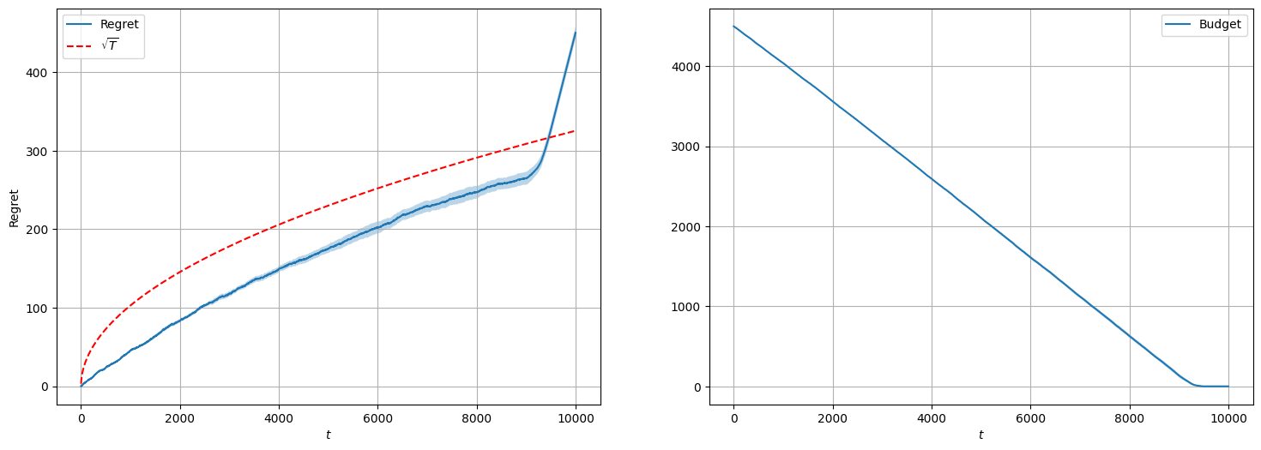
Requirement 1.2 Single product stochastic environment with inventory constraint

Slide 7
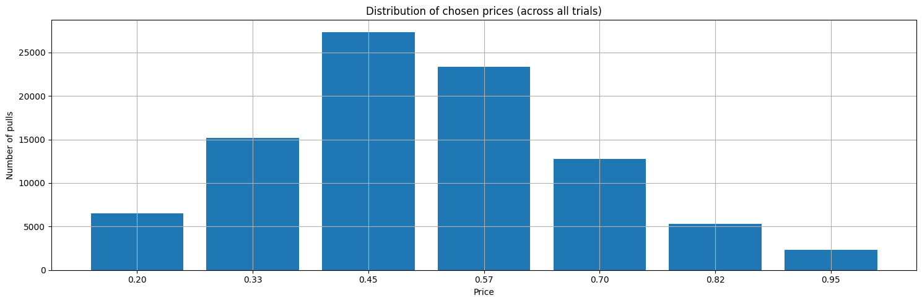
Requirement 1.2 Single product stochastic environment with inventory constraint
Distribution of chosen prices (across all trials)

Slide 8
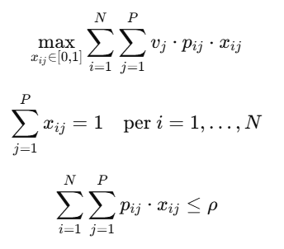



Requirement 2 Multiple product stochastic environment with inventory constraint
AGENT
Combinatorial- UCB
To extend the inventory constraint we modified the standard Combinatorial-UCB with UCB-like
PARAMETERS
Time horizon: T = 10000
Prices: pi ∈ [0,1]
Budget: 75% T
Number of products: N=3
BASELINE
Price chosen by solving the following LP
VALUATION DISTRIBUTION
At each round the valuation is sampled from

Slide 9
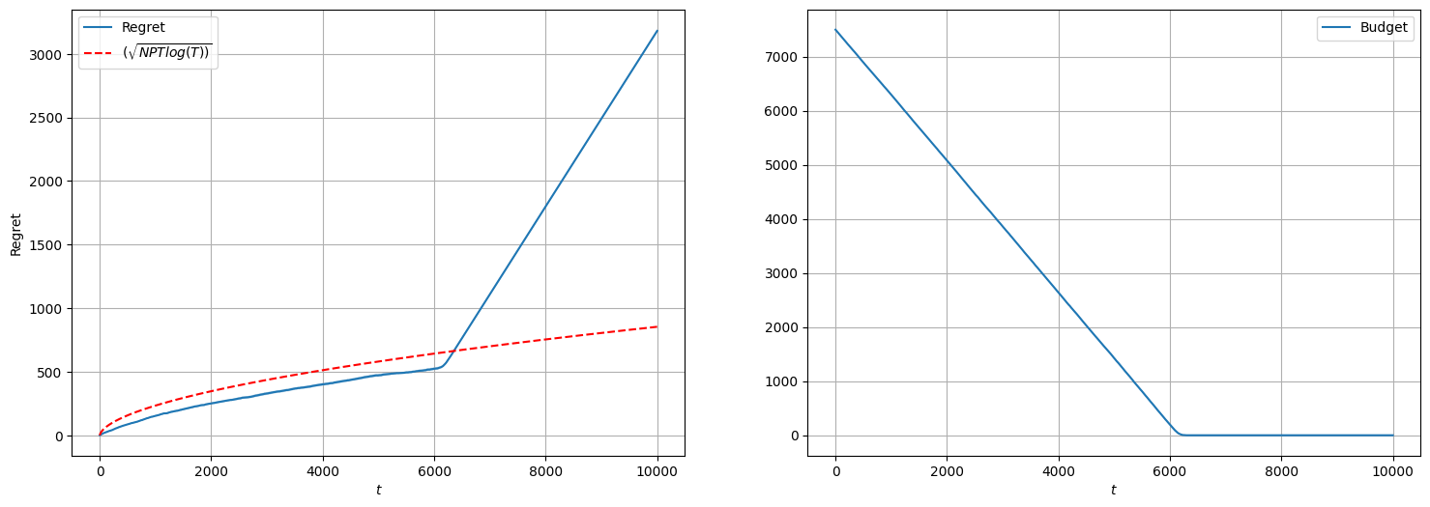
Requirement 2 Multiple product stochastic environment with inventory constraint

Slide 10
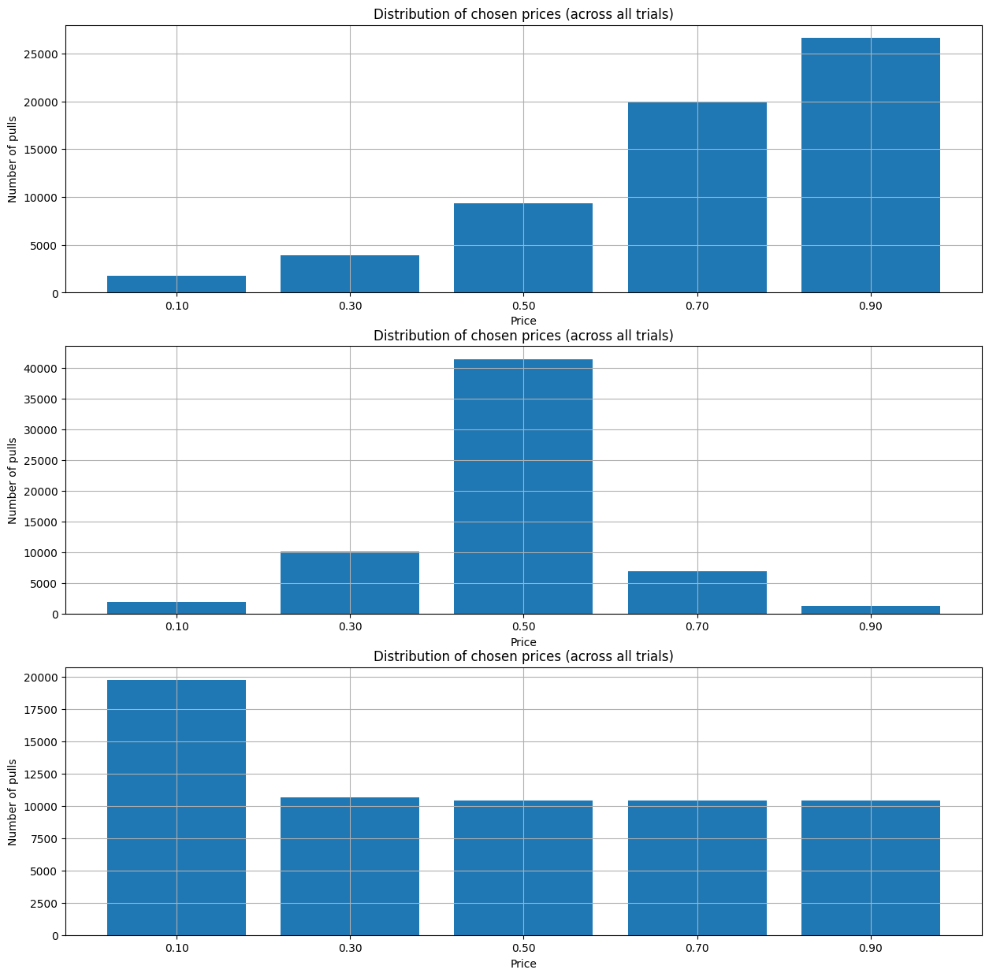
Requirement 2 Multiple product stochastic environment Inventory constraint

Slide 11
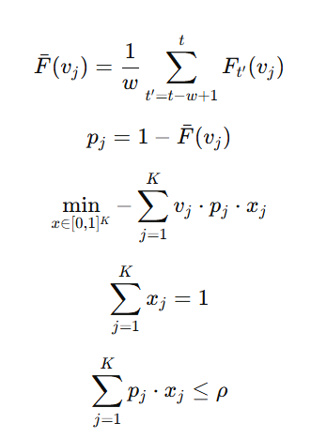
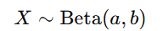
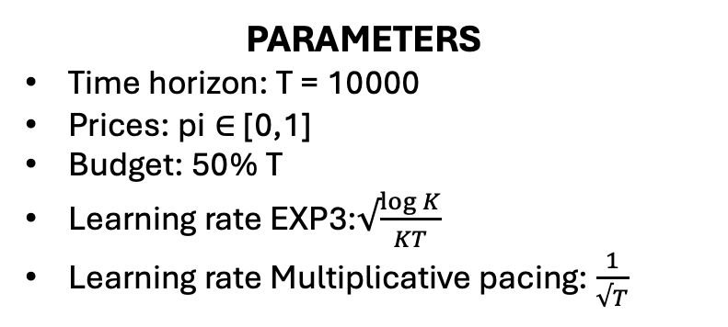
Requirement 3 Best-of-both-worlds algorithms with a single product with inventory constraint
AGENT
Multiplicative Pacing
EXP3 as regret minimizer
PARAMETERS
Time horizon: T = 10000
Prices: pi ∈ [0,1]
Budget: 50% T
Learning rate EXP3:$√\frac{\log{K}}{KT}$
Learning rate Multiplicative pacing: $\frac{1}{√T}$
BASELINE
Price chosen by solving the following LP
VALUATION DISTRIBUTION
At each round the valuation is sampled from
Adversarial
Stationary

Slide 12
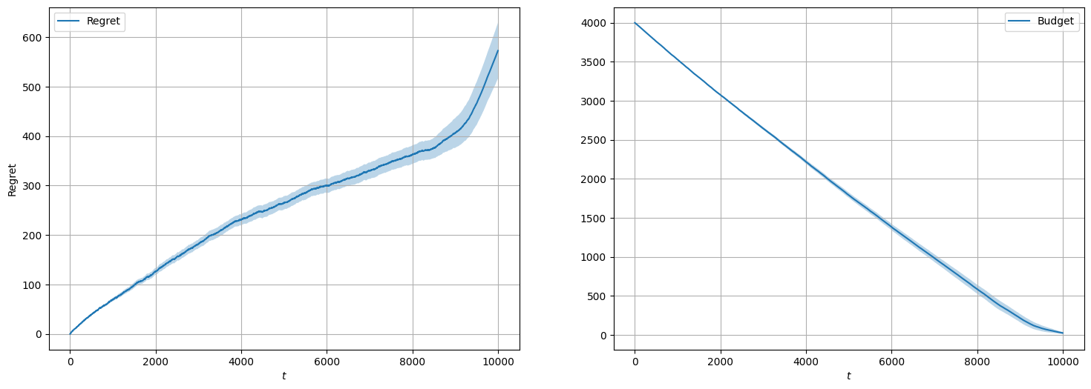
Requirement 3 Best-of-both-worlds algorithms with a single product with inventory constraint
ADVERSARIAL ENVIRONMENT

Slide 13
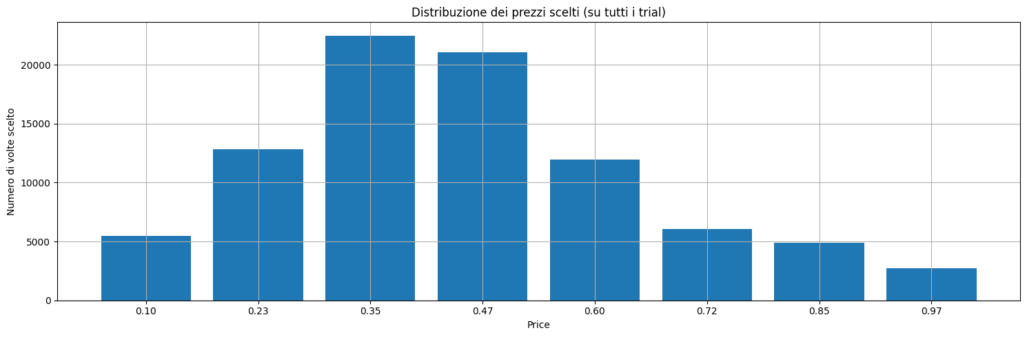
Requirement 3 Best-of-both-worlds algorithms with a single product with inventory constraint
ADVERSARIAL ENVIRONMENT
Distribution of chosen prices

Slide 14
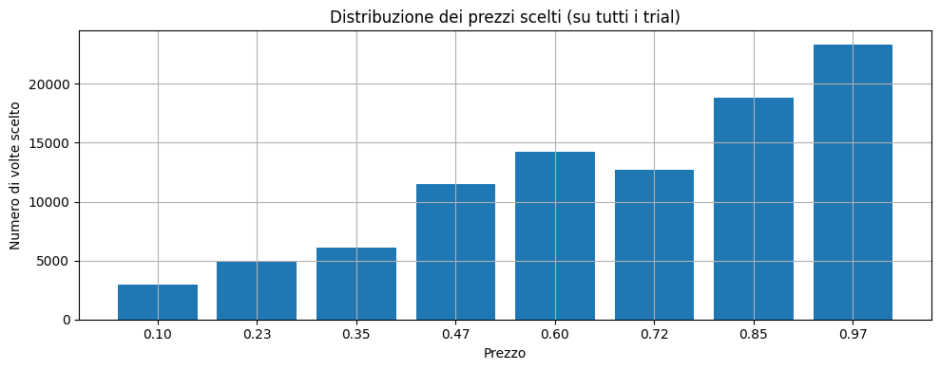
Requirement 3 Best-of-both-worlds algorithms with a single product with inventory constraint
STATIONARY ENVIRONMENT
Distribution of chosen prices

Slide 15
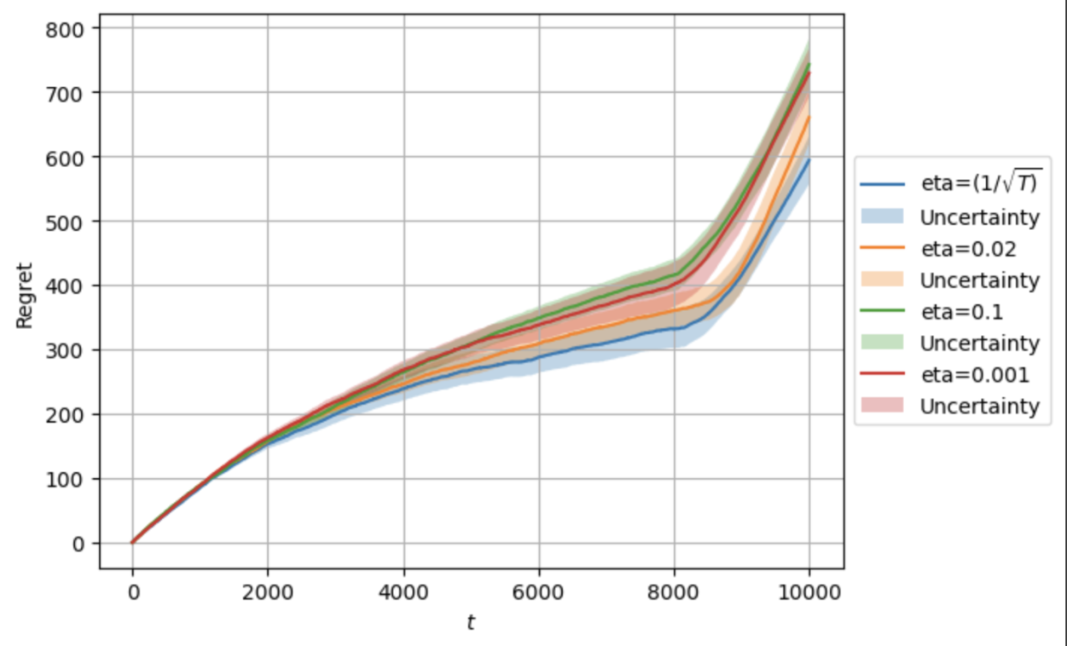
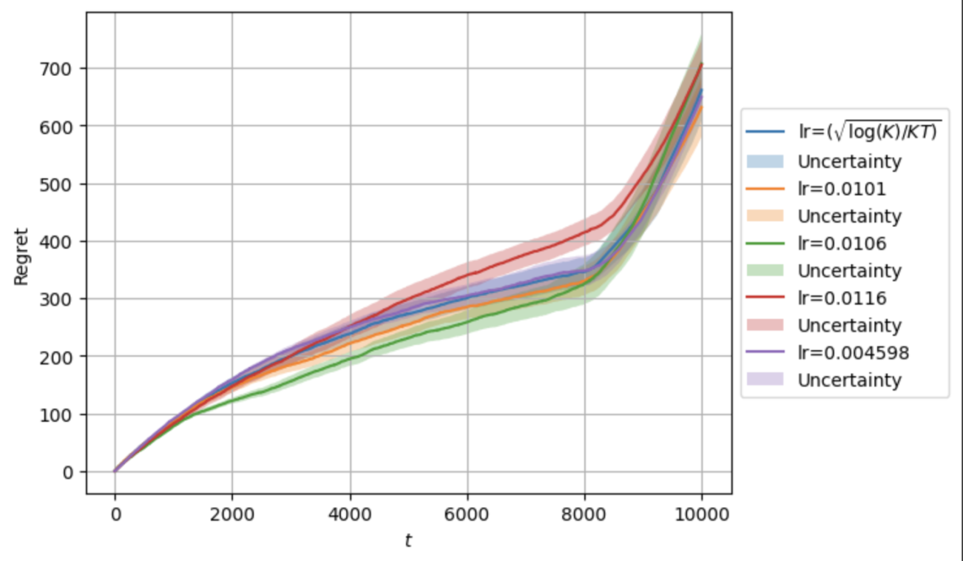
Requirement 3 Best-of-both-worlds algorithms with a single product with inventory constraint
Tests on EXP3 parameters

Slide 16
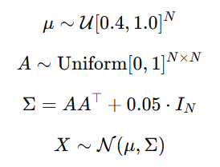
Requirement 4 Best-of-both-worlds with multiple products with inventory constraint
PARAMETERS
Time horizon: T = 10000
Prices: pi ∈ [0,1]
Budget: 75% T
Number of products: N=3
HIGHLY NON-STATIONARY ENVIRONMENT
A sequence of correlated valuations
for each type of product that changes quickly over time
At each round the valuation is sampled from (mean and covariance change at each round)
STATIONARY ENVIRONMENT
At each round the valuation is sampled from
(mean and covariance fixed for all the rounds):

Slide 17
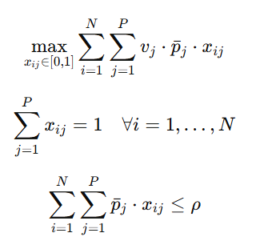
Requirement 4 Best-of-both-worlds with multiple products with inventory constraint
AGENT
Multiplicative pacing agent for multiple product
A different EXP3 agent for each product is used as a regret minimizer
BASELINE
At every round the chosen price is the one that maximises the following LP:

Slide 18
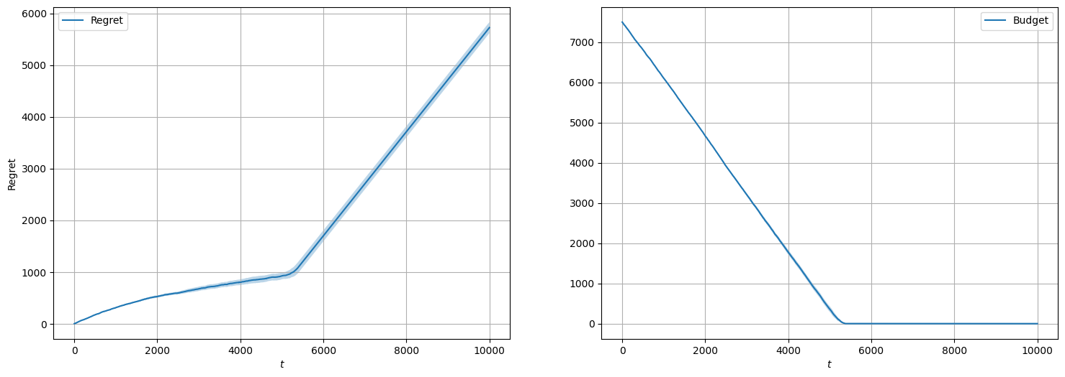
Requirement 4 Best-of-both-worlds with multiple products with inventory constraint
ADVERSARIAL ENVIRONMENT

Slide 19
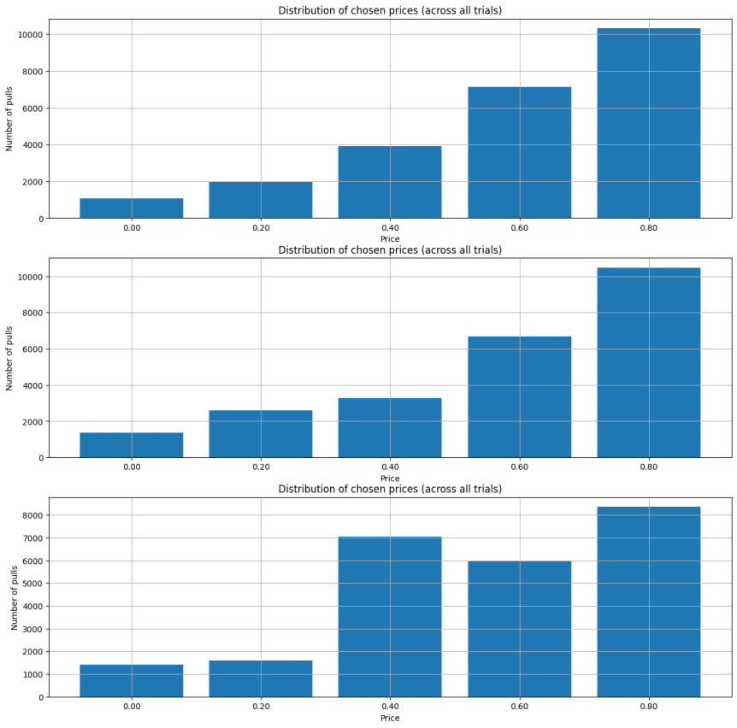
Requirement 4 Best-of-both-worlds with multiple products with inventory constraint
ADVERSARIAL ENVIRONMENT

Slide 20
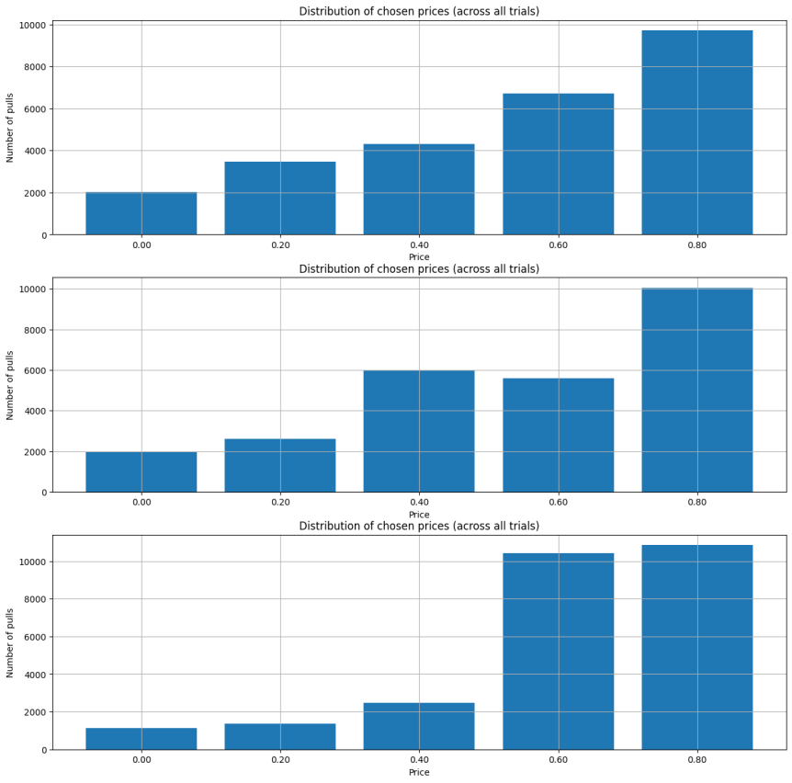
Requirement 4 Best-of-both-worlds with multiple products with inventory constraint
STATIONARY ENVIRONMENT

Slide 21
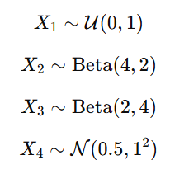
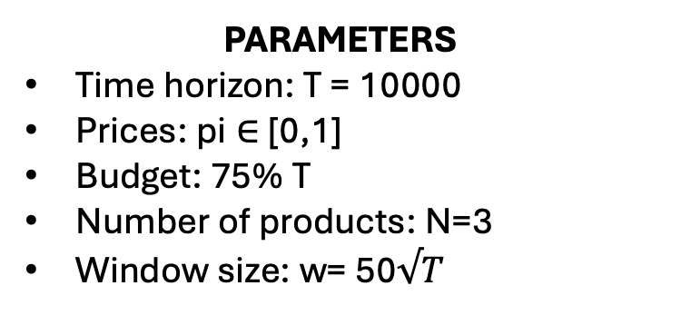
Requirement 5 Slightly non-stationary environments with multiple products and inventory constraint
SLIGTHLY NON-STATIONARY ENVIRONMENT
Rounds are partitioned in intervals of different sizes
In each interval the distribution of products valuations is chosen randomly between the following:
PARAMETERS
Time horizon: T = 10000
Prices: pi ∈ [0,1]
Budget: 75% T
Number of products: N=3
Window size: w= 50$√T$

Slide 22
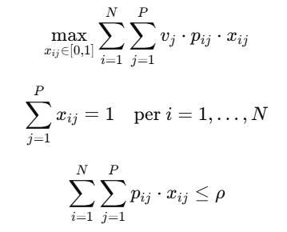
Requirement 5 Slightly non-stationary environments with multiple products and inventory constraint
AGENT
Combinatorial- UCB with sliding window
To extend the inventory constraint we modified the standard Combinatorial-UCB with UCB-like
BASELINE
For each interval chooses the price that maximises the following LP:

Slide 23
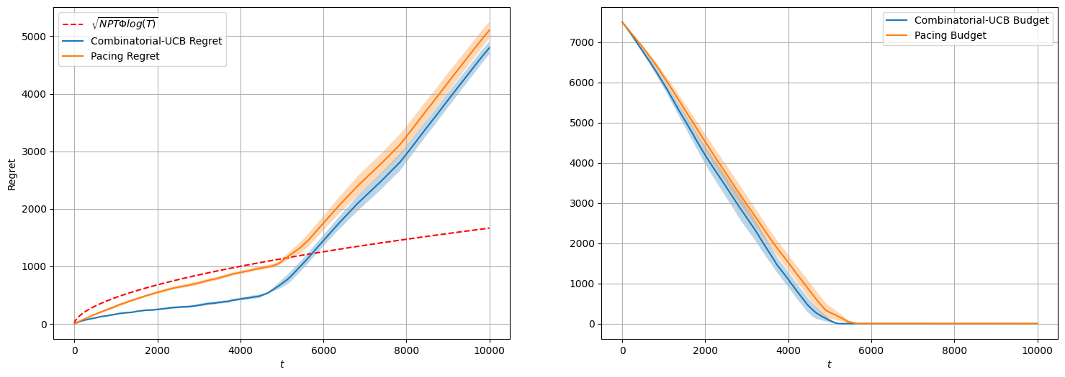
Comparison in slightly non-stationary environment

Slide 24
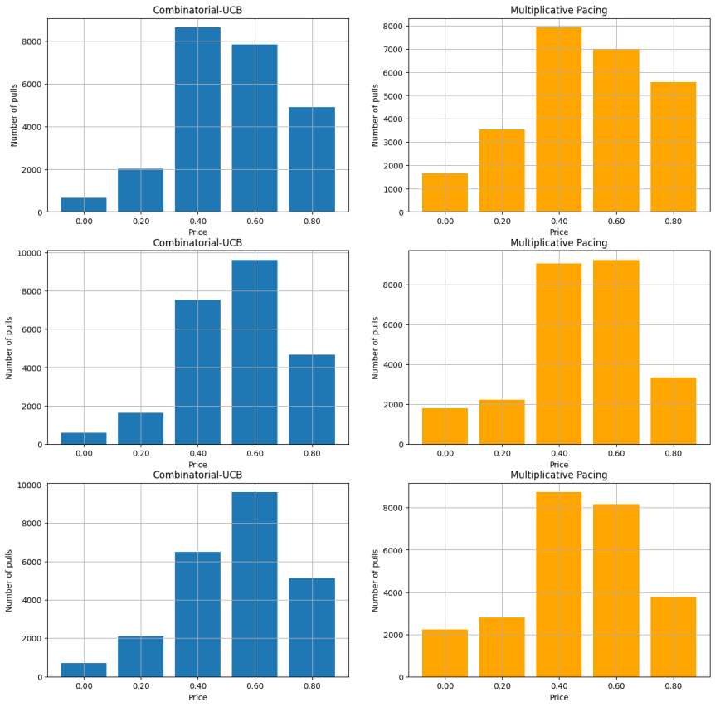
Requirement 5 Slightly non-stationary environments with multiple products and inventory constraint

