Slide 1
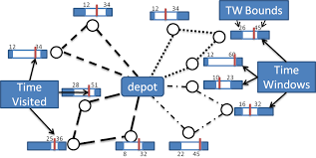
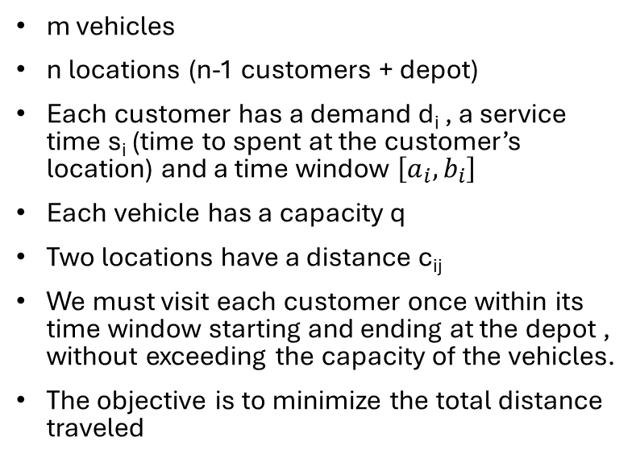
Capacited Vehicle Routing Problem with Time Windows
m vehicles
n locations (n-1 customers + depot)
Each customer has a demand d_{i} , a service time s_{i} (time to spent at the customer’s location) and a time window $\left[a_{i}, b_{i}\right]$
Each vehicle has a capacity q
Two locations have a distance c_{ij}
We must visit each customer once within its time window starting and ending at the depot , without exceeding the capacity of the vehicles.
The objective is to minimize the total distance traveled

Slide 2
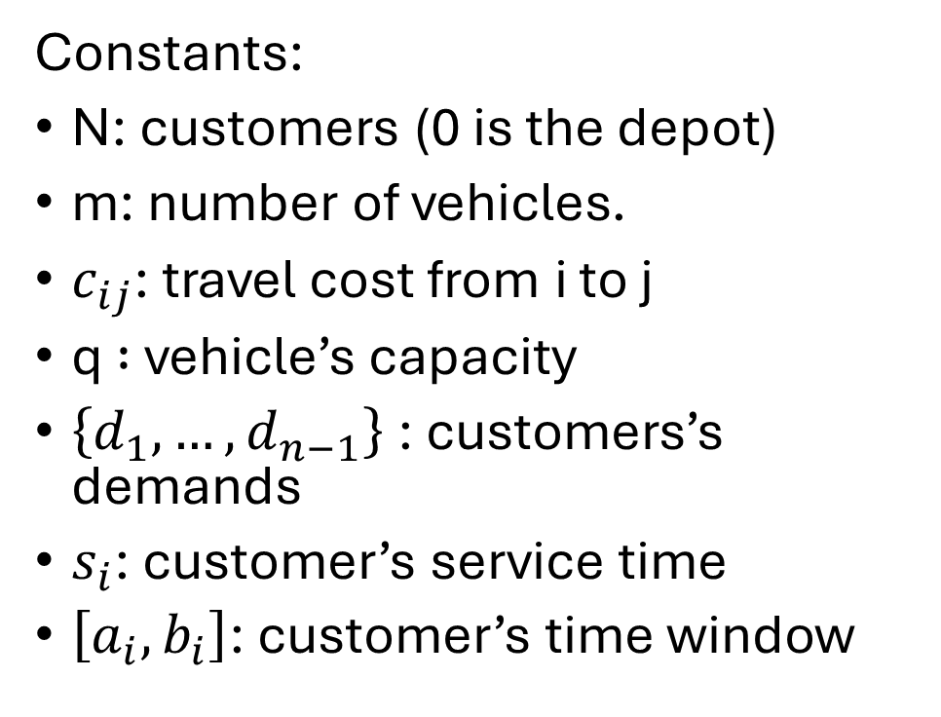
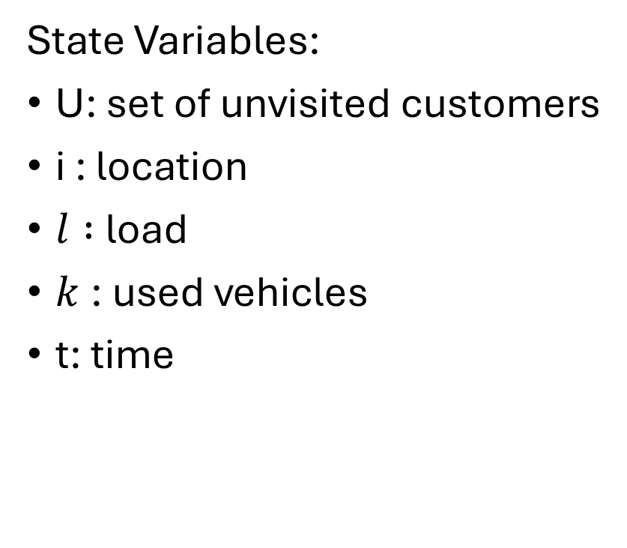
DIDP Formulation
State Variables:
U: set of unvisited customers
i : location
$l :$load
$k$: used vehicles
t: time
Constants:
N: customers (0 is the depot)
m: number of vehicles.
$c_{ij}$: travel cost from i to j
q $:$ vehicle’s capacity
$\left\{d_{1},…,d_{n−1}\right\}$: customers’s demands
$s_{i}$: customer’s service time
$\left[a_{i}, b_{i}\right]$: customer’s time window

Slide 3

DIDP Formulation
$$compute V(N \backslash \left\{0\right\}, 0, 0, 1, 0)$$
$$V\left(U,i,l,k,t\right)=\left\{\begin{aligned}\begin{aligned}min\left\{\begin{aligned}\min_{j∈U;l +d_{j}≤q;t+c_{ij}≤b_{j} }\left(c_{ij}+V\left(U\backslash \left\{j\right\},j,l+d_{j},k,s_{j}+max\left(t+c_{ij},a_{j}\right)\right)\right) \\ \min_{ j∈U}\left(c_{i0}+c_{0j}+V\left(U\backslash \left\{j\right\},j,d_{j},k+1,s_{j}+max\left(c_{0j},a_{j}\right)\right)\right)\end{aligned}\right. if U≠∅, k<m \\ \\ \min_{j∈U;l +d_{j}≤q;t+c_{ij}≤b_{j} }\left(c_{ij}+V\left(U\backslash \left\{j\right\},j,l+d_{j},k,s_{j}+max\left(t+c_{ij},a_{j}\right)\right)\right) if U≠∅, k=m \\ \\ c_{i0}+V\left(U,0, k, l,t\right) if U=∅, i≠0 \\ \\ 0 if U =∅,i=0\end{aligned} \\ \end{aligned}\right.$$

Slide 4
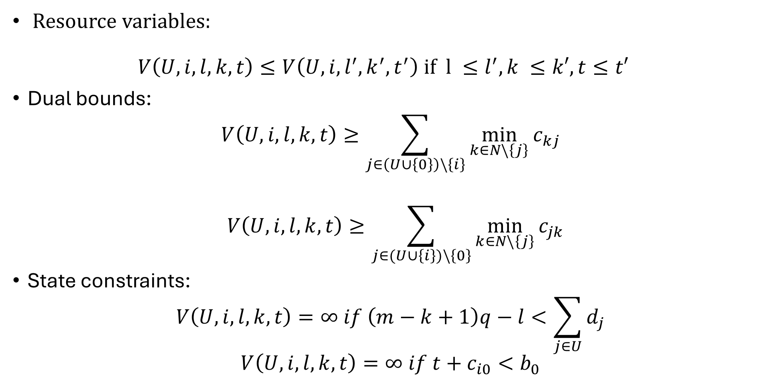
DIDP Formultation
Resource variables: $V\left(U,i,l,k,t\right)≤V\left(U,i,l^{′},k^{′},t^{′}\right) if l ≤l^{′}, k ≤k′, t≤t′$
Dual bounds:
$$V\left(U,i,l,k,t\right)≥\sum_{j∈\left(U∪\left\{0\right\}\right)\backslash \left\{i\right\}}{\min_{k∈N\backslash \left\{j\right\}}{c_{kj}}}$$
$$V\left(U,i,l,k,t\right)≥\sum_{j∈(U∪\left\{i\right\})\backslash \left\{0\right\}}{\min_{k∈N\backslash \left\{j\right\}}{c_{jk}}}$$
State constraints:
$$V\left(U,i,l,k,t\right)=∞ if \left(m−k+1\right)q−l<\sum_{j∈U}{d_{j}}$$
$$V\left(U,i,l,k,t\right)=∞ if t+c_{i0}<b_{0}$$

Slide 5
Testing the models
Four different DIDP models: complete; without dual bounds; without resource variables; without dual bounds and resource variables.
Each model has been run on the Solomon’s benchmark instances with LNBS solver with a time limit of 10 minutes on an ASUS Zenbook UX431FN, Intel(R) Core(TM)i7-8565U CPU @ 1.80GHz, 8,00 GB RAM.
The primal integral has been computed to compare the performances with a CP model defined on Minizinc, using LNS and Gecode as solver.

Slide 6
Solomon’s benchmark instances
Composed by six sets of instances highlighting several factors that affect the behavior of routing and scheduling algorithms:
C1 & C2: clustered geographical data
R1 & 2: random-generated geographical data
CR1 & CR2: mixture of clustered and random data
The coordinates are the same within sets of problems of one type (C, R, RC), but C1, R1 and RC1 have a shorter scheduling horizon, allowing only a few customers for route.

