Slide 1
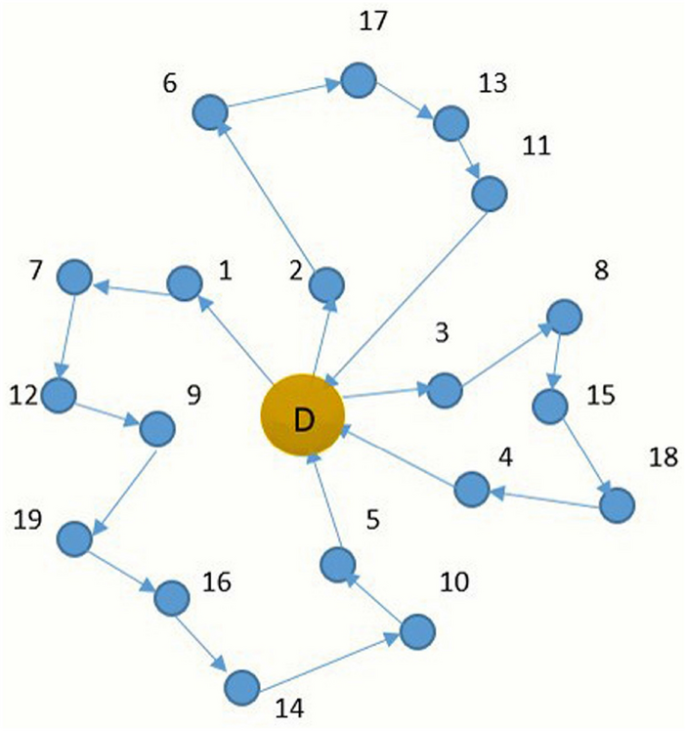
Min-Max Capacited Vehicle Routing Problem
m vehicles
n locations (n-1 customers + depot)
Each customer has a demand d_{i}
Each vehicle has a capacity q_{z}
Two locations have a distance c_{ij}
We must visit each customer once starting and ending at the depot, without exceeding each vehicle’s capacity.
The objective is to minimize the maximum distance traveled by a single vehicle.

Slide 2
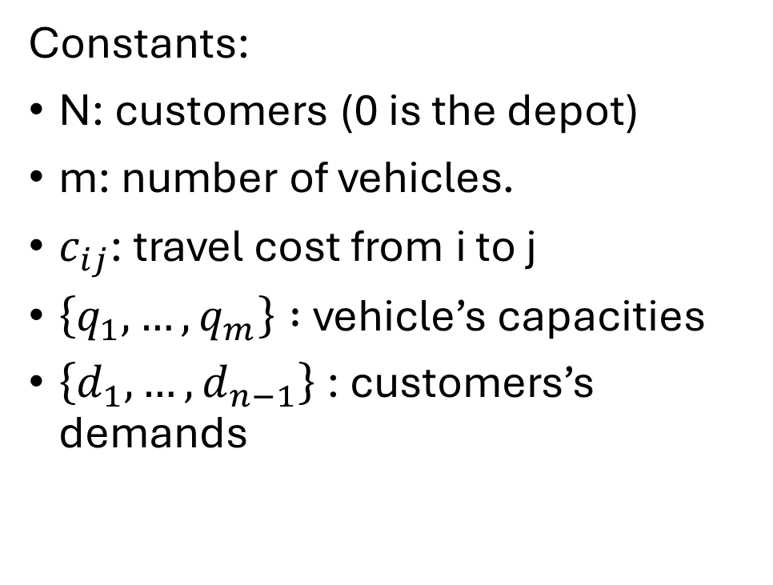
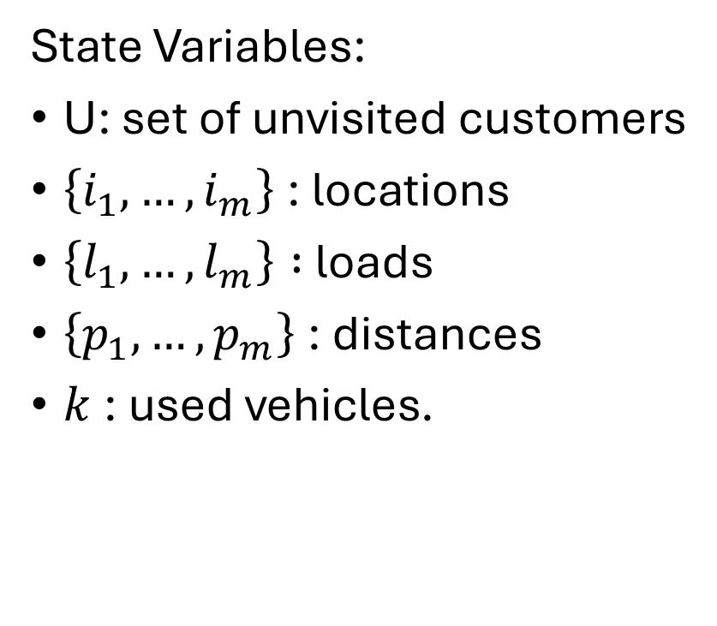
DIDP Formulation
State Variables:
U: set of unvisited customers
$\left\{i_{1},…,i_{m}\right\}$: locations
$\left\{l_{1},…,l_{m}\right\} :$loads
$\left\{p_{1},…,p_{m}\right\}$: distances
$k$: used vehicles.
Constants:
N: customers (0 is the depot)
m: number of vehicles.
$c_{ij}$: travel cost from i to j
$\left\{q_{1},…,q_{m}\right\} :$ vehicle’s capacities
$\left\{d_{1},…,d_{n−1}\right\}$: customers’s demands

Slide 3

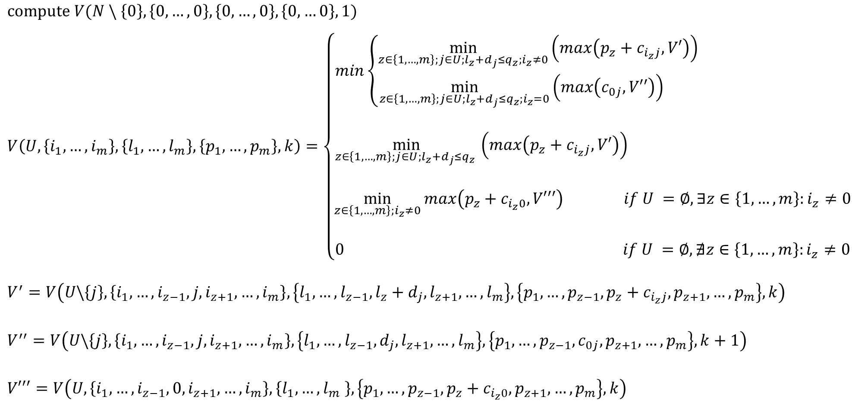

DIDP Formulation
$$compute V(N \backslash \left\{0\right\}, \left\{0,…,0\right\}, \left\{0, …,0\right\}, \left\{0,…0\right\}, 1)$$
$$V\left(U,\left\{i_{1},…,i_{m}\right\},\left\{l_{1},…,l_{m}\right\},\left\{p_{1},…,p_{m}\right\},k\right)=\left\{\begin{aligned}min\left\{\begin{aligned}\min_{z∈\left\{1,…,m\right\};j∈U;l_{z}+d_{j}≤q_{z};i_{z}≠0}\left(max\left(p_{z}+c_{i_{z}j}, V′\right)\right) \\ \min_{z∈\left\{1,…,m\right\};j∈U;l_{z}+d_{j}≤q_{z};i_{z}=0}\left(max\left(c_{0j}, V′′\right)\right) \end{aligned} \right. \\ \\ \min_{z∈\left\{1,…,m\right\};j∈U;l_{z}+d_{j}≤q_{z} }\left(max\left(p_{z}+c_{i_{z}j}, V′\right)\right) \\ \\ \min_{z∈\left\{1,…,m\right\};i_{z}≠0}{max\left(p_{z}+c_{i_{z}0}, V′′′\right) if U =∅,∃z∈\left\{1,…,m\right\}:i_{z}≠0} \\ \\ 0 if U =∅,∄z∈\left\{1,…,m\right\}:i_{z}≠0\end{aligned}\right.$$
$$V^{′}=V\left(U\backslash \left\{j\right\},\left\{i_{1},…,i_{z−1},j,i_{z+1},…,i_{m}\right\},\left\{l_{1},…,l_{z−1},l_{z}+d_{j},l_{z+1},…,l_{m}\right\},\left\{p_{1},…,p_{z−1},p_{z}+c_{i_{z}j},p_{z+1},…,p_{m}\right\},k\right)$$
$$V^{′′}=V\left(U\backslash \left\{j\right\},\left\{i_{1},…,i_{z−1},j,i_{z+1},…,i_{m}\right\},\left\{l_{1},…,l_{z−1}, d_{j},l_{z+1},…,l_{m}\right\},\left\{p_{1},…,p_{z−1}, c_{0j},p_{z+1},…,p_{m}\right\},k+1\right)$$
$$V′′′=V\left(U,\left\{i_{1},…,i_{z−1},0,i_{z+1},…,i_{m}\right\},\left\{l_{1},…,l_{m} \right\},\left\{p_{1},…,p_{z−1},p_{z}+c_{i_{z}0},p_{z+1},…,p_{m}\right\},k\right)$$
$$if U≠∅, k<m$$
$$if U≠∅,k=m$$

Slide 4
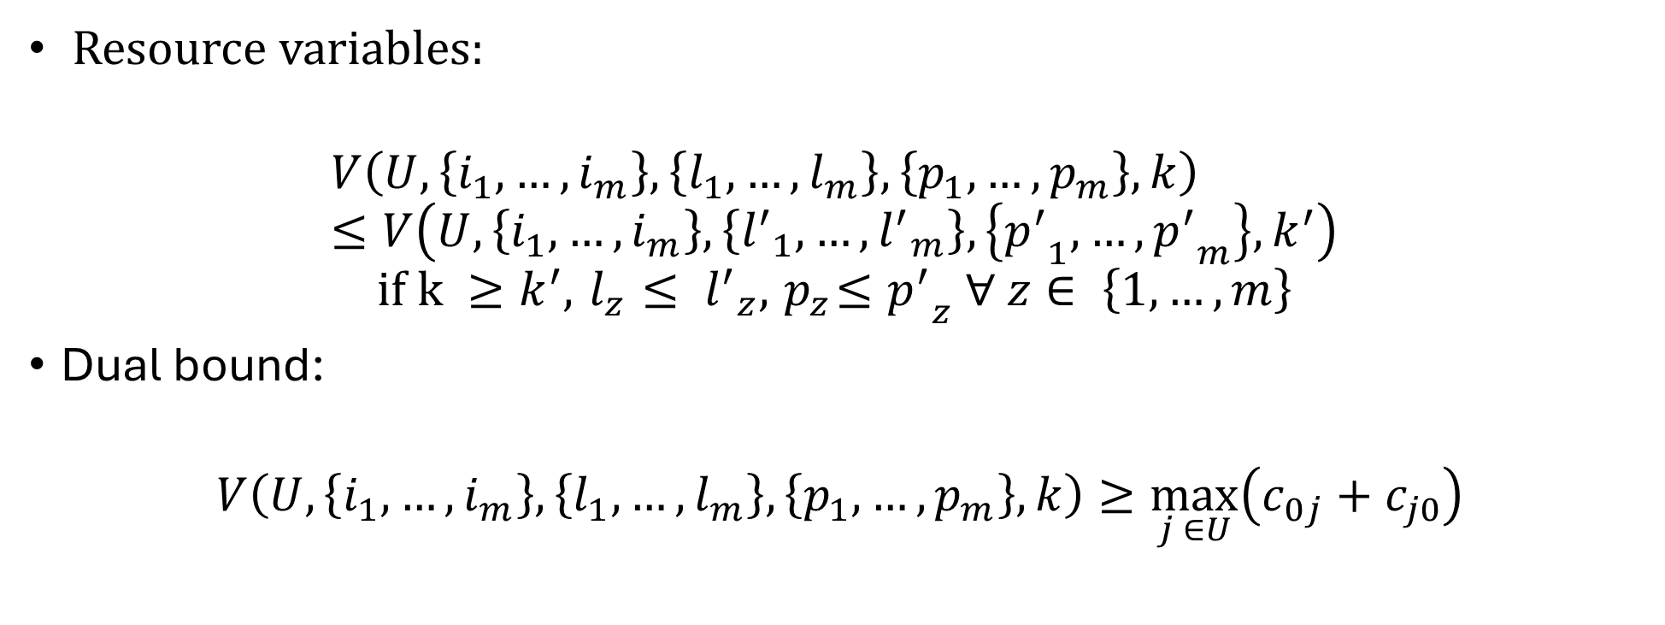
DIDP Formultation
Resource variables:
$$V\left(U,\left\{i_{1},…,i_{m}\right\},\left\{l_{1},…,l_{m}\right\},\left\{p_{1},…,p_{m}\right\},k\right)≤V\left(U,\left\{i_{1},…,i_{m}\right\},\left\{{l^{′}}_{1},…,{l^{′}}_{m}\right\},\left\{{p^{′}}_{1},…,{p^{′}}_{m}\right\},k^{′}\right)$$
$$if k ≥k^{′}, { l}_{z} ≤ {l^{′}}_{z}, { p}_{z}≤{p^{′}}_{z} ∀ z∈ \left\{1,…,m\right\}$$
Dual bound:
$$V\left(U,\left\{i_{1},…,i_{m}\right\},\left\{l_{1},…,l_{m}\right\},\left\{p_{1},…,p_{m}\right\},k\right)≥\max_{j ∈U}\left(c_{0j}+c_{j0}\right)$$

Slide 5
Testing the models
Two different models: bound vs no bound.
Each model has been run on 21 instances with LNBS solver and with a time limit of 5 minutes on an ASUS Zenbook UX431FN, Intel(R) Core(TM)i7-8565U CPU @ 1.80GHz, 8,00 GB RAM.
Two metrics computed: coverage and mean primal gap.

Slide 6
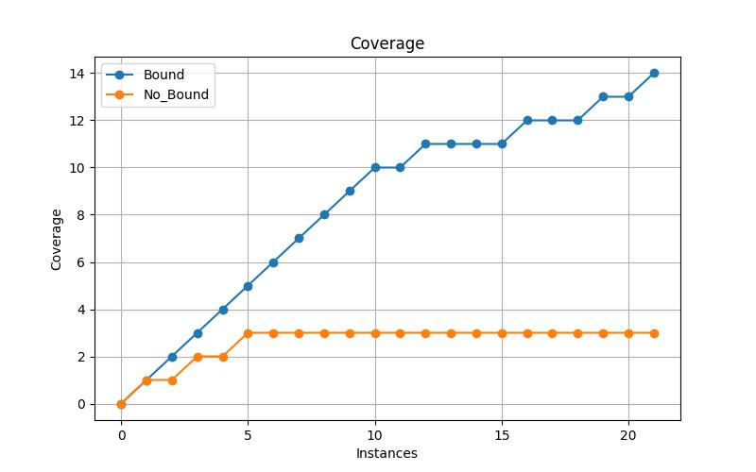
Results
Mean primal gap
Bound | No Bound
0.05 | 0.0
The defined dual bound is probably better at pruning the solution space rather than guiding the search process.

