Slide 1
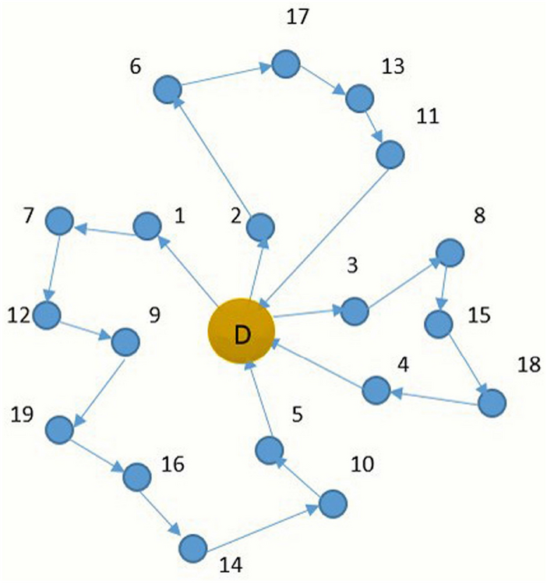
Min-Max Capacitated Vehicle Routing Problem
m vehicles
n locations (n-1 customers + depot)
Each customer has a demand d_{i}
Each vehicle has a capacity q_{z}
Two locations have a distance c_{ij}
We must visit each customer once, starting and ending at the depot, without exceeding each vehicle’s capacity.
The objective is to minimize the maximum distance traveled by a single vehicle.

Slide 2
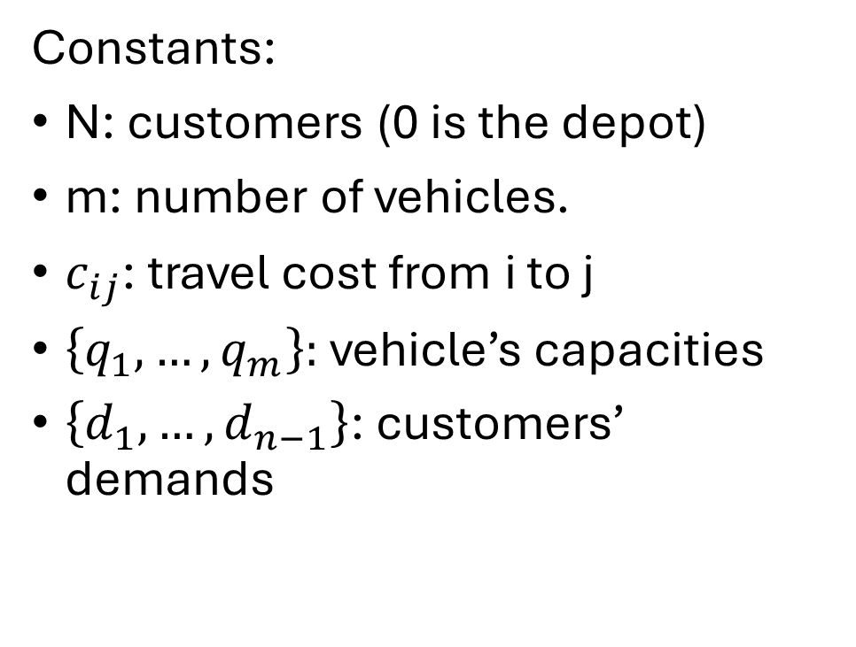
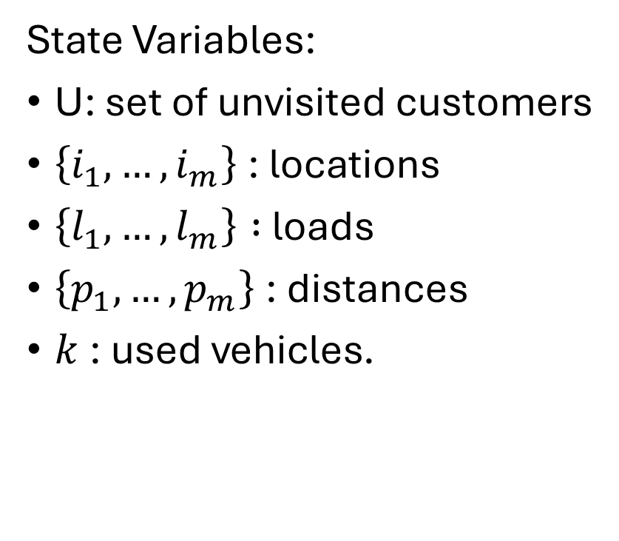
DIDP Formulation
State Variables:
U: set of unvisited customers
$\left\{i_{1},…,i_{m}\right\}$: locations
$\left\{l_{1},…,l_{m}\right\} :$loads
$\left\{p_{1},…,p_{m}\right\}$: distances
$k$: used vehicles.
Constants:
N: customers (0 is the depot)
m: number of vehicles.
$c_{ij}$: travel cost from i to j
$\left\{q_{1},…,q_{m}\right\}:$ vehicle’s capacities
$\left\{d_{1},…,d_{n−1}\right\}$: customers’ demands

Slide 3

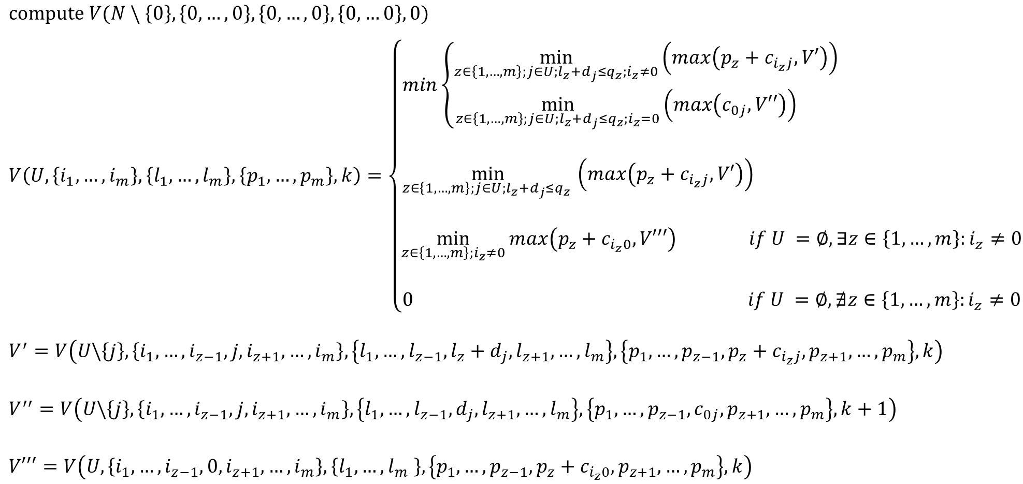

DIDP Formulation
$$compute V(N \backslash \left\{0\right\}, \left\{0,…,0\right\}, \left\{0, …,0\right\}, \left\{0,…0\right\}, 0)$$
$$V\left(U,\left\{i_{1},…,i_{m}\right\},\left\{l_{1},…,l_{m}\right\},\left\{p_{1},…,p_{m}\right\},k\right)=\left\{\begin{aligned}min\left\{\begin{aligned}\min_{z∈\left\{1,…,m\right\};j∈U;l_{z}+d_{j}≤q_{z};i_{z}≠0}\left(max\left(p_{z}+c_{i_{z}j}, V′\right)\right) \\ \min_{z∈\left\{1,…,m\right\};j∈U;l_{z}+d_{j}≤q_{z};i_{z}=0}\left(max\left(c_{0j}, V′′\right)\right) \end{aligned} \right. \\ \\ \min_{z∈\left\{1,…,m\right\};j∈U;l_{z}+d_{j}≤q_{z} }\left(max\left(p_{z}+c_{i_{z}j}, V′\right)\right) \\ \\ \min_{z∈\left\{1,…,m\right\};i_{z}≠0}{max\left(p_{z}+c_{i_{z}0}, V′′′\right) if U =∅,∃z∈\left\{1,…,m\right\}:i_{z}≠0} \\ \\ 0 if U =∅,∄z∈\left\{1,…,m\right\}:i_{z}≠0\end{aligned}\right.$$
$$V^{′}=V\left(U\backslash \left\{j\right\},\left\{i_{1},…,i_{z−1},j,i_{z+1},…,i_{m}\right\},\left\{l_{1},…,l_{z−1},l_{z}+d_{j},l_{z+1},…,l_{m}\right\},\left\{p_{1},…,p_{z−1},p_{z}+c_{i_{z}j},p_{z+1},…,p_{m}\right\},k\right)$$
$$V^{′′}=V\left(U\backslash \left\{j\right\},\left\{i_{1},…,i_{z−1},j,i_{z+1},…,i_{m}\right\},\left\{l_{1},…,l_{z−1}, d_{j},l_{z+1},…,l_{m}\right\},\left\{p_{1},…,p_{z−1}, c_{0j},p_{z+1},…,p_{m}\right\},k+1\right)$$
$$V′′′=V\left(U,\left\{i_{1},…,i_{z−1},0,i_{z+1},…,i_{m}\right\},\left\{l_{1},…,l_{m} \right\},\left\{p_{1},…,p_{z−1},p_{z}+c_{i_{z}0},p_{z+1},…,p_{m}\right\},k\right)$$
$$if U≠∅, k<m$$
$$if U≠∅,k=m$$

Slide 4
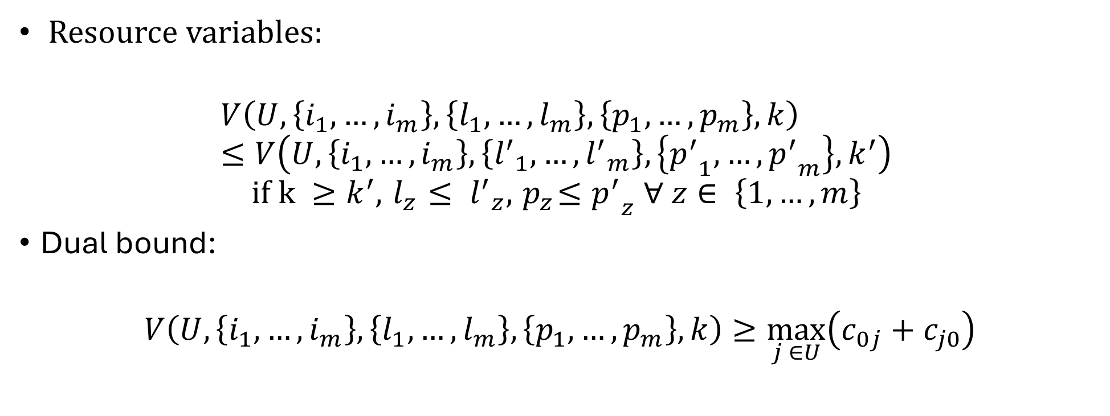
DIDP Formultation
Resource variables:
$$V\left(U,\left\{i_{1},…,i_{m}\right\},\left\{l_{1},…,l_{m}\right\},\left\{p_{1},…,p_{m}\right\},k\right)≤V\left(U,\left\{i_{1},…,i_{m}\right\},\left\{{l^{′}}_{1},…,{l^{′}}_{m}\right\},\left\{{p^{′}}_{1},…,{p^{′}}_{m}\right\},k^{′}\right)$$
$$if k ≥k^{′}, { l}_{z} ≤ {l^{′}}_{z}, { p}_{z}≤{p^{′}}_{z} ∀ z∈ \left\{1,…,m\right\}$$
Dual bound:
$$V\left(U,\left\{i_{1},…,i_{m}\right\},\left\{l_{1},…,l_{m}\right\},\left\{p_{1},…,p_{m}\right\},k\right)≥\max_{j ∈U}\left(c_{0j}+c_{j0}\right)$$

Slide 5
Testing the models
Two different models: bound vs. no bound.
Each model has been run on 21 instances with the LNBS solver and with a time limit of 5 minutes on an ASUS Zenbook UX431FN, Intel(R) Core(TM)i7-8565U CPU @ 1.80GHz, 8,00 GB RAM.
Two metrics computed: coverage and mean primal gap.
The performances of the models have been evaluated against CP, SAT, SMT, and MIP models developed to solve the same instances with the same experimental setup.

Slide 6
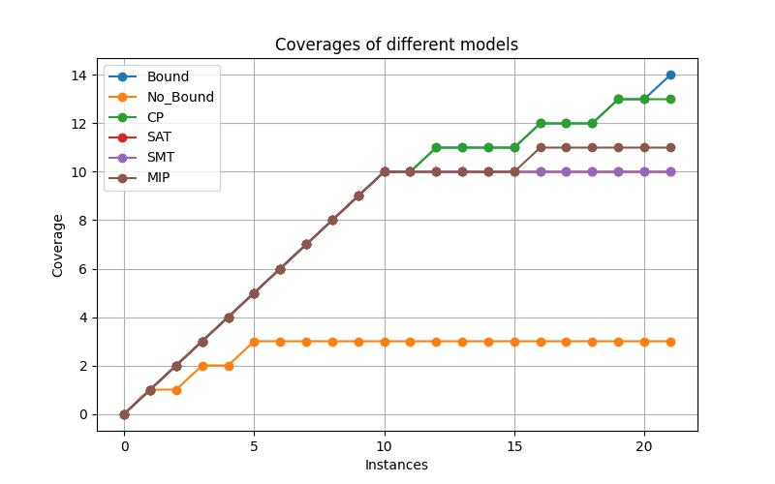
Results
Model | Mean primal gap
DIDP_Bound | 0.055
DIDP_No_Bound | 0.004
CP | 0.100
SAT | 0.475
SMT | 0.237
MIP | 0228

Slide 7
Results
In terms of coverage, the dual bound defined for the DIDP model is necessary to prove the optimality of the instances, effectively pruning states during the search.
On the contrary, the DIDP model without the bound is finding better quality solutions, probably because the bound is not as effective also for search guidance.
Overall, in terms of solution quality, both the DIDP models outperform the other approaches.

