Slide 1
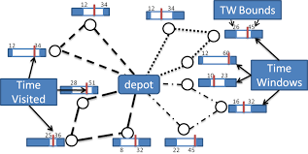
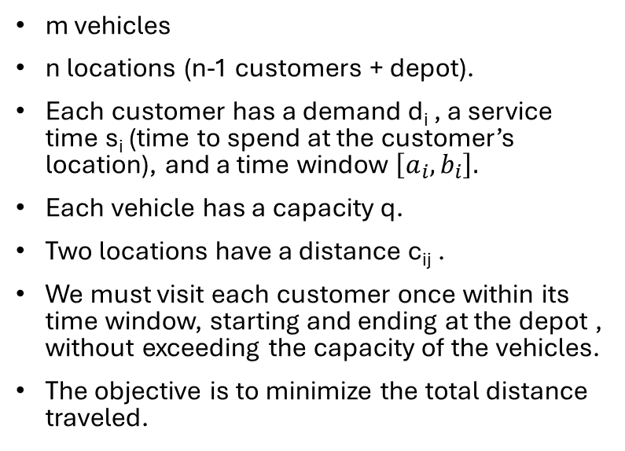
Capacitated Vehicle Routing Problem with Time Windows
m vehicles
n locations (n-1 customers + depot).
Each customer has a demand d_{i} , a service time s_{i} (time to spend at the customer’s location), and a time window $\left[a_{i}, b_{i}\right].$
Each vehicle has a capacity q.
Two locations have a distance c_{ij} .
We must visit each customer once within its time window, starting and ending at the depot , without exceeding the capacity of the vehicles.
The objective is to minimize the total distance traveled.

Slide 2
Source code and datasets
The source code is available at: https://github.com/FabioGiordana/DIDP-On-Routing-Problems
All the benchmark instances has been taken from the following source: http://vrp.atd-lab.inf.puc-rio.br/index.php/en/

Slide 3
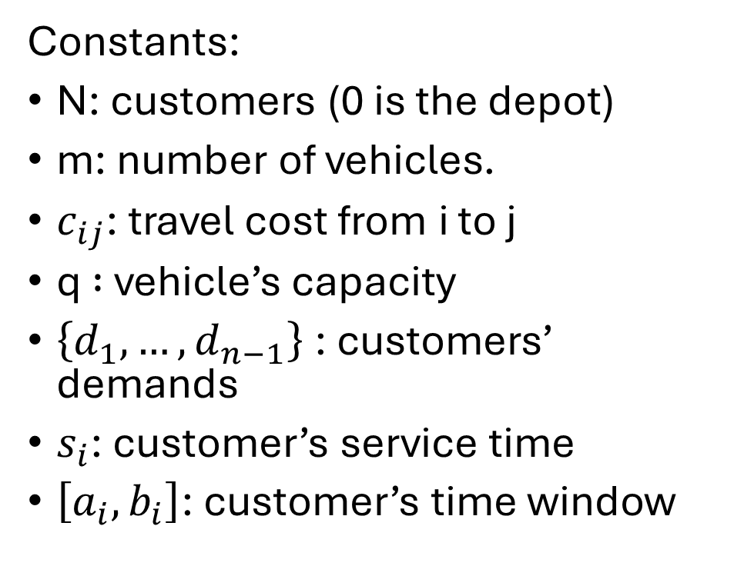
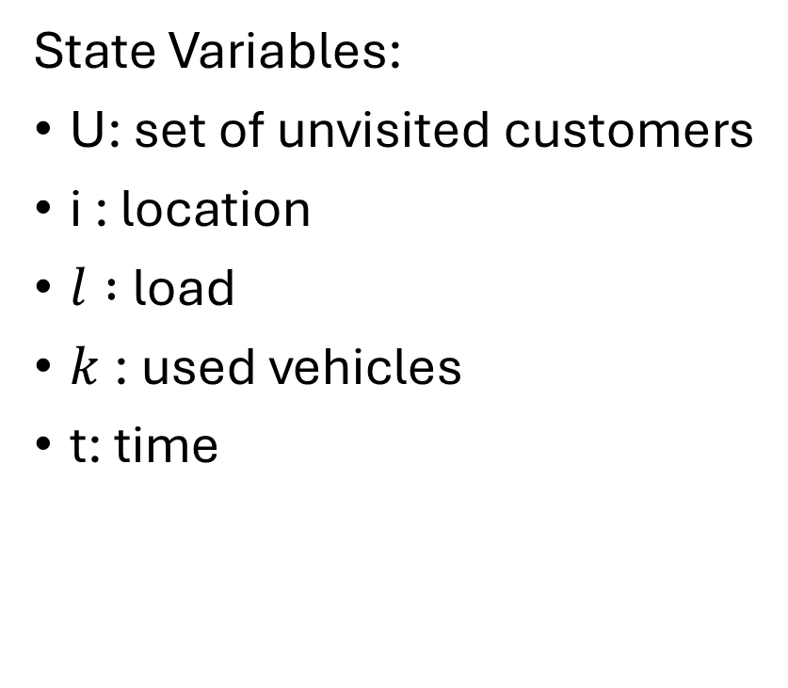
DIDP Formulation
State Variables:
U: set of unvisited customers
i : location
$l :$load
$k$: used vehicles
t: time
Constants:
N: customers (0 is the depot)
m: number of vehicles.
$c_{ij}$: travel cost from i to j
q $:$ vehicle’s capacity
$\left\{d_{1},…,d_{n−1}\right\}$: customers’ demands
$s_{i}$: customer’s service time
$\left[a_{i}, b_{i}\right]$: customer’s time window

Slide 4

DIDP Formulation
$$compute V(N \backslash \left\{0\right\}, 0, 0, 1, 0)$$
$$V\left(U,i,l,k,t\right)=\left\{\begin{aligned}\begin{aligned}min\left\{\begin{aligned}\min_{j∈U;l +d_{j}≤q;t+c_{ij}≤b_{j} }\left(c_{ij}+V\left(U\backslash \left\{j\right\},j,l+d_{j},k,s_{j}+max\left(t+c_{ij},a_{j}\right)\right)\right) \\ \min_{ j∈U}\left(c_{i0}+c_{0j}+V\left(U\backslash \left\{j\right\},j,d_{j},k+1,s_{j}+max\left(c_{0j},a_{j}\right)\right)\right)\end{aligned}\right. if U≠∅, k<m \\ \\ \min_{j∈U;l +d_{j}≤q;t+c_{ij}≤b_{j} }\left(c_{ij}+V\left(U\backslash \left\{j\right\},j,l+d_{j},k,s_{j}+max\left(t+c_{ij},a_{j}\right)\right)\right) if U≠∅, k=m \\ \\ c_{i0}+V\left(U,0, k, l,t+c_{i0}\right) if U=∅, i≠0 \\ \\ 0 if U =∅,i=0\end{aligned} \\ \end{aligned}\right.$$

Slide 5
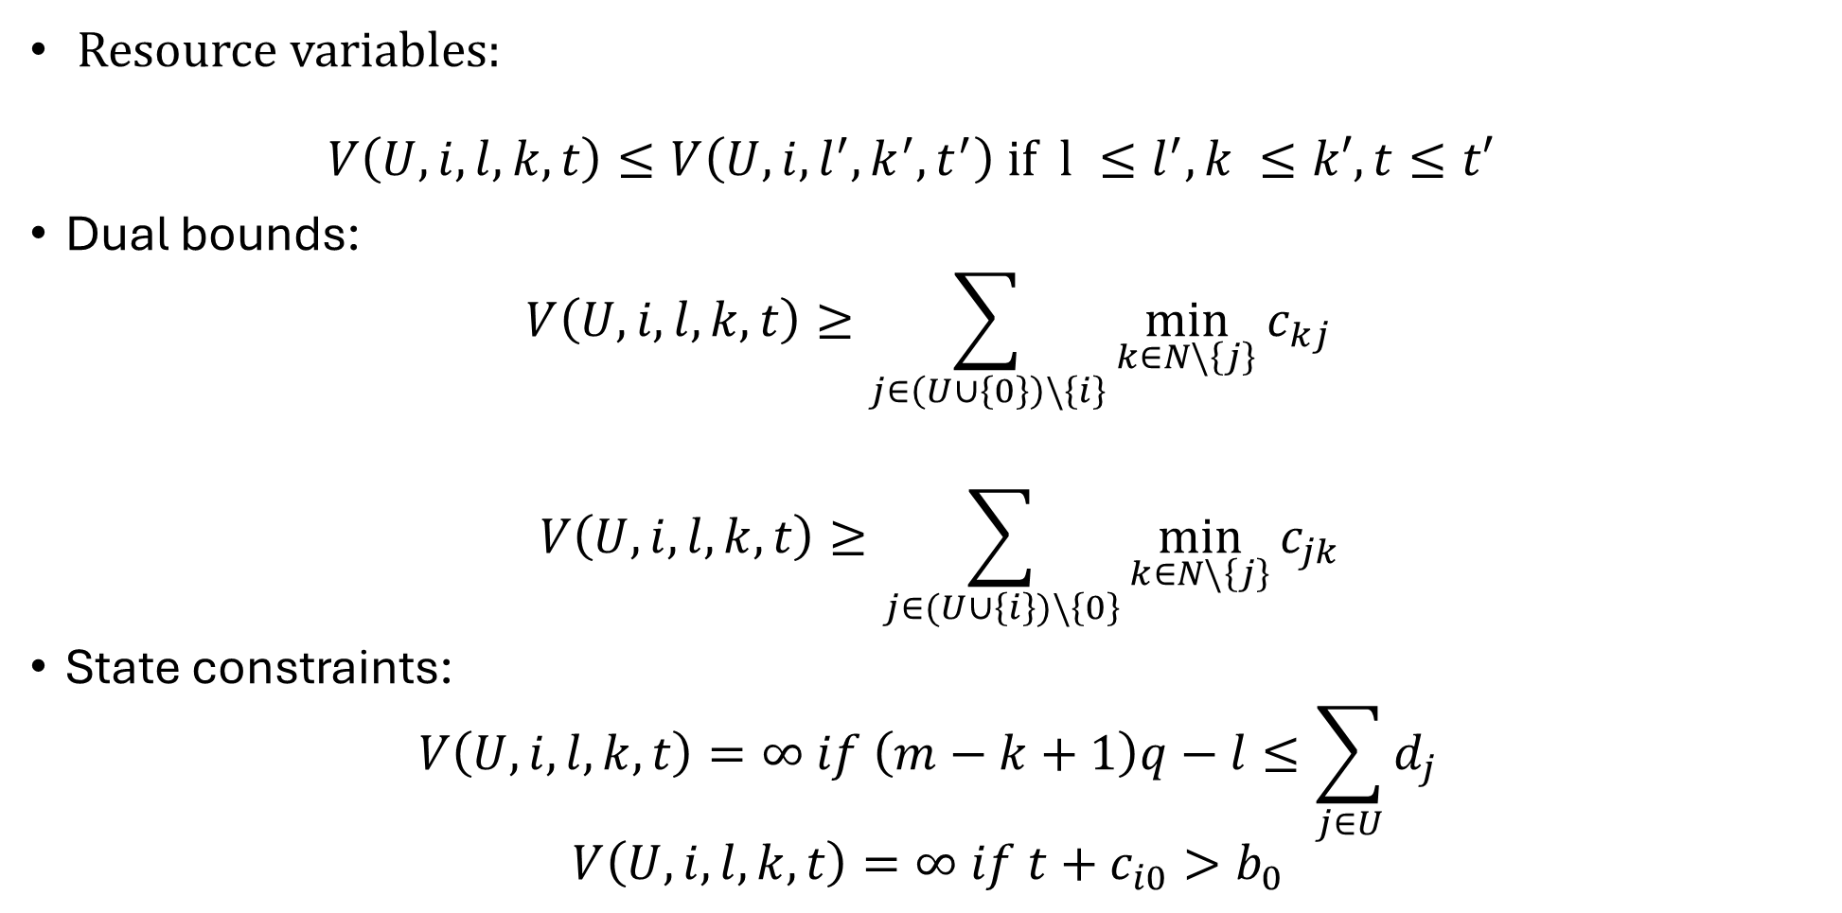
DIDP Formultation
Resource variables: $V\left(U,i,l,k,t\right)≤V\left(U,i,l^{′},k^{′},t^{′}\right) if l ≤l^{′}, k ≤k′, t≤t′$
Dual bounds:
$$V\left(U,i,l,k,t\right)≥\sum_{j∈\left(U∪\left\{0\right\}\right)\backslash \left\{i\right\}}{\min_{k∈N\backslash \left\{j\right\}}{c_{kj}}}$$
$$V\left(U,i,l,k,t\right)≥\sum_{j∈(U∪\left\{i\right\})\backslash \left\{0\right\}}{\min_{k∈N\backslash \left\{j\right\}}{c_{jk}}}$$
State constraints:
$$V\left(U,i,l,k,t\right)=∞ if \left(m−k+1\right)q−l≤\sum_{j∈U}{d_{j}}$$
$$V\left(U,i,l,k,t\right)=∞ if t+c_{i0}>b_{0}$$

Slide 6
Testing the models
Four different DIDP models: complete; without dual bounds; without resource variables; and without dual bounds and resource variables.
Each model has been run on the Solomon’s benchmark instances with the LNBS solver with a time limit of 10 minutes on an ASUS Zenbook UX431FN, Intel(R) Core(TM)i7-8565U CPU @ 1.80GHz, 8,00 GB RAM.
The primal integral and the primal gap have been computed to compare the performances with a CP model defined on MiniZinc, using LNS and Gecode as solver.

Slide 7
Solomon’s benchmark instances
Composed of six sets of instances highlighting several factors that affect the behavior of routing and scheduling algorithms:
C1 & C2: clustered geographical data
R1 & R2: random-generated geographical data
RC1 & RC2: mixture of clustered and random data
The coordinates are the same within sets of problems of one type (C, R, RC), but C1, R1 and RC1 have a shorter scheduling horizon and a lower vehicle capacity, allowing only a few customers per route.

Slide 8
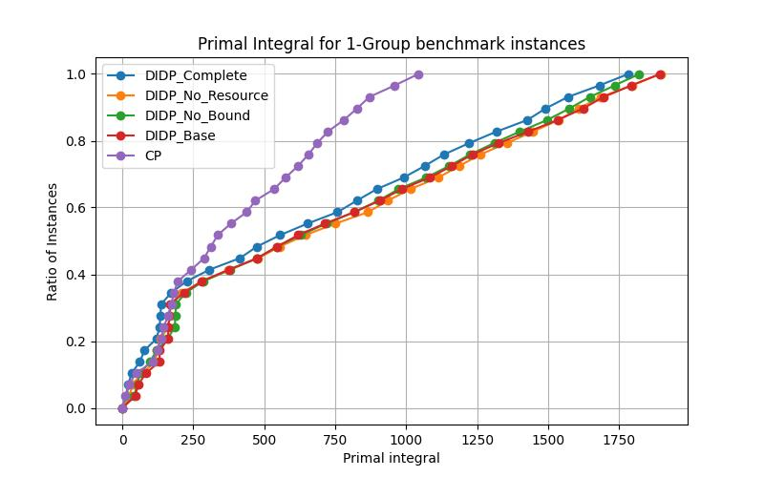
Results on the 1-Group instances

Slide 9
Results on the 1-Group instances
The CP model outperforms the DIDP models.
In 1-Group, we have stricter constraints on time windows and capacity, allowing fewer transitions in each state.
With a lower branching factor, the dual bounds seem to be good for search guidance, making the Complete model the best among the DIDP variations.
The worst DIDP models are the ones without resource variables.
The difference in performances between DIDP models is not so high compared to CP vs DIDP.

Slide 10
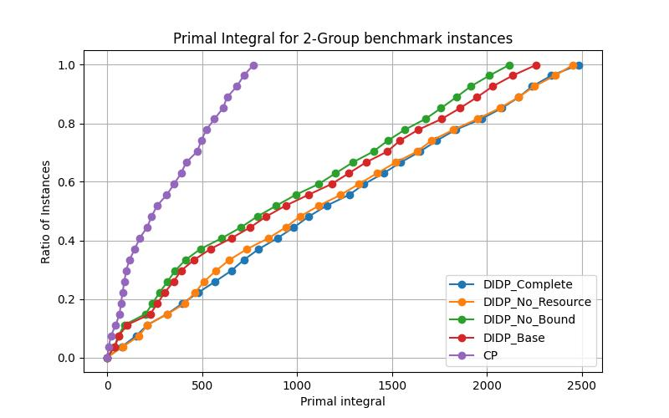
Results on the 2-Group instances

Slide 11
Results on the 2-Group instances
The CP model outperforms the DIDP models.
In 2-Group, the instances are less constrained.
The dual bounds seem to struggle more in the search guidance process, making the two DIDP models without dual bounds perform better.
The highest performance gap remains the one between CP and DIDP.

Slide 12
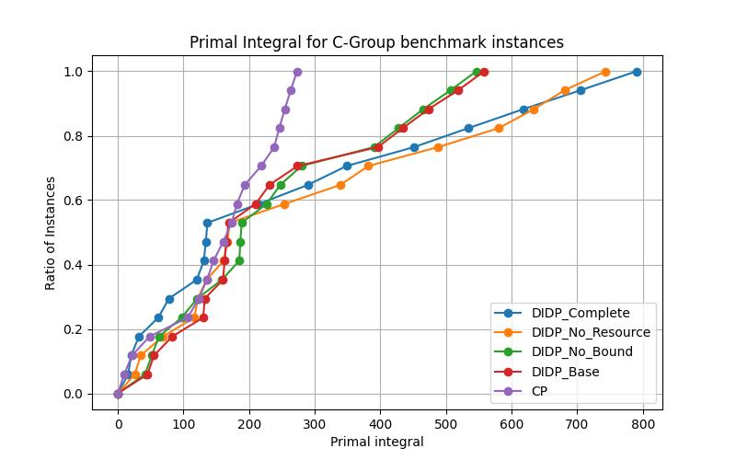
Results on the C-Group instances

Slide 13
Results on the C-Group instances
The C-group shows a stranger behavior, with DIDP complete even slightly outperforming CP at the beginning, before becoming the worst among all models.
C instances have clustered locations: dual bounds are unable to capture the high discrepancy between the minimum distance from and to a location (distances inside the same cluster) and the actual cost of a transition if we have to reach a location from outside its cluster.
In C1, the natural solution of trying to assign a vehicle for cluster is not possible due to the strict constraints, so the dual bounds are not penalizing the search process, leading to similar performances for all the models.
In C2, the low quality of the dual bounds for search guidance emerges, making the models with bounds the worst.

Slide 14
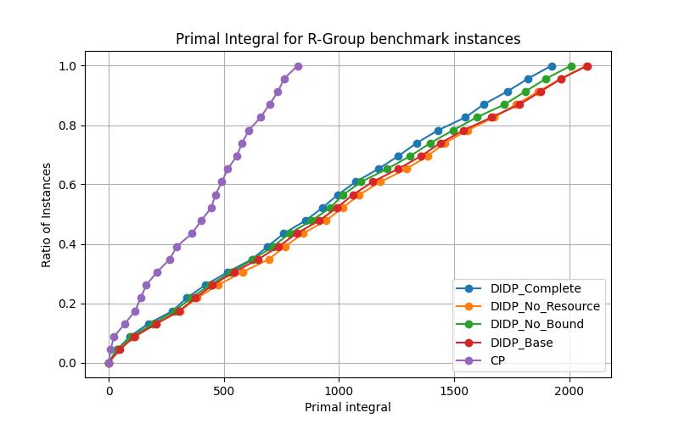
Results on the R-Group instances

Slide 15
Results on the R-Group instances
R instances have random locations: the discrepancy between the minimum distance from and to a location and the actual cost of a transition is probably lower than in the C instances.
In this case the dual bounds actually help the search process.
As for the 1-Group, the resource variables make the models perform better independently from the usage of dual bounds.
The greatest gap remains between CP and DIDP.

Slide 16
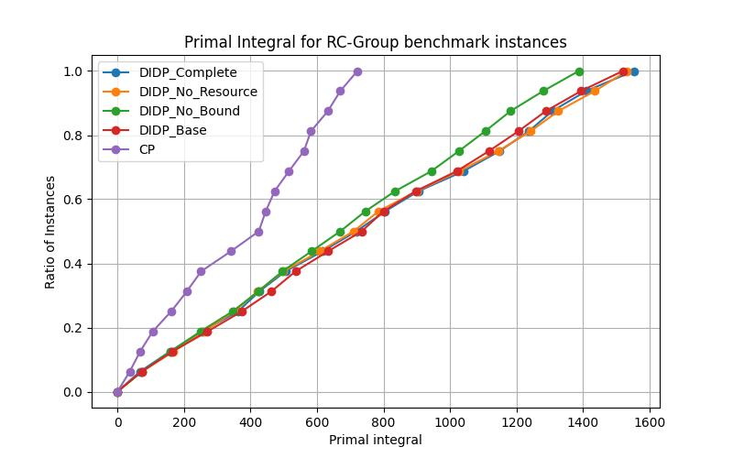
Results on the RC-Group instances

Slide 17
Results on the RC-Group instances
As for the C-group, the model without the bounds and with the resource variables is the best among the DIDP models.
The difference in the performances is mitigated by the fact that only part of the customers are clustered.

Slide 18
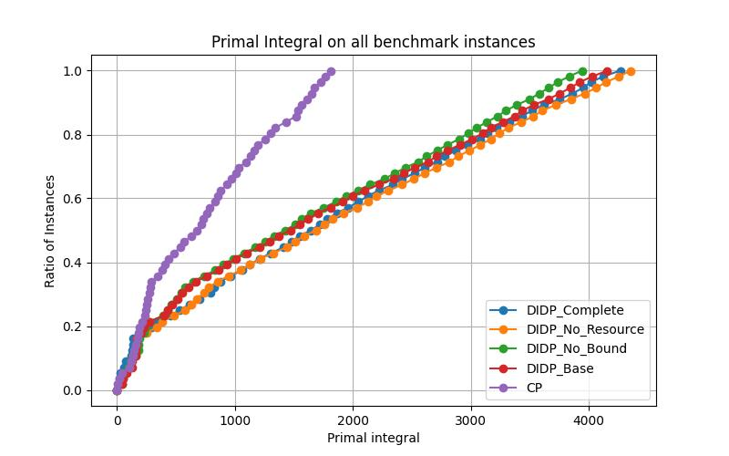
Total perfomances

Slide 19
Total performances
CP outperforms all the DIDP models.
The difference in overall performances between the DIDP models is not so big, but we can state that:
For most of the instances, the dual bounds are not good for search guidance.
If the only difference between two models is the usage of resource variables, the one exploiting them has better performance than the other.

