Slide 1
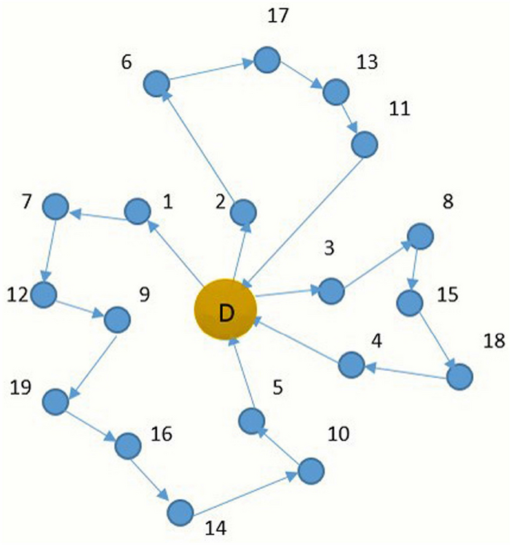
DIDP on CVRP
A brief summary
The objective of this work was to study the performance of DIDP models in solving variations of the Capacitated Vehicles Routing Problem.
Each DIDP model was tested with slight variations (such as dual bound vs no dual bound).
A CP model was used as a baseline for the performance.
First Variation: Time Windows.
Second Variation: Min-Max objective function.

Slide 2
Source code and datasets
The source code is available at: https://github.com/FabioGiordana/DIDP-On-Routing-Problems
All the benchmark instances has been taken from the following source: http://vrp.atd-lab.inf.puc-rio.br/index.php/en/

Slide 3
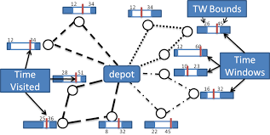
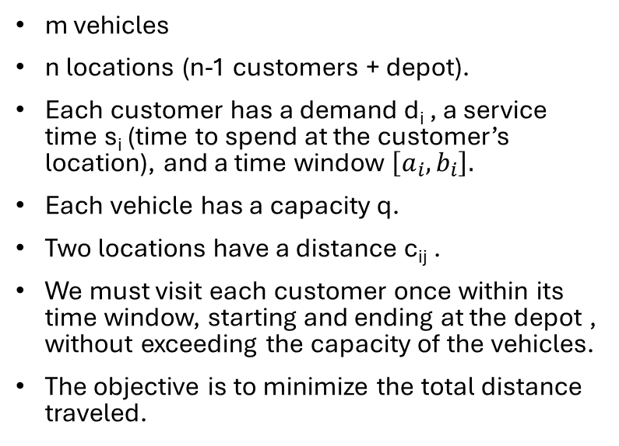
First Variation: Capacitated Vehicle Routing Problem with Time Windows
m vehicles
n locations (n-1 customers + depot).
Each customer has a demand d_{i} , a service time s_{i} (time to spend at the customer’s location), and a time window $\left[a_{i}, b_{i}\right].$
Each vehicle has a capacity q.
Two locations have a distance c_{ij} .
We must visit each customer once within its time window, starting and ending at the depot , without exceeding the capacity of the vehicles.
The objective is to minimize the total distance traveled.

Slide 4
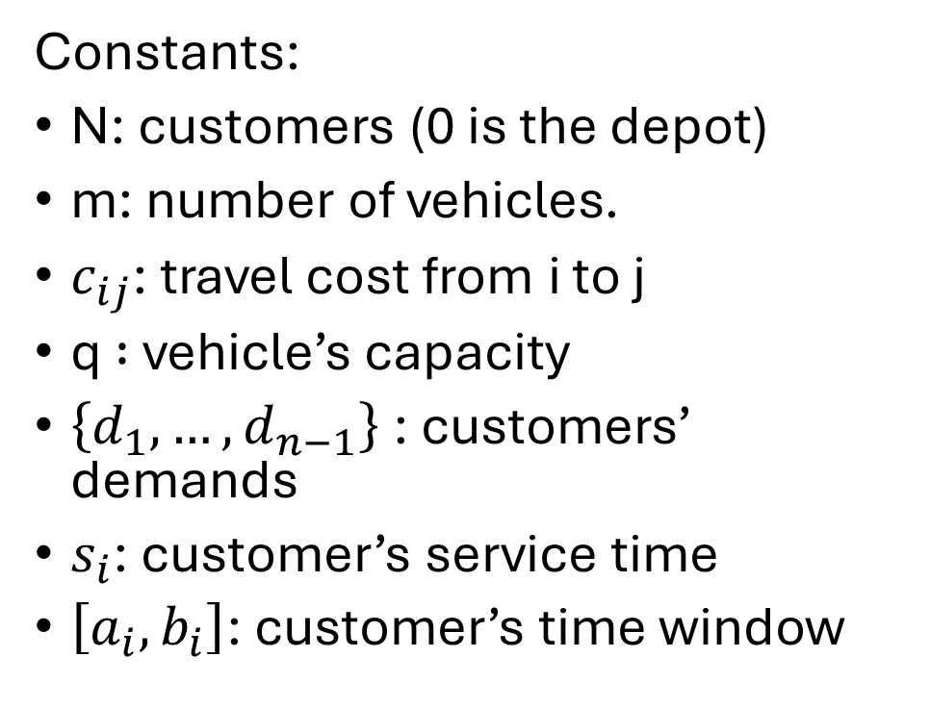
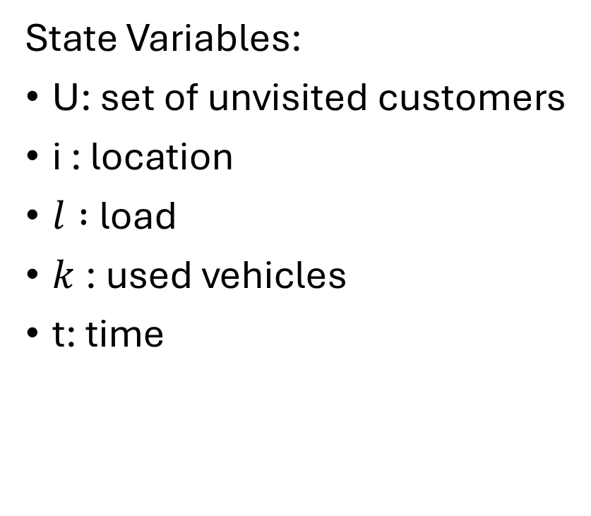
DIDP Formulation
State Variables:
U: set of unvisited customers
i : location
$l :$load
$k$: used vehicles
t: time
Constants:
N: customers (0 is the depot)
m: number of vehicles.
$c_{ij}$: travel cost from i to j
q $:$ vehicle’s capacity
$\left\{d_{1},…,d_{n−1}\right\}$: customers’ demands
$s_{i}$: customer’s service time
$\left[a_{i}, b_{i}\right]$: customer’s time window

Slide 5

DIDP Formulation
$$compute V(N \backslash \left\{0\right\}, 0, 0, 1, 0)$$
$$V\left(U,i,l,k,t\right)=\left\{\begin{aligned}\begin{aligned}min\left\{\begin{aligned}\min_{j∈U;l +d_{j}≤q;t+c_{ij}≤b_{j} }\left(c_{ij}+V\left(U\backslash \left\{j\right\},j,l+d_{j},k,s_{j}+max\left(t+c_{ij},a_{j}\right)\right)\right) \\ \min_{ j∈U}\left(c_{i0}+c_{0j}+V\left(U\backslash \left\{j\right\},j,d_{j},k+1,s_{j}+max\left(c_{0j},a_{j}\right)\right)\right)\end{aligned}\right. if U≠∅, k<m \\ \\ \min_{j∈U;l +d_{j}≤q;t+c_{ij}≤b_{j} }\left(c_{ij}+V\left(U\backslash \left\{j\right\},j,l+d_{j},k,s_{j}+max\left(t+c_{ij},a_{j}\right)\right)\right) if U≠∅, k=m \\ \\ c_{i0}+V\left(U,0, k, l,t+c_{i0}\right) if U=∅, i≠0 \\ \\ 0 if U =∅,i=0\end{aligned} \\ \end{aligned}\right.$$

Slide 6
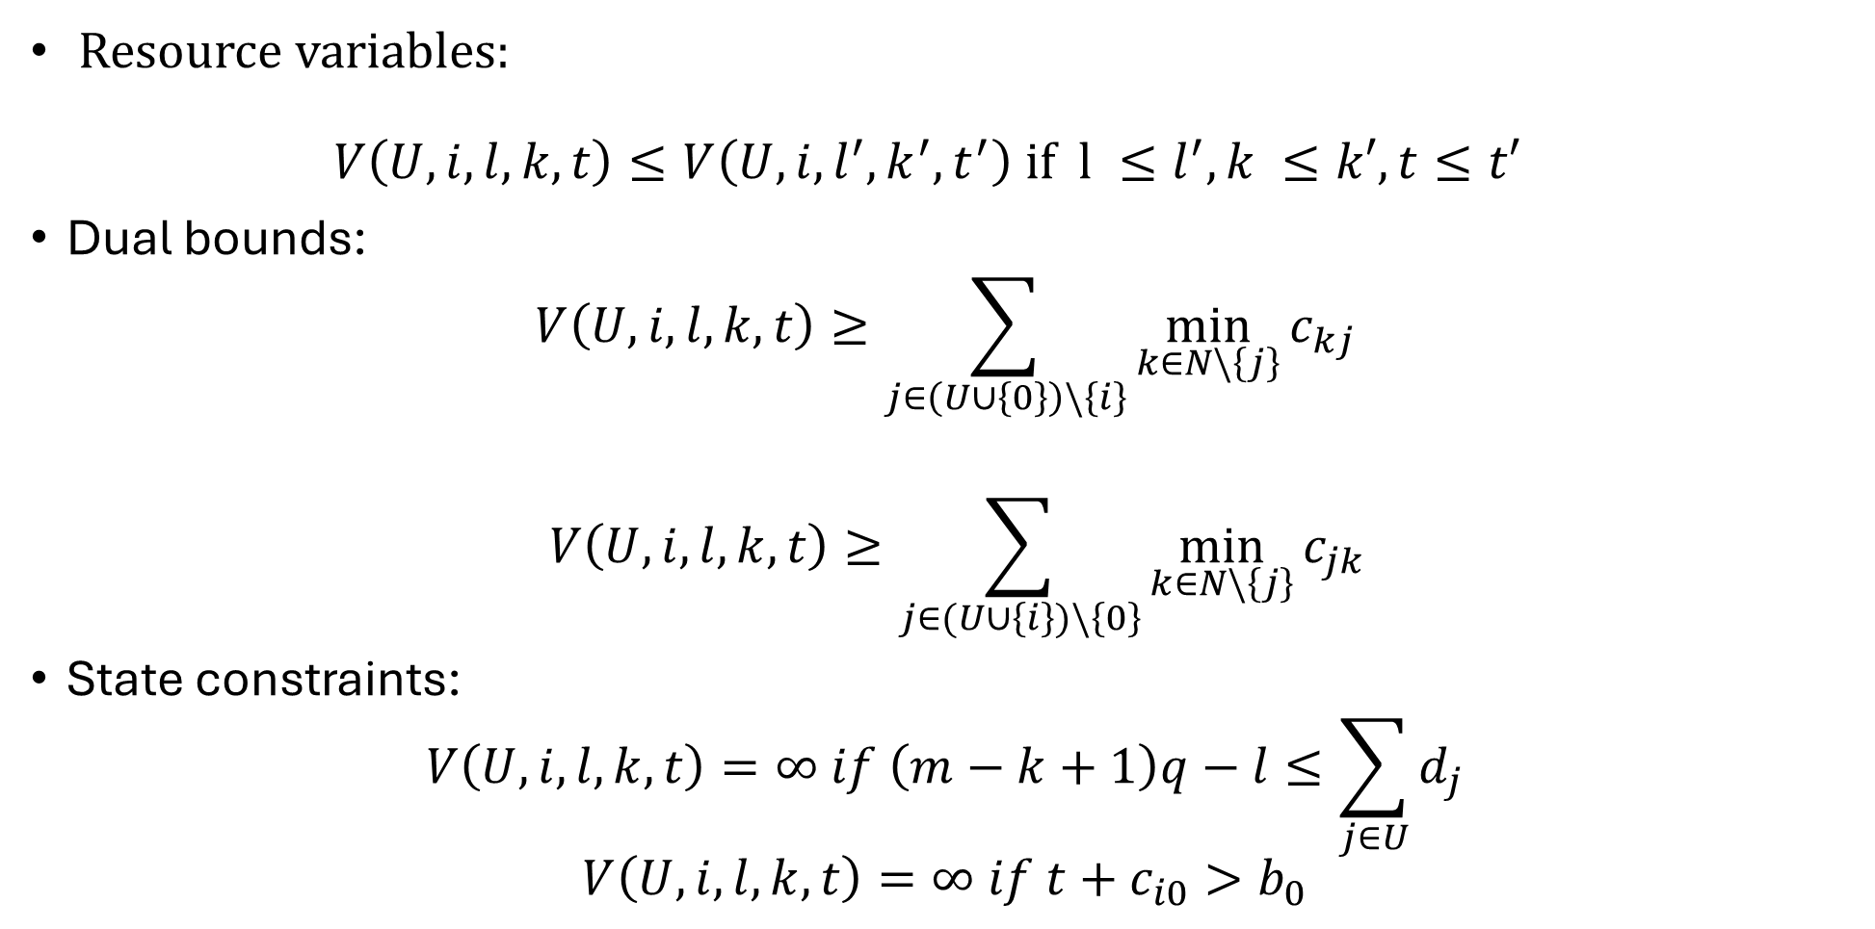
DIDP Formulation
Resource variables: $V\left(U,i,l,k,t\right)≤V\left(U,i,l^{′},k^{′},t^{′}\right) if l ≤l^{′}, k ≤k′, t≤t′$
Dual bounds:
$$V\left(U,i,l,k,t\right)≥\sum_{j∈\left(U∪\left\{0\right\}\right)\backslash \left\{i\right\}}{\min_{k∈N\backslash \left\{j\right\}}{c_{kj}}}$$
$$V\left(U,i,l,k,t\right)≥\sum_{j∈(U∪\left\{i\right\})\backslash \left\{0\right\}}{\min_{k∈N\backslash \left\{j\right\}}{c_{jk}}}$$
State constraints:
$$V\left(U,i,l,k,t\right)=∞ if \left(m−k+1\right)q−l≤\sum_{j∈U}{d_{j}}$$
$$V\left(U,i,l,k,t\right)=∞ if t+c_{i0}>b_{0}$$

Slide 7
Testing the models
Four different DIDP models: complete; without dual bounds; without resource variables; and without dual bounds and resource variables.
Each model has been run on the Solomon’s benchmark instances with the LNBS solver with a time limit of 10 minutes on an ASUS Zenbook UX431FN, Intel(R) Core(TM)i7-8565U CPU @ 1.80GHz, 8,00 GB RAM.
The primal integral and the primal gap have been computed to compare the performances with a CP model defined on MiniZinc, using LNS and Gecode as solver.

Slide 8
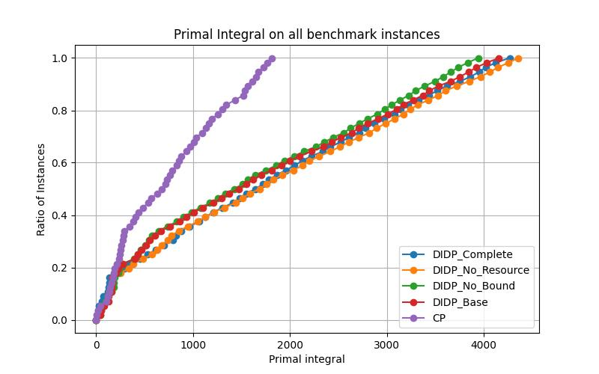
Total performances

Slide 9
Total performances
CP outperforms all the DIDP models.
The difference in overall performances between the DIDP models is not so big, but we can state that:
For most of the instances, the dual bounds are not good for search guidance.
If the only difference between two models is the usage of resource variables, the one exploiting them has better performance than the other.

Slide 10
Second Variation: Min-Max Capacitated Vehicle Routing Problem
m vehicles
n locations (n-1 customers + depot)
Each customer has a demand d_{i}
Each vehicle has a capacity q
Two locations have a distance c_{ij}
We must visit each customer once, starting and ending at the depot, without exceeding the capacity of the vehicles.
The objective is to minimize the maximum distance traveled by a single vehicle.

Slide 11
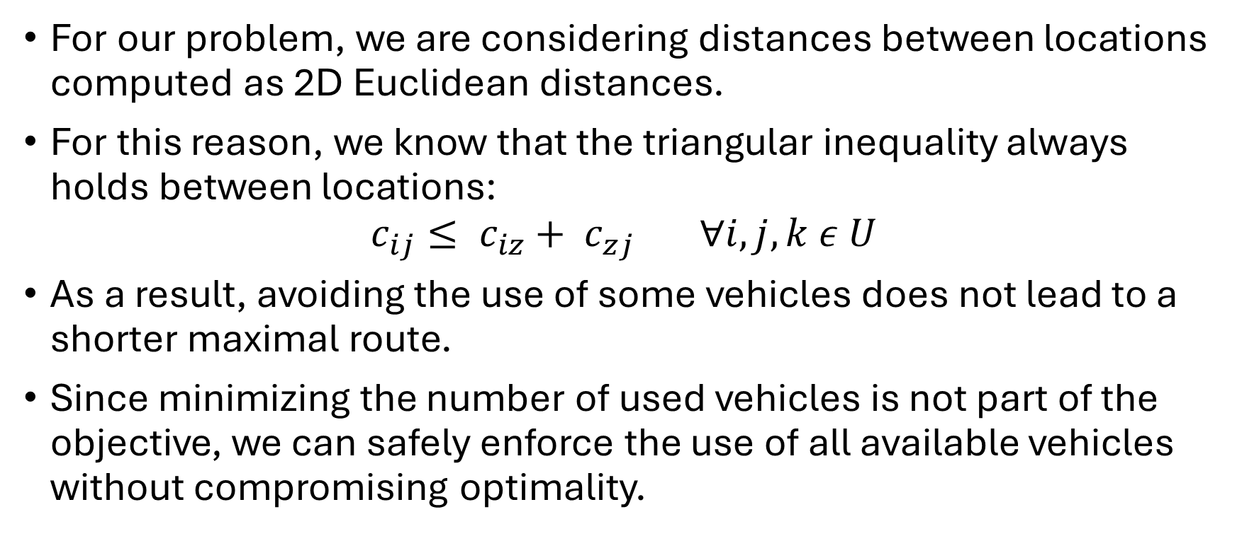
Exploiting the implied constraint
For our problem, we are considering distances between locations computed as 2D Euclidean distances.
For this reason, we know that the triangular inequality always holds between locations:
$$c_{ij}≤ c_{iz}+ c_{zj} ∀i,j,k ε U$$
As a result, avoiding the use of some vehicles does not lead to a shorter maximal route.
Since minimizing the number of used vehicles is not part of the objective, we can safely enforce the use of all available vehicles without compromising optimality.

Slide 12
Alternative Formulations
The first DIDP and CP formulations were based on the belief that with this type of objective function, it was necessary to build the paths in parallel to more easily distribute the distances travelled.
The giant tour CP formulation remains a valid alternative (if not the best), for reasons such as the possibility to exploit global constraints on the variables.
For this reason, also the effectiveness of a variation of a giant tour representation for DIDP was tested, together with the model already proposed.

Slide 13
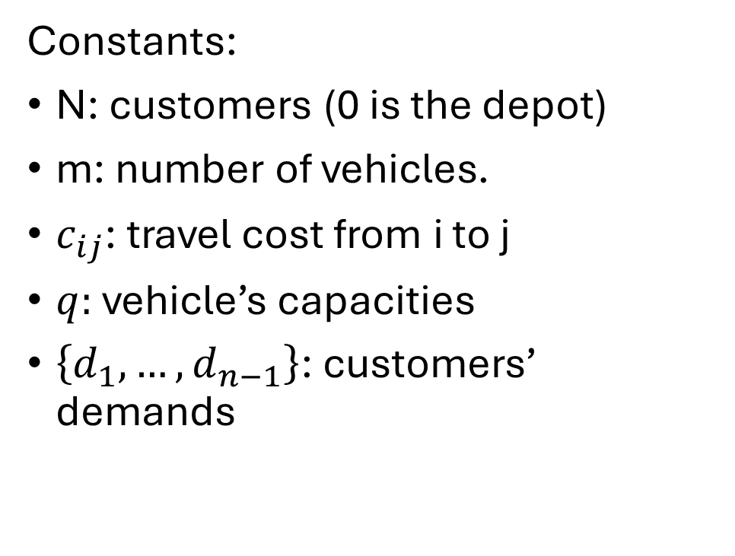
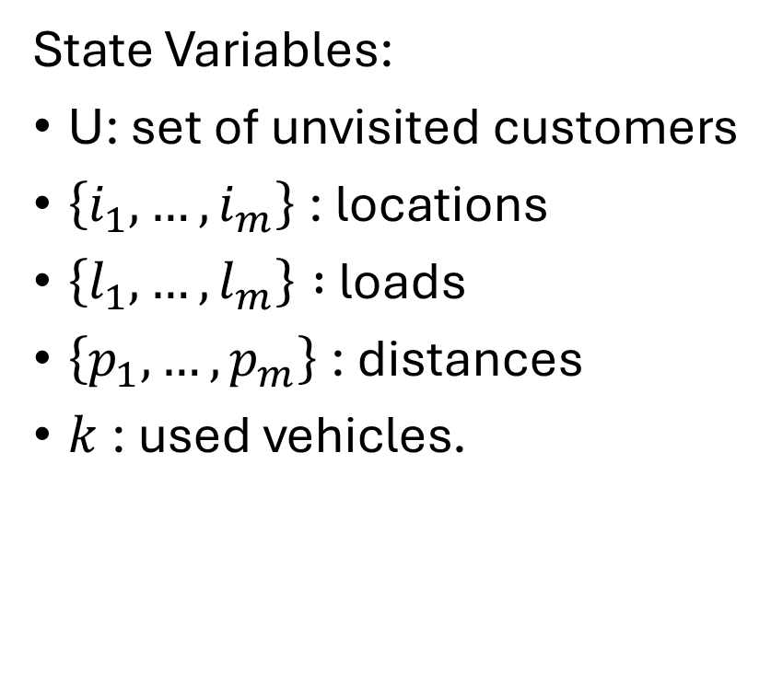
First model: DIDP Formulation
State Variables:
U: set of unvisited customers
$\left\{i_{1},…,i_{m}\right\}$: locations
$\left\{l_{1},…,l_{m}\right\} :$loads
$\left\{p_{1},…,p_{m}\right\}$: distances
$k$: used vehicles.
Constants:
N: customers (0 is the depot)
m: number of vehicles.
$c_{ij}$: travel cost from i to j
$q:$ vehicle’s capacities
$\left\{d_{1},…,d_{n−1}\right\}$: customers’ demands

Slide 14

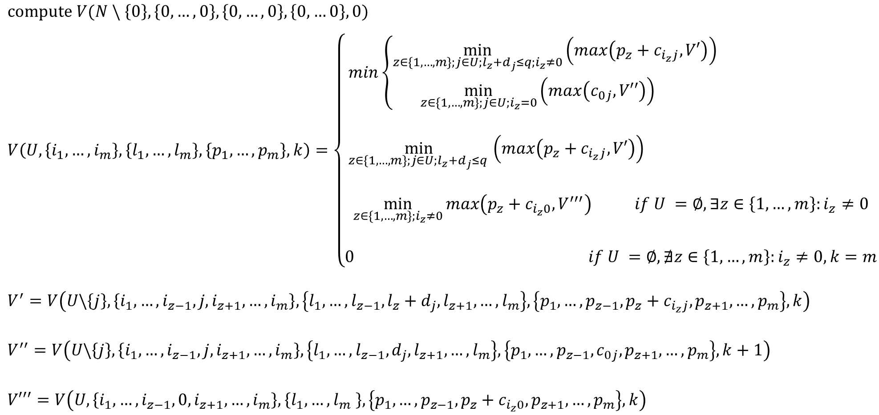

First Model: DIDP Formulation
$$compute V(N \backslash \left\{0\right\}, \left\{0,…,0\right\}, \left\{0, …,0\right\}, \left\{0,…0\right\}, 0)$$
$$V\left(U,\left\{i_{1},…,i_{m}\right\},\left\{l_{1},…,l_{m}\right\},\left\{p_{1},…,p_{m}\right\},k\right)=\left\{\begin{aligned}min\left\{\begin{aligned}\min_{z∈\left\{1,…,m\right\};j∈U;l_{z}+d_{j}≤q;i_{z}≠0}\left(max\left(p_{z}+c_{i_{z}j}, V′\right)\right) \\ \min_{z∈\left\{1,…,m\right\};j∈U;i_{z}=0}\left(max\left(c_{0j}, V′′\right)\right) \end{aligned} \right. \\ \\ \min_{z∈\left\{1,…,m\right\};j∈U;l_{z}+d_{j}≤q }\left(max\left(p_{z}+c_{i_{z}j}, V′\right)\right) \\ \\ \min_{z∈\left\{1,…,m\right\};i_{z}≠0}{max\left(p_{z}+c_{i_{z}0}, V^{′′′}\right) if U =∅,∃z∈\left\{1,…,m\right\}:i_{z}≠0} \\ \\ 0 if U =∅,∄z∈\left\{1,…,m\right\}:i_{z}≠0, k=m\end{aligned}\right.$$
$$V^{′}=V\left(U\backslash \left\{j\right\},\left\{i_{1},…,i_{z−1},j,i_{z+1},…,i_{m}\right\},\left\{l_{1},…,l_{z−1},l_{z}+d_{j},l_{z+1},…,l_{m}\right\},\left\{p_{1},…,p_{z−1},p_{z}+c_{i_{z}j},p_{z+1},…,p_{m}\right\},k\right)$$
$$V^{′′}=V\left(U\backslash \left\{j\right\},\left\{i_{1},…,i_{z−1},j,i_{z+1},…,i_{m}\right\},\left\{l_{1},…,l_{z−1}, d_{j},l_{z+1},…,l_{m}\right\},\left\{p_{1},…,p_{z−1}, c_{0j},p_{z+1},…,p_{m}\right\},k+1\right)$$
$$V′′′=V\left(U,\left\{i_{1},…,i_{z−1},0,i_{z+1},…,i_{m}\right\},\left\{l_{1},…,l_{m} \right\},\left\{p_{1},…,p_{z−1},p_{z}+c_{i_{z}0},p_{z+1},…,p_{m}\right\},k\right)$$
$$if U≠∅, k<m$$
$$if U≠∅,k=m$$

Slide 15
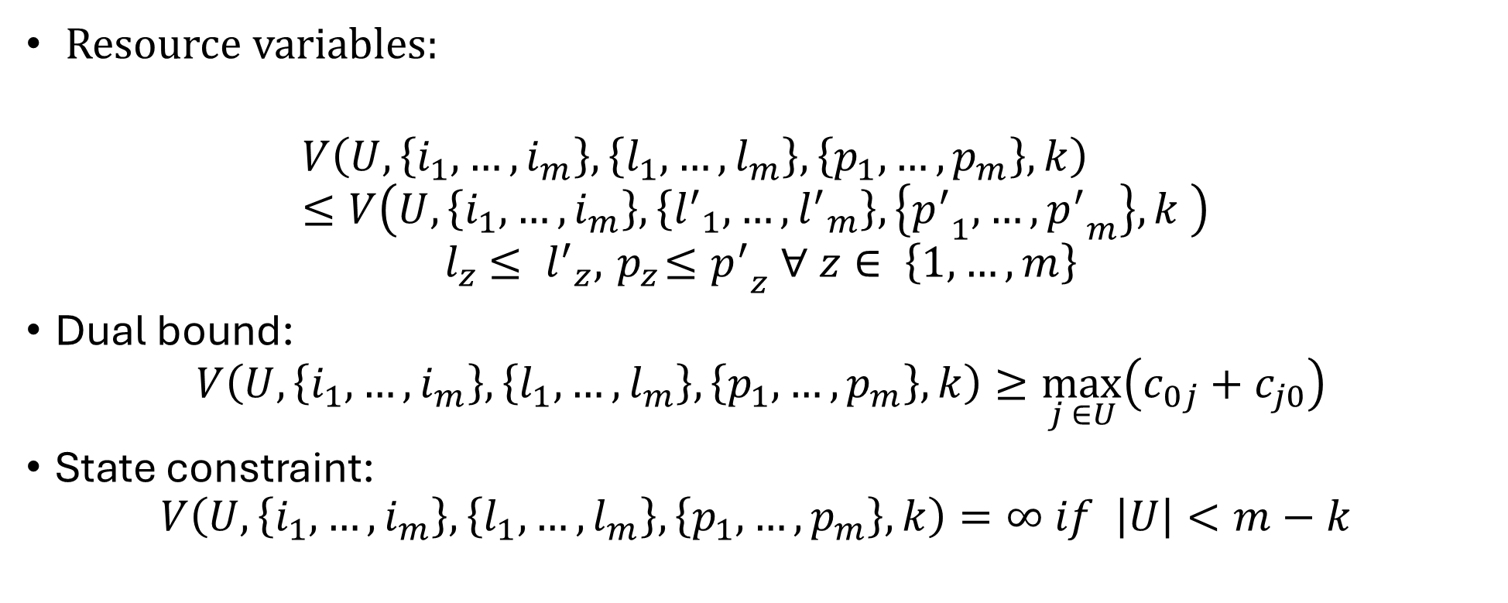
First Model: DIDP Formulation
Resource variables:
$$V\left(U,\left\{i_{1},…,i_{m}\right\},\left\{l_{1},…,l_{m}\right\},\left\{p_{1},…,p_{m}\right\},k\right)≤V\left(U,\left\{i_{1},…,i_{m}\right\},\left\{{l^{′}}_{1},…,{l^{′}}_{m}\right\},\left\{{p^{′}}_{1},…,{p^{′}}_{m}\right\},k \right)$$
$${ l}_{z} ≤ {l^{′}}_{z}, { p}_{z}≤{p^{′}}_{z} ∀ z∈ \left\{1,…,m\right\}$$
Dual bound:
$$V\left(U,\left\{i_{1},…,i_{m}\right\},\left\{l_{1},…,l_{m}\right\},\left\{p_{1},…,p_{m}\right\},k\right)≥\max_{j ∈U}\left(c_{0j}+c_{j0}\right)$$
State constraint:
$$V\left(U,\left\{i_{1},…,i_{m}\right\},\left\{l_{1},…,l_{m}\right\},\left\{p_{1},…,p_{m}\right\},k\right)=∞ if \left|U\right|<m−k$$

Slide 16
First DIDP model
As seen in the formulation of the model, to enforce the implied constraint it is necessary to define the number of active vehicles as a state variable.
For this reason, two different (but very similar) types of transitions are needed: adding a location to an already not empty path and adding the first location to a path.
The latter is needed because it has the additional effect of increasing the number of active vehicles k.
For the models without the implied constraint, it is possible to define just one type of transition from the current location to a location different from the depot, reducing the complexity of the model.

Slide 17
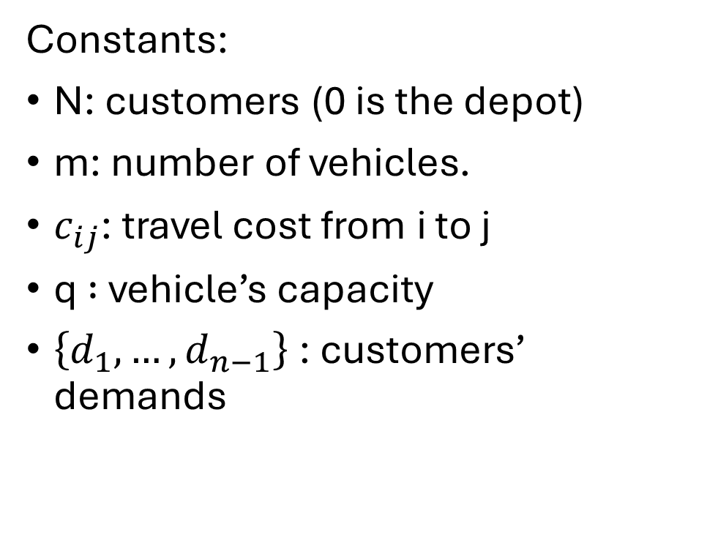
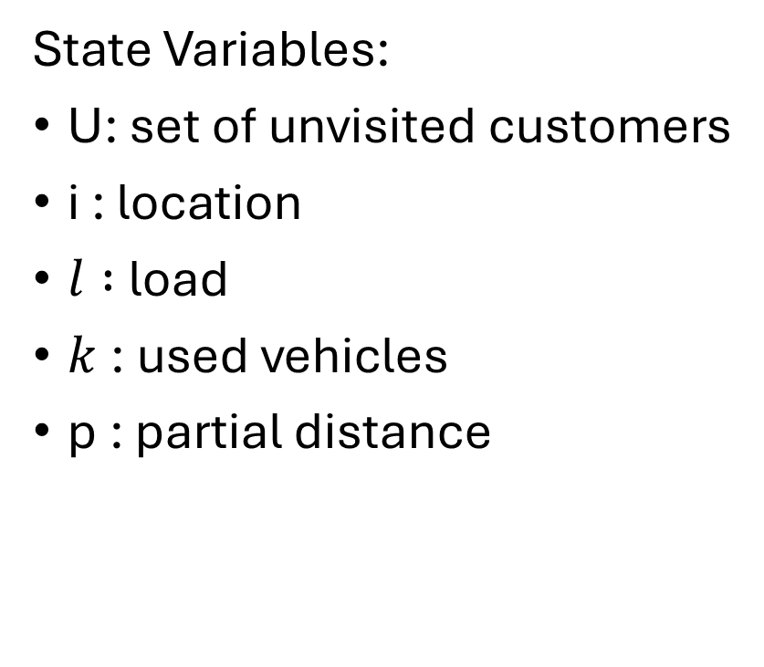
Second Model: DIDP Formulation
State Variables:
U: set of unvisited customers
i : location
$l :$load
$k$: used vehicles
p : partial distance
Constants:
N: customers (0 is the depot)
m: number of vehicles.
$c_{ij}$: travel cost from i to j
q $:$ vehicle’s capacity
$\left\{d_{1},…,d_{n−1}\right\}$: customers’ demands

Slide 18

Second Model: DIDP Formulation
$$compute V(N \backslash \left\{0\right\}, 0, 0, 1, 0)$$
$$V\left(U,i,l,k,t\right)=\left\{\begin{aligned}\begin{aligned}min\left\{\begin{aligned}\min_{j∈U;l +d_{j}≤q }max\left({p+ c}_{ij}, V\left(U\backslash \left\{j\right\},j,l+d_{j},k,{p+ c}_{ij}\right)\right) \\ \min_{ j∈U}\left({\max_{}\left({max⁡(c}_{0j}, p+ c_{i0}),V\left(U\backslash \left\{j\right\},j,d_{j},k+1, c_{0j} \right)\right)⁡}_{}\right)\end{aligned}\right. if U≠∅, k<m \\ \\ \min_{j∈U;l +d_{j}≤q }max\left({p+ c}_{ij}, V\left(U\backslash \left\{j\right\},j,l+d_{j},k,{p+ c}_{ij}\right)\right) if U≠∅, k=m \\ \\ \max\left({p+ c}_{i0}, V\left(U,0,l,k,{p+ c}_{i0}\right)\right) if U=∅, i≠0 \\ \\ 0 if U =∅,i=0, k=m\end{aligned} \\ \end{aligned}\right.$$

Slide 19

Second model: DIDP Formulation
Resource variables: $V\left(U,i,l,k,p\right)≤V\left(U,i,l^{′},k,p^{′}\right) if l ≤l^{′}, p≤p′$
Dual bounds:
$$V\left(U,i,l,k,p\right)≥\max_{j ∈U}\left(c_{0j}+c_{j0}\right)$$
State constraints:
$$V\left(U,i,l,k,p\right)=∞ if \left(m−k+1\right)q−l<\sum_{j∈U}{d_{j}}$$
$$V\left(U,i,l,k,p\right)=∞ if \left|U\right|<m−k$$

Slide 20
Testing the models
Both DIDP models were tested with slight variations, in particular: with and without the implied constraint on the number of vehicles and with and without the dual bound.
Each model has been run on two different sets of benchmark instances, to study the performance of the model with instances of different dimensions and complexity.
The experiments were run with the LNBS solver with a time limit of 10 minutes on an ASUS Zenbook UX431FN, Intel(R) Core(TM)i7-8565U CPU @ 1.80GHz, 8,00 GB RAM.
The primal integral has been computed to compare the performances with a CP model defined on MiniZinc, using LNS and Gecode as solver.

Slide 21
The Benchmark instances
The A set of benchmark instances (Augerat, 1995) are instances going from 30 to 80 locations and from 5 to 10 vehicles. Those are used to evaluate the performance of models on small instances.
The Golden set of benchmark instances (Golden et al., 1998) are instances going from 200 to almost 500 locations and from 5 to almost 40 vehicles. Those are used to evaluate the performance of models on medium/big size instances.

Slide 22
Results on the A Set
Since multiple models and their variations were tested, subsets of the totality of the models will be evaluated at the beginning, to enhance the readability of the results that will be shown.
For each subgroup the best performing model will be selected for the final evaluation.

Slide 23
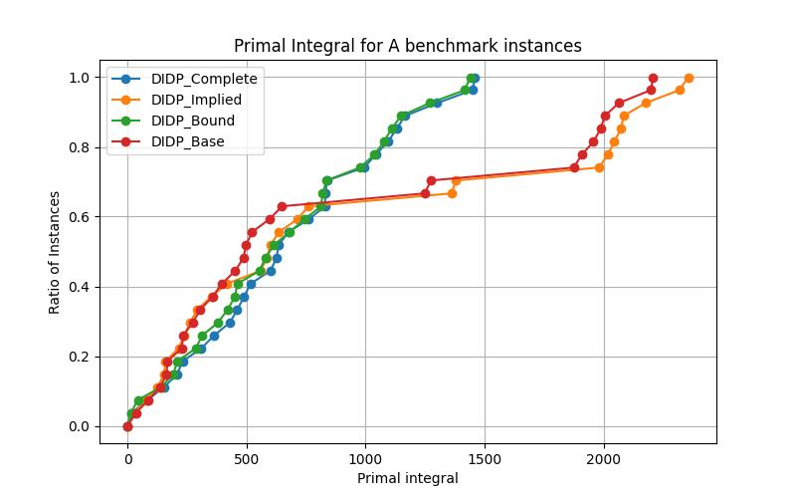
First DIDP model

Slide 24
First DIDP model
For the smaller instances, the dual bound has a positive effect on the performance.
The implied constraint seems to have a very little effect on performances.
For the final evaluation, the model with the bound and without the implied constraint will be kept.

Slide 25
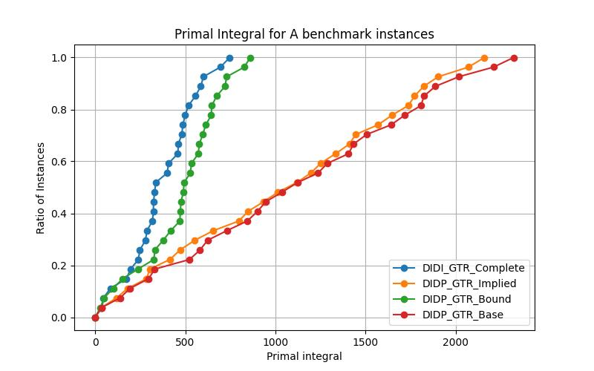
Second DIDP model

Slide 26
Second DIDP model
As for the previous model, the dual bound has a positive effect on the performance.
The presence of the implied constraint is not as decisive as the dual bound, but it seems to have a clearer positive effect than before.
For the final evaluation, the model with the bound and the implied constraint will be kept.

Slide 27
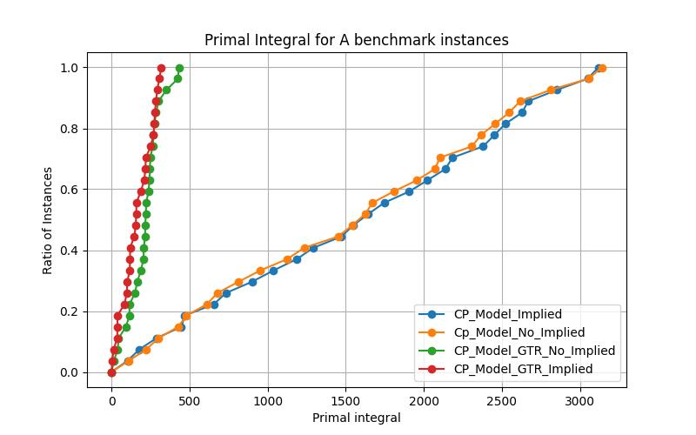
CP models

Slide 28
CP models
The CP model implementing the giant tour representation is clearly outperforming the model based on constructing all the tours in parallel, as expected.
The implied constraint seems to make performance slightly better.
The GTR model with the implied constraint will be used for the final evaluation.

Slide 29
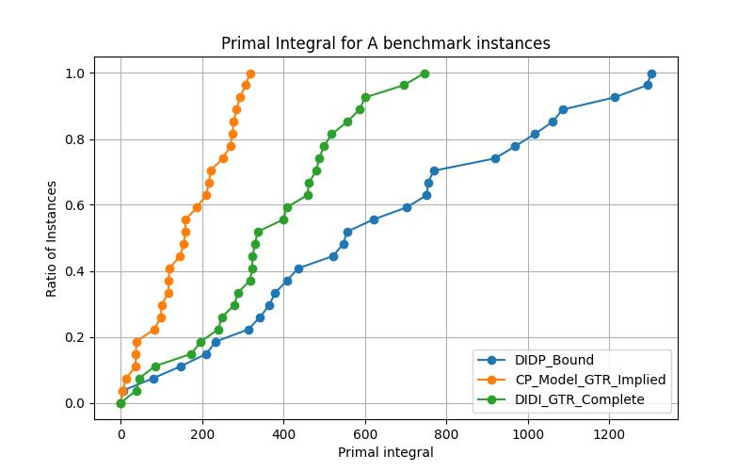
A Set: Final Evaluation

Slide 30
A Set: Final Evaluation
The DIDP model with the formulation based on the giant tour representation is outperforming the other DIDP model.
The CP model used as baseline is the best overall model for the smaller instances.

Slide 31
Results on the Golden Set
Since multiple models and their variations were tested, subsets of the totality of the models will be evaluated at the beginning, to enhance the readability of the results that will be shown.
For each subgroup the best performing model will be selected for the final evaluation.

Slide 32
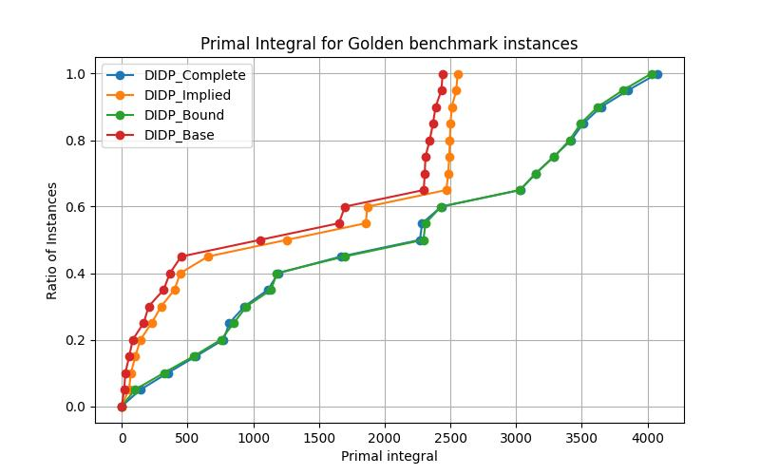
First DIDP model

Slide 33
First DIDP model
For greater instances, the dual bound makes the performance of the model worse.
The implied constraint is probably less effective than just reducing the complexity of the model by exploiting less transitions.
The base model will be kept for the final evaluation, without any additional constraint and dual bound.

Slide 34
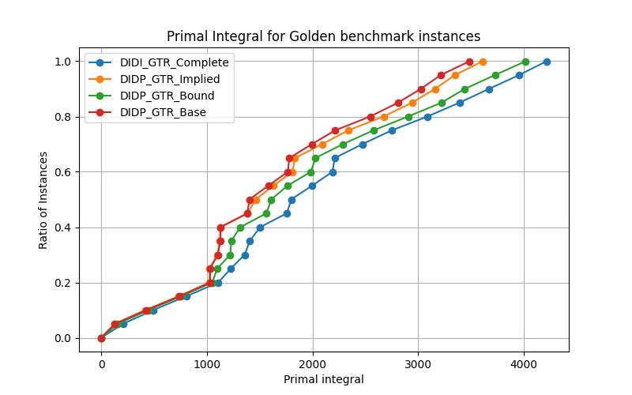
Second DIDP model

Slide 35
Second DIDP model
The performance’s trends that can be observed are the same of the previous DIDP model: both the dual bound and the implied constraint make the performance worse.
As for the previous case, the base model will be kept for the final evaluation.

Slide 36
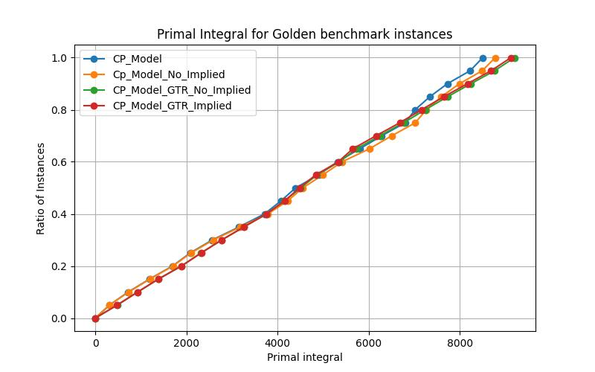
CP models

Slide 37
CP models
All the CP models have very similar performances, with the model building all the paths in parallel (without giant tour representation) and without the implied constraint being slightly better than the others.

Slide 38
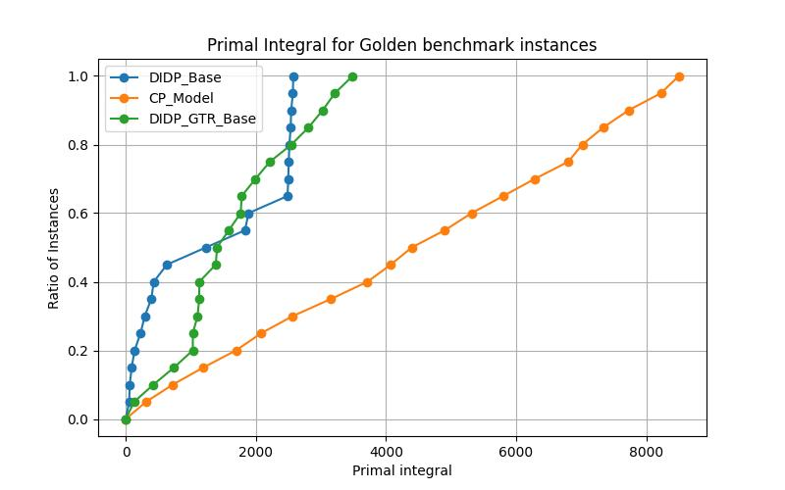
Golden Set: Final Evaluation

Slide 39
Golden Set: Final Evaluation
For the Golden benchmark instances, the baseline CP model is surprisingly the one with the worst performance.
The DIDP model constructing in parallel all the paths has the best performance.

Slide 40
Final Considerations
Considering the dual bound, its effect on the performance of the models seems coherent with what has been observed for CVRP-TW: for smaller/more constrained instances with lower branching factor, the dual bound can actually be useful for search guidance, while it makes the performance worse for greater/less constrained instances.
In all the models, the impact of the implied constraint (either positive or negative) is almost negligible, with the dual bound being the most determining factor for performance.

Slide 41
Final Considerations
For both CP and DIDP, the model formulation building all the paths in parallel lead to better results (even if only slightly) then the alternative formulation when applied on the bigger instances.
The only case where the CP model was not the best performer occurred in the Min-Max CVRP on the Golden instances. This is likely due to the nature of the objective function, which is not a simple linear summation and is therefore harder to optimize, especially when combined with the increased complexity of larger instances.
Even additional attempts with symmetry breaking constraints were not successful on improving the performance.
It should also be considered that the CP models developed in Minizinc and solved with Gecode do not represent the state-of-the-art technology for solving routing problems.

