Slide 1
Large-Scale and Multi-Structured Databases DietManager
Bensi Simone, Malloggi Fabio, Nocchi Tommaso

Slide 2
Application Highlights
DietManager is an application which basically allows registered standard users to find diets using specific filters provided by nutritionists and follow them. Moreover, users can add a list of eaten food in order to check if he/she is respecting the current selected diet.

Slide 3
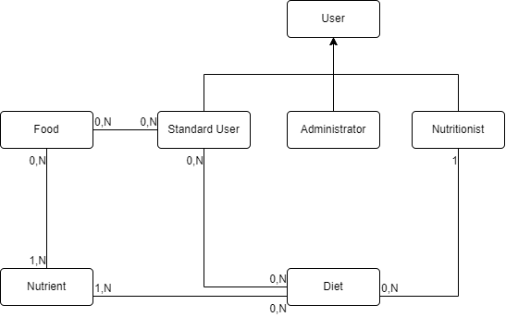
UML Class Diagram

Slide 4
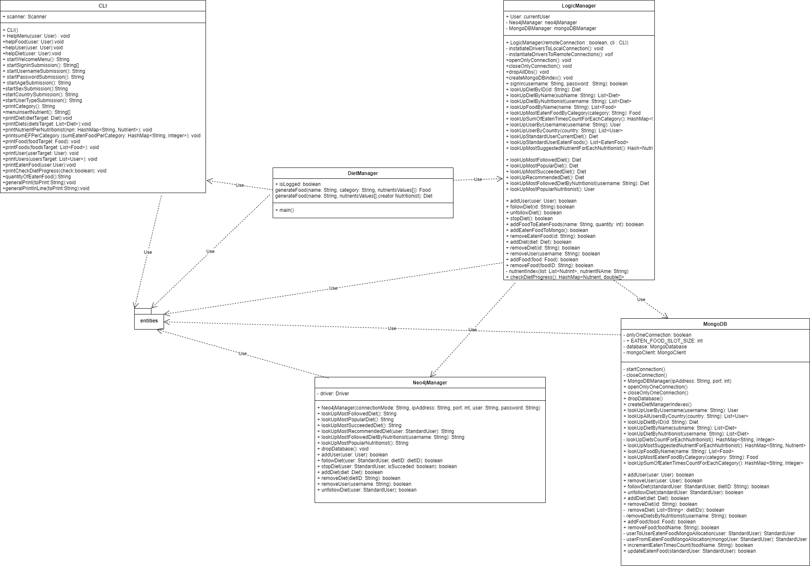
Class Diagram

Slide 5
Dataset Description
Source:
Users/Nutritionists:
https://www.kaggle.com/heesoo37/120-years-of-olympic-history-athletes-and-results. It occupies around 40 MB (~ 130000 entries)
Foods:
https://www.kaggle.com/johncsloan/usda-fooddata-central?select=JCS_FoodId-FoodName-BRCat-UPC-BrandOwner-SvgSizeHgs_branded.csv. It occupies around 0.5 GB (~ 1000000 entries)
https://data.world/craigkelly/usda-national-nutrient-db. It occupies around 4MB (~8600)
Description: User dataset includes a list of generic users used to populate the application.
Food dataset includes a list of generic and specific food used to populate the application.
Volume: After some data filtering and cleaning we obtained a food dataset with about 7300 entries and a user/nutritionist dataset with about 52000 entries. We also obtained about 2000 diets randomly generated. The complete dataset occupies around 75 MB.

Slide 6
Dataset Description
Variety: food information are taken from Kaggle and data.world.
Variability/Velocity: users can add eaten foods and nutritionists can add diets. Users can finish followed diets and follow another diet.

Slide 7
Non-functional requirements
The content of the application should be highly available in any moment.
The code must be readable and easy to maintain.
The system is tolerant to data lost.
The system doesn’t have a single point of failure.
The system has fast response times, in order to make the application enjoyable for users.
Accordingly to non-functional requirements, the application ensures AP edge of the CAP triangle, namely availability and partition tolerance.
In particular, the highest availability is achieved through the use of replicas and the setting of write concern to 1 and read preferences to nearest.

Slide 8
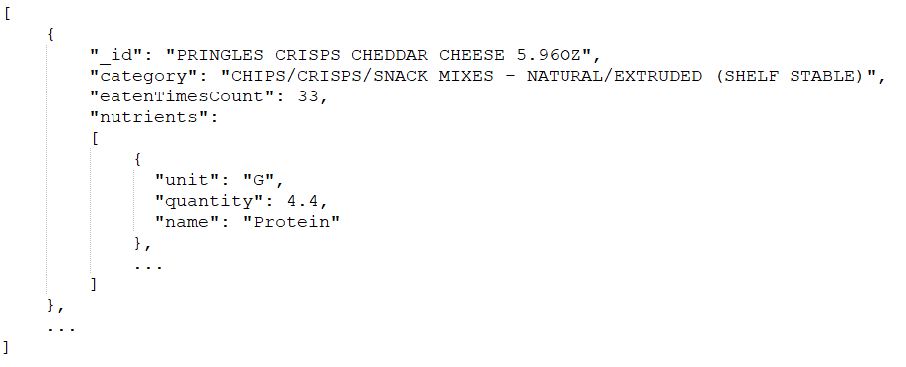
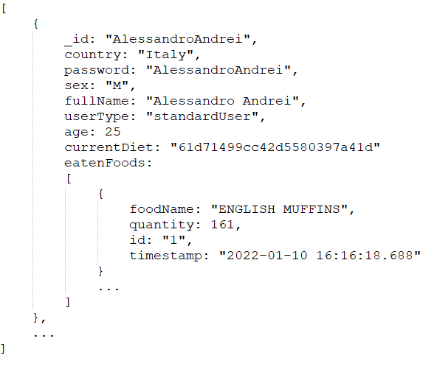
MongoDB Design
Foods collection
User collection

Slide 9
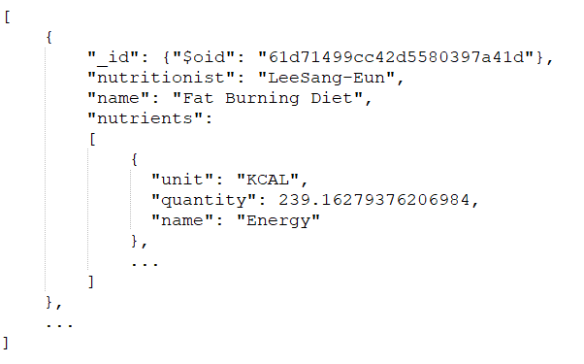
MongoDB Design
Diets collection
MongoDB Queries
Look up for total number of diets suggested by each nutritionist
Look up for the most suggested nutrient for each nutritionist
Look up for the total number of times that a food has been eaten for each category

Slide 10
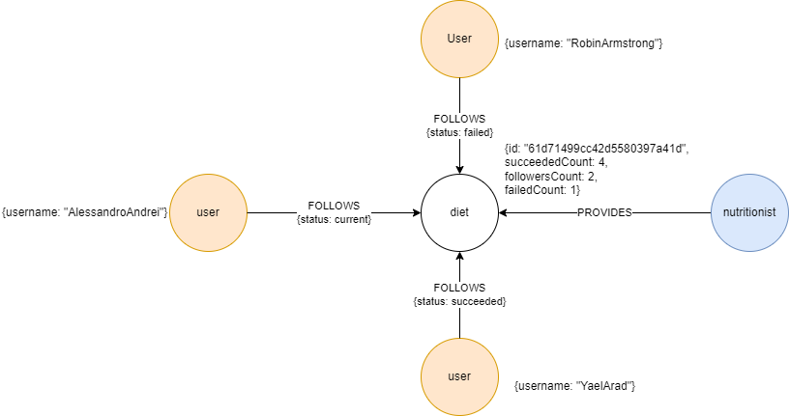
Neo4j Design

Slide 11
Neo4j Queries
Find the most followed diet
Find the most popular diet
Find the most succeeded diet
Find the most recommended diet
Find the most popular nutritionist
Find the most followed nutritionist

Slide 12
Data consistency management
Using two different database architectures for data management, we needed to manage possible states of inconsistency in the following situations:
Register standard user or nutritionist
Add diet
Remove user
Remove diet
Follow diet
Stop diet
Writings are made first on one database, then, if there aren’t any errors, them are made on the other. In case of error an error message will be displayed. In case of error on the second writing the previous operation done on the other database will be rollback.

Slide 13
Sharding proposal
Sharding, together with data replication, would allow for load-balancing purposes, achieving better performances. To implement such sharding, we would select three different sharding keys, one for each collection of our document database:
Foods collection: key “category”
Users collection: key “country”
Diets collection: key “nutritionist”
We selected the hashing partitioning method, in order to map the fields chosen as sharding key through a hash function.

Slide 14
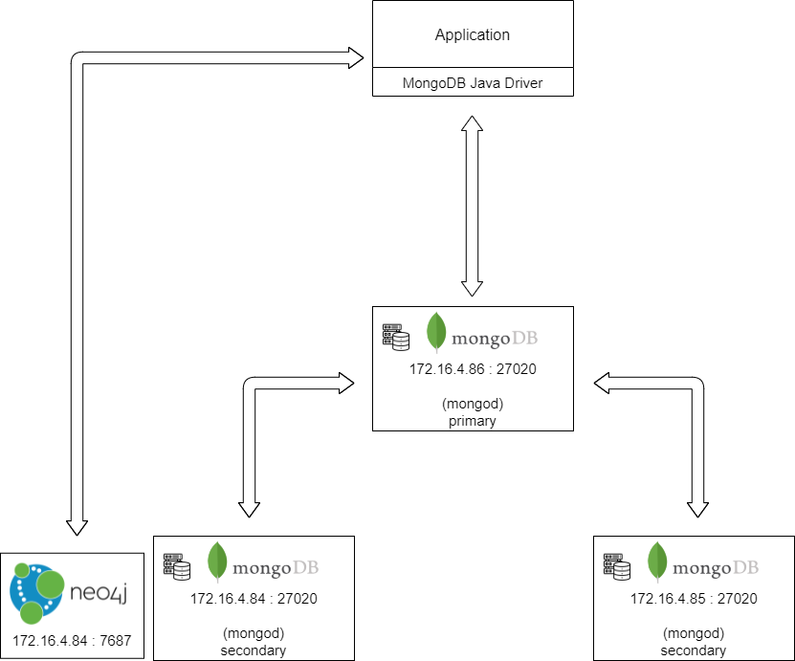
Hardware and Software Architecture

