Slide 1
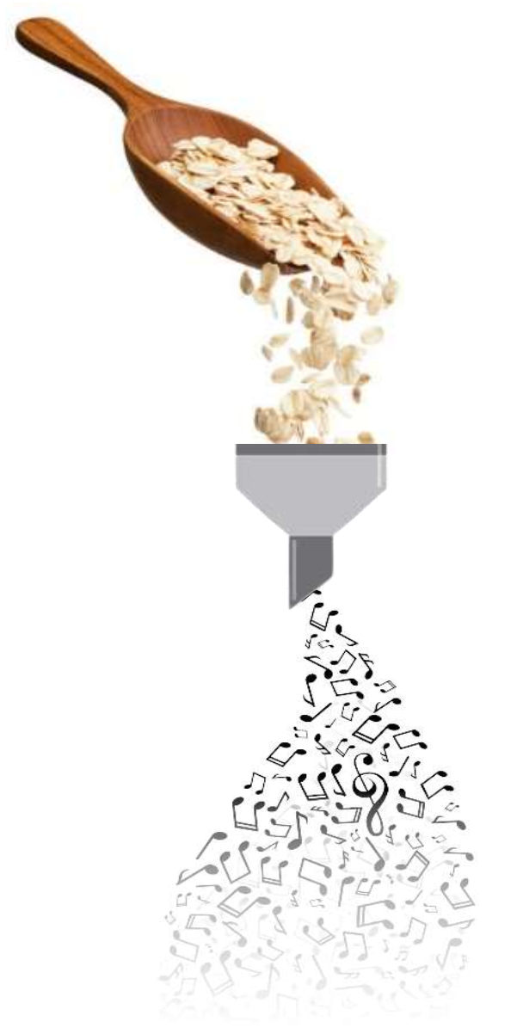
Systematic Classification Experiments
Team Oatmeal:
David Kürnsteiner, Christian Peinthor, Fabio Pöschko, Elias Ramoser, Georg Storz

Slide 2
Outline
Prediction of four emotion classes, with:
kNN
Boosted Tree
SVM
NN
Prediciton of major/minor feature

Slide 3
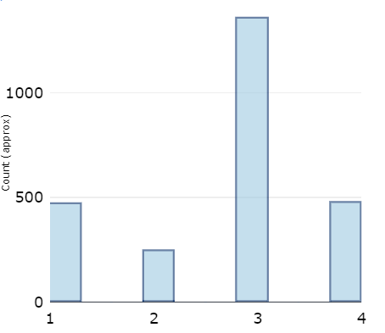
Underlying Data: Class Distribution
Unbalanced Distribution
Class 3 most dominant
Class 2 least dominant

Slide 4
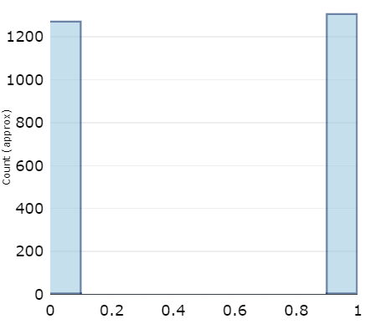
Underlying Data: Score Mode Distribution
Score Mode (major/minor) feature is strongly balanced

Slide 5
Prediction on emotion classes: general info
Models trained on quadrant labels
Excluded features: score / id This was done, because they will not be provided in the later tasks
Preprocessing / Normalization was done
To have better results with distance based classifiers (kNN, SVC)
To have better gradient descent with the NN
We used 10-fold Cross Validation for each classifier
10 was a good balance between training time and results
We had some overfitting („high“ hyperparameters), which was avoided with 10-fold cross validation

Slide 6
kNN
Dataset normalized with MinMax normalization
75/25 stratified train/test set split
f1-score as metric
Test set scored with best classifier

Slide 7
kNN: results
n | p | weights | mean_test_score
5 | 1 | distance | 0,7546
5 | 1 | uniform | 0,7490
10 | 1 | distance | 0,7449
5 | 2 | distance | 0,7403
10 | 2 | distance | 0,7367
10 | 1 | uniform | 0,7336
2 | 1 | distance | 0,7326
5 | 2 | uniform | 0,7321
10 | 2 | uniform | 0,7234
25 | 1 | distance | 0,7224
25 | 1 | uniform | 0,7137
25 | 2 | distance | 0,7122
2 | 1 | uniform | 0,7122
25 | 2 | uniform | 0,7071
50 | 1 | distance | 0,7030
15 best classifiers
Parameter p:
1: manhatten distance
2: euclidian distance
Parameter weights:
Uniform: all points are weighted equally
Distance: closer points have higher influence
Result: 75% accuracy

Slide 8
Boosted Tree
Used model class:
Lightgbm multiclass gradient boosted decision tree
Dataset normalized with Zscore-normalization
75/25 stratified train/test set splitPermutation feature importance with accuracy as metric

Slide 9
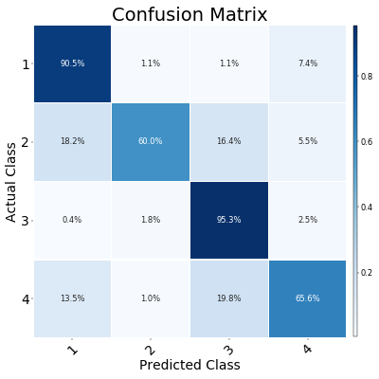
Boosted Tree: results
Learning rate | Minimum number of samples per leaf node | Number of trees constructed | Maximum number of leaves per tree | Mean test accuracy
0,1 | 10 | 500 | 32 | 0,800
0,05 | 1 | 500 | 32 | 0,799
0,05 | 10 | 500 | 32 | 0,799
0,2 | 50 | 500 | 32 | 0,799
0,2 | 50 | 500 | 128 | 0,799
0,05 | 50 | 500 | 128 | 0,799
0,05 | 50 | 500 | 32 | 0,799
0,025 | 10 | 500 | 32 | 0,797
0,1 | 1 | 500 | 32 | 0,797
0,2 | 50 | 500 | 8 | 0,796
0,4 | 1 | 100 | 32 | 0,796
0,1 | 50 | 500 | 128 | 0,795
0,1 | 10 | 500 | 128 | 0,795
0,1 | 50 | 500 | 32 | 0,795
0,4 | 10 | 500 | 8 | 0,794
15 best classifiers
Result: 85% accuracy on test set (best model class, of the four tested)

Slide 10
SVM
LinearSVC: one vs one mutliclass classifier
Dataset normalized with MinMax-normalization
Split 80/20 into stratified train/test setPermutation feature importance with accuracy as metric

Slide 11
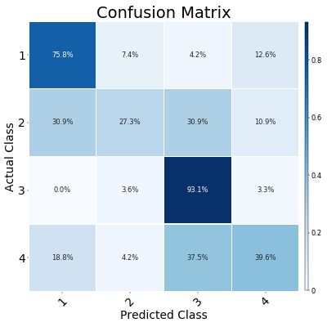
SVM: results
Lambda | Number of iterations | mean test accuracy
1 | 1000 | 0,740
1 | 100 | 0,735
0,1 | 100 | 0,727
0,1 | 1000 | 0,720
1 | 10 | 0,698
0,1 | 10 | 0,697
10 | 1000 | 0,689
10 | 100 | 0,686
10 | 10 | 0,677
1 | 1 | 0,604
0,1 | 1 | 0,602
10 | 1 | 0,599
100 | 1 | 0,529
100 | 10 | 0,529
100 | 100 | 0,529
15 best classifiers
Result 73% on test set
Worse than kNN (75%) and Boosted Tree (85%)

Slide 12
Neural Network
Fully connected NN with 3 hidden layers (each 100 neurons)
Dataset normalized with MinMax-normalization
Split 80/20 into stratified train/test setPermutation feature importance with accuracy as metric

Slide 13
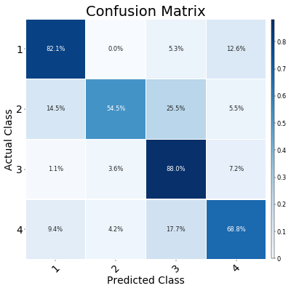
Neural Network: results
Learning rate | Number of learning iterations | mean test accuracy
0,01 | 320 | 0,762
0,1 | 160 | 0,754
0,01 | 640 | 0,754
0,01 | 2560 | 0,754
0,1 | 640 | 0,754
0,1 | 1280 | 0,754
0,1 | 2560 | 0,754
0,1 | 320 | 0,753
0,01 | 1280 | 0,752
0,001 | 1280 | 0,752
0,001 | 2560 | 0,750
0,01 | 160 | 0,747
0,001 | 640 | 0,727
0,001 | 320 | 0,698
0,001 | 160 | 0,665
Best 15 classifiers
Result: 80% on test set
Confusion Matrix more equally distributed

Slide 14
Feature importances
All features that had an importance of at least 3% in any of the last three classifiers
Feature | Boosted Tree | SVM | NN
essentia_onset_rate | 13,40% | 14,55% | 15,51%
midlevel_features_melody | 2,30% | 9,20% | 7,66%
librosa_bpm | 5,75% | 0,96% | 2,87%
midlevel_features_articulation | 1,92% | 2,68% | 5,56%
midlevel_features_rhythm_complexity | 3,07% | 4,60% | 1,92%
midlevel_features_dissonance | 0,19% | 1,34% | 4,21%
librosa_spectral_bandwidth_mean | 1,72% | 3,45% | 1,72%
midlevel_features_minorness | 2,30% | 3,26% | 1,34%

Slide 15
Score mode predictions: Random Forest
For all predictions: 80/20 - train / test split
Random Forest
Accuracy: 53,64%
After dropping some unnecessary features: 55,94%
After GridSearchCV: 55,94%

Slide 16
Naive Bayes / SVM
Gaussian NB
Result: 49,8%
Bernoulli NB
Result: 52,87%
SVM
Poly: 43,9%
RBF: 45,6%
Sigmoid: 45,8%

Slide 17
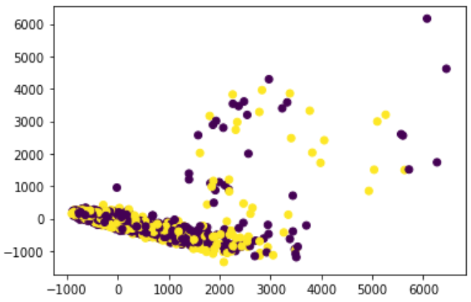
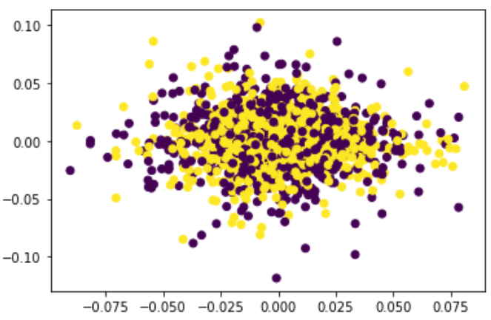
PCA / ICA
PCA ICA
No significant separation visible

Slide 18
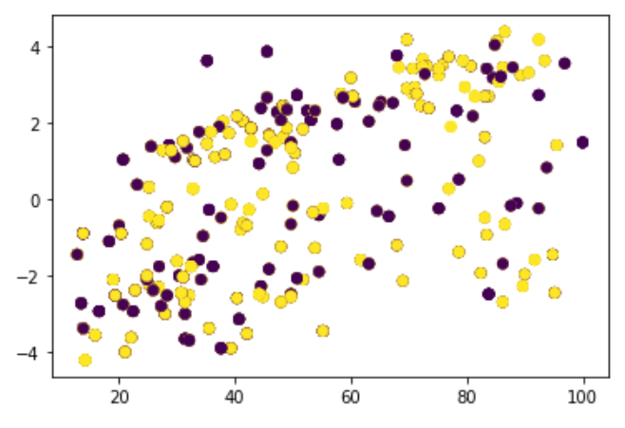
Conclusion for our mode prediction
Results are really bad
Could be the case due to the much overlapping distribution of major and minor samples
Distribution of score mode

