Slide 1



HPC projects presentation
Luca Lo Brutto s346285
Fabio Garrone s349449
Andrea Ruggiero s341930

Slide 2
MPI
Andrea Ruggiero s341930

Slide 3
General Overview
MPI: Systolic array structures for matrix multiplication
CUDA: Fundamentals of multi-dimensional data processing
OpenMP: Heat Diffusion Simulation in 2D Grid

Slide 4
Exercise Overview: MPI
Introduction
Solution Description
Experimental Results
Conclusions

Slide 5
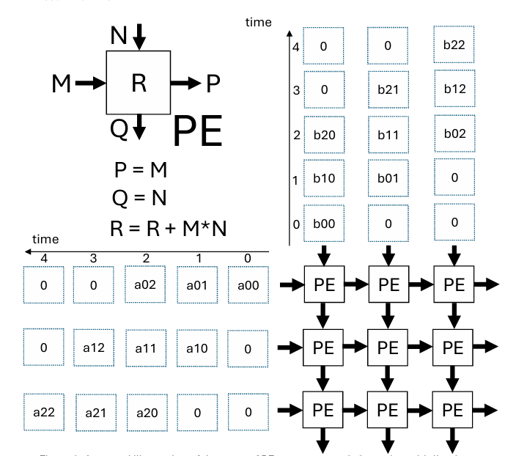
Introduction
The MPI exercise is based on Systolic array.
Each Processing Element (PE) is a process that receives and passes sub-matrices to and from neighbors using MPI communication.

Slide 6
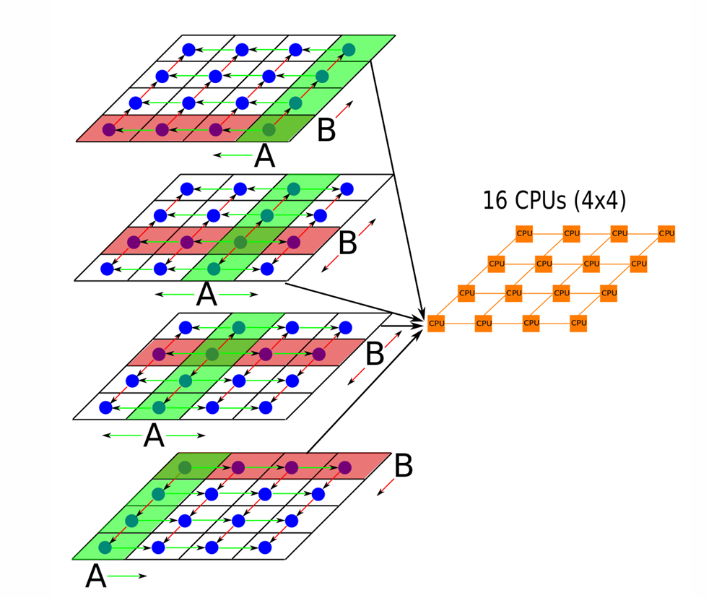
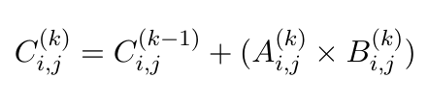
Solution Description
Multi-threading
After submatix scattering the node
compute the k-th partial result:
Then the final result is reconstrut as combination of partial computations

Slide 7
Solution Description
Single thread
One of the main problem of multy process and distributed system is Race condition and Synchronization loss.
This problem is solved assigning statically the memory blocks:
Root manage the input matrices
Node contain scattered submatrices
Thread manage their portion of output matrix
th0
Multiple thread
th2
th1
th0

Slide 8
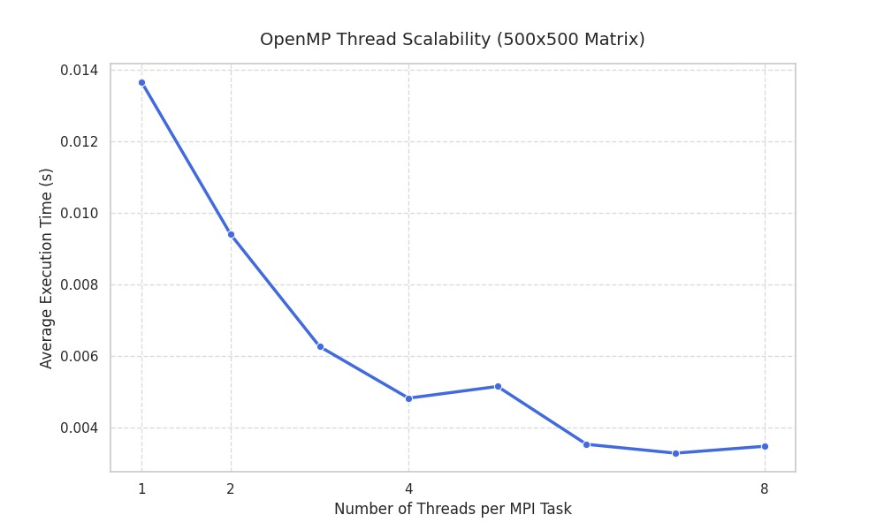
Experimental Results
Amdahl law
The computation result is aligned to experimental result
The tradeoff is ~ 7 thread
Except for one anomalies

Slide 9
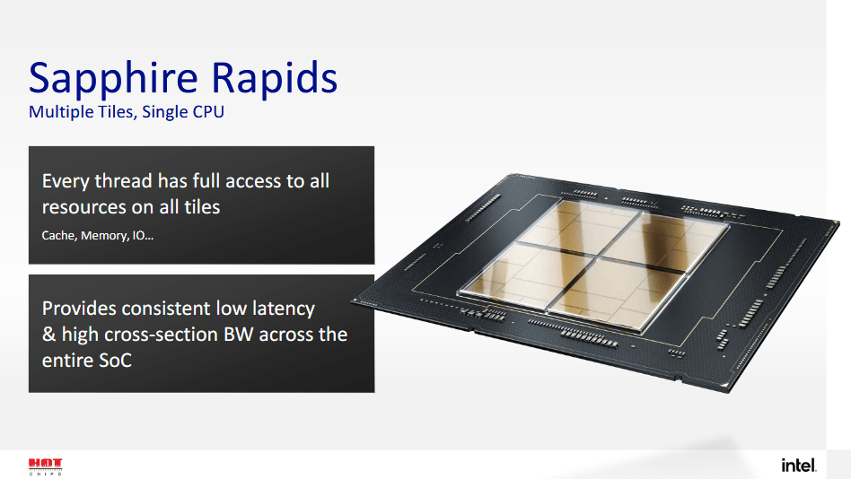
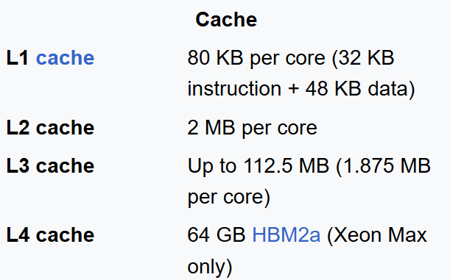
Experimental Results
HPC architecture

Slide 10
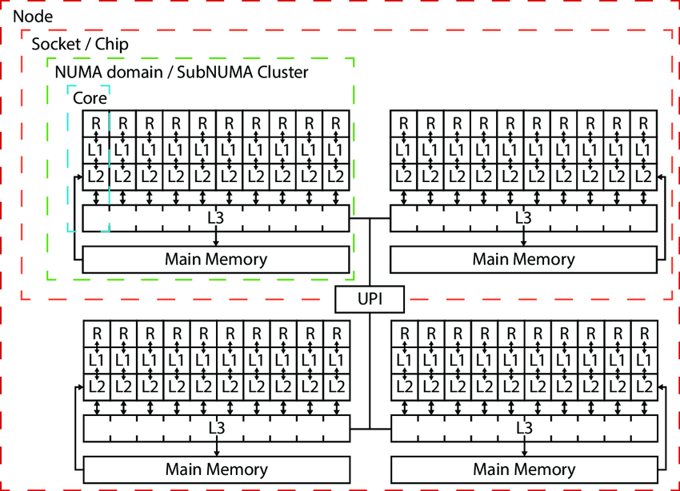
Experimental Results
HPC hypothesis
500/2 (two nodes)
250x250=62500 [float]
=250000byte ~ 244 [KB]
244 [KB]x5 ~ 1.19 [MB]
All matrices are in L2

Slide 11
Experimental Results
HPC hypothesis
The main hypothesis are:
Cache miss
Hardware conflict

Slide 12
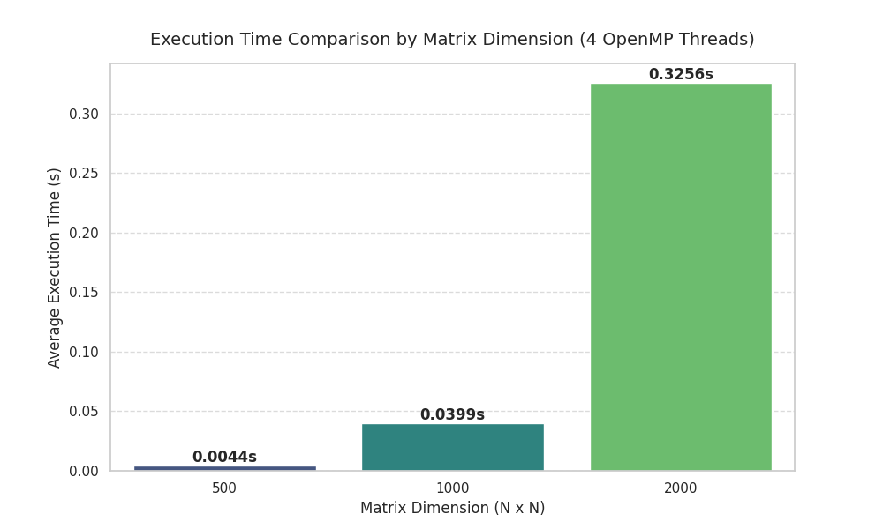
Experimental Results
Memory footprint scales quadratically O(n²) with matrix size,
while computational load scales cubically O(n³),
highlighting the need for efficient parallelization to manage execution time.

Slide 13
Conclusions
Amdahl’s Law: Speedup is strictly limited by the serial bottleneck of MPI communication.
Non-parallelizable Overhead: Some operation like matrix read/write and work fragmentation is non-parallelizable
Scaling Divergence: Memory follows O(N²), while computational load follows O(N³)

Slide 14
CUDA
Fabio Garrone s349449

Slide 15
Exercise Overview: CUDA
Introduction
Solution Description
Experimental Results
Conclusions

Slide 16

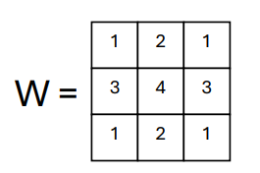
Introduction
Application of a low-pass filter to images with Salt-Pepper Noise through convolution

Slide 17
Introduction
Different resolution: 4K, 8K and 16K
Different percentage of noise → 50%, 75% and 90%.
Performance evaluation based on the number of utilized Blocks (8, 16 ,32) and number of GPUs.
Every variable changes (image, n° of blocks, …) had 10 run to get more precise timing

Slide 18
Solution Description
RGB division with the split function of OpenCV
Loop unrolling for the sum (reducing branch divergence)
Halo zone to avoid repeated operations
W matrix put in constant memory avoiding bottleneck

Slide 19
Experimental Results

Slide 20
Experimental Results
Block size doesn’t impact performance so much
2 GPUs takes more time because of parallelization

Slide 21
Experimental Results

Slide 22
Experimental Results
PSNR doesn’t change too much between resolution for the same level of noise
The Salt-Pepper noise is assimilable to a Dirac Delta, so this type of filter isn’t efficient

Slide 23
Experimental Results

Slide 24
Conclusions
Better filter are needed for Salt-Pepper Noise, like Median filter.
Performance is bounded to VRAM Band (GDDR6 vs HBM2)

Slide 25
Open MP
Luca Lo Brutto s346285

Slide 26
Exercise Overview: OpenMP
Introduction
Solution Description
Experimental Results
Conclusions

Slide 27
Introduction
Simulation of heat diffusion through an anisotropic 2D metal slab.
Performance optimization achieved using OpenMP.
Performance evaluation based on the number of utilized threads.
Study of the correlation between elapsed time and iteration count.

Slide 28
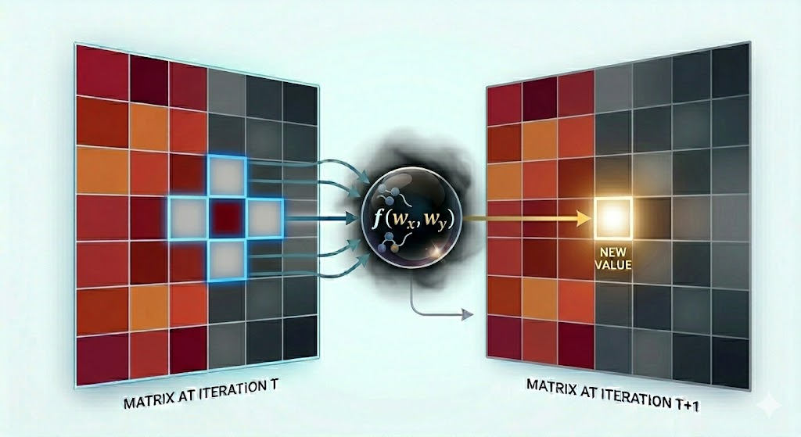
Solution Description
Core alghoritm
Diffusion model: Compute temperature of cell based on neighborhood and and coefficients.
Boundary cells: handling out-of-bounds memory errors.
Optimization: swapping input and output matrices.
Parallelization: static scheduling.

Slide 29
Solution Description
Convergence & Scalability Testing
Convergence: checking if the maximum temperature change in an iteration is higher then set threshold (0.001ºC).
Simulation executed with different number of threads (1,2,4,8,16,32).
Performance Tracking: execution time measured with omp_get_wtime() to analyze parallel speedup.
Snapshots: images taken in a separate simulation to not affect the performance.

Slide 30


Experimental Results
Simulation 1
Simulation 2

Slide 31
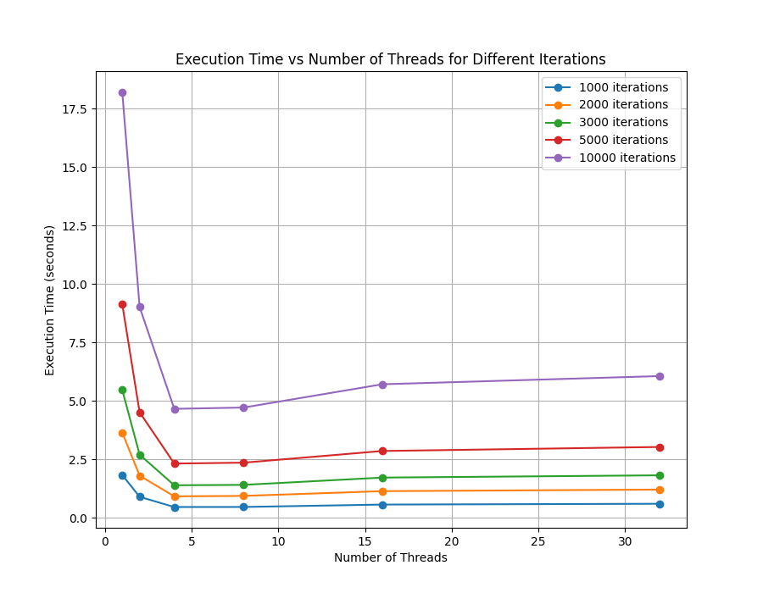
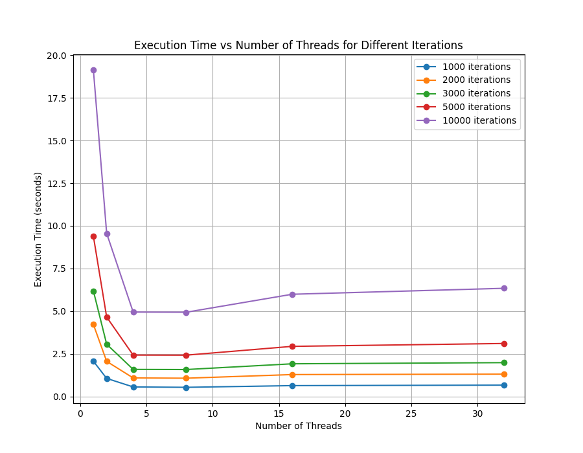
Experimental Results
Simulation 1
Simulation 2

Slide 32
Conclusions
Optimal Scaling: performance gains from parallelization, achieving maximum speedup at 4/8 threads.
Hardware Alignment: Improvement of performance.
Resource Contention: Allocating threads beyond the physical core limit introduces context-switching overhead and hardware competition.

