Slide 1
SUB-METERING PROPOSAL
Alejandro-Jasper-Fabi.
IOT Analytics Department

Slide 2

01
02
03
04
05
06
ADVANTAGES
ENERGY POWER SYSTEM
TABLE OF CONTENT
PROJECT DEFINITION AND STAGES
PROJECT GOALS AND DASHBOARD
BUDGET
FIRST INSIGHTS

Slide 3
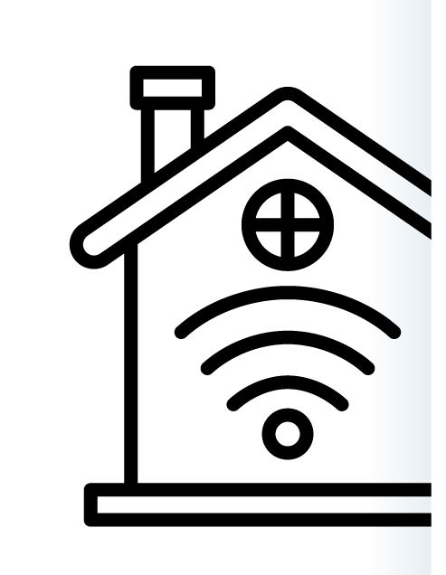
ENERGY POWER SYSTEM IN SMART HOMES
The Energy Management segment covers the sale of products and services for the control and reduction of energy consumption
Main product category are: smart thermostats in combination with AC and radiator controls built by Google Nest, Bosch, or Samsung.
The average revenue per installed Smart Home currently amounts to US$77.54 and it is expected to hit by 2024.
Notes:
The Smart Home market constitutes the sale of networked devices and related services that enable home automation for private end users (B2C).
Internet of Things, is an essential component of intelligent home automation.
Submetering

Slide 4

ADVANTAGES
CONNECTIONS
Information in Real Time
Digitally connected and controlled devices within a house that can be remotely controlled
.
Sensors, and cloud services that support automation
REDUCE ENERGY USAGE
ENVIRONMENTAL AWARENESS
Predicting future usage
Avoid posible electronic devices´ malfunction
Savings on energy consumption

Slide 5
PROJECT STAGES
STAGE 3
Predict Future electric usage
Avoid future electrical devices damage
Electric devices preference.
STAGE 2
Electric devices usage.
STAGE 1
Trends of behaivor
Electricity usage rates.

Slide 6
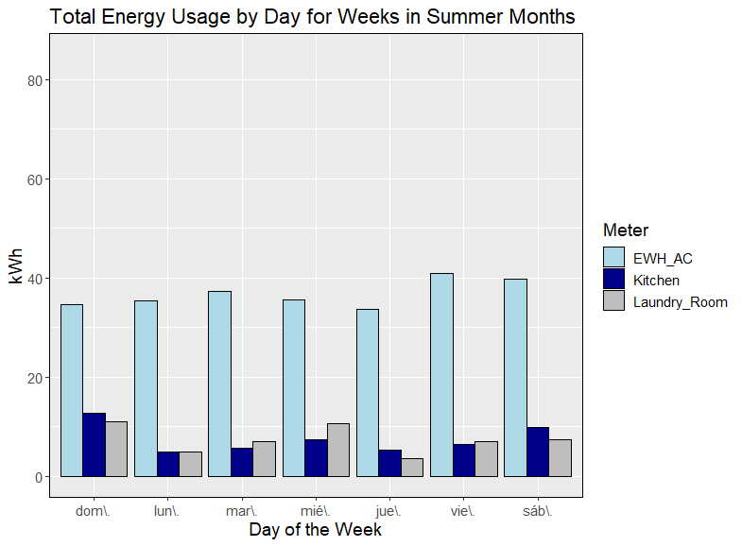
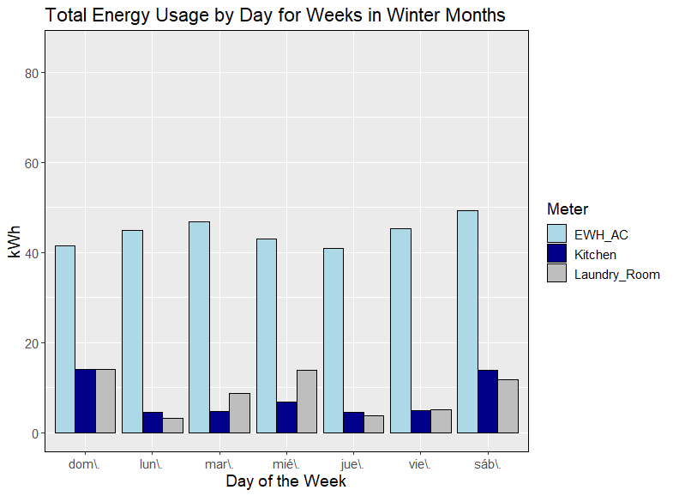
1 STAGE

Slide 7

2 -3 STAGE
DASHBOARD
Control of the average temperature.
Better maintenance of electric devices.
Lowest rates.
Predict future usage.
.
Notes:
Possible ADD on,
Subscription fees for control apps or external monitoring services
Subscription fees for control apps or external monitoring services
Better contract with electric
Alarm

Slide 8
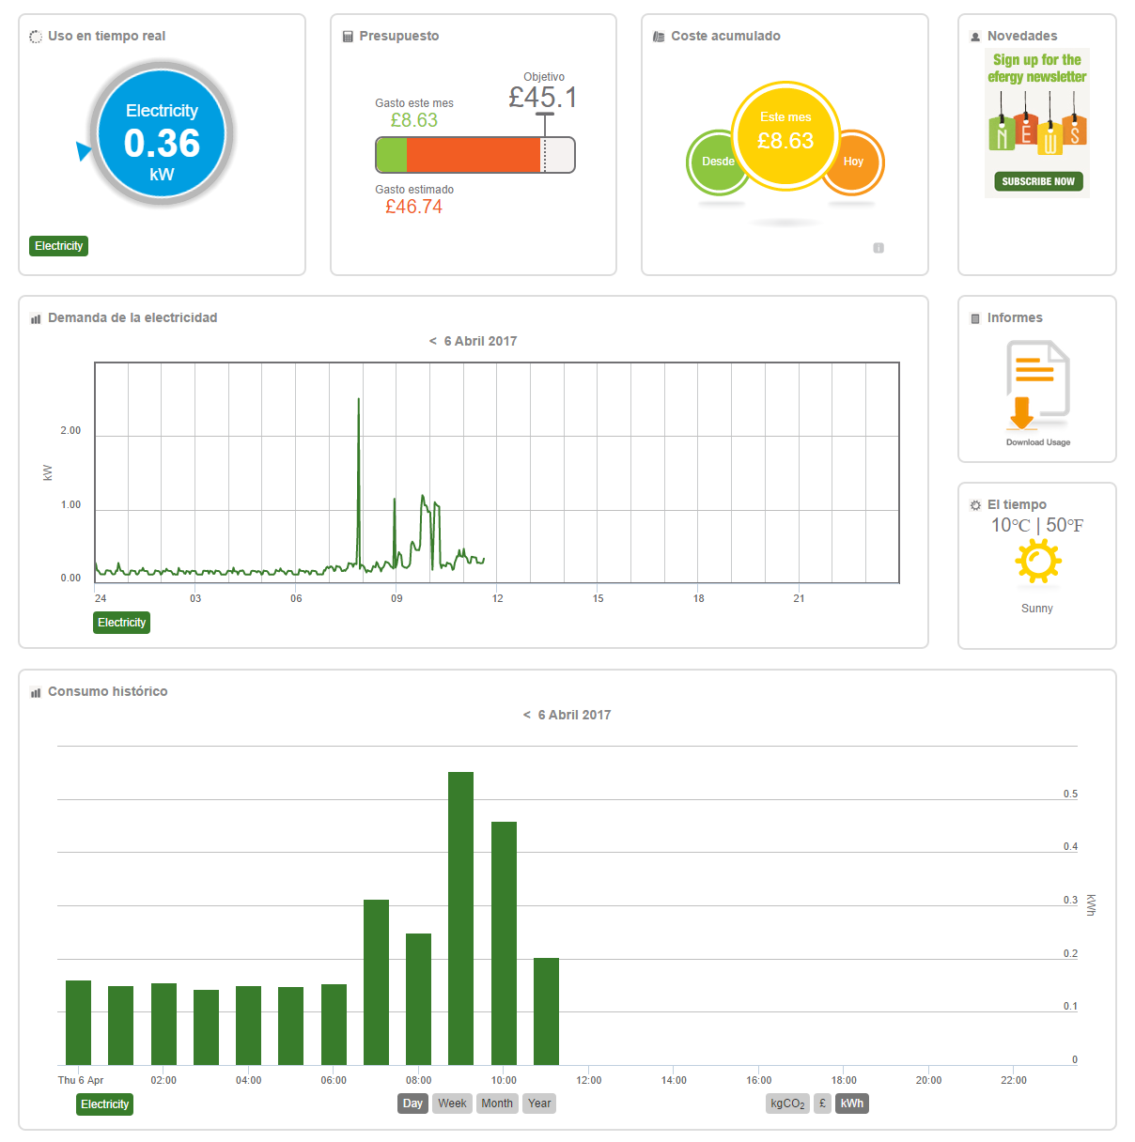
DASHBOARD
.

Slide 9
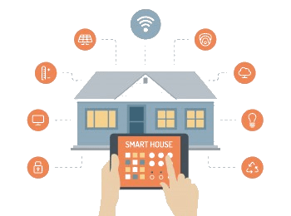
GOALS
Improve energy efficiency
Save energy using the sub-metering information (and other proposals)
Monitoring and awareness
Engagement and satisfaction
Personalized consumption creates a better customer experience, fostering engagement and satisfaction
Increased awareness of activity can enhance home security, home automation solutions and enable services

Slide 10
BUDGET PROPOSAL PER PROJECT (3 MONTHS)
30,000
DATA DESIGN
$10,950
DATA DEPARTMENT
$18,750
SOFTWARE
$300
Notes:
ALEEEJANDROOO TIENE QUE COMPLETAR

Slide 11
ADDED VALUE FROM PREDICTED RESULTS
20%
Oportunity to improve electric rates.
One click
Optimization of the energy at one click
30%
Less energy wasted

Slide 12

THANKS
Does anyone have any questions?
fja@iotdepartment
+91 620 421 838
Follow the project updates
@iotanalytcs

