Slide 1
AMD
Final project

Slide 2
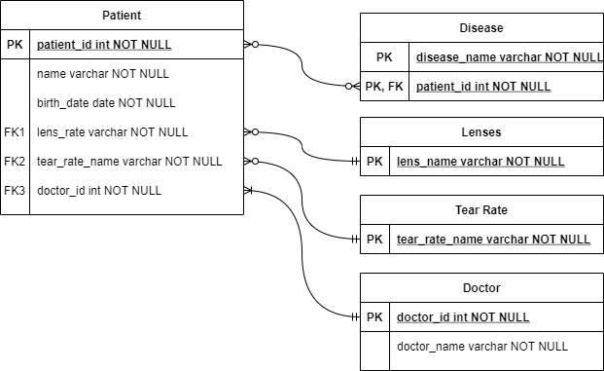
Entity-Relationship Model

Slide 3
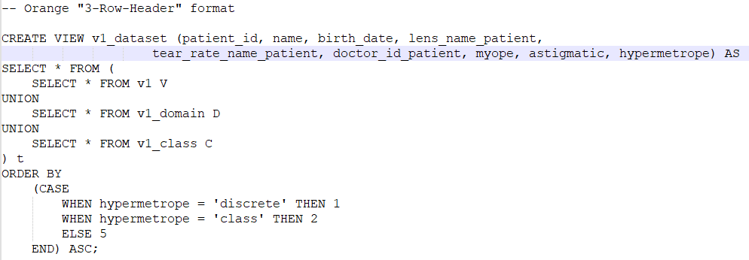

Exported view

