Slide 1
Early Sepsis Prediction with LSTM
ML/DL Assignment on mimic-III dataset Github Link

Slide 2
Dataset and Preprocessing
Dataset: MIMIC-III ICU data (CHARTEVENTS, LABEVENTS, ICUSTAYS, DIAGNOSES_ICD, D_ITEMS)
Goal: Predict early sepsis in ICU patients
Preprocessing:
Load Data and extract the vitals and their itemids from d_items.
Get chartevents data with those itemids .
Make pivot table with the vitals as features
Handle missing values
Normalize/scale data
Get sepsis subject data with ICD9_CODE of sepsis from diagnoses , Labeling for sepsis
Split into train/test
Create sequences for time series input

Slide 3
What is Sepsis & How We Predict It
Sepsis is a life-threatening organ dysfunction caused by a dysregulated body response to infection
Early detection is crucial to reduce mortality in ICU patients
We predict sepsis by:
Monitoring time-series data (vital signs such as - 'heart_rate', 'sbp', 'dbp', 'resp_rate', 'spo2', 'temperature' , lab results)
Using LSTM to detect patterns indicating early signs
Classifying sequences into sepsis or non-sepsis cases

Slide 4
LSTM Overview
LSTM (Long Short-Term Memory) is a type of Recurrent Neural Network (RNN)
Good at capturing long-term dependencies in sequential data
Ideal for time-series problems like patient vital sign monitoring

Slide 5
Why Use LSTM?
Sepsis develops over time – we need to capture temporal patterns
LSTM handles sequences well and remembers past information

Slide 6
Code Explanation: Summary
Load and preprocess the dataset
At first we will get the itemids of the vitals from d_items data.
Then with those itemids we can extract the vitals data from chartevents
As there are many nan values so using Forward + backward fill per patient, it will fill the null values with the last known values or the next known values of a particular subject_id
Define a function `create_sequences()` to turn time-series into LSTM-friendly sequences
Instead of feeding all 10 hours into the model at once, we can use a window of fixed size (say 6 hours), and slide it forward to generate multiple training samples.This is called a sliding window, and it's how LSTM learns from shorter chunks of time instead of the whole sequence.
Split data into training and testing sets

Slide 7
Code Explanation: Summary
Build the LSTM model using Keras
Compile with loss = binary_crossentropy (for classification)
Train the model and validate on test data
Plot training/validation loss and accuracy

Slide 8
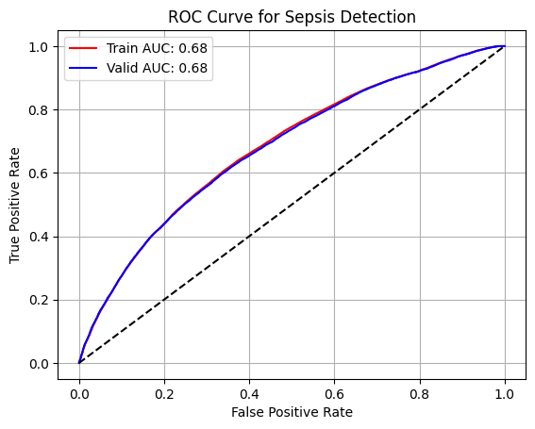
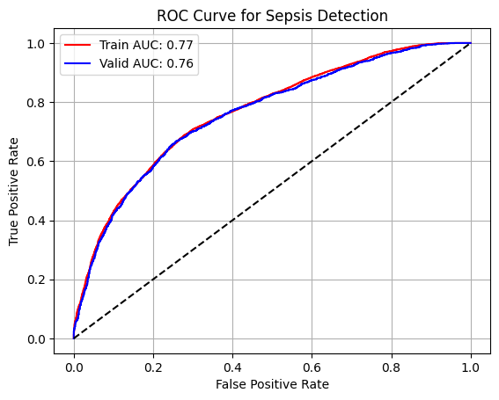
Evaluation of Results
Accuracy and loss plots show how well the model trained
Model performance depends on the sequence length and features
LSTM shows potential in predicting sepsis early

Slide 9
Evaluation Explained
The ROC curves for both sets are close to the diagonal (black line)
The model has limited ability to distinguish between septic and non-septic patients
It performs only slightly better than random guessing
Consistency between train/valid AUC → not overfitting, but still underperforming
ROC curves are bowed up nicely → much better separation between classes
The model learned patterns that distinguish septic vs. non-septic well — in this small cohort
Overfitting is not present, generalization is strong here

Slide 10
Future Improvement:
The results are not performing well. So we can do improvements .
Add More Features. Such as Include lab values: WBC, creatinine, platelets.
Sequence window changing
Hyperparameter tuning, try latger LSTM.

