Slide 1
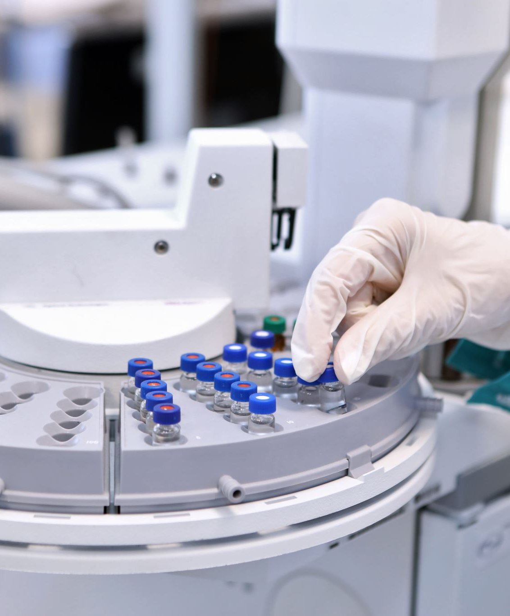
Post-COVID Symptom Analysis: A Comparative Study of OpenAI, DeepSeek, and Traditional Machine Learning Models
Fabliha Fairooz

Slide 2
Contents
Introduction (3)
Methods (4-11)
Results (12)
Future Directions (13)
Code Demo (14)

Slide 3

Introduction and Objectives
This presentation explores the process of utilizing large language models (LLMs) such as OpenAI's GPT and DeepSeek, in conjunction with Traditional machine learning (ML) approaches, for analyzing patient case narratives and predicting the likelihood that symptoms are related to post-COVID conditions. The workflow involves embedding patient case data, building retrieval and reasoning systems, evaluating predictive outcomes, and comparing performance metrics across methods.

Slide 4
Methods
Data Preparation and Embedding Techniques
Constructing the FAISS Vector Database
Case Analysis with OpenAI LLM: A Retrieval-Augmented Generation Approach
Traditional Machine Learning Baseline
Evaluation of DeepSeek LLM RAG System

Slide 5

Data Preprocessing for Post-COVID Symptoms Analysis
Data Sources:
Synthea 10k COVID Dataset: Synthetic patient data, including demographic information, conditions, medications, and encounters.
Data Merging & Filtering:
Merged datasets from patient records, conditions, medications, immunizations, and hospital encounters.
Filtered out irrelevant records and missing data to ensure high-quality data for analysis.
Recovery Dates Calculation:
Identified recovery dates by analyzing discharge information from hospital encounters.
Defined recovery as the last recorded encounter or treatment for COVID-19.

Slide 6
Data Preprocessing for Post-COVID Symptoms Analysis
Symptom Labeling:
Labeled post-COVID symptoms based on ICD-10 codes and conditions identified after the recovery date.
Focused on specific symptoms like fatigue, respiratory issues, and neurological symptoms.
Data Enrichment:
Enriched data with additional demographic information, comorbidities, medications, immunizations, encounter types, and hospitalization details.
This enrichment helped create a comprehensive picture of the post-recovery phase.

Slide 7
Data Preparation and Embedding
Generating Embeddings with OpenAI
Used the OpenAI API's text-embedding-ada-002 model to create 1536-dimensional vector embeddings from patient narratives. This structured format allows for efficient similarity searches and machine learning applications. Dummy vectors were used for missing narrative data.
Storing Processed Data
Embeddings and corresponding narrative-label pairs were saved for reproducibility and future use. Numpy arrays were used for vector storage while CSVs retained text and label data for each patient case.

Slide 8

Building the FAISS Vector Database
FAISS Indexing for Fast Retrieval
The FAISS library was used to create an index based on L2 (Euclidean) distance, enabling efficient similarity search over patient embeddings. All narratives were added, allowing rapid contextual retrieval for downstream tasks.
Integration with Retrieval-Augmented Generation (RAG)
When a query is made, its embedding is generated and searched against the index. The nearest narratives are fetched to provide context for language model responses, effectively implementing Retrieval-Augmented Generation for medical queries.

Slide 9
OpenAI LLM-Based Case Analysis
Interactive Querying
GPT-3.5-turbo generates informative and accurate responses by leveraging contextual information from previous examples.
Patient Symptom Evaluation
For a query about the likelihood of fever being post-COVID in a 30-year-old female with a fever and COVID history, the model retrieves relevant narratives and answers with a concise 'Yes' or 'No' as requested.
Batch Evaluation and LLM Performance
On a test set of 500 records, the LLM is asked to make binary post-COVID relation predictions for each narrative, which are then compared to true labels for performance assessment.

Slide 10

Traditional Machine Learning Approach
Logistic Regression Modeling
A logistic regression model was trained using attributes of the data (not on patient narrative) on the training set of 3745 Data and corresponding labels ("likely related" or "unlikely related"). Then it was tested against the heldout dataset of 937 patient data.
Prediction and Evaluation
Test cases undergo the same embedding process and are classified by the trained model. The predictions are evaluated using robust statistical metrics (AUROC and AUPRC) for direct comparison with the LLM-based RAG system.

Slide 11
DeepSeek LLM RAG Evaluation
Alternative LLM Embedding and Search
The DeepSeek approach uses the 'nomic-embed-text' model for embeddings, combined with FAISS for semantic indexing. Patient narratives are embedded and indexed just as with OpenAI-driven workflows.
RAG Prompting with DeepSeek-R1
For each test patient, retrieved similar cases are compiled into a context, and the DeepSeek LLM is prompted in a zero-shot RAG setup to return a binary answer. This method is systematically evaluated over the same 500 test cases.

Slide 12
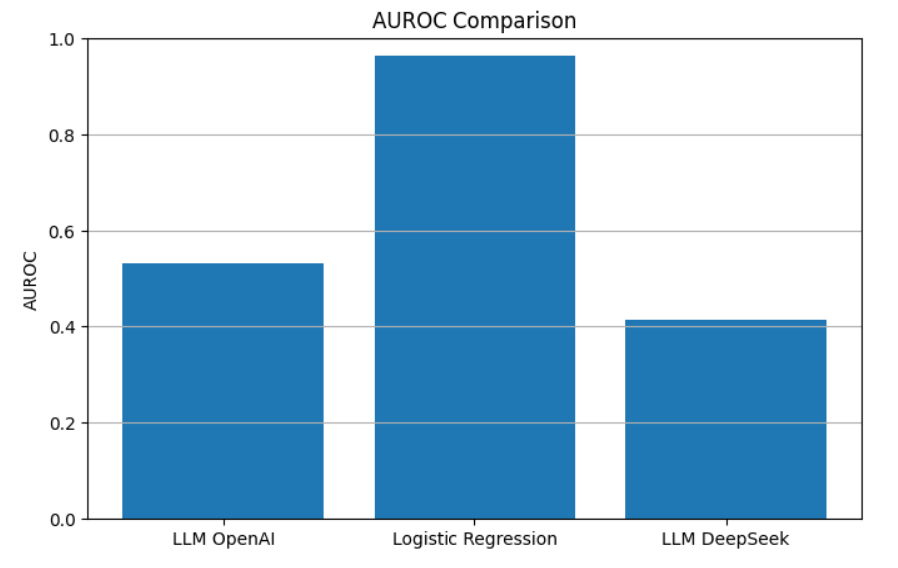
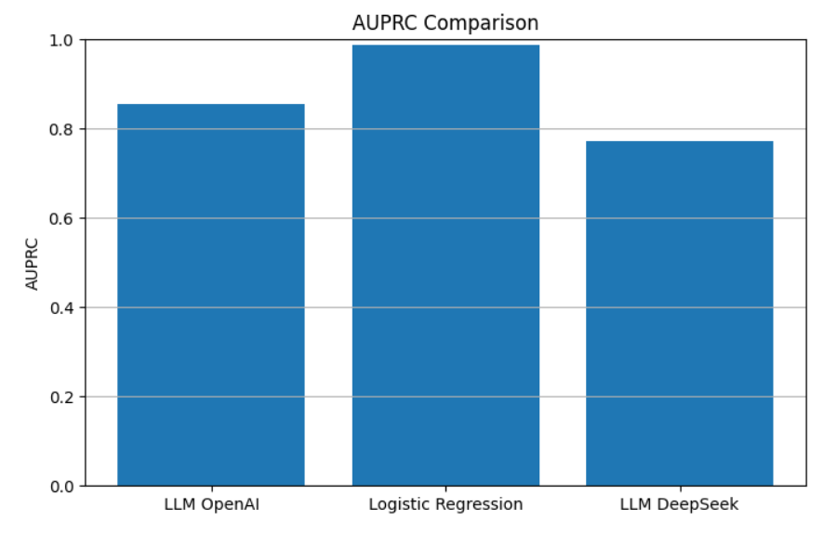
Results: Performance Comparison Benchmarking Results (500 Test Cases)
0.965
0.965
Quantitative Metrics
Performance is assessed using Area Under the Receiver Operating Curve (AUROC) and Average Precision-Recall Curve (AUPRC). Metrics are calculated for each method to provide a robust evaluation of discrimination and predictive reliability.
Summary of Findings
OpenAI LLM (RAG): AUROC = 0.506, AUPRC = 0.849
Logistic Regression: AUROC = 0.965, AUPRC = 0.987
DeepSeek LLM (RAG): AUROC = 0.883, AUPRC = 0.79
Classical ML surprisingly outperforms the OpenAI RAG system, and DeepSeek's LLM delivers the best trade-off between recall and precision.

Slide 13
Future Directions
Use all the symptoms from the dataset instead of specific symptoms
Instead of using 60 days as cutoff recovery days, it can be changed for better data availability and actual medical preference.
For the experiments, more attributes can be added or removed depending on the resource’s availability
Experiment with more prompt engineering techniques.
Try to include external medical knowledge to assist the large language model in generating the correct answer
Experiments with other open sourced LLMs.
Fine-tuning LLMs on labeled data or using LLMs to explain or highlight tricky cases could help make them more useful in clinical tasks.

Slide 14
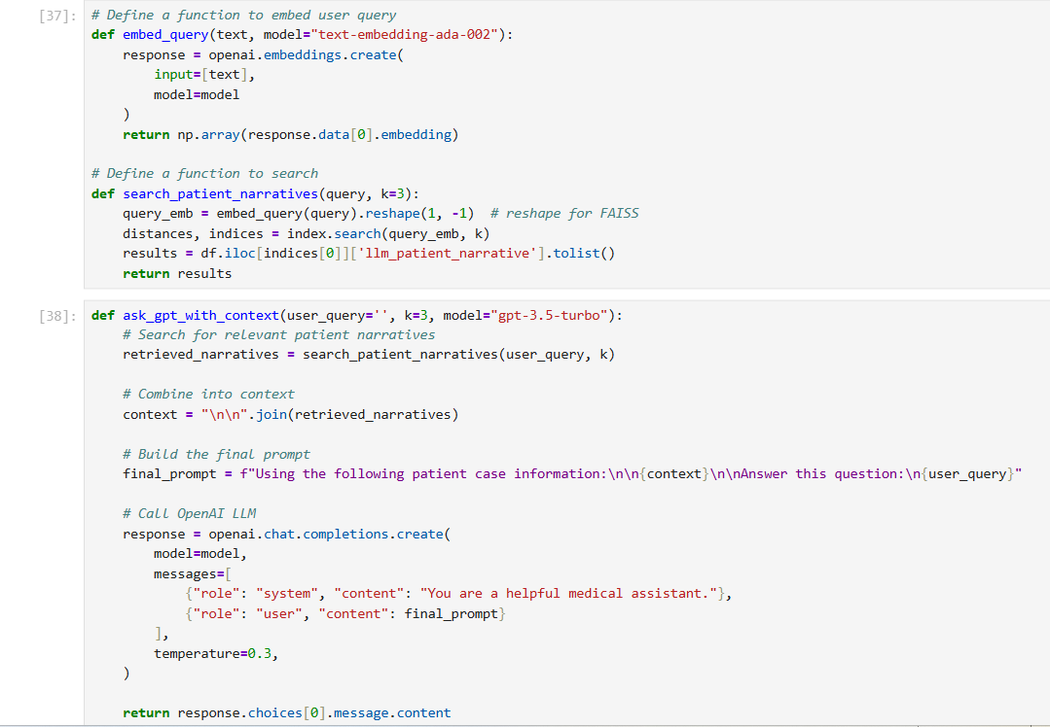
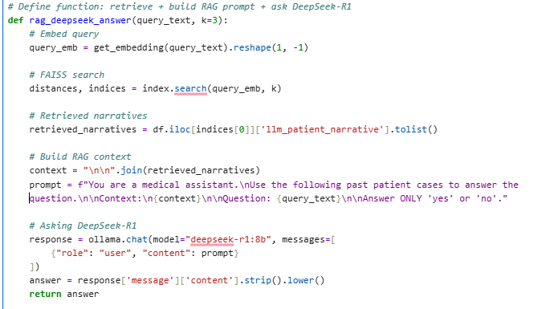
CODE DEMO
There are two .ipynb files , one for data processing and another for the research codes
Github Link : https://github.com/Fabliha-Bd/LLM-comparative-study

Slide 15

Conclusion and Key Takeaways
This comparative analysis uncovers the relative strengths of:
LLM-based semantic retrieval and reasoning
Traditional ML
State-of-the-art LLMs like DeepSeek for structured medical text analysis.
Classical logistic regression on well-embedded data excels in this scenario.
Recent advances in alternative LLM-based RAG systems show promise and may close performance gaps.
Ongoing model refinement, domain adaptation, and rigorous testing remain essential when deploying such systems in medical decision support contexts.

