Slide 1
a Solver for VRPTW
and
Fixed Fleet size VRPTW
Workgroup Assignment
Group 12
Luca Benedetto
Jacopo Bufalino
Chiara Di Nardo
Fabio Ellena
Fabio Ferrero
Matteo Fiore

Slide 2
a Solver for VRPTW
Level 1

Slide 3
HEURISTIC Approach
to find the best configuration
Subsequent generation of “childhood” starting from six initial configuration (one for each acceptor) by changing, step by step, different type of parameters.
At every step, the new “childhood” is created stating from the best configurations found so far.
Insertion
Alpha
Acceptor
Probability
Memory
Selector
Share
InitialThreshold
Group 12 - Level 1

Slide 4
First result
and first selection
After some test on the acceptor and selector, the best combinations found were (on the average of results)
greedy acceptance with selectBest
greedy acceptance with selectRandomly
shrimpf acceptance with selectRandomly
All the tests have been done on C100-C200 and rC100-rC200 instances, in order to have the performance of the configuration as general as possible (on customer disposition and TW).
Group 12 - Level 1

Slide 5
second result
and second selection
Tests on different combination of insertions, ruin share and probability distribution figured out that a greedy with an almost balanced probability and a share of 05-03 or 04-04 on strategies were good combinations (on avg 1,85% from best known).
But why don’t change the memory size? After other tests changing the memory we found that the shrimpf acceptance was on average, on all instances, less than 1,4% from Best Known!
Group 12 - Level 1

Slide 6
Last Selection
our best configuration
But last tests on alpha and initialThreshold on the shrimpf shows that this configuration was really good only on rC200 instances, with not so good result on rC100 problems.
rC100 problems were solved in a good way by greedy strategies, so… why don’t mix them together?
We biult a 4 strategies configuration 80% shrimpf and 20% greedy!
Group 12 - Level 1

Slide 7
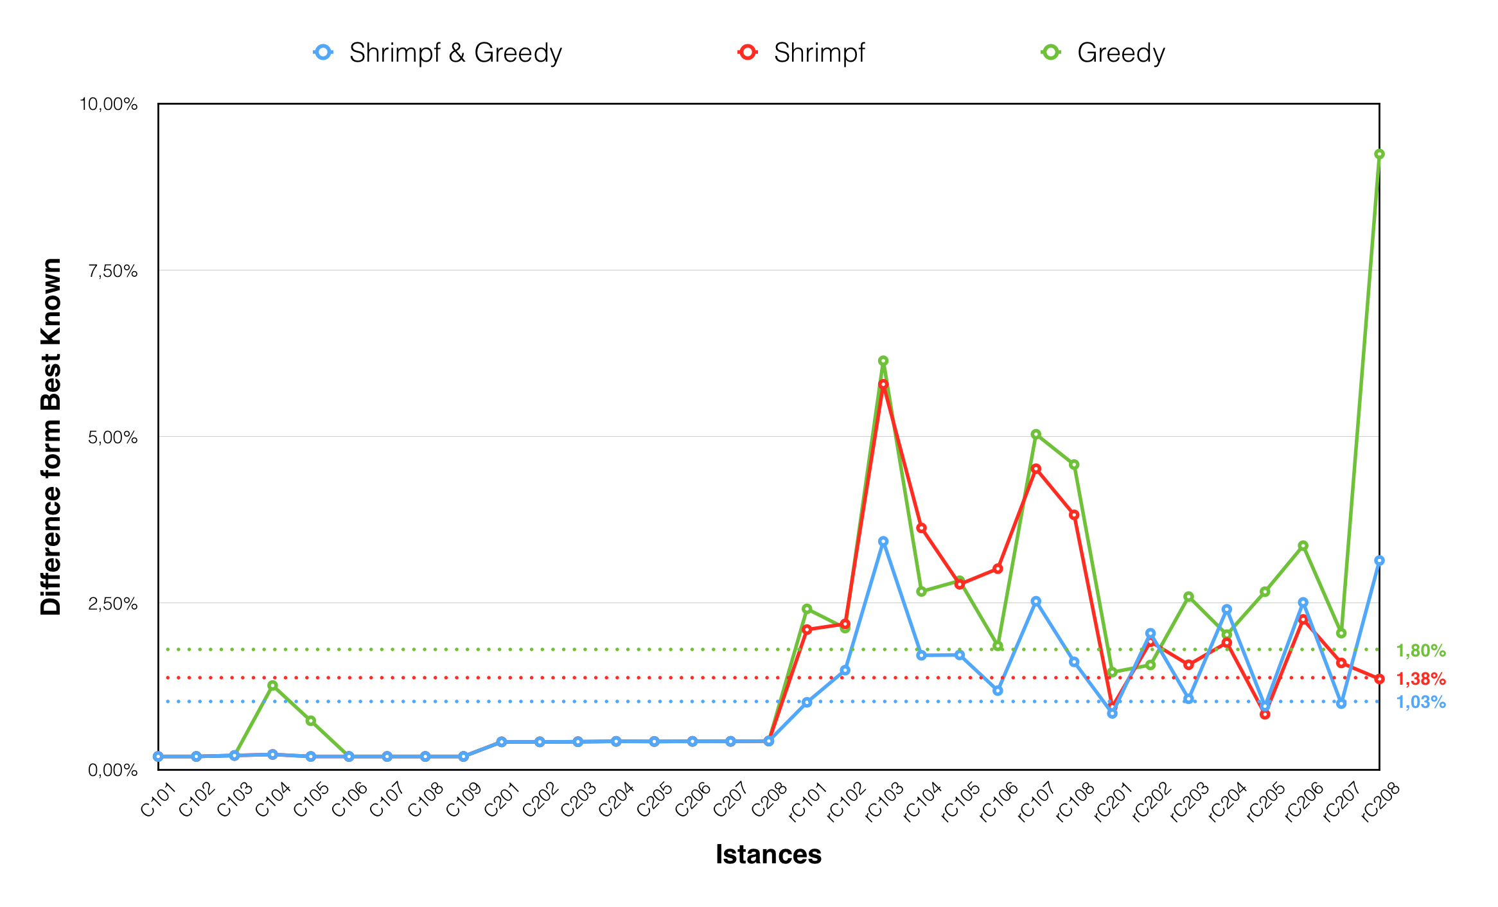
Group 12 - Level 1

Slide 8
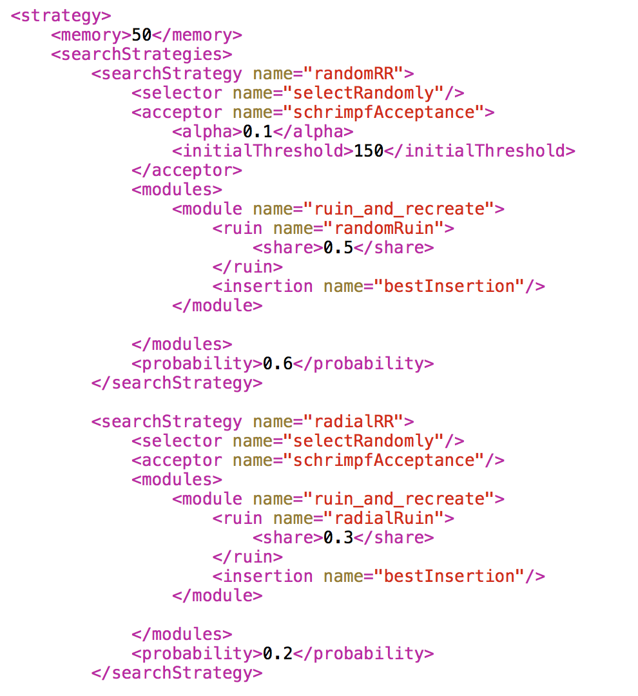
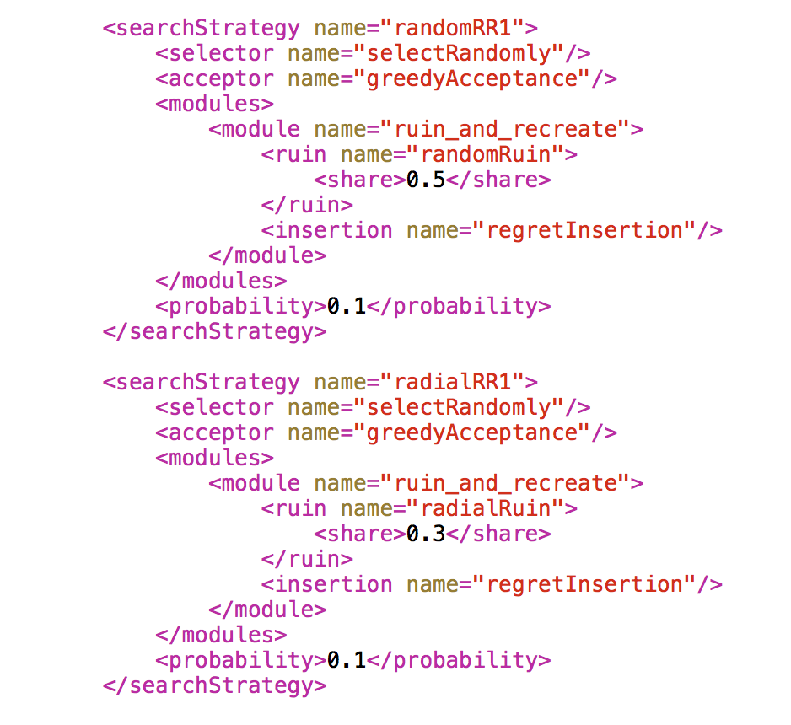
our Configuration
on details
Group 12 - Level 1

Slide 9
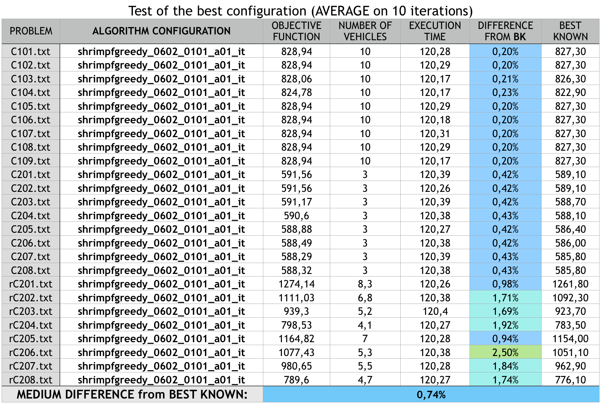
Group 12 - Level 1

Slide 10
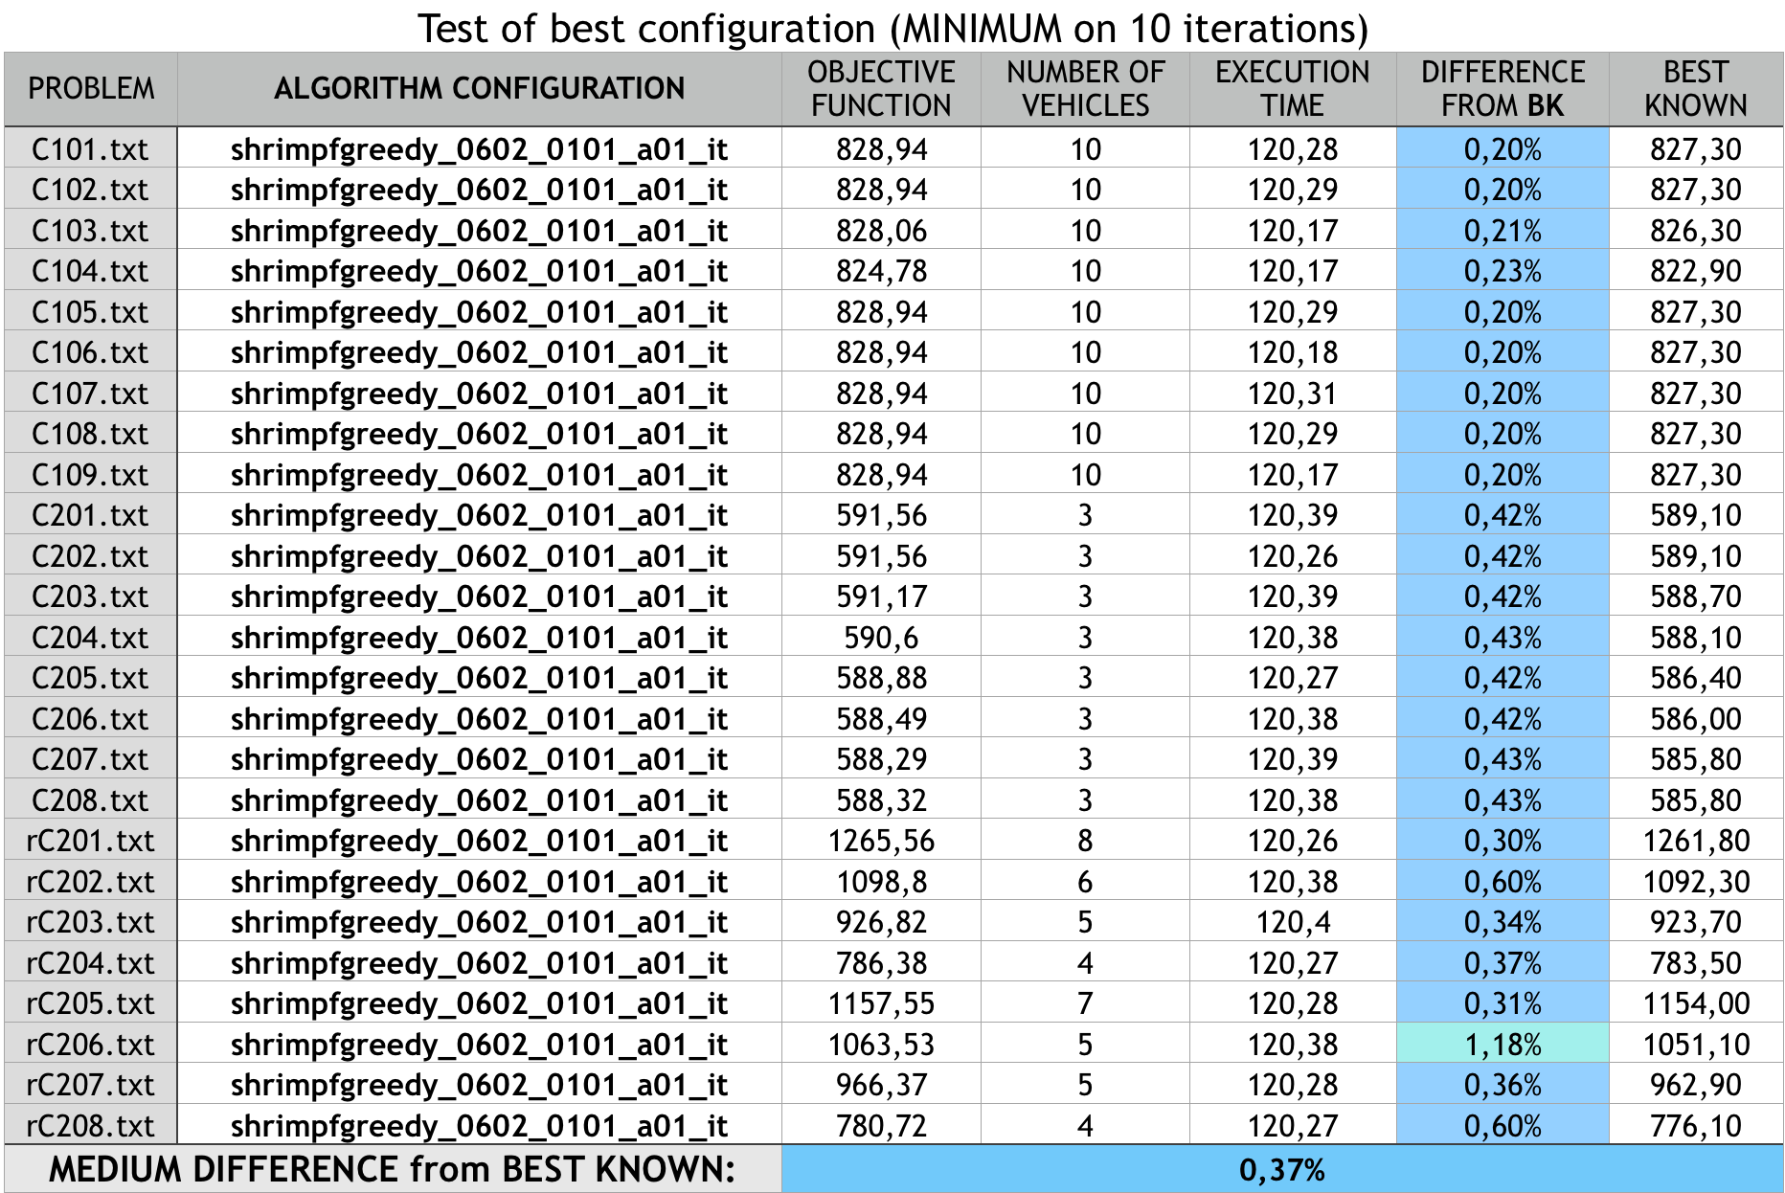
Group 12 - Level 1

Slide 11
Level 2
Fixed Fleet size VRPTW

Slide 12
Fixed number of vehicle
balancing Two-Phase Approach
Create initial solution
80 seconds
Not balanced
Balance the solution
40 seconds
Group 12 - Level 2

Slide 13
INITIAL SOLUTION
not balanced
Computed using the same configuration found in part 1.
In order to fix the number of vehicles we added a soft constraint that assigns a huge penalty proportional to the vehicles number error.
In this way, the solution always has the desired number of vehicles
Group 12 - Level 2

Slide 14
from part 1 to 2
In order to use the best solution found so far as the initial solution of the balancing part, it’s necessary to recalculate its cost using the rules to evaluate the correct balancing
Now we have an initial solution for the balancing part.
Group 12 - Level 2

Slide 15
balancing algorithm
It consists in a soft constraint that:
1. Calculates the average service time on all routes
2. Calculates the average transport cost on all routes
3. Penalizes every route with service time out of a range of ±20% from average proportionally to the distance by average; no penalty for route into the range
4. Same approach for the cost
Group 12 - Level 2

Slide 16
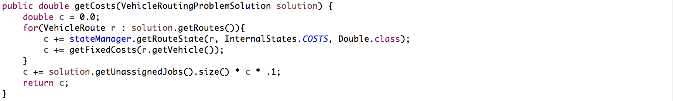
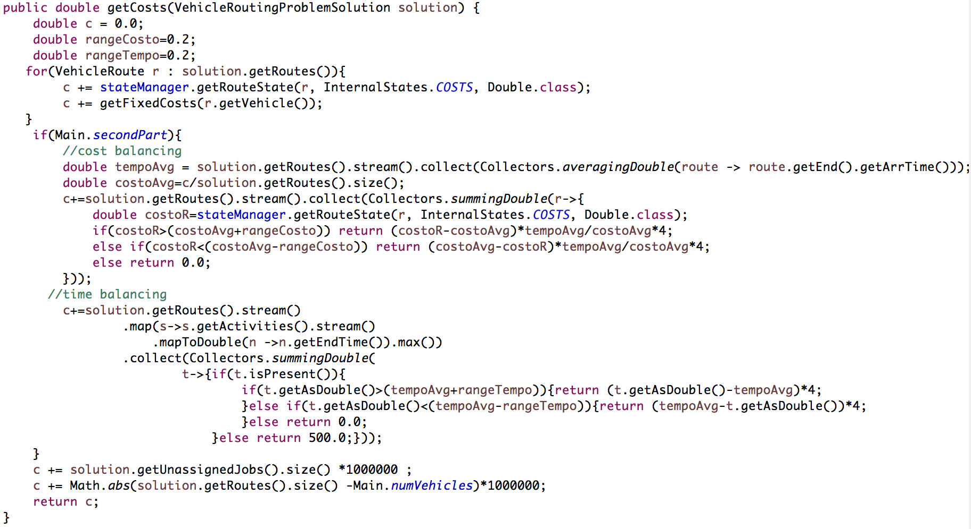
Implementation of soft Constraint
Before
After

Slide 17
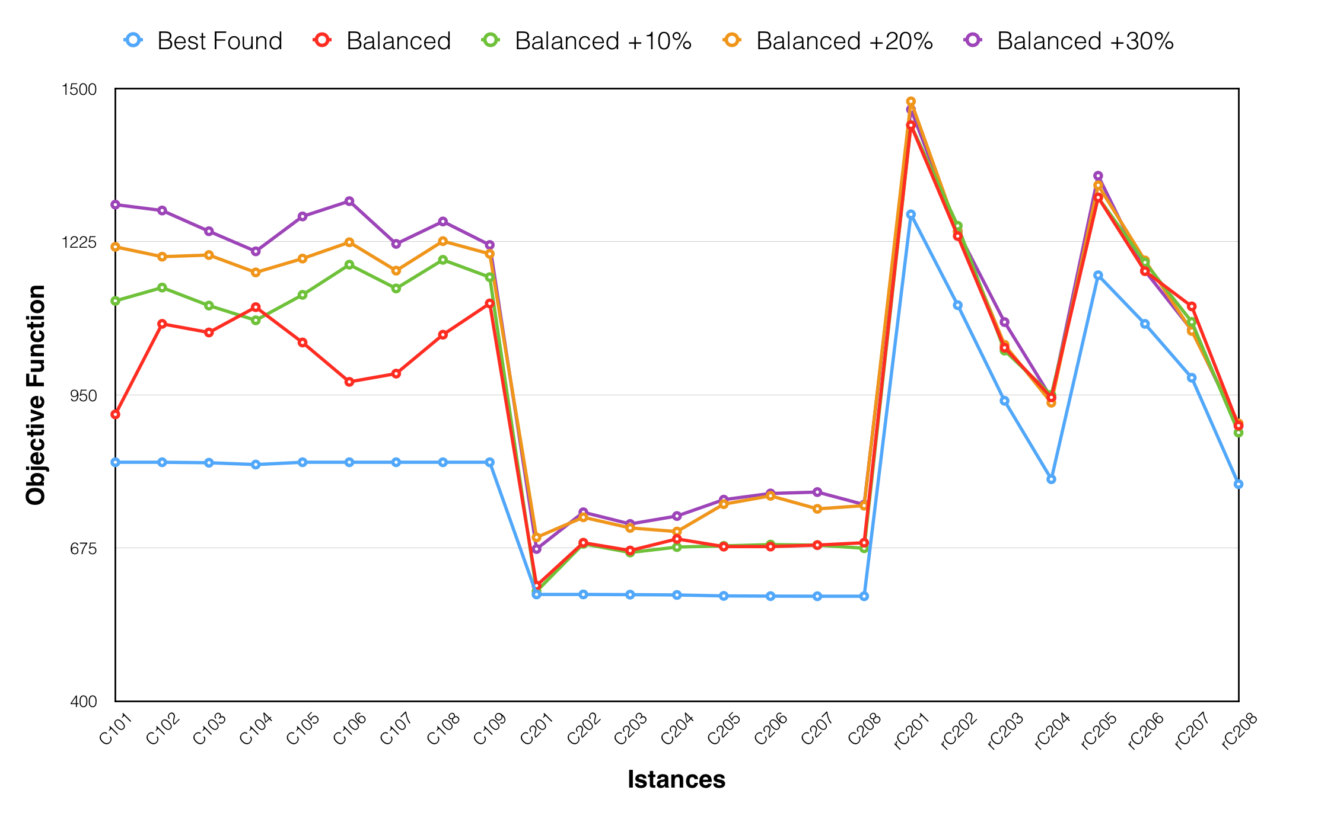
Group 12 - Level 2

Slide 18
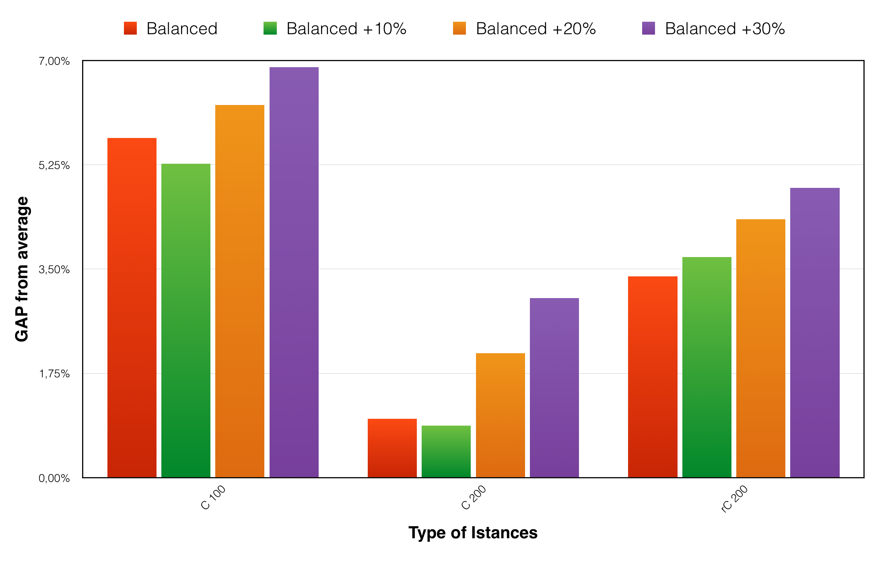
Group 12 - Level 2

Slide 19
Thank you!

