Slide 1
Deutsche Bahn Delay
A Study of Official Statistical Bias and Empirical Modeling
Xiao Shen, Yuanye Xu
October 29, 2025

Slide 2
The Passenger Experience Problem
While traveling on Deutsche Bahn trains in Germany, we encountered highly unpredictable punctuality. Delays ranged from acceptable ten-minute waits to hour-long disruptions with last-minute platform changes or complete cancellations.
This prompted us to examine DB's official statistics—and we discovered a striking gap between reported data and actual passenger experience.

Slide 3
The Statistical Paradox
89.5%
62.5%
90.7%
Overall Punctuality
Long-Distance Reality
Regional Performance
DB's reported rate for all passenger rail transport in 2024
Actual punctuality for ICE and IC trains
Regional trains masking long-distance problems

Slide 4
The Hidden Truth
A weighted calculation reveals the statistical sleight of hand: long-distance services account for just 4.3% of total passenger traffic, while regional services make up 95.7%.
The high punctuality of regional trains statistically "dilutes" poor long-distance performance, masking the severity of delays that intercity travelers actually experience.

Slide 5



Research Objectives
Expose Bias
Build Models
Reflect Reality
Reassess DB's reporting methodology and reveal structural biases
Create data-driven delay prediction models
Provide statistics that match actual passenger experience

Slide 6
Methodological Biases
Three critical flaws in DB's punctuality statistics

Slide 7

Bias #1: Overly Lenient Definition
DB considers trains "punctual" if they arrive with less than six minutes of delay—among the most lenient thresholds in Europe.
France's SNCF: 5 minutes
Japan's JR: 1 minute
6
DB's standard: 6 minutes
This inflates punctuality statistics and fails to reflect passenger experience.
Minutes
DB's tolerance threshold

Slide 8
Our Standard: 5 Minutes
We adopt a five-minute threshold for punctuality, aligning with common European standards and providing a more realistic reflection of traveler perception.
This evidence-based approach replaces institutional convention with empirical reasoning.

Slide 9
Bias #2: Excluding Cancellations
What's Excluded
The Problem
Our Approach
Ersatzverkehr (substitute bus services) and Ausfälle (cancelled trains) are completely removed from official statistics
From a passenger perspective, cancellation is the most severe form of delay—yet it's invisible in DB's data
We treat cancelled trains as extreme delays and include them in our analysis

Slide 10
Bias #3: Oversimplified Classification
DB divides trains into only two categories: "long-distance" (ICE, IC) and "regional" (RE, RB, S-Bahn). This oversimplification overlooks operational differences and allows S-Bahn's high punctuality to artificially inflate regional averages.
S-Bahn services operate mainly within metropolitan areas and have limited relevance to intercity travel quality.

Slide 11
Our Three-Tier Classification
Long-Distance
Regional
Urban
ICE, IC trains for intercity travel
RE, RB trains for medium-haul journeys
S-Bahn services for metropolitan commuting
This refined taxonomy aligns with functional and scheduling characteristics, enabling more accurate delay analysis across the rail network.

Slide 12
Data Collection
Overcoming DB's data opacity

Slide 13
The Data Challenge
DB does not publicly release detailed delay data. The only accessible source is their real-time departure board, which refreshes every few seconds and displays only short-term operational data.
Even with web scraping, we could only capture a few days of recent records—insufficient for long-term analysis.

Slide 14
Our Data Source
Third-Party Dataset
Why It Works
We used a Kaggle dataset compiled by independent developers through automated scraping of DB's real-time boards.
Though limited in time span, these samples represent typical operational conditions and are suitable for analyzing daily punctuality patterns.
Coverage: July 20–25, 2024 and September 1–2, 2024
The dataset includes over 30 train categories and thousands of records.
Scope: 20 major German cities

Slide 15
Data Cleaning Process
01
02
Remove Bus Services
Reclassify Trains
Eliminated all Ersatzverkehr records to focus on rail operations
Applied three-tier classification based on service characteristics
03
04
Define Delay Status
Extract Features
Trains delayed >5 minutes or cancelled = delayed (0); otherwise on-time (1)
Date, stations, train category, departure time bucket, punctuality status

Slide 16
Descriptive Analysis
Clear structural patterns emerge

Slide 17
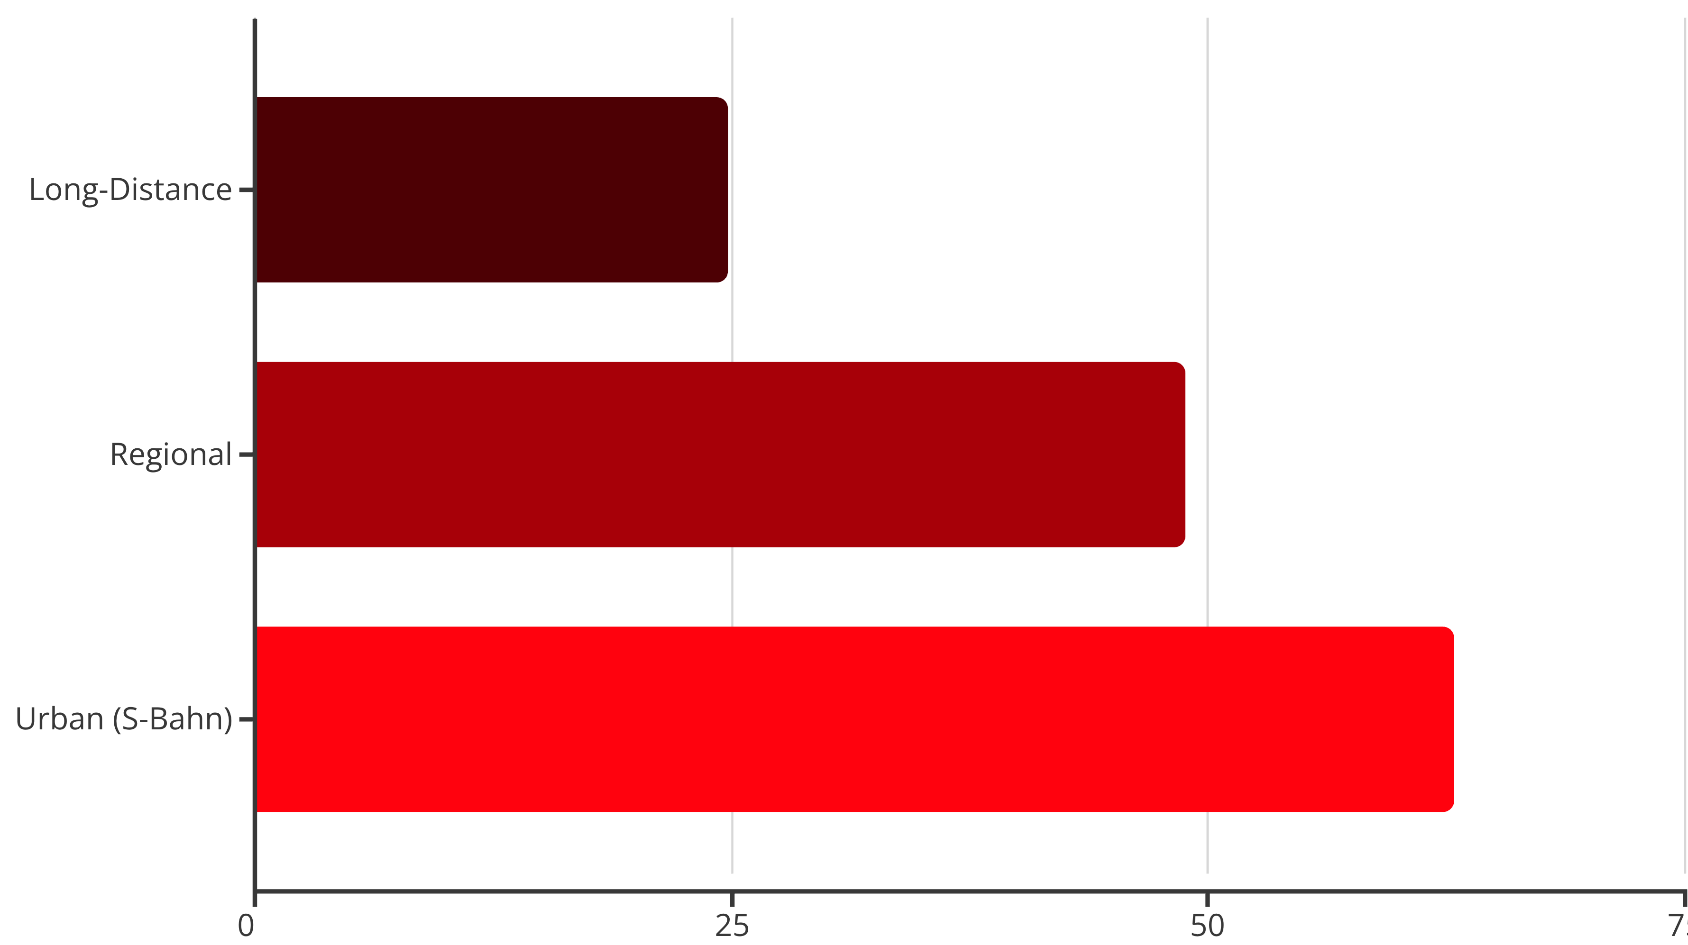
Punctuality by Train Category
Long-distance trains achieved only 24.84% punctuality—roughly one in four arrived on schedule. Urban trains performed best, reflecting the resilience of short-distance commuter operations.

Slide 18
The Long-Distance Crisis
1/4
75%
Success Rate
Delay Rate
Only one in four long-distance trains arrives on time
Three-quarters of ICE and IC trains experience delays
This catastrophic performance directly contradicts DB's official 62.5% punctuality claim for long-distance services.

Slide 19
Daily Punctuality Patterns
Punctuality follows an inverted-U pattern throughout the day:
03:00–04:00
Late Evening
Highest: 67–74%
Recovery: slightly higher
1
2
3
10:00–18:00
Lowest: 46–50%
Traffic density and infrastructure load strongly affect performance, with daytime peak hours suffering heaviest congestion and operational interference.

Slide 20
Modeling Approach
Four models of increasing complexity

Slide 21
Model Development Strategy
We merged July and September samples and performed an 80/20 train-test split to ensure balanced distributions and robust generalization.
All categorical variables (departure station, arrival station, train type, departure time bucket) were encoded using OneHotEncoder to eliminate false ordinal relationships.

Slide 22
Model 1: Logistic Regression
The Baseline
Interpretation
As a linear model, logistic regression offers interpretability and efficiency. It estimates the probability of a train being on time using the logistic function.
Positive coefficients increase the log-odds of punctuality; negative coefficients imply higher delay likelihood.
Performance:
Errors concentrated near borderline cases, such as minor delays close to the five-minute threshold.
Accuracy: 77.4%
F1-score: 0.77
Recall: 0.80 (on-time), 0.75 (delayed)

Slide 23
Model 2: Random Forest
Capturing Nonlinearity
Performance Gains
Better Recognition
Random Forest was developed to capture nonlinear relationships that logistic regression missed.
Achieved 78.2% accuracy and F1-score of 0.78—a modest but meaningful improvement over the baseline.
Correctly identified more on-time trains (5,846 vs. 5,712) and reduced false negatives (1,337 vs. 1,471).

Slide 24
Why Random Forest Works Better
The improvement stems from Random Forest's ability to capture nonlinear interactions between spatial and temporal variables—such as station combinations and departure times.
While Logistic Regression remains conservative and balanced, Random Forest offers stronger generalization and better recognition of borderline cases, reflecting the clustered and systemic nature of DB's delays.

Slide 25



Feature Importance Insights
63%
25%
12%
Station Pairs
Time Buckets
Train Category
Departure and arrival stations dominate predictions
Departure time plays secondary role
Service type matters least
Major hubs like Munich, Hamburg, and Stuttgart dominated top ranks, confirming spatial concentration of delays across Germany's rail network.

Slide 26
Geographic Delay Hotspots
Feature importance analysis revealed that delays are not random but strongly associated with spatial factors. The Frankfurt–Köln–München corridor shows the highest delay concentration.
These heavily congested routes handle the densest traffic and most complex scheduling in the German rail network, highlighting the clustered and systemic nature of DB's delay patterns.

Slide 27
Models 3 & 4: Gradient Boosting
LightGBM
XGBoost
Accuracy: 79.25%
Accuracy: 78.64%
F1-score: 0.8019
F1-score: 0.7969
AUC: 0.8727
AUC: 0.8689
Histogram-based split and leaf-wise growth strategy enhance efficiency in sparse environments.
Level-wise growth produces slightly lower accuracy but greater stability on smaller feature spaces.

Slide 28
Best Model: LightGBM
79.25%
0.8727
0.8019
Accuracy
AUC Score
F1-Score
Highest among all models tested
Strong discriminative ability
Balanced precision and recall
LightGBM achieved the best overall performance, efficiently capturing feature interactions in high-dimensional, sparse data.

Slide 29
Key Findings
What the models reveal

Slide 30
Nonlinear Interactions Drive Delays
The modeling results demonstrate that DB's punctuality is not linearly separable but influenced by multiple nonlinear interactions.
Train type, departure time, and departure station interact strongly—verified by LightGBM's feature importance analysis. The combination of departure and arrival stations remains the most significant factor, accounting for over 60% of total importance.

Slide 31

Practical Implications for Travelers
High-Risk Routes
Buffer Time
Avoid Peak Hours
Journeys between major hubs like Frankfurt, Munich, and Cologne carry significantly higher delay risk
Allow extra time for transfers when traveling between major cities
Schedule travel outside 10:00–18:00 window and avoid holidays

Slide 32



Recommendations for Deutsche Bahn
Focus on High-Risk Corridors
Prioritize capacity management on Frankfurt–Köln–München routes
Optimize Peak-Hour Scheduling
Reduce congestion during 10:00–18:00 window through better planning
Transparent Reporting
Adopt stricter punctuality thresholds and include cancellations in statistics

Slide 33
Limitations and Future Directions
Although the four models differ in accuracy, their overall performance is similar (77–79%), indicating that available features nearly exhaust the dataset's explanatory power.
Since input variables are mostly categorical, their relationships with punctuality are largely linear. Nonlinear models offer stronger flexibility but limited improvement without additional dynamic features.

Slide 34
Future Research Opportunities
Weather Integration
Maintenance Schedules
Incorporate real-time weather data to capture environmental impacts on delays
Include planned construction and track work in predictive models
Holiday Effects
Historical Patterns
Analyze impact of holidays and special events on network congestion
Leverage long-term delay data to identify seasonal and cyclical trends

Slide 35
Conclusion
This study exposed significant methodological biases in Deutsche Bahn's official punctuality statistics and developed empirical models that better reflect passenger experience.
By adopting stricter thresholds, including cancellations, and refining train classifications, we revealed that long-distance punctuality is far worse than officially reported—only 24.84% under realistic standards.
Our machine learning models achieved up to 79% accuracy, demonstrating that delays are predictable, spatially concentrated, and strongly influenced by route and time factors. These findings provide actionable insights for both travelers and DB to improve Germany's rail experience.

